Slide 1
Recursion

Slide 2
What is recursion?
Recursion
Learning Objective(s)
This material should address the following question(s).
How to develop a recursive function?

Slide 3
Discussion Point
Recursion: The Core Concepts.

Slide 4



“Images” of Itself
Sierpinsky triangle
Tree branches
Matryoshka dolls

Slide 5
Question
What is recursion?

Slide 6

Definition
Recursion is a problem-solving technique to answer a problem that consists of “images” or “copies” of itself.
Usually, the implementation is in the form of a function that calls itself from the inside its body.
Recursion calls form a stack of function calls.

Slide 7
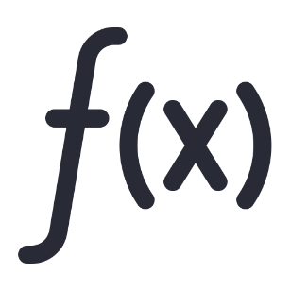
Recursion: The Base Case
A recursive function invokes itself to solve the problem.
Question: when should the self-invocation stop?
A non-stopping recursion will overflow the memory.
The recursive function has to decide when to stop.
Base case is the condition which eventually stops the recursion.

Slide 8
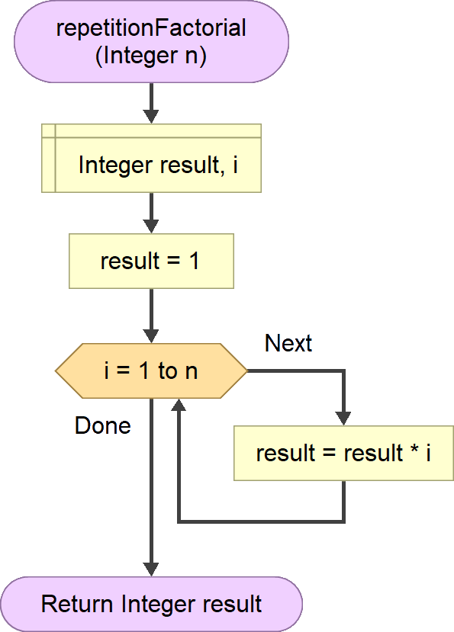

Factorial
A solution for factorial problem can be drawn using repetitive strategy.
$$n!=1×2×…×n$$

Slide 9
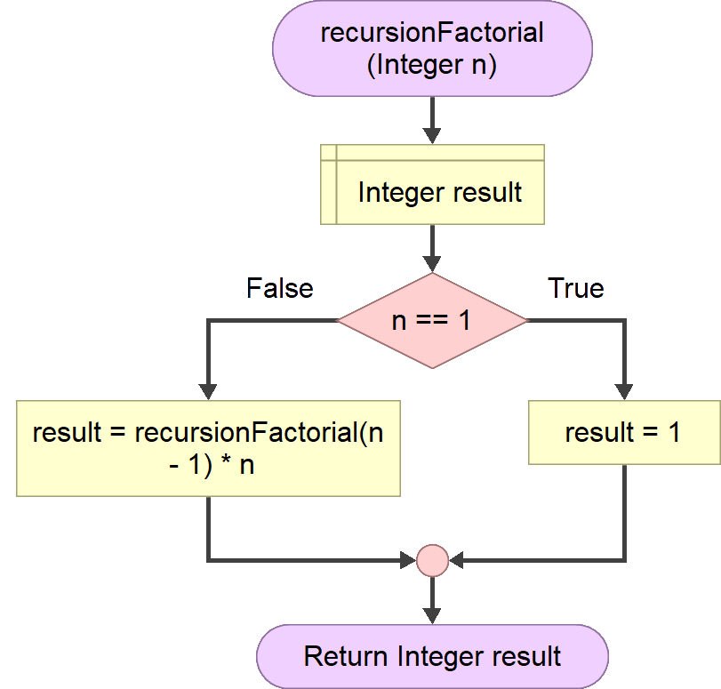
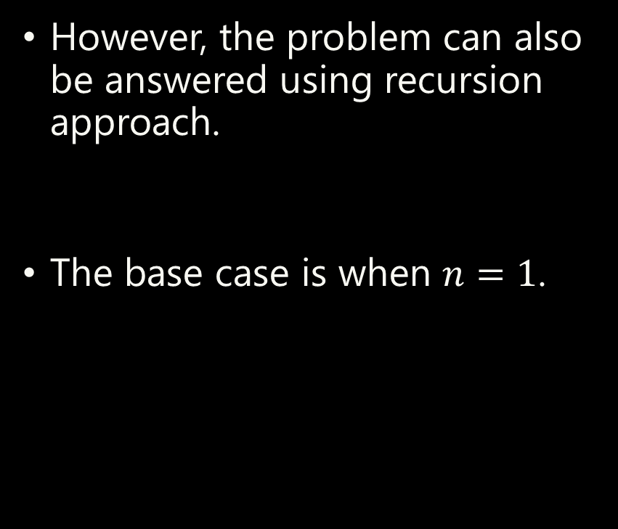
Factorial
However, the problem can also be answered using recursion approach.
The base case is when $n=1$.
$$n!=1×2×…×n$$

Slide 10
Main
Workflow
recursiveFactorial(n=3)
When:
The recursion routine finally stops when recursiveFactorial is supplied with n = 1.
recursiveFactorial(n=2)
return recursiveFactorial(2) * 3
recursiveFactorial(n=1)
6
return recursiveFactorial(1) * 2
2
return 1
1

Slide 11
Repetition vs. Recursion
Efficient (low memory).
Using constructs, such as: for, while, do-while.
Favored more in the imperative languages.
Fast (CPU usage, parallelism).
A recursive function invokes itself until the base case is hit.
Uses stack data structure.
Beware of memory overflows.
Favored more in the functional languages (Go, Lisp, etc).
Special cases or challenges.

Slide 12
Final Thoughts.

Slide 13
Conclusion
A recursive function invokes itself to solve the problem.
A recursion must stop one time in the future.
A non-stop recursion will surely flood the memory (overflow).
A base case is the final expected stopping point.

Slide 14
References
Wassberg, J. (2020). Computer Programming for Absolute Beginners. Packt.

