Slide 1
Validation

Slide 2
What is validation?
Validation
Learning Objective(s)
This material should address the following question(s).
How to do validation?

Slide 3
Discussion Point
Validation:
The Core Concepts.

Slide 4
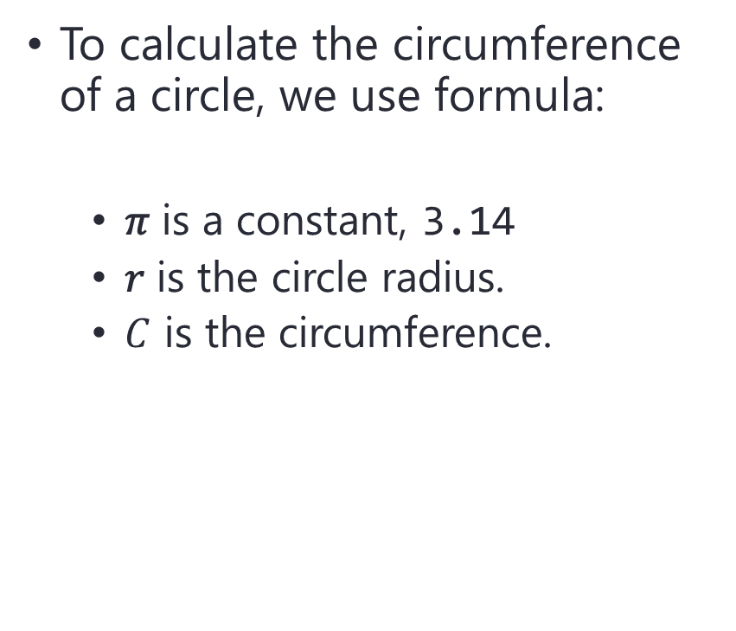

Problem
To calculate the circumference of a circle, we use formula:
  𝜋 is a constant, 3.14
  𝑟 is the circle radius.
  $C$ is the circumference.
$$C=2πr$$
$$r$$

Slide 5
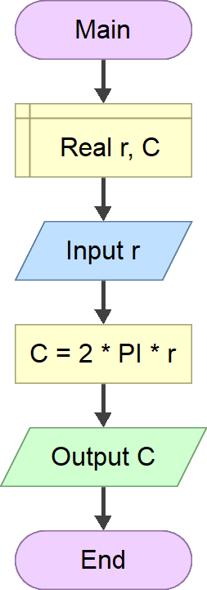

Problem
The solution asks an input from the user for the radius.
$$C=2πr$$
Accepting input from the user for the radius.

Slide 6



Problem
The solution asks an input from the user for the radius.
What if, the user enters $r≤0$.
  0, -5, -10?
Accepting input from the user for the radius.
Accepting $r≤0$
would be disastrous.

Slide 7
Problem
User input cannot be trusted.
How to prevent such things?

Slide 8

Definition
Validation is a mechanism to check the validity of values.
When the checking fails, the intended process should be halted and not proceed.

Slide 9
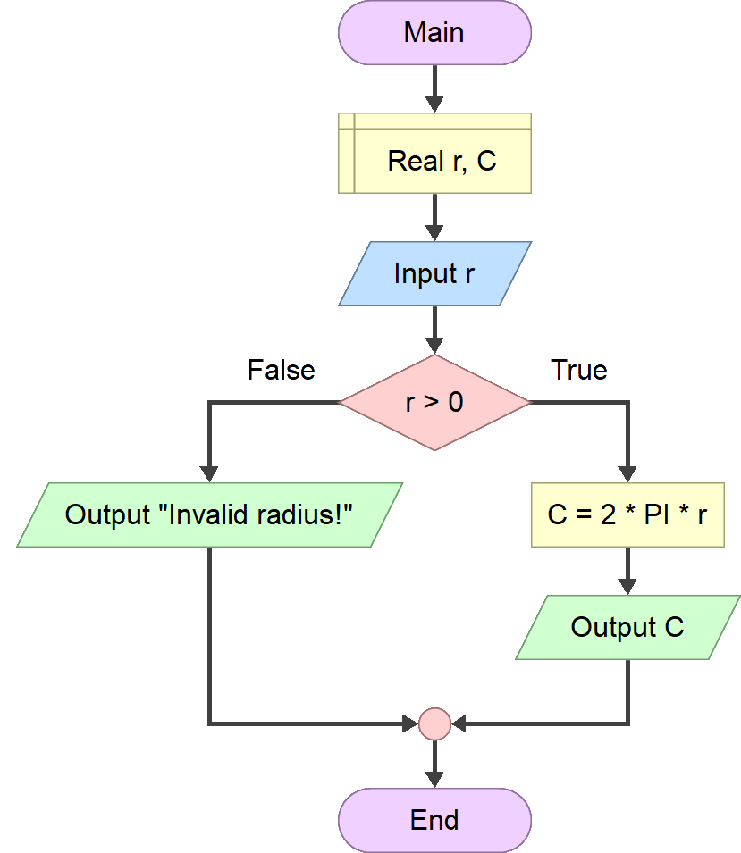
Validation
To validate input, it is very common to use branching.
In sophisticated languages, Exception is employed.
Checking up the radius entered by the user.

Slide 10
Final Thoughts.

Slide 11
Conclusion
Do not trust values entered by the user.
  They might be dangerous to the solution.
Validating user input is a way to prevent invalid values.
  Branching is the most basic way to validate input.

Slide 12
References
Wassberg, J. (2020). Computer Programming for
Absolute Beginners. Packt.

