Slide 1
Validation

Slide 2
How to do validation?
Validation
Learning Objective(s)
This material should address the following question(s).

Slide 3
Discussion Point
Validation: A Simulation.

Slide 4
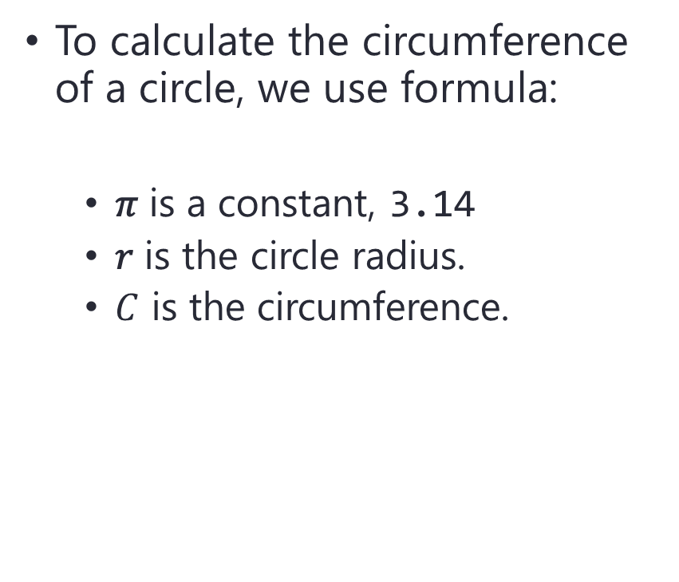

Problem
To calculate the circumference of a circle, we use formula:
𝜋 is a constant, 3.14
𝑟 is the circle radius.
$C$ is the circumference.
$$C=2πr$$
$$r$$

Slide 5

Problem
$$C=2πr$$
Calculating a circle’s circumference.
The user should be able to enter the circle’s radius.
The solution then calculate the circumference.
Lastly, the solution display the calculated circumference.
$$r$$

Slide 6


Problem
$$C=2πr$$
What if, the user enters an invalid value, $r≤0$.
0, -5, -10?
$$r$$

Slide 7
Problem
User input cannot be trusted.
How to prevent such things?

