Slide 1
Solution Modeling

Slide 2
How to express a solution?
Solution Modeling
Learning Objective(s)
This material should address the following question(s).
Is visual modeling a good option to express a solution?

Slide 3
Discussion Point
Expressing A Solution.

Slide 4
Problem Requires Solution
Algorithm
Data
Solution

Slide 5
Solution Development
Analyzing the problem
Designing the solution
Coding
A problem
Executable solution
understanding the problem
using models
in Java, Python, …
in binaries

Slide 6
Challenges for beginners
Freshmen find programming, coding in particular, is difficult.
Even for students from computing major.

Slide 7
What makes coding difficult?
Difficulty in understanding logic.
Complicated programming language.
Boilerplate codes.
Rules & conventions.
Paradigm.
Documentation.
Examples.

Slide 8
How can we express out solution without the actual coding? Or at least, delay it for later.

Slide 9
Discussion Point
Expressing A Solution: Modeling.

Slide 10
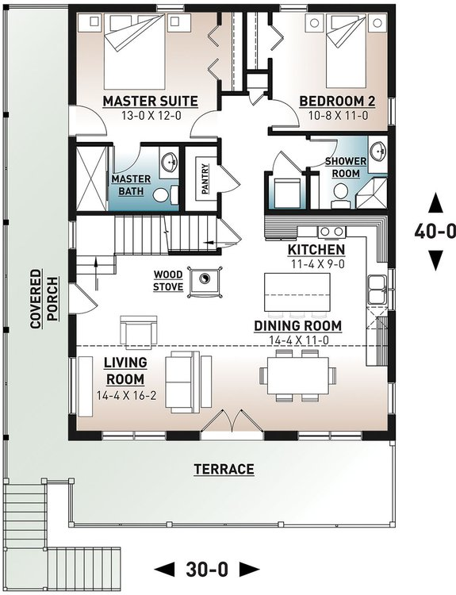
Modeling
A model is an abstraction of an activity or an artifact.
It temporarily omits irrelevant aspects from our view.
Modeling is the process of building a model.
Modeling language.
In programming:
Pseudocode (like codes).
Diagrams (visual objects).
Floor plan
https://cdn.houseplansservices.com/

Slide 11
Modeling
Advantages of modeling:
Could find patterns on similar solutions.
Could find points of improvement.
Could conduct testing before materializing it.
Floor plan
https://cdn.houseplansservices.com/

Slide 12
Discussion Point
Pseudocode vs. Diagrams

Slide 13
Challenge
Smallest number finder.
There are three arbitrary numbers, say x, y, and z.
How to determine which number is the smallest one?
x, y, z?

Slide 14
Challenge
One possible solution:
1st: compare the first two numbers to find the smallest.
2nd: compare the outcome of the 1st step to z.
x, y, z?

Slide 15

Pseudocode
PROGRAM: Smallest Number Finder
This program accepts three numbers and returns the smallest between the three.
DECLARATION:
x, y, z : integer {the inputs given by the user}
s : integer {where the the output will be stored}
ALGORITHM:
x := read user input {reading the user input}
y := read user input {reading the user input}
z := read user input {reading the user input}
if(x < y) {when the value of x is less than the value of y}
s := x {set s with the value of x}
else {when the value of x is NOT less than the value of y}
s := y {set s with the value of y}
endif {end the comparison}
if(z < s) {when the value of z is less than the value of s}
s := z {set s with the value of x}
endif {end the comparison}
return(s) {return s as the final result}
Pseudocode

Slide 16
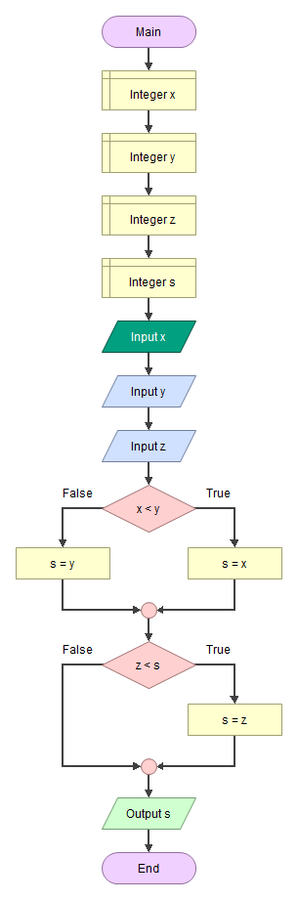
Pseudocode
Flowchart
PROGRAM: Smallest Number Finder
This program accepts three numbers and returns the smallest between the three.
DECLARATION:
x, y, z : integer {the inputs given by the user}
s : integer {where the the output will be stored}
ALGORITHM:
x := read user input {reading the user input}
y := read user input {reading the user input}
z := read user input {reading the user input}
if(x < y) {when the value of x is less than the value of y}
s := x {set s with the value of x}
else {when the value of x is NOT less than the value of y}
s := y {set s with the value of y}
endif {end the comparison}
if(z < s) {when the value of z is less than the value of s}
s := z {set s with the value of x}
endif {end the comparison}
return(s) {return s as the final result}
Pseudocode

Slide 17
Modeling with Visual Objects
Advantages:
Intuitive.
Easier to understand.
Less to no boilerplate code.
Focus on the solution.
Fit for beginner.
Disadvantages:
Not suitable to draw complex and large solutions.

Slide 18
Final Thoughts.

Slide 19
Conclusion
Solutions are expressed in codes written in a specific programing language.
Later, the code will be translated into machine language.
Writing code could be hard, especially for beginners (freshmen).
Modeling could help us focus on the solution.
Pseudocode vs. diagram (visual objects).

Slide 20
References
Wassberg, J. (2020). Computer Programming for Absolute Beginners. Packt.

