Slide 1
Input/Output

Slide 2
How to accept input and send output?
Input/Output
Learning Objective(s)
This material should address the following question(s).

Slide 3
Discussion Point
User-Solution Interaction: A Simulation.

Slide 4
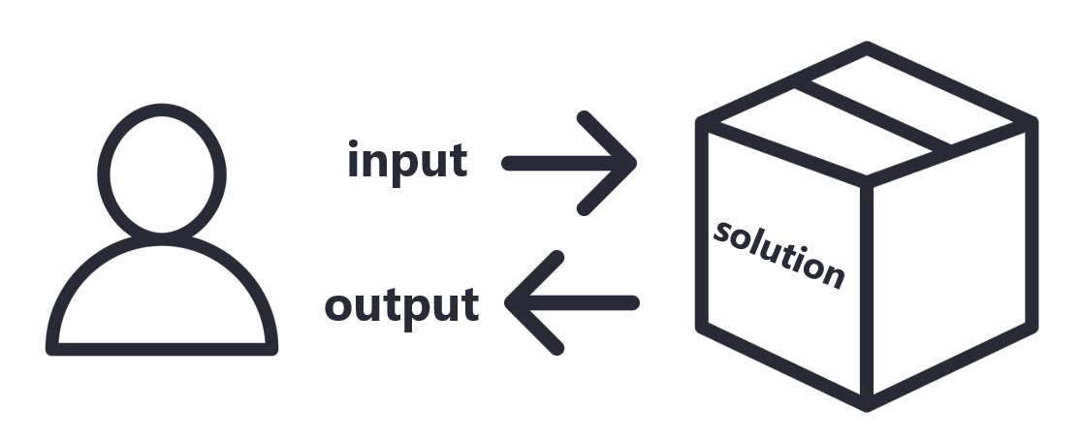
Name Shouter
The user should entry a name into the solution.
The solution accept the input and display an output "My name is <name>".
An example:
If the user enters "Mario" then the solution should output "My name is Mario"

