Slide 1
What is Variable?

Slide 2
What is variable?
What is variable?
Learning Objective(s)
This material should address the following question(s).
How to declare and use variable?

Slide 3
Discussion Point
Variable: The Core Concepts.

Slide 4


Problem
In the circle area calculation, we have three values:
𝜋 is a constant, whereas
𝑟 and 𝐴 are variable values, they may change.
$$r$$
$$A=πr^{2}$$

Slide 5
Question
What is variable?

Slide 6
Definition
In programming, a variable is a labeled-space in the (main) memory used for storing a value (data).
In other words, it is a container for a value (data).

Slide 7

Variable
A variable is a labeled by a unique name → identifier.
An identifier has to be unique and meaningful.
Should form a noun.
Writing convention:
snake_case or CamelCase.
Which of the following identifiers are good?
full_name, TotalPrice, buy, and box1.

Slide 8

A Real-typed data.
27.14cm
Say, line_length is a variable, its type is Real.
In the example, both of the value and the variable have the same type, Real.
Variable stores the value but not the metric.

Slide 9
Discussion Point
The Lifecycle of A Variable.

Slide 10
Variable Lifecycle
Declaration
Initialization (optional)
Manipulation
Destroyed
At this phase, the underlying Operating Systems will reserve a space in the main memory.
Different data type requires different memory space.
Some languages do not require explicit data type.
E.g. PHP,, JavaScript, etc.

Slide 11
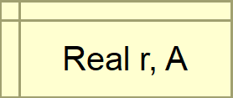
Variable Declaration
The Declare Statement is used to declare a variable.
Data type
Variable identifier(s)

Slide 12
Variable Lifecycle
Declaration
Initialization (optional)
Manipulation
Destroyed
At the initialization phase, we set an initial value of a variable.
Optional, but it is a good practice.
Some programming languages do not handle uninitialized variables.
An uninitialized variable may contain … anything → latent vault.

Slide 13
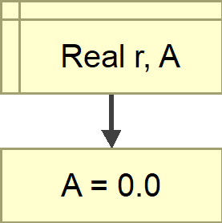
Variable Initialization
The Assign Statement is used to setup the initial value of a variable.
Set the initial value of A.

Slide 14
Variable Lifecycle
Declaration
Initialization (optional)
Manipulation
Destroyed
During this phase, the variable is available for any operation relevant to the data type.
E.g. change its value, use it in an operation, etc.

Slide 15
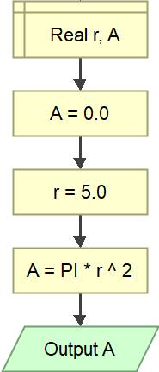
Manipulating Variable
Many type of statements are used to manipulate a variable.
Manipulating A.
Print out the value of A.

Slide 16
Variable Lifecycle
Declaration
Initialization (optional)
Manipulation
Destroyed
When everything is done, unused variables are destroyed.
This phase frees up the reserved space in the (main) memory.
Most programming language does this automatically.

Slide 17
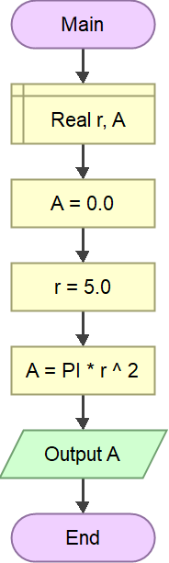
Destroying Variable
A variable will be marked as destroyed when either one of the following points is reached:
the end of the scope; or
the end of the program.
Both A and r will be marked as destroyed once the solution ends.

Slide 18
Variables in Java
1| public class UsingVariable {
2|
3| public static void main(String[] args) {
4| double PI = 3.14; // declaration & initialization
5|
6| double r, A; // declaration
7|
8| r = 5.0; // used, manipulation
9|
10| A = PI * Math.pow(r, 2); // used
11|
12| System.out.println(A); // used
13| } // once this routine ends, the pi, r, and a are destroyed
14|
15| }

Slide 19
Discussion Point
Value Casting.

Slide 20
Question
Is it possible to a variable to store a value with different type?

Slide 21
Variable: Value Casting
For instance, a String-typed variable to store an Integer value.
In such situation, some programming languages will try to cast or “convert” the value into the strorage’s type.
A casted value may lose its actual value.
E.g. casting a Real-typed value into an Integer value, 8.12 → 8.
The casting capabilities is vary from language to language.
Check the documentation!

Slide 22
A Real-typed data.
3.14
What if the variable is an Integer?
In the example, 3.14 is casted to 3.
It loses its fractional value.
In such case, the platform will try to cast the value.
Not all types are castable.

Slide 23
Final Thoughts.

Slide 24
Conclusion
A variable is a labeled-space to store a value.
Its value may change from time to time, modifiable.
The lifecycle of a variable:
declaration → initialization → manipulation → destroyed.
A value may be casted to another type.

Slide 25
References
Wassberg, J. (2020). Computer Programming for Absolute Beginners. Packt.
Declaring Variables – Flowgorithm http://www.flowgorithm.org/documentation/declare.html

