Slide 1
Operators

Slide 2
What are operators and their importance?
Operators
Learning Objective(s)
This material should address the following question(s).
What are the types of operators?

Slide 3
Discussion Point
Operators: The Core Concepts.

Slide 4

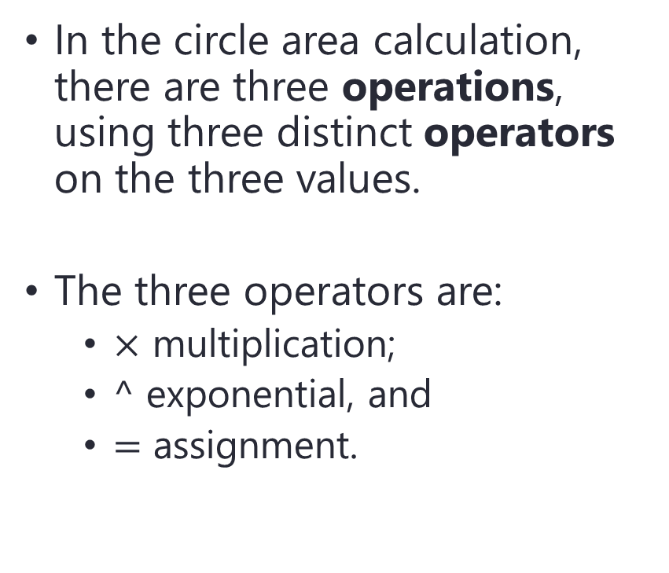

Problem
In the circle area calculation, there are three operations, using three distinct operators on the three values.
The three operators are:
$×$ multiplication;
$^$ exponential, and
$=$ assignment.
$$A=πr^{2}$$
$$r$$

Slide 5

using assignment operator.
using exponential operator.
assignment operation
exponential operation
$$A=πr^{2}$$
multiplication operation
using multiplication operator.

Slide 6
Question
What is an operator?

Slide 7
Definition
An operator operates one or more operands (values), including values hold by variables or constants.

Slide 8

biker: operator
biking: operation
bike: operand

Slide 9
Discussion Point
Types of Operator.

Slide 10
Types of Operator
Nature of the operation:
Arithmetic operators.
Assignment operator.
Logical operators.
Relational operators.
Concatenation operator.
Increment/decrement operators.
Bitwise operators.
The number of operand:
Unary → one operand.
Binary → two operands.
Ternary → three operands.

Slide 11
Final Thoughts.

Slide 12
Conclusion
An operator is used to operate value(s).
Operators are clustered based on:
The nature of the operation.
Assignment, arithmetic, logical, relational, and concatenation.
Increment/decrement and bitwise are not supported by Flowgorithm.
The number of operand they operate.
Unary, binary, and ternary.

Slide 13
References
Wassberg, J. (2020). Computer Programming for Absolute Beginners. Packt.
Operators – Flowgorithm http://www.flowgorithm.org/documentation/operators.html

