Slide 1
Arithmetic Operators

Slide 2
What are arithmetic operators?
Arithmetic Operators
Learning Objective(s)
This material should address the following question(s).
How to use the arithmetic operators?

Slide 3
Discussion Points
Arithmetic Operators: The Core Concepts.

Slide 4

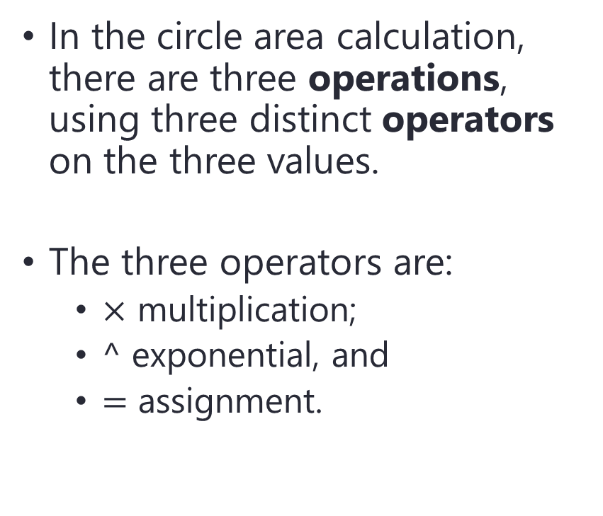

Problem
In the circle area calculation, there are three operations, using three distinct operators on the three values.
The three operators are:
$×$ multiplication;
$^$ exponential, and
$=$ assignment.
$$A=πr^{2}$$
$$r$$

Slide 5

using assignment operator.
using exponential operator.
assignment operation
exponential operation
$$A=πr^{2}$$
multiplication operation
using multiplication operator.

Slide 6
Question
Both multiplication and exponential are arithmetic operators.
What are arithmetic operators?

Slide 7

Definition
Arithmetic operators are operators used to operate numerical value (number).
These operators produce a numerical value.

Slide 8
Arithmetic Operators
No | Operator | C-Family | BASIC Family
1. | addition | + | +
2. | subtraction | - | -
3. | multiplication | * | *
4. | division | / | /
5. | modulo | % | mod
6. | exponential | not applicable | ^
7. | negation | - | -

Slide 9
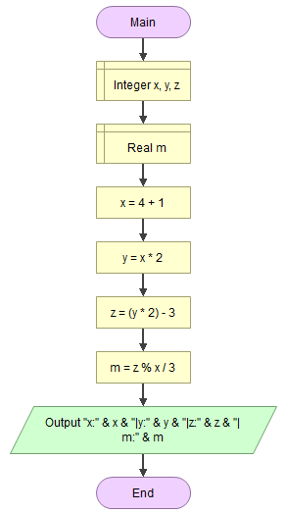
Hands On
x → 5
It is possible to have multiple operations in a one expression.
y → 10
z → 17
m → 0.666667

Slide 10
Question
In the case of multiple operations in a single expression.
When the involved operators are in different types, then which operator precedes first?
We will discuss this later.

Slide 11
Final Thoughts.

Slide 12
Conclusion
Arithmetic operators operate numerical values.
It is possible to have multiple operations in one expression.
Operator precedence?

Slide 13
References
Wassberg, J. (2020). Computer Programming for Absolute Beginners. Packt.
Operators – Flowgorithm http://www.flowgorithm.org/documentation/operators.html

