Slide 1
Assignment Operators

Slide 2
What are assignment operators?
Assignment Operators
Learning Objective(s)
This material should address the following question(s).
How to use the assignment operators?

Slide 3
Discussion Point
Assignment Operators: The Core Concepts.

Slide 4

Definition
Assignment operator is a unary operator used to set a value into a variable or a constant.

Slide 5
Assignment Operators
No | Operator | C-Family | BASIC Family
1. | Assignment (base) | = | =
2. | addition assignment | += | +=
3. | subtraction assignment | -= | -=
4. | multiplication assignment | *= | *=
5. | division assignment | /= | /=
6. | modulo assignment | %= | not applicable

Slide 6
a shorten form of self addition.
int x = 10;
x = x + 2;
x += 2;
equals to
A self addition.

Slide 7
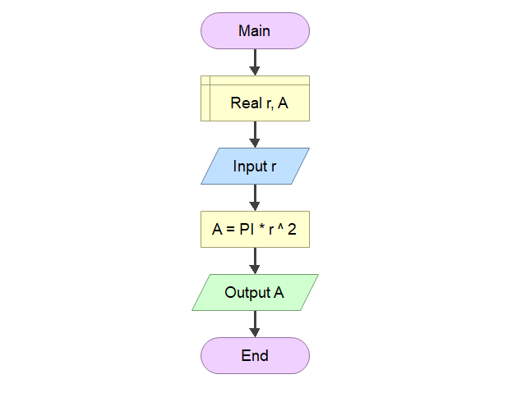
Hands On
In Flowgorithm, there are two ways to express an assignment operation:
the input instruction.
It reads a value from the user and store it into a variable.
the assignment instruction.
input instruction
assignment instruction

Slide 8
Final Thoughts.

Slide 9
Conclusion
The assignment operator is used to set a value into a variable or a constant.
There are combinations with arithmetic operators.

Slide 10
References
Wassberg, J. (2020). Computer Programming for Absolute Beginners. Packt.
Operators – Flowgorithm http://www.flowgorithm.org/documentation/operators.html

