Slide 1
Relational Operators

Slide 2
What are relational operators?
Relational Operators
Learning Objective(s)
This material should address the following question(s).
How to use the relational operators?

Slide 3
Discussion Point
Relational Operators: The Core Concepts.

Slide 4

Problem
A book store is currently making a clearance sale.
The discount is gigantic, 50%.
To be eligible for the discount, a transaction is must be at least worth $200.

Slide 5



checking the relation between the value of the transaction and the minimum asking value, $200.
relational operation, using a relational operator
≥
$200
rule: the discount will be applied only when the transaction hits at least $200.

Slide 6
Question
What is relational operator?

Slide 7

Definition
Relational operators are operators used to test the relation between two operands.
These operators compares two values and return a logical value (Boolean).

Slide 8
Relational Operators
No. | Operator | C-Family | BASIC Family
1. | equality | == | =
2. | inequality | != | <>
3. | greater than | > | >
4. | greater than or equal to | >= | >=
5. | less than | < | <
6. | less than or equal to | <= | <=

Slide 9
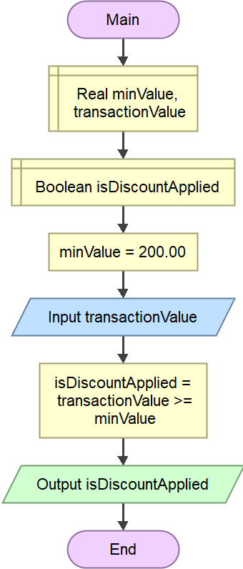
Hands On
The solution uses the greater than or equal to operator to test the eligibility.
testing the fulfillment to the predefined rules.

Slide 10
Final Thoughts.

Slide 11
Conclusion
Relational operators compares two values.
A relational operator will return a logical value (boolean).

Slide 12
References
Wassberg, J. (2020). Computer Programming for Absolute Beginners. Packt.
Operators – Flowgorithm http://www.flowgorithm.org/documentation/operators.html

