Slide 1
Repetition (Loop)

Slide 2
What is repetition and its importance?
Repetition (Loop)
Learning Objective(s)
This material should address the following question(s).
What are the forms of repetition?

Slide 3
Discussion Point
Repetition: The Core Concepts.

Slide 4
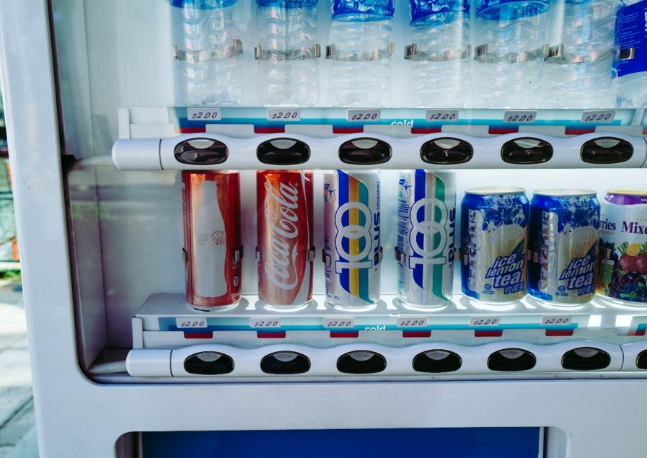
Problem
A vending machine is an automated outlet for selling item (e.g. snacks, drinks).
It is convenient.
Cost-effective.
It serves customers autonomously without any supervision.

Slide 5
Problem
Steps in serving a transaction:
… a customer enters a payment.
It accepts payment.
It accepts item selection.
It dispenses selected item.
It finalizes transaction.
… repeats
Repetition happens here.

Slide 6
Problem
How many transaction should the vending machine serve?
Depends on how many item left in the machine.

Slide 7
Question
What is repetition?

Slide 8
Definition
As its name suggests, a repetition (loop) repeats a sequence of instructions when a condition is met.
E.g. The vending machine repeats transaction handling when there is item left.

Slide 9

Repetition
The decision to repeat relies on an evaluation of a predefined conditional expression that produces a logical value.
Relational, logical, or combination of the two.

Slide 10
Discussion Point
Forms of Repetition.

Slide 11
Forms of Repetition
Basically, there are for, while and do-while forms.
Characteristics | for | while | do-while
Conditional expression | beginning | beginning | end
Case suitability | deterministic, range | non-deterministic | non-deterministic
Min. #of iteration | 0 | 0 | 1

Slide 12
Suitable Cases: for
Characteristics:
Deterministic.
Sample cases:
Jump 10 times.
Checking student attendance.

Slide 13
Suitable Cases: while
Characteristic:
Non-deterministic.
Sample cases:
Jog for 10 minutes.
How many steps?
Read a novel.
How many pages?

Slide 14
Suitable Cases: do-while
Characteristics:
Non-deterministic.
It runs at least once.
Sample cases:
Guessing game!
How many guessing is needed?
A cashier processes payment.
How many item in a transaction?

Slide 15
Final Thoughts.

Slide 16
Conclusion
Repetition (loop) is a way to repeat a set of instruction.
The decision to repeat relies on the evaluation of a predefined conditional expression.
Basically, there are three forms of repetition.
for, while, and do-while forms.

Slide 17
References
Wassberg, J. (2020). Computer Programming for Absolute Beginners. Packt.
Repetition – Flowgorithm http://www.flowgorithm.org/documentation/do.html
http://www.flowgorithm.org/documentation/for.html
http://www.flowgorithm.org/documentation/while.html

