Slide 1
Array

Slide 2
What is array and how it is different to variable?
Array
Learning Objective(s)
This material should address the following question(s).
How to use array correctly?

Slide 3
Discussion Point
Array: The Core Concepts.

Slide 4

Problem
A to-do list holds a handful of important agenda (items) we need to do.
Any addressed item is marked as finished or done.

Slide 5
Distinction between the “done” and “undone” items.
An example of a to-do list.
Today’s To Do List:
Meeting with supervisor. [done]
Do Math exercise, due tonight. [done]
Group discussion (lunch).
Designing the change-password feature.
The number of items are arbitrary, but planned.
The items are textual and written concisely.
How many variables do we need?
Is 5 enough? 10?

Slide 6
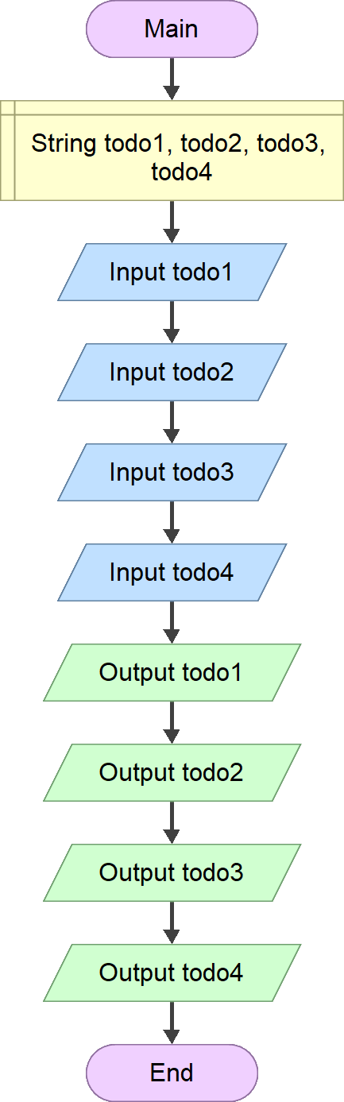
Problem
How to address the arbitrariness number of data?
Can ordinary variables answer the challenge?

Slide 7
Problem
Ordinary variable cannot be the solution due to its limitation to only handle one value at a time.
Instead, use array in combination with repetition.

Slide 8
Question
What is array?

Slide 9

Definition
Unlike an ordinary variable, an array is capable to hold multiple values at once.
The size of an array (n) reflects the number of its elements. Each element is addressable through an index, 0 – n-1.

Slide 10

Array
Similar to a variable, an array must be uniquely identified.
An array should be labeled in plural form.
E.g. names, grades, statuses, etc.
Generally, an array holds a fixed number of homogenous values.
Some languages support heterogeneous type and size alteration.
Multidimensional array is supported in most languages.

Slide 11
If 10 is the size (n) of an array, then:
it may hold up to 10 distinct elements,
each is addressable through index 0 – 9.
The size of the array, the number of elements it has. Each element holds a value.
identifier[n]
The square brackets indicate the use of array, not ordinary variable.
Array identifier is in plural form of noun.

Slide 12
An example of a to-do list.
Today’s To Do List:
Meeting with supervisor. [done]
Do Math exercise, due tonight. [done]
Group discussion (lunch).
Designing the change-password feature.

Slide 13
int n = 4;
String[] todos = new String[n];
Declaring an array of String with size = 4.
It has 4 elements:
+ the 1st element is at index 0, todos[0].
+ the last element is at index 3, todos[3].

Slide 14
int n = 4;
String[] todos = new String[n];
todos[0] = "Meeting with ...";
todos[1] = "Do Math exercise, ...";
...
todos[3] = "Designing the ...";

Slide 15
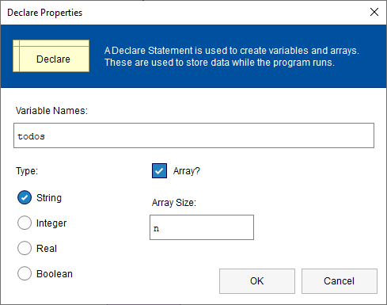

Slide 16
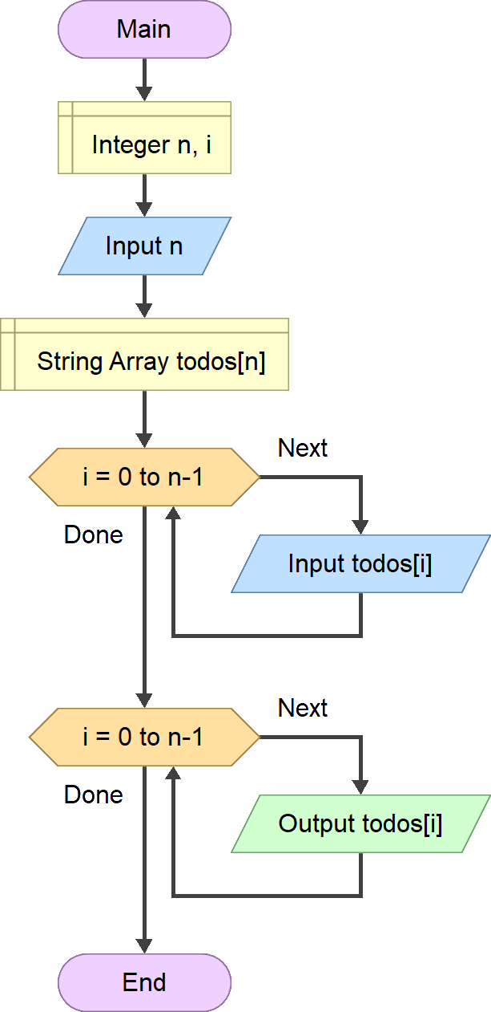
Ordinary Variable.
Using Array.
Inflexible.
Flexible.

Slide 17
Can array be the answer to this challenge?
Distinction between the “done” and “undone” items.
Today’s To Do List:
Meeting with supervisor. [done]
Do Math exercise, due tonight. [done]
Group discussion (lunch).
Designing the change-password feature.

Slide 18
Final Thoughts.

Slide 19
Conclusion
An array is capable to store multiple values at once.
An n-size array has elements with index 0 – n-1.
Homogenous type.
To match the array size arbitrariness, it is very common to also use repetition along with it.
The array—repetition combos.

Slide 20
References
Wassberg, J. (2020). Computer Programming for Absolute Beginners. Packt.
Declare – Flowgorithm http://www.flowgorithm.org/documentation/declare.html

