Slide 1
DSL in Course Scheduling
Zhuopeng Zhang

Slide 2
Task
DSL in this project focuses on course scheduling at school.
It is used to manually make timetables for all classes at school and automatically validate the timetables.
Notes:
This implementation of the DSL will not automatically create timetables for classes. At first, I considered the idea that timetables were produced by providing some criteria , and then adjusted manually. That can reduce the workload of scheduling courses. But I didn’t finish this work in time.

Slide 3
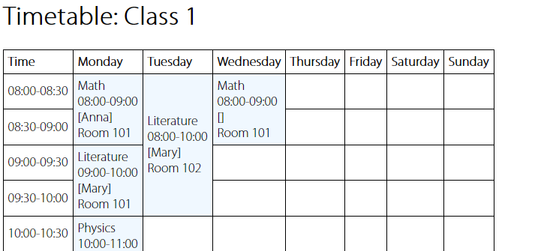
Timetable
Notes:
A timetable consists of these elements: class number, time, day, course.
The details about a course are name, time, instructor, and classroom.
Bases on these, I build my metamodel in next page.

Slide 4
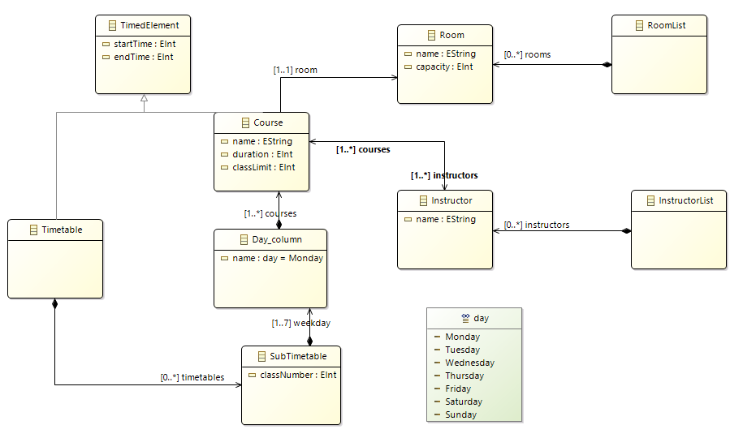
Metamodel
Notes:
This metamodel have more classes than elements I talked in previous page.
TimedElement is a basic class which is used in other classes. It contain 2 attribution: startTime and endTime.
Timetable is a class for the whole school. Time used here is the school open and end time.
Next, SubTimetable is the timetable for every class. I also thought of another form to represent these two classes. We can use one class Timetable and make a reference to itself. It is okey for the class diagram. But I think it can’t explicitly show the hierarchy of these two. Under the self-reference, any timetable can have a sub-timetable.
Day_column represents the column in the timetable. Here, I declare an enum datatype to its attribution name.
Course has attributes name, duration, classLimit and inherited startTime and endTime. classLimit used to check the capacity of the room allocated. Usually we mark a course with it’s start and duration. The end time can be calculated by there two. Course also has two reference to Room and Instructor.
Here, I declare two other classes RoomList and InsturctorList to store the rooms and instructors.

Slide 5
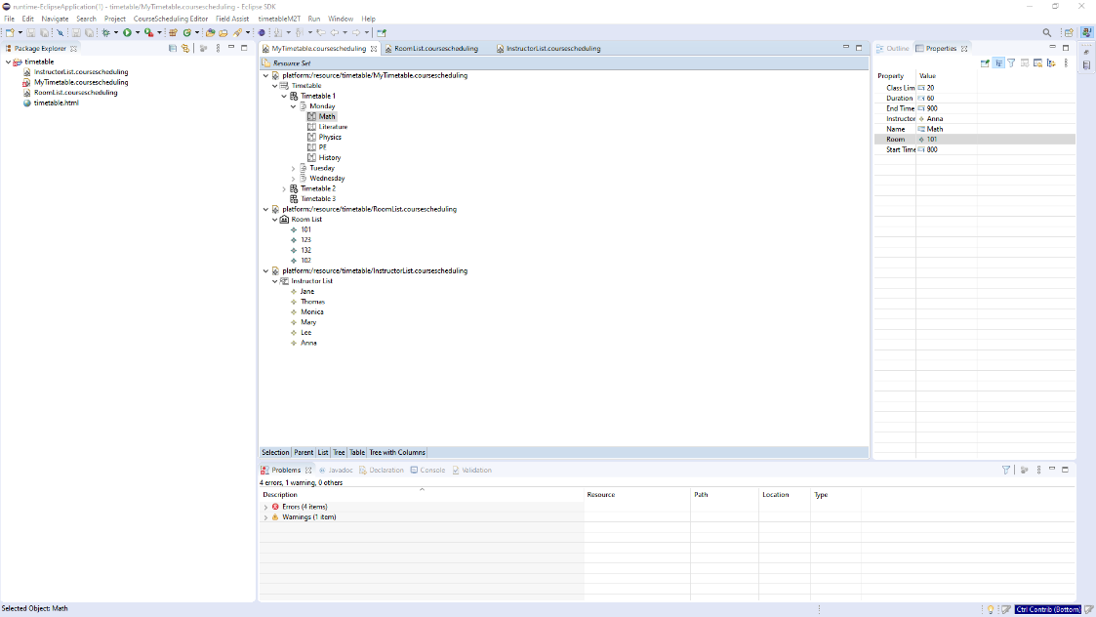
Generated Tree-based Editor
Notes:
From the Emfatic file conforming to the metamodel, I generated a dedicated tree-based editor.
The reason I choose the tree-based editor is easy to get started and clear hierarchy.
To use this editor, we need start a new project, and build three instances of Timetable, InstructorList and RoomList. Under the root Timetable, we start to schedule courses for every classes.
In the property tab, we input the information.
Here, for convenience I assume that the time is always the hour or half the hour.
There are two points we need notice. The time format is 24-hour. For example, we input 800 if the time is 8 o’clock, and 1330 if the time is 13:30. To schedule a course, we only input the start and duration. The end time can be auto filled.
Tree-bases editor is easy to operate. As you can see here, we can get structured timetables as once. But the biggest problem is that it is not convenient to edit, read and check details as text-based editor.

Slide 6
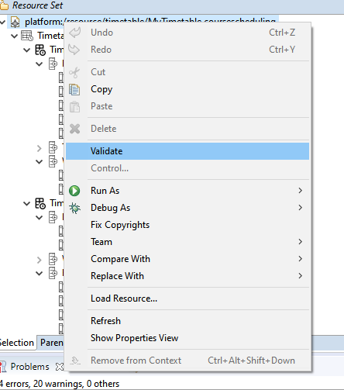
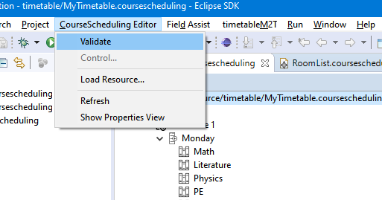
EVL
Notes:
I integrate the EVL as a plugin into the editor. We can use the validate command to invoke this plugin.

Slide 7
EVL
Blank property
Time format
Repetitive day
Wrong time
Overlapped course time
Room issue
Instructor with two courses
Notes:
There are the constraints I check in the EVL file.
Blank property is used to reminder there are some information users forget to input.
Time format is used to reminder check the time inputted is 24-hour.
Repetitive day is used to check the Day_columns in a timetable have the same name.
Wrong time is used to check the startTime is smaller than the endTime in Timetable.
Overlapped course time is used to check the courses’ time in one day is collided.
Room issue is used to check the classlimit of a course is within the capacity of the room arranged.
Instructor with two courses is used to make sure there were not a teacher arranged for more than one courses at the same time.

Slide 8
M2T
Notes:
At last, I use the model-to-text transformation to produce a html file to show the result of the course scheduling.
As mentioned before, the time in the timetable is the hour or half the hour for the convenience.

Slide 9
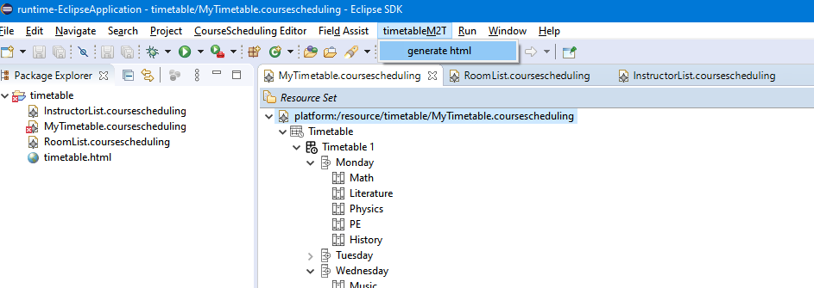
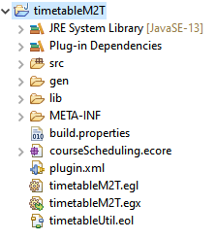
M2T
Notes:
Users can get the html file in the present workspace by using the command in the menu bar.
The command will call the EGX file in the plugin to transform the model MyTimetable.coursescheduling by the template EGL file.

