Slide 1

Análise De Séries Temporais
Aula 6

Slide 2
ProCESSO AUTOREGRESSIVO
Leitura:
Cryer & Chan (2008), Cap. 4
Coperwait & Metcalfe, Cap. 4
Shumway & Stoffer (2011), Cap. 3
(Processo AR(2))

Slide 3


ProCESSO AUTOREGRESSIVO
AR(2): estrutura de autocovariância
$$Y_{t}=φ_{1}Y_{t−1}+φ_{2}Y_{t−2}+ε_{t},$$
$$t∈ℤ.$$

Slide 4
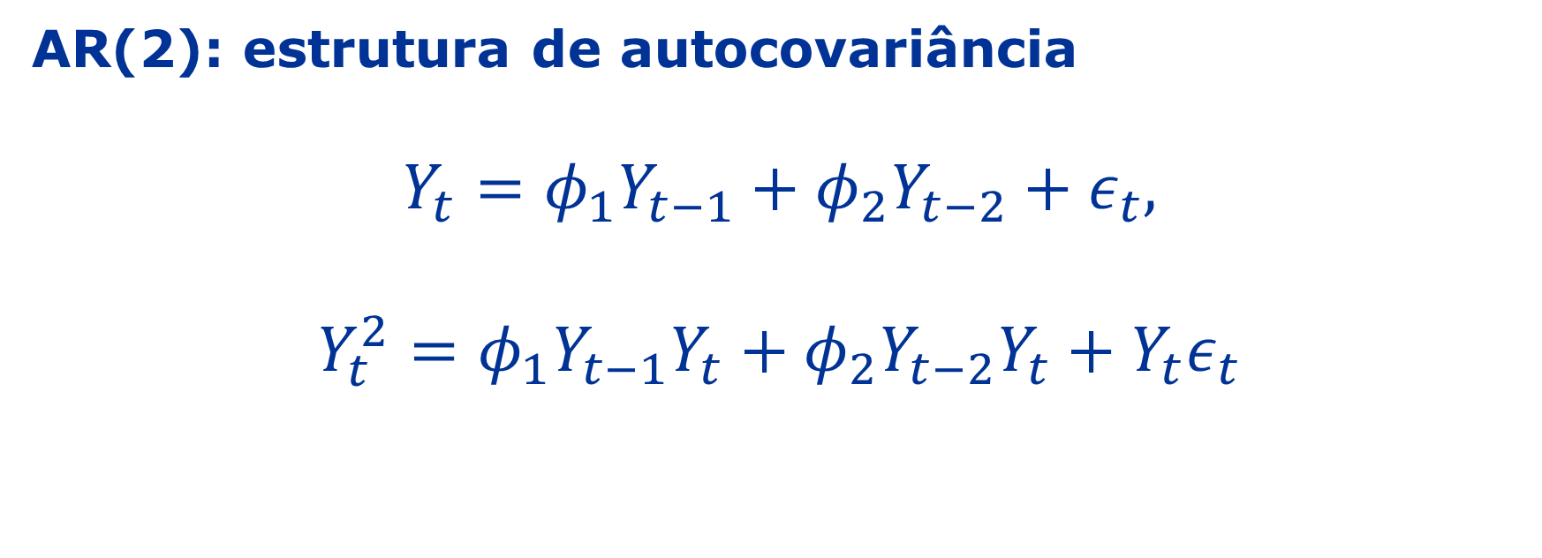
ProCESSO AUTOREGRESSIVO
AR(2): estrutura de autocovariância
$$Y_{t}=φ_{1}Y_{t−1}+φ_{2}Y_{t−2}+ε_{t},$$
$$Y_{t}^{2}=φ_{1}Y_{t−1}Y_{t}+φ_{2}Y_{t−2}Y_{t}+Y_{t}ε_{t}$$
$$t∈ℤ.$$

Slide 5
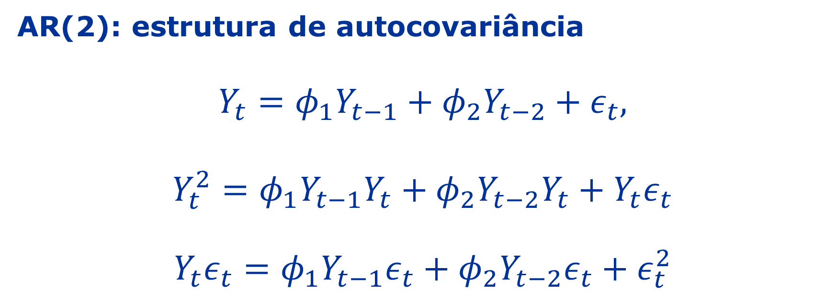
ProCESSO AUTOREGRESSIVO
AR(2): estrutura de autocovariância
$$Y_{t}=φ_{1}Y_{t−1}+φ_{2}Y_{t−2}+ε_{t},$$
$$Y_{t}^{2}=φ_{1}Y_{t−1}Y_{t}+φ_{2}Y_{t−2}Y_{t}+Y_{t}ε_{t}$$
$$Y_{t}ε_{t}=φ_{1}Y_{t−1}ε_{t}+φ_{2}Y_{t−2}ε_{t}+ε_{t}^{2}$$
$$t∈ℤ.$$

Slide 6
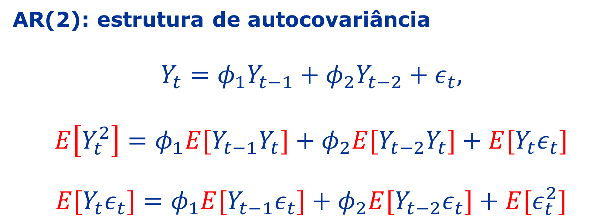
ProCESSO AUTOREGRESSIVO
AR(2): estrutura de autocovariância
$$Y_{t}=φ_{1}Y_{t−1}+φ_{2}Y_{t−2}+ε_{t},$$
$$E\left[Y_{t}^{2}\right]=φ_{1}E[Y_{t−1}Y_{t}]+φ_{2}{E[Y}_{t−2}Y_{t}]+E[Y_{t}ε_{t}]$$
$${E[Y}_{t}ε_{t}]=φ_{1}E[Y_{t−1}ε_{t}]+φ_{2}E[Y_{t−2}ε_{t}]+{E[ε}_{t}^{2}]$$
$$t∈ℤ.$$

Slide 7
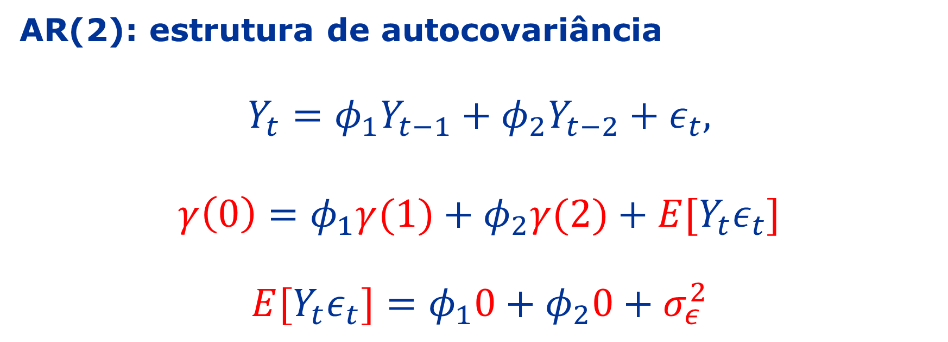
ProCESSO AUTOREGRESSIVO
AR(2): estrutura de autocovariância
$$Y_{t}=φ_{1}Y_{t−1}+φ_{2}Y_{t−2}+ε_{t},$$
$$γ\left(0\right)=φ_{1}γ(1)+φ_{2}γ(2)+E[Y_{t}ε_{t}]$$
$${E[Y}_{t}ε_{t}]=φ_{1}0+φ_{2}0+σ_{ε}^{2}$$
$$t∈ℤ.$$

Slide 8
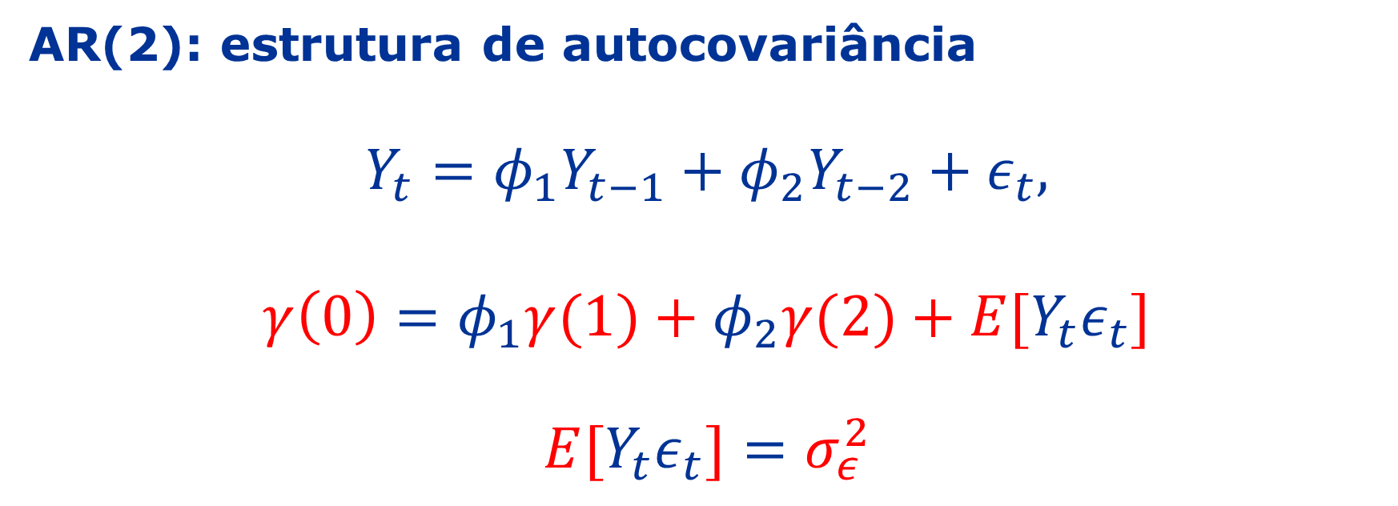
ProCESSO AUTOREGRESSIVO
AR(2): estrutura de autocovariância
$$Y_{t}=φ_{1}Y_{t−1}+φ_{2}Y_{t−2}+ε_{t},$$
$$γ\left(0\right)=φ_{1}γ(1)+φ_{2}γ(2)+E[Y_{t}ε_{t}]$$
$${E[Y}_{t}ε_{t}]=σ_{ε}^{2}$$
$$t∈ℤ.$$

Slide 9
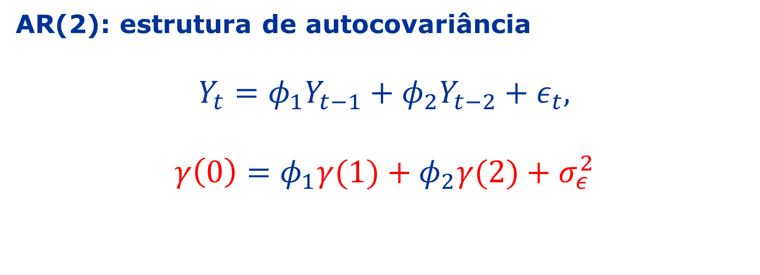
ProCESSO AUTOREGRESSIVO
AR(2): estrutura de autocovariância
$$Y_{t}=φ_{1}Y_{t−1}+φ_{2}Y_{t−2}+ε_{t},$$
$$γ\left(0\right)=φ_{1}γ(1)+φ_{2}γ(2)+σ_{ε}^{2}$$
$$t∈ℤ.$$

Slide 10
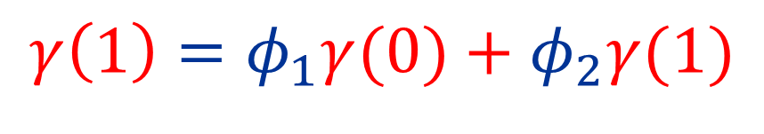
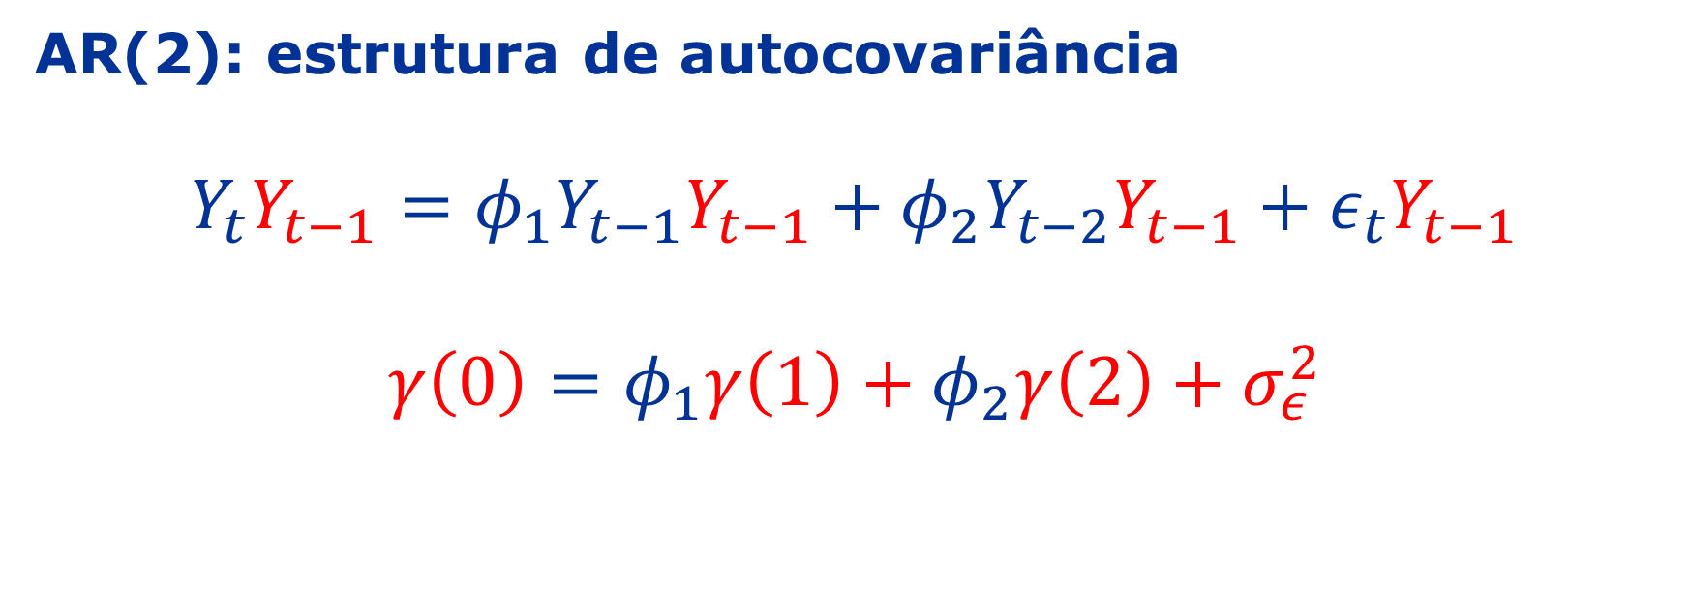
ProCESSO AUTOREGRESSIVO
AR(2): estrutura de autocovariância
$$Y_{t}Y_{t−1}=φ_{1}Y_{t−1}Y_{t−1}+φ_{2}Y_{t−2}Y_{t−1}+ε_{t}Y_{t−1}$$
$$γ\left(0\right)=φ_{1}γ\left(1\right)+φ_{2}γ\left(2\right)+σ_{ε}^{2}$$
$$γ\left(1\right)=φ_{1}γ(0)+φ_{2}γ(1)$$

Slide 11
ProCESSO AUTOREGRESSIVO
AR(2): estrutura de autocovariância
$$Y_{t}Y_{t−1}=φ_{1}Y_{t−1}Y_{t−1}+φ_{2}Y_{t−2}Y_{t−1}+ε_{t}Y_{t−1}$$
$$γ\left(0\right)=φ_{1}γ\left(1\right)+φ_{2}γ\left(2\right)+σ_{ε}^{2}$$
$$γ\left(1\right)=φ_{1}γ(0)+φ_{2}γ(1)$$

Slide 12
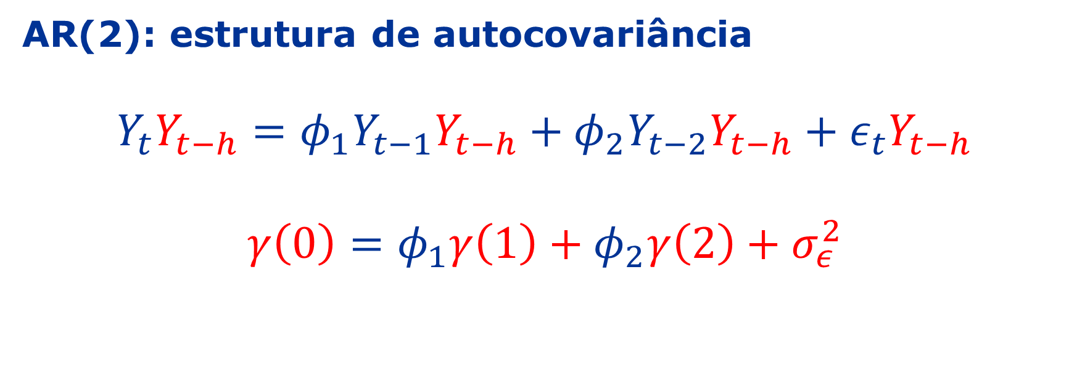

ProCESSO AUTOREGRESSIVO
$$h≥0$$
AR(2): estrutura de autocovariância
$$Y_{t}Y_{t−h}=φ_{1}Y_{t−1}Y_{t−h}+φ_{2}Y_{t−2}Y_{t−h}+ε_{t}Y_{t−h}$$
$$γ\left(0\right)=φ_{1}γ\left(1\right)+φ_{2}γ\left(2\right)+σ_{ε}^{2}$$
$$γ\left(1\right)=φ_{1}γ(0)+φ_{2}γ(1)$$

Slide 13
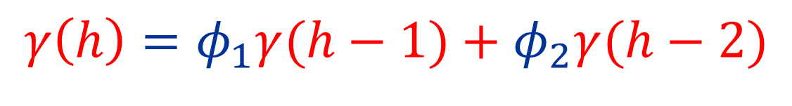

ProCESSO AUTOREGRESSIVO
$$h≥2$$
AR(2): estrutura de autocovariância
$$Y_{t}Y_{t−h}=φ_{1}Y_{t−1}Y_{t−h}+φ_{2}Y_{t−2}Y_{t−h}+ε_{t}Y_{t−h}$$
$$γ\left(0\right)=φ_{1}γ\left(1\right)+φ_{2}γ\left(2\right)+σ_{ε}^{2}$$
$$γ\left(1\right)=φ_{1}γ(0)+φ_{2}γ(1)$$
$$γ\left(h\right)=φ_{1}γ(h−1)+φ_{2}γ(h−2)$$

Slide 14

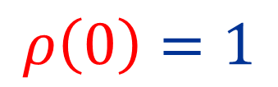


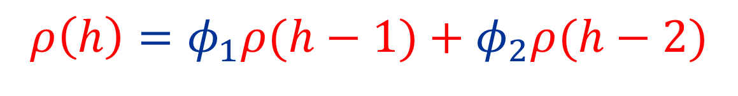
ProCESSO AUTOREGRESSIVO
$$h≥2$$
AR(2): estrutura de autocorrelação
$$Y_{t}Y_{t−h}=φ_{1}Y_{t−1}Y_{t−h}+φ_{2}Y_{t−2}Y_{t−h}+ε_{t}Y_{t−h}$$
Dividindo $γ\left(h\right)$ por $γ\left(0\right)$
$$ρ\left(0\right)=1$$
$$ρ\left(1\right)=\frac{φ_{1}}{1−φ_{2}}$$
$$ρ\left(h\right)=φ_{1}ρ(h−1)+φ_{2}ρ(h−2)$$

Slide 15



ProCESSO AUTOREGRESSIVO
$$h≥2$$
AR(2): estrutura de autocorrelação
$$Y_{t}Y_{t−h}=φ_{1}Y_{t−1}Y_{t−h}+φ_{2}Y_{t−2}Y_{t−h}+ε_{t}Y_{t−h}$$
Dividindo $γ\left(h\right)$ por $γ\left(0\right)$
$${|φ}_{1}|<2$$
$${|φ}_{2}|<1$$
$$ρ\left(0\right)=1$$
$$φ_{2}+φ_{1}<1$$
$$ρ\left(1\right)=\frac{φ_{1}}{1−φ_{2}}$$
$$φ_{2}−φ_{1}<1$$
Eq. de diferença:
$$ρ\left(h\right)=φ_{1}ρ(h−1)+φ_{2}ρ(h−2)$$

Slide 16
ProCESSO AUTOREGRESSIVO
$$h≥2$$
AR(2): estrutura de autocorrelação
$$Y_{t}Y_{t−h}=φ_{1}Y_{t−1}Y_{t−h}+φ_{2}Y_{t−2}Y_{t−h}+ε_{t}Y_{t−h}$$
Dividindo $γ\left(h\right)$ por $γ\left(0\right)$
$${|φ}_{1}|<2$$
$${|φ}_{2}|<1$$
$$ρ\left(0\right)=1$$
$$φ_{2}+φ_{1}<1$$
$$ρ\left(1\right)=\frac{φ_{1}}{1−φ_{2}}$$
$$φ_{2}−φ_{1}<1$$
Eq. de diferença:
$$ρ\left(h\right)=φ_{1}ρ(h−1)+φ_{2}ρ(h−2)$$
Como essa função se comporta à medida que $h$aumenta?

Slide 17
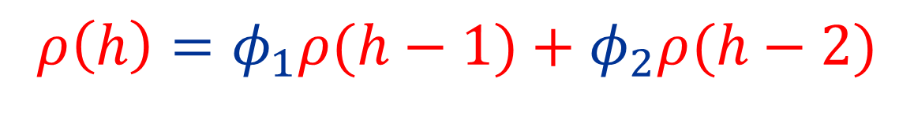


ProCESSO AUTOREGRESSIVO
$$ρ\left(0\right)=1$$
$$ρ\left(1\right)=\frac{φ_{1}}{1−φ_{2}}$$
$$h≥2$$
AR(2): estrutura de autocorrelação
$$Y_{t}Y_{t−h}=φ_{1}Y_{t−1}Y_{t−h}+φ_{2}Y_{t−2}Y_{t−h}+ε_{t}Y_{t−h}$$
$$ρ\left(h\right)=φ_{1}ρ(h−1)+φ_{2}ρ(h−2)$$

Slide 18

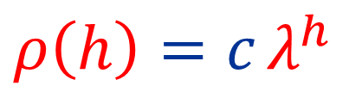
ProCESSO AUTOREGRESSIVO
$$ρ\left(0\right)=1$$
$$ρ\left(1\right)=\frac{φ_{1}}{1−φ_{2}}$$
$$h≥2$$
AR(2): estrutura de autocorrelação
$$Y_{t}Y_{t−h}=φ_{1}Y_{t−1}Y_{t−h}+φ_{2}Y_{t−2}Y_{t−h}+ε_{t}Y_{t−h}$$
$$ρ\left(h\right)=φ_{1}ρ(h−1)+φ_{2}ρ(h−2)$$
Solução tentativa:
$ρ\left(h\right)=c$ $λ^{h}$
$$λ≠0$$

Slide 19
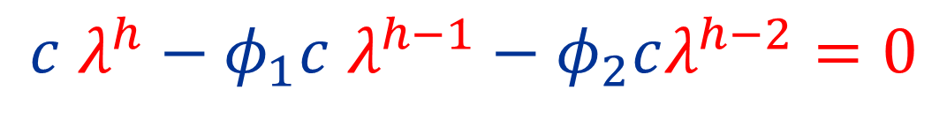
ProCESSO AUTOREGRESSIVO
$$ρ\left(0\right)=1$$
$$ρ\left(1\right)=\frac{φ_{1}}{1−φ_{2}}$$
$$h≥2$$
AR(2): estrutura de autocorrelação
$$Y_{t}Y_{t−h}=φ_{1}Y_{t−1}Y_{t−h}+φ_{2}Y_{t−2}Y_{t−h}+ε_{t}Y_{t−h}$$
$$ρ\left(h\right)=φ_{1}ρ(h−1)+φ_{2}ρ(h−2)$$
Solução tentativa:
$ρ\left(h\right)=c$ $λ^{h}$
$$c λ^{h}−φ_{1}c λ^{h−1}−φ_{2}cλ^{h−2}=0$$

Slide 20
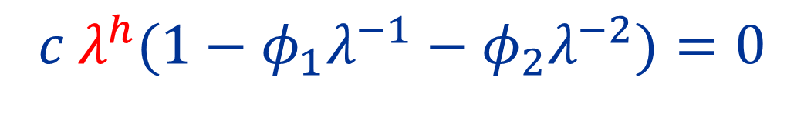
ProCESSO AUTOREGRESSIVO
$$ρ\left(0\right)=1$$
$$ρ\left(1\right)=\frac{φ_{1}}{1−φ_{2}}$$
$$h≥2$$
AR(2): estrutura de autocorrelação
$$Y_{t}Y_{t−h}=φ_{1}Y_{t−1}Y_{t−h}+φ_{2}Y_{t−2}Y_{t−h}+ε_{t}Y_{t−h}$$
$$ρ\left(h\right)=φ_{1}ρ(h−1)+φ_{2}ρ(h−2)$$
Solução tentativa:
$ρ\left(h\right)=c$ $λ^{h}$
$$c λ^{h}(1−φ_{1}λ^{−1}−φ_{2}λ^{−2})=0$$

Slide 21
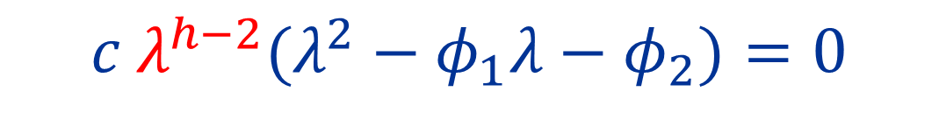
ProCESSO AUTOREGRESSIVO
$$ρ\left(0\right)=1$$
$$ρ\left(1\right)=\frac{φ_{1}}{1−φ_{2}}$$
$$h≥2$$
AR(2): estrutura de autocorrelação
$$Y_{t}Y_{t−h}=φ_{1}Y_{t−1}Y_{t−h}+φ_{2}Y_{t−2}Y_{t−h}+ε_{t}Y_{t−h}$$
$$ρ\left(h\right)=φ_{1}ρ(h−1)+φ_{2}ρ(h−2)$$
Solução tentativa:
$ρ\left(h\right)=c$ $λ^{h}$
$$c λ^{h−2}(λ^{2}−φ_{1}λ−φ_{2})=0$$

Slide 22
ProCESSO AUTOREGRESSIVO
$$ρ\left(0\right)=1$$
$$ρ\left(1\right)=\frac{φ_{1}}{1−φ_{2}}$$
$$h≥2$$
AR(2): estrutura de autocorrelação
$$Y_{t}Y_{t−h}=φ_{1}Y_{t−1}Y_{t−h}+φ_{2}Y_{t−2}Y_{t−h}+ε_{t}Y_{t−h}$$
$$ρ\left(h\right)=φ_{1}ρ(h−1)+φ_{2}ρ(h−2)$$
Solução tentativa:
$ρ\left(h\right)=c$ $λ^{h}$
$$c λ^{h−2}(λ^{2}−φ_{1}λ−φ_{2})=0$$
Equação auxiliar

Slide 23
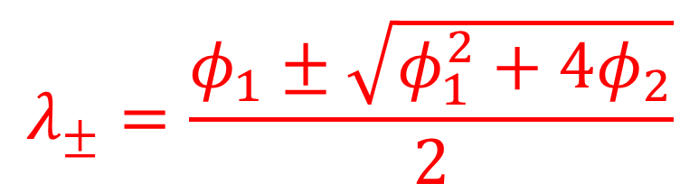
ProCESSO AUTOREGRESSIVO
$$ρ\left(0\right)=1$$
$$ρ\left(1\right)=\frac{φ_{1}}{1−φ_{2}}$$
$$h≥2$$
AR(2): estrutura de autocorrelação
$$Y_{t}Y_{t−h}=φ_{1}Y_{t−1}Y_{t−h}+φ_{2}Y_{t−2}Y_{t−h}+ε_{t}Y_{t−h}$$
$$ρ\left(h\right)=φ_{1}ρ(h−1)+φ_{2}ρ(h−2)$$
Solução tentativa:
$ρ\left(h\right)=c$ $λ^{h}$
$$λ_{±}=\frac{φ_{1}±\sqrt{φ_{1}^{2}+4φ_{2}}}{2}$$
$$c λ^{h−2}(λ^{2}−φ_{1}λ−φ_{2})=0$$
Equação auxiliar

Slide 24
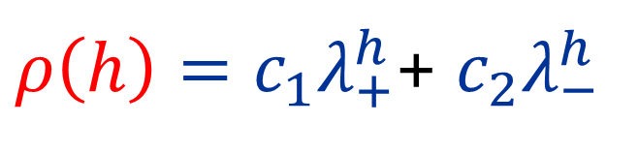
ProCESSO AUTOREGRESSIVO
$$ρ\left(0\right)=1$$
$$ρ\left(1\right)=\frac{φ_{1}}{1−φ_{2}}$$
$$h≥2$$
AR(2): estrutura de autocorrelação
$$Y_{t}Y_{t−h}=φ_{1}Y_{t−1}Y_{t−h}+φ_{2}Y_{t−2}Y_{t−h}+ε_{t}Y_{t−h}$$
$$ρ\left(h\right)=φ_{1}ρ(h−1)+φ_{2}ρ(h−2)$$
Nova solução tentativa:
$ρ\left(h\right)=c_{1}λ_{+}^{h}$+ $c_{2}λ_{−}^{h}$
$$λ_{±}=\frac{φ_{1}±\sqrt{φ_{1}^{2}+4φ_{2}}}{2}$$
$$c λ^{h−2}(λ^{2}−φ_{1}λ−φ_{2})=0$$
Equação auxiliar

Slide 25
ProCESSO AUTOREGRESSIVO
$$ρ\left(0\right)=1$$
$$ρ\left(1\right)=\frac{φ_{1}}{1−φ_{2}}$$
$$h≥2$$
AR(2): estrutura de autocorrelação
$$Y_{t}Y_{t−h}=φ_{1}Y_{t−1}Y_{t−h}+φ_{2}Y_{t−2}Y_{t−h}+ε_{t}Y_{t−h}$$
$$ρ\left(h\right)=φ_{1}ρ(h−1)+φ_{2}ρ(h−2)$$
Nova solução tentativa:
$ρ\left(h\right)=c_{1}λ_{+}^{h}$+ $c_{2}λ_{−}^{h}$
$$λ_{±}=\frac{φ_{1}±\sqrt{φ_{1}^{2}+4φ_{2}}}{2}$$

Slide 26
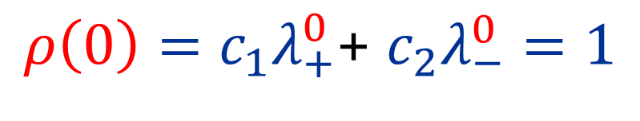
ProCESSO AUTOREGRESSIVO
$$ρ\left(0\right)=1$$
$$ρ\left(1\right)=\frac{φ_{1}}{1−φ_{2}}$$
$$h≥2$$
AR(2): estrutura de autocorrelação
$$Y_{t}Y_{t−h}=φ_{1}Y_{t−1}Y_{t−h}+φ_{2}Y_{t−2}Y_{t−h}+ε_{t}Y_{t−h}$$
$$ρ\left(h\right)=φ_{1}ρ(h−1)+φ_{2}ρ(h−2)$$
Nova solução tentativa:
$ρ\left(h\right)=c_{1}λ_{+}^{h}$+ $c_{2}λ_{−}^{h}$
$$λ_{±}=\frac{φ_{1}±\sqrt{φ_{1}^{2}+4φ_{2}}}{2}$$
$$ρ\left(0\right)=c_{1}λ_{+}^{0}\text{+} c_{2}λ_{−}^{0}=1$$

Slide 27
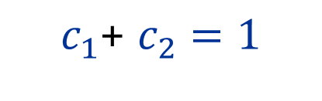
ProCESSO AUTOREGRESSIVO
$$c_{1}\text{+} c_{2}=1$$
$$ρ\left(0\right)=1$$
$$ρ\left(1\right)=\frac{φ_{1}}{1−φ_{2}}$$
$$h≥2$$
AR(2): estrutura de autocorrelação
$$Y_{t}Y_{t−h}=φ_{1}Y_{t−1}Y_{t−h}+φ_{2}Y_{t−2}Y_{t−h}+ε_{t}Y_{t−h}$$
$$ρ\left(h\right)=φ_{1}ρ(h−1)+φ_{2}ρ(h−2)$$
Nova solução tentativa:
$ρ\left(h\right)=c_{1}λ_{+}^{h}$+ $c_{2}λ_{−}^{h}$
$$λ_{±}=\frac{φ_{1}±\sqrt{φ_{1}^{2}+4φ_{2}}}{2}$$
$$ρ\left(0\right)=c_{1}λ_{+}^{0}\text{+} c_{2}λ_{−}^{0}=1$$

Slide 28
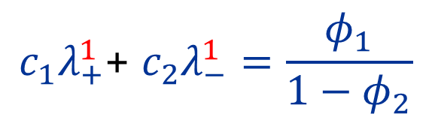
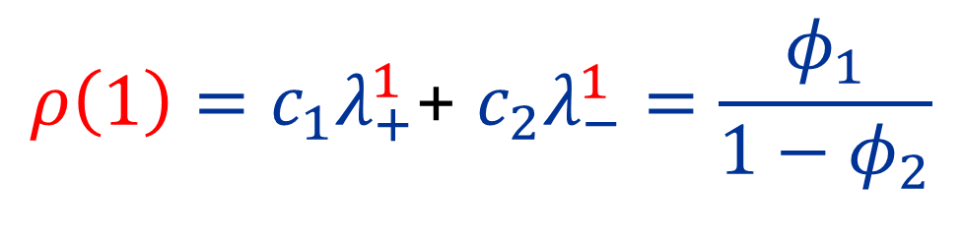
ProCESSO AUTOREGRESSIVO
$$c_{1}\text{+} c_{2}=1$$
$$ρ\left(0\right)=1$$
$$c_{1}λ_{+}^{1}\text{+} c_{2}λ_{−}^{1}=\frac{φ_{1}}{1−φ_{2}}$$
$$ρ\left(1\right)=\frac{φ_{1}}{1−φ_{2}}$$
$$h≥2$$
AR(2): estrutura de autocorrelação
$$Y_{t}Y_{t−h}=φ_{1}Y_{t−1}Y_{t−h}+φ_{2}Y_{t−2}Y_{t−h}+ε_{t}Y_{t−h}$$
$$ρ\left(h\right)=φ_{1}ρ(h−1)+φ_{2}ρ(h−2)$$
Nova solução tentativa:
$ρ\left(h\right)=c_{1}λ_{+}^{h}$+ $c_{2}λ_{−}^{h}$
$$λ_{±}=\frac{φ_{1}±\sqrt{φ_{1}^{2}+4φ_{2}}}{2}$$
$$ρ\left(1\right)=c_{1}λ_{+}^{1}\text{+} c_{2}λ_{−}^{1}=\frac{φ_{1}}{1−φ_{2}}$$

Slide 29
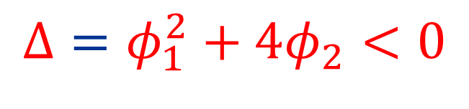
ProCESSO AUTOREGRESSIVO
$$c_{1}\text{+} c_{2}=1$$
$$ρ\left(0\right)=1$$
$$c_{1}λ_{+}^{1}\text{+} c_{2}λ_{−}^{1}=\frac{φ_{1}}{1−φ_{2}}$$
$$ρ\left(1\right)=\frac{φ_{1}}{1−φ_{2}}$$
$$h≥2$$
AR(2): estrutura de autocorrelação
$$Y_{t}Y_{t−h}=φ_{1}Y_{t−1}Y_{t−h}+φ_{2}Y_{t−2}Y_{t−h}+ε_{t}Y_{t−h}$$
$$Δ=φ_{1}^{2}+4φ_{2}<0$$
Nova solução tentativa:
$ρ\left(h\right)=c_{1}λ_{+}^{h}$+ $c_{2}λ_{−}^{h}$
$$λ_{±}=\frac{φ_{1}±\sqrt{φ_{1}^{2}+4φ_{2}}}{2}$$
$$ρ\left(1\right)=c_{1}λ_{+}^{1}\text{+} c_{2}λ_{−}^{1}=\frac{φ_{1}}{1−φ_{2}}$$

Slide 30

ProCESSO AUTOREGRESSIVO
$$c_{1}\text{+} c_{2}=1$$
$$ρ\left(0\right)=1$$
$$c_{1}λ_{+}^{1}\text{+} c_{2}λ_{−}^{1}=\frac{φ_{1}}{1−φ_{2}}$$
$$ρ\left(1\right)=\frac{φ_{1}}{1−φ_{2}}$$
$$h≥2$$
AR(2): estrutura de autocorrelação
$$Y_{t}Y_{t−h}=φ_{1}Y_{t−1}Y_{t−h}+φ_{2}Y_{t−2}Y_{t−h}+ε_{t}Y_{t−h}$$
$$Δ=φ_{1}^{2}+4φ_{2}<0$$
$ρ\left(h\right)=c_{1}λ_{+}^{h}$+ $c_{2}λ_{−}^{h}$
$$λ_{±}=\frac{φ_{1}±\sqrt{φ_{1}^{2}+4φ_{2}}}{2}$$
$$ρ\left(1\right)=c_{1}λ_{+}^{1}\text{+} c_{2}λ_{−}^{1}=\frac{φ_{1}}{1−φ_{2}}$$

Slide 31

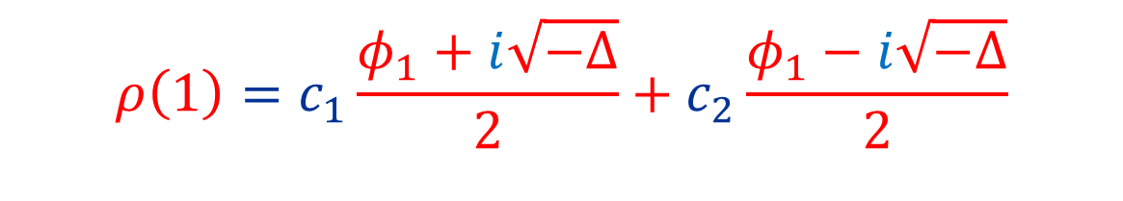
ProCESSO AUTOREGRESSIVO
$$c_{1}\text{+} c_{2}=1$$
$$ρ\left(0\right)=1$$
$$c_{1}λ_{+}^{1}\text{+} c_{2}λ_{−}^{1}=\frac{φ_{1}}{1−φ_{2}}$$
$$ρ\left(1\right)=\frac{φ_{1}}{1−φ_{2}}$$
$$h≥2$$
AR(2): estrutura de autocorrelação
$$Y_{t}Y_{t−h}=φ_{1}Y_{t−1}Y_{t−h}+φ_{2}Y_{t−2}Y_{t−h}+ε_{t}Y_{t−h}$$
$$Δ=φ_{1}^{2}+4φ_{2}<0$$
$ρ\left(h\right)=c_{1}λ_{+}^{h}$+ $c_{2}λ_{−}^{h}$
$$λ_{±}=\frac{φ_{1}±i\sqrt{−Δ}}{2}$$
$$ρ\left(1\right)=c_{1}\frac{φ_{1}+i\sqrt{−Δ}}{2}+c_{2}\frac{φ_{1}−i\sqrt{−Δ}}{2}$$

Slide 32
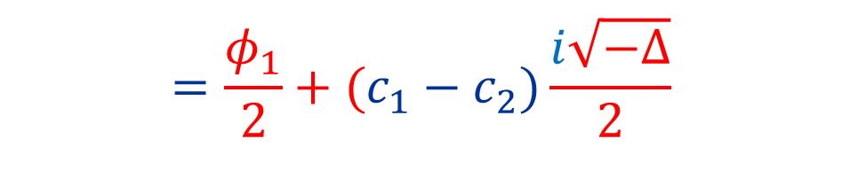
ProCESSO AUTOREGRESSIVO
$$c_{1}\text{+} c_{2}=1$$
$$ρ\left(0\right)=1$$
$$c_{1}λ_{+}^{1}\text{+} c_{2}λ_{−}^{1}=\frac{φ_{1}}{1−φ_{2}}$$
$$ρ\left(1\right)=\frac{φ_{1}}{1−φ_{2}}$$
$$h≥2$$
AR(2): estrutura de autocorrelação
$$Y_{t}Y_{t−h}=φ_{1}Y_{t−1}Y_{t−h}+φ_{2}Y_{t−2}Y_{t−h}+ε_{t}Y_{t−h}$$
$$Δ=φ_{1}^{2}+4φ_{2}<0$$
$ρ\left(h\right)=c_{1}λ_{+}^{h}$+ $c_{2}λ_{−}^{h}$
$$λ_{±}=\frac{φ_{1}±i\sqrt{−Δ}}{2}$$
$$ρ\left(1\right)=c_{1}\frac{φ_{1}+i\sqrt{−Δ}}{2}+c_{2}\frac{φ_{1}−i\sqrt{−Δ}}{2}$$
$$=\frac{φ_{1}}{2}+(c_{1}−c_{2})\frac{i\sqrt{−Δ}}{2}$$

Slide 33
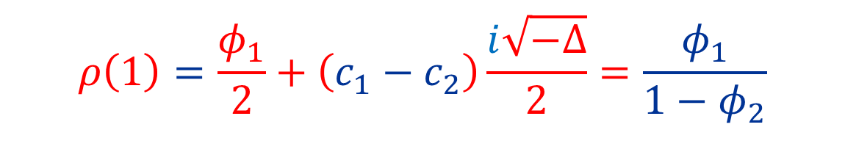
ProCESSO AUTOREGRESSIVO
$$c_{1}\text{+} c_{2}=1$$
$$ρ\left(0\right)=1$$
$$c_{1}λ_{+}^{1}\text{+} c_{2}λ_{−}^{1}=\frac{φ_{1}}{1−φ_{2}}$$
$$ρ\left(1\right)=\frac{φ_{1}}{1−φ_{2}}$$
$$h≥2$$
AR(2): estrutura de autocorrelação
$$Y_{t}Y_{t−h}=φ_{1}Y_{t−1}Y_{t−h}+φ_{2}Y_{t−2}Y_{t−h}+ε_{t}Y_{t−h}$$
$$Δ=φ_{1}^{2}+4φ_{2}<0$$
$ρ\left(h\right)=c_{1}λ_{+}^{h}$+ $c_{2}λ_{−}^{h}$
$$λ_{±}=\frac{φ_{1}±i\sqrt{−Δ}}{2}$$
$$ρ\left(1\right)=\frac{φ_{1}}{2}+\left(c_{1}−c_{2}\right)\frac{i\sqrt{−Δ}}{2}=\frac{φ_{1}}{1−φ_{2}}$$

Slide 34
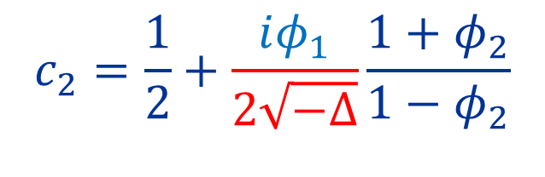
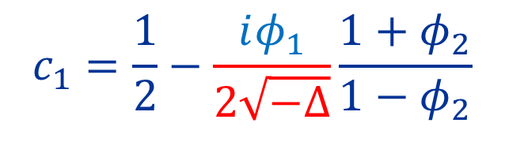
ProCESSO AUTOREGRESSIVO
$$c_{1}\text{+} c_{2}=1$$
$$ρ\left(0\right)=1$$
$$c_{1}λ_{+}^{1}\text{+} c_{2}λ_{−}^{1}=\frac{φ_{1}}{1−φ_{2}}$$
$$ρ\left(1\right)=\frac{φ_{1}}{1−φ_{2}}$$
$$h≥2$$
AR(2): estrutura de autocorrelação
$$Y_{t}Y_{t−h}=φ_{1}Y_{t−1}Y_{t−h}+φ_{2}Y_{t−2}Y_{t−h}+ε_{t}Y_{t−h}$$
$$Δ=φ_{1}^{2}+4φ_{2}<0$$
$ρ\left(h\right)=c_{1}λ_{+}^{h}$+ $c_{2}λ_{−}^{h}$
$$λ_{±}=\frac{φ_{1}±i\sqrt{−Δ}}{2}$$
$$c_{1}=\frac{1}{2}−\frac{iφ_{1}}{2\sqrt{−Δ}}\frac{1+φ_{2}}{1−φ_{2}}$$
$$ρ\left(1\right)=\frac{φ_{1}}{2}+\left(c_{1}−c_{2}\right)\frac{i\sqrt{−Δ}}{2}=\frac{φ_{1}}{1−φ_{2}}$$
$$c_{2}=\frac{1}{2}+\frac{iφ_{1}}{2\sqrt{−Δ}}\frac{1+φ_{2}}{1−φ_{2}}$$

Slide 35


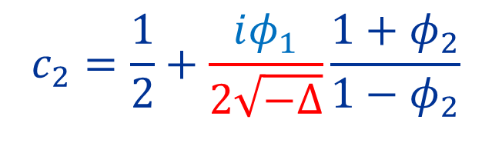

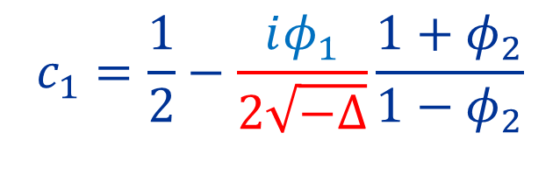
ProCESSO AUTOREGRESSIVO
$$Δ<0$$
$$c_{1}\text{+} c_{2}=1$$
$$ρ\left(0\right)=1$$
$$c_{1}λ_{+}^{1}\text{+} c_{2}λ_{−}^{1}=\frac{φ_{1}}{1−φ_{2}}$$
$$ρ\left(1\right)=\frac{φ_{1}}{1−φ_{2}}$$
$ρ\left(h\right)=c_{1}λ_{+}^{h}$+ $c_{2}λ_{−}^{h}$
$$h≥2$$
AR(2): estrutura de autocorrelação
$$Y_{t}Y_{t−h}=φ_{1}Y_{t−1}Y_{t−h}+φ_{2}Y_{t−2}Y_{t−h}+ε_{t}Y_{t−h}$$
$$λ_{±}=\frac{φ_{1}±i\sqrt{−Δ}}{2}$$
$$c_{1}=\frac{1}{2}−\frac{iφ_{1}}{2\sqrt{−Δ}}\frac{1+φ_{2}}{1−φ_{2}}$$
$$c_{2}=\frac{1}{2}+\frac{iφ_{1}}{2\sqrt{−Δ}}\frac{1+φ_{2}}{1−φ_{2}}$$

Slide 36
ProCESSO AUTOREGRESSIVO
$$Δ<0$$
$$c_{1}\text{+} c_{2}=1$$
$$ρ\left(0\right)=1$$
$$c_{1}λ_{+}^{1}\text{+} c_{2}λ_{−}^{1}=\frac{φ_{1}}{1−φ_{2}}$$
$$ρ\left(1\right)=\frac{φ_{1}}{1−φ_{2}}$$
$ρ\left(h\right)=c_{1}λ_{+}^{h}$+ $c_{2}λ_{−}^{h}$
$$h≥2$$
AR(2): estrutura de autocorrelação
$$Y_{t}Y_{t−h}=φ_{1}Y_{t−1}Y_{t−h}+φ_{2}Y_{t−2}Y_{t−h}+ε_{t}Y_{t−h}$$
$$λ_{±}=\frac{φ_{1}±i\sqrt{−Δ}}{2}$$
$$c_{1}=\frac{1}{2}−\frac{iφ_{1}}{2\sqrt{−Δ}}\frac{1+φ_{2}}{1−φ_{2}}$$
$$c_{2}=\frac{1}{2}+\frac{iφ_{1}}{2\sqrt{−Δ}}\frac{1+φ_{2}}{1−φ_{2}}$$
$$λ_{±}=|λ_{±}|cos\left(ω\right)±|λ_{±}|i sin{(ω)}$$

Slide 37
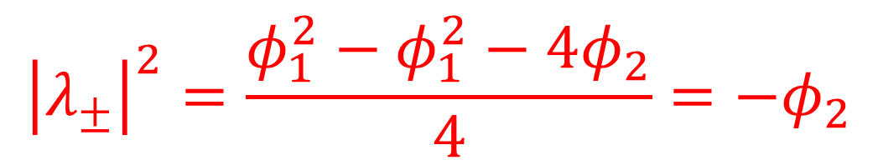
ProCESSO AUTOREGRESSIVO
$$Δ<0$$
$$c_{1}\text{+} c_{2}=1$$
$$ρ\left(0\right)=1$$
$$c_{1}λ_{+}^{1}\text{+} c_{2}λ_{−}^{1}=\frac{φ_{1}}{1−φ_{2}}$$
$$ρ\left(1\right)=\frac{φ_{1}}{1−φ_{2}}$$
$ρ\left(h\right)=c_{1}λ_{+}^{h}$+ $c_{2}λ_{−}^{h}$
$$h≥2$$
AR(2): estrutura de autocorrelação
$$Y_{t}Y_{t−h}=φ_{1}Y_{t−1}Y_{t−h}+φ_{2}Y_{t−2}Y_{t−h}+ε_{t}Y_{t−h}$$
$$λ_{±}=\frac{φ_{1}±i\sqrt{−Δ}}{2}$$
$$c_{1}=\frac{1}{2}−\frac{iφ_{1}}{2\sqrt{−Δ}}\frac{1+φ_{2}}{1−φ_{2}}$$
$$c_{2}=\frac{1}{2}+\frac{iφ_{1}}{2\sqrt{−Δ}}\frac{1+φ_{2}}{1−φ_{2}}$$
$$λ_{±}=|λ_{±}|cos\left(ω\right)±|λ_{±}|i sin{(ω)}$$
$${\left|λ_{±}\right|}^{2}=\frac{φ_{1}^{2}−φ_{1}^{2}−4φ_{2}}{4}=−φ_{2}$$

Slide 38
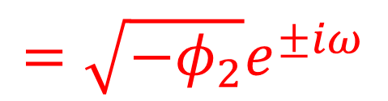
ProCESSO AUTOREGRESSIVO
$$Δ<0$$
$$c_{1}\text{+} c_{2}=1$$
$$ρ\left(0\right)=1$$
$$c_{1}λ_{+}^{1}\text{+} c_{2}λ_{−}^{1}=\frac{φ_{1}}{1−φ_{2}}$$
$$ρ\left(1\right)=\frac{φ_{1}}{1−φ_{2}}$$
$ρ\left(h\right)=c_{1}λ_{+}^{h}$+ $c_{2}λ_{−}^{h}$
$$h≥2$$
AR(2): estrutura de autocorrelação
$$Y_{t}Y_{t−h}=φ_{1}Y_{t−1}Y_{t−h}+φ_{2}Y_{t−2}Y_{t−h}+ε_{t}Y_{t−h}$$
$$λ_{±}=\frac{φ_{1}±i\sqrt{−Δ}}{2}$$
$$c_{1}=\frac{1}{2}−\frac{iφ_{1}}{2\sqrt{−Δ}}\frac{1+φ_{2}}{1−φ_{2}}$$
$$c_{2}=\frac{1}{2}+\frac{iφ_{1}}{2\sqrt{−Δ}}\frac{1+φ_{2}}{1−φ_{2}}$$
$$λ_{±}=|λ_{±}|cos\left(ω\right)±|λ_{±}|i sin{(ω)}$$
$$=\sqrt{−φ_{2}}e^{±iω}$$
$${\left|λ_{±}\right|}^{2}=\frac{φ_{1}^{2}−φ_{1}^{2}−4φ_{2}}{4}=−φ_{2}$$

Slide 39

ProCESSO AUTOREGRESSIVO
$$Δ<0$$
$$c_{1}\text{+} c_{2}=1$$
$$ρ\left(0\right)=1$$
$$c_{1}λ_{+}^{1}\text{+} c_{2}λ_{−}^{1}=\frac{φ_{1}}{1−φ_{2}}$$
$$ρ\left(1\right)=\frac{φ_{1}}{1−φ_{2}}$$
$ρ\left(h\right)=c_{1}λ_{+}^{h}$+ $c_{2}λ_{−}^{h}$
$$h≥2$$
AR(2): estrutura de autocorrelação
$$Y_{t}Y_{t−h}=φ_{1}Y_{t−1}Y_{t−h}+φ_{2}Y_{t−2}Y_{t−h}+ε_{t}Y_{t−h}$$
$$λ_{±}=\frac{φ_{1}±i\sqrt{−Δ}}{2}$$
$$c_{1}=\frac{1}{2}−\frac{iφ_{1}}{2\sqrt{−Δ}}\frac{1+φ_{2}}{1−φ_{2}}$$
$$c_{2}=\frac{1}{2}+\frac{iφ_{1}}{2\sqrt{−Δ}}\frac{1+φ_{2}}{1−φ_{2}}$$
$$λ_{±}=|λ_{±}|cos\left(ω\right)±|λ_{±}|i sin{(ω)}$$
$$=\sqrt{−φ_{2}}e^{±iω}$$
$${\left|c_{1}\right|}^{2}={\left|c_{2}\right|}^{2}=|c|$$

Slide 40
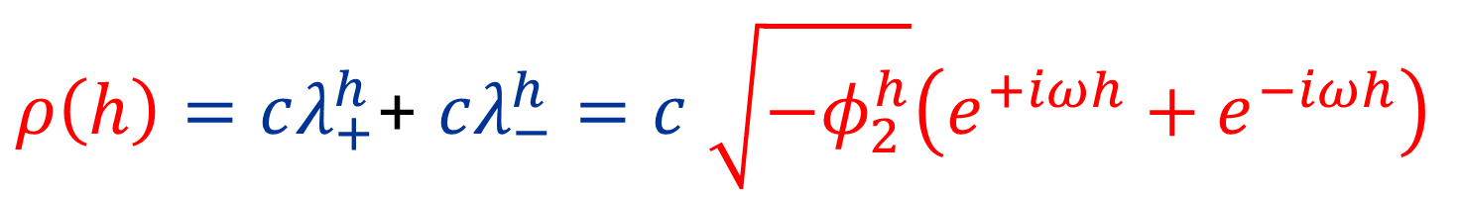
ProCESSO AUTOREGRESSIVO
$$Δ<0$$
$$c_{1}\text{+} c_{2}=1$$
$$ρ\left(0\right)=1$$
$$c_{1}λ_{+}^{1}\text{+} c_{2}λ_{−}^{1}=\frac{φ_{1}}{1−φ_{2}}$$
$$ρ\left(1\right)=\frac{φ_{1}}{1−φ_{2}}$$
$ρ\left(h\right)=c_{1}λ_{+}^{h}$+ $c_{2}λ_{−}^{h}$
$$h≥2$$
AR(2): estrutura de autocorrelação
$$Y_{t}Y_{t−h}=φ_{1}Y_{t−1}Y_{t−h}+φ_{2}Y_{t−2}Y_{t−h}+ε_{t}Y_{t−h}$$
$$λ_{±}=\frac{φ_{1}±i\sqrt{−Δ}}{2}$$
$$c_{1}=\frac{1}{2}−\frac{iφ_{1}}{2\sqrt{−Δ}}\frac{1+φ_{2}}{1−φ_{2}}$$
$$c_{2}=\frac{1}{2}+\frac{iφ_{1}}{2\sqrt{−Δ}}\frac{1+φ_{2}}{1−φ_{2}}$$
$$λ_{±}=|λ_{±}|cos\left(ω\right)±|λ_{±}|i sin{(ω)}$$
$$=\sqrt{−φ_{2}}e^{±iω}$$
$ρ\left(h\right)=cλ_{+}^{h}\text{+} cλ_{−}^{h}=c$ $\sqrt{−φ_{2}^{h}}\left(e^{+iωh}+e^{−iωh}\right)$

Slide 41
ProCESSO AUTOREGRESSIVO
$$Δ<0$$
$$c_{1}\text{+} c_{2}=1$$
$$ρ\left(0\right)=1$$
$$c_{1}λ_{+}^{1}\text{+} c_{2}λ_{−}^{1}=\frac{φ_{1}}{1−φ_{2}}$$
$$ρ\left(1\right)=\frac{φ_{1}}{1−φ_{2}}$$
$ρ\left(h\right)=c_{1}λ_{+}^{h}$+ $c_{2}λ_{−}^{h}$
$$h≥2$$
AR(2): estrutura de autocorrelação
$$Y_{t}Y_{t−h}=φ_{1}Y_{t−1}Y_{t−h}+φ_{2}Y_{t−2}Y_{t−h}+ε_{t}Y_{t−h}$$
$$λ_{±}=\frac{φ_{1}±i\sqrt{−Δ}}{2}$$
$$c_{1}=\frac{1}{2}−\frac{iφ_{1}}{2\sqrt{−Δ}}\frac{1+φ_{2}}{1−φ_{2}}$$
$$c_{2}=\frac{1}{2}+\frac{iφ_{1}}{2\sqrt{−Δ}}\frac{1+φ_{2}}{1−φ_{2}}$$
$$λ_{±}=|λ_{±}|cos\left(ω\right)±|λ_{±}|i sin{(ω)}$$
$$=\sqrt{−φ_{2}}e^{±iω}$$
$$ρ\left(h\right)=cλ_{+}^{h}\text{+} cλ_{−}^{h}=c{\left(−φ_{2}\right)}^{h/2}cos(ωh)$$

Slide 42
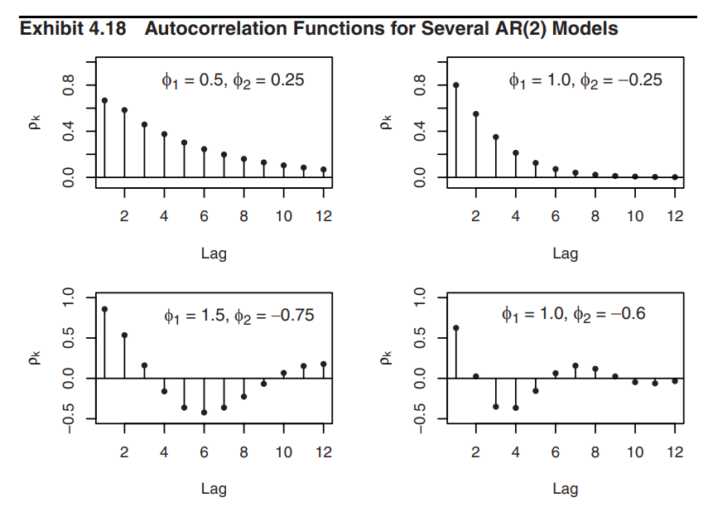

Slide 43
