Slide 1

Análise De Séries Temporais
Aula 17

Slide 2
Séries de contagens
Leitura:
Harvey (1990), Seção 6.6, p.348-362
(Filtro de Kalman não linear)

Slide 3
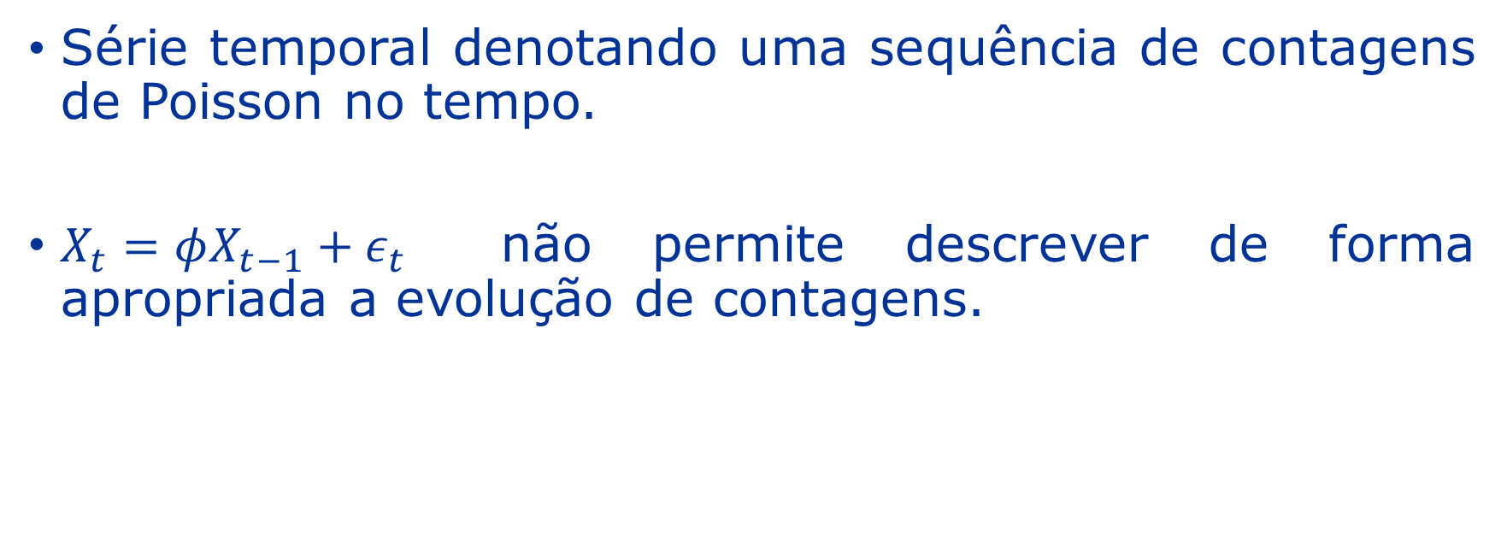
Séries de contagens: POiSSon
Série temporal denotando uma sequência de contagens de Poisson no tempo.
$X_{t}=φX_{t−1}+ε_{t}$ não permite descrever de forma apropriada a evolução de contagens.

Slide 4
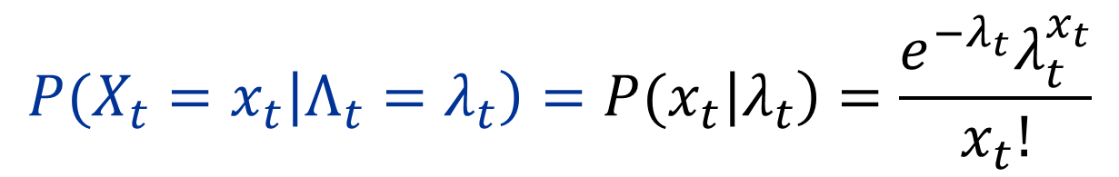
Séries de contagens: poisson
$${P(X}_{t}=x_{t}\left|{Λ_{t}=λ}_{t}\right)=P(x_{t}\left|λ_{t}\right)=\frac{e^{−λ_{t}}λ_{t}^{x_{t}}}{x_{t}!}$$

Slide 5
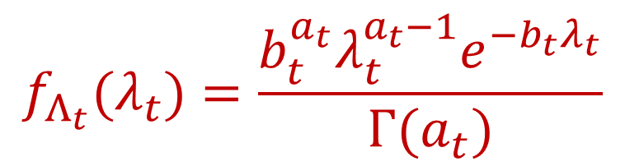
Séries de contagens: poisson
$${P(X}_{t}=x_{t}\left|{Λ_{t}=λ}_{t}\right)=P(x_{t}\left|λ_{t}\right)=\frac{e^{−λ_{t}}λ_{t}^{x_{t}}}{x_{t}!}$$
$$f_{Λ_{t}}(λ_{t})=\frac{b_{t}^{a_{t}}λ_{t}^{a_{t}−1}e^{−b_{t}λ_{t}}}{Γ(a_{t})}$$

Slide 6
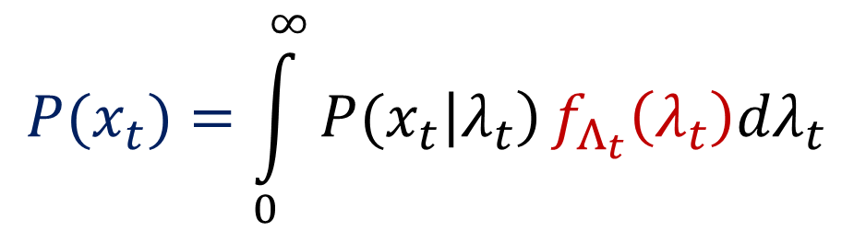
Séries de contagens: Poisson
$${P(X}_{t}=x_{t}\left|{Λ_{t}=λ}_{t}\right)=P(x_{t}\left|λ_{t}\right)=\frac{e^{−λ_{t}}λ_{t}^{x_{t}}}{x_{t}!}$$
$$f_{Λ_{t}}(λ_{t})=\frac{b_{t}^{a_{t}}λ_{t}^{a_{t}−1}e^{−b_{t}λ_{t}}}{Γ(a_{t})}$$
$$P(x_{t})=\int_{0}^{∞}{P(x_{t}\left|λ_{t}\right)}f_{Λ_{t}}\left(λ_{t}\right)dλ_{t}$$

Slide 7
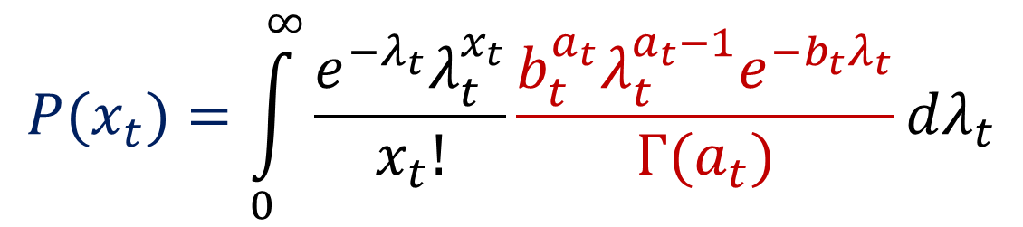
Séries de contagens: Poisson
$${P(X}_{t}=x_{t}\left|{Λ_{t}=λ}_{t}\right)=P(x_{t}\left|λ_{t}\right)=\frac{e^{−λ_{t}}λ_{t}^{x_{t}}}{x_{t}!}$$
$$f_{Λ_{t}}(λ_{t})=\frac{b_{t}^{a_{t}}λ_{t}^{a_{t}−1}e^{−b_{t}λ_{t}}}{Γ(a_{t})}$$
$$P(x_{t})=\int_{0}^{∞}{\frac{e^{−λ_{t}}λ_{t}^{x_{t}}}{x_{t}!}}\frac{b_{t}^{a_{t}}λ_{t}^{a_{t}−1}e^{−b_{t}λ_{t}}}{Γ(a_{t})}dλ_{t}$$

Slide 8
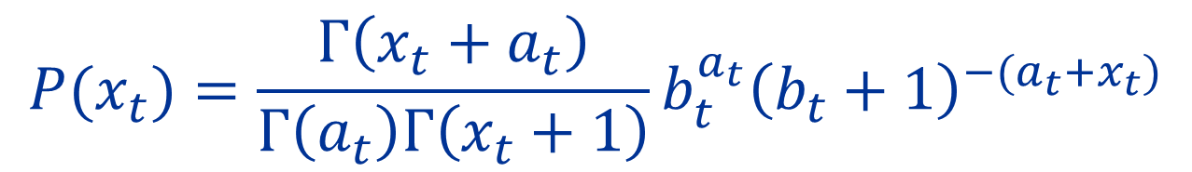
Séries de contagens: poisson
$${P(X}_{t}=x_{t}\left|{Λ_{t}=λ}_{t}\right)=P(x_{t}\left|λ_{t}\right)=\frac{e^{−λ_{t}}λ_{t}^{x_{t}}}{x_{t}!}$$
$$f_{Λ_{t}}(λ_{t})=\frac{b_{t}^{a_{t}}λ_{t}^{a_{t}−1}e^{−b_{t}λ_{t}}}{Γ(a_{t})}$$
$$P(x_{t})=\frac{Γ\left(x_{t}+a_{t}\right)}{Γ\left(a_{t}\right)Γ\left(x_{t}+1\right)}b_{t}^{a_{t}}{\left(b_{t}+1\right)}^{−(a_{t}+x_{t})}$$

Slide 9
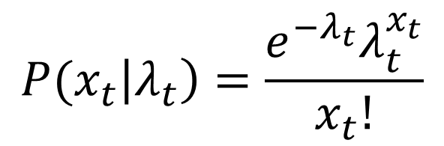
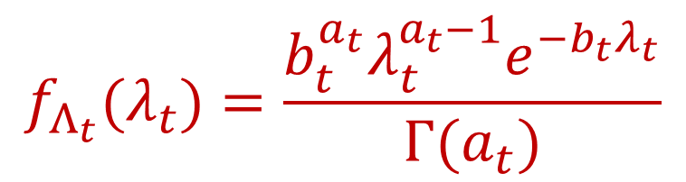
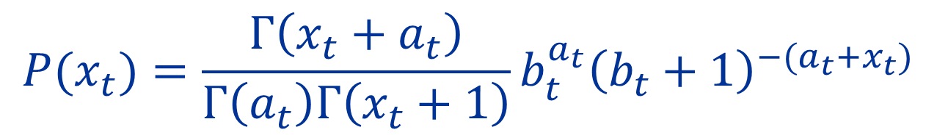
Séries de contagens: poisson
$$f_{Λ_{t}}(λ_{t})=\frac{b_{t}^{a_{t}}λ_{t}^{a_{t}−1}e^{−b_{t}λ_{t}}}{Γ(a_{t})}$$
$$P(x_{t}\left|λ_{t}\right)=\frac{e^{−λ_{t}}λ_{t}^{x_{t}}}{x_{t}!}$$
$$P(x_{t})=\frac{Γ\left(x_{t}+a_{t}\right)}{Γ\left(a_{t}\right)Γ\left(x_{t}+1\right)}b_{t}^{a_{t}}{\left(b_{t}+1\right)}^{−(a_{t}+x_{t})}$$

Slide 10
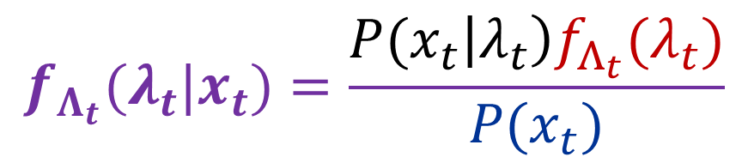
Séries de contagens: poisson
$$f_{Λ_{t}}(λ_{t})=\frac{b_{t}^{a_{t}}λ_{t}^{a_{t}−1}e^{−b_{t}λ_{t}}}{Γ(a_{t})}$$
$$P(x_{t}\left|λ_{t}\right)=\frac{e^{−λ_{t}}λ_{t}^{x_{t}}}{x_{t}!}$$
$$P(x_{t})=\frac{Γ\left(x_{t}+a_{t}\right)}{Γ\left(a_{t}\right)Γ\left(x_{t}+1\right)}b_{t}^{a_{t}}{\left(b_{t}+1\right)}^{−(a_{t}+x_{t})}$$
$$f_{Λ_{t}}(λ_{t}|x_{t})=\frac{P(x_{t}\left|λ_{t}\right)f_{Λ_{t}}(λ_{t})}{P(x_{t})}$$

Slide 11
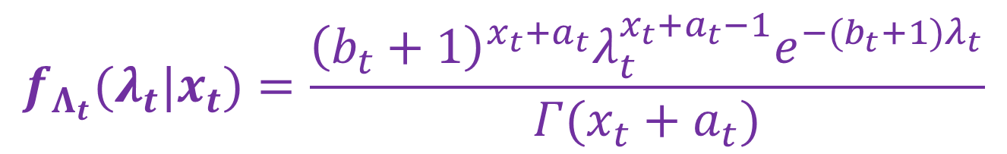
Séries de contagens: poisson
$$f_{Λ_{t}}(λ_{t})=\frac{b_{t}^{a_{t}}λ_{t}^{a_{t}−1}e^{−b_{t}λ_{t}}}{Γ(a_{t})}$$
$$P(x_{t}\left|λ_{t}\right)=\frac{e^{−λ_{t}}λ_{t}^{x_{t}}}{x_{t}!}$$
$$P(x_{t})=\frac{Γ\left(x_{t}+a_{t}\right)}{Γ\left(a_{t}\right)Γ\left(x_{t}+1\right)}b_{t}^{a_{t}}{\left(b_{t}+1\right)}^{−(a_{t}+x_{t})}$$
$$f_{Λ_{t}}(λ_{t}|x_{t})=\frac{{\left(b_{t}+1\right)}^{x_{t}+a_{t}}λ_{t}^{{x_{t}+a}_{t}−1}e^{−{(b}_{t}+1)λ_{t}}}{Γ({x_{t}+a}_{t})}$$

Slide 12
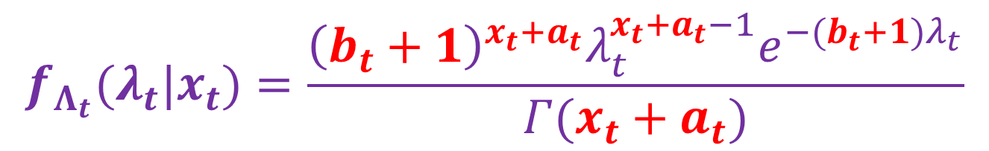
Séries de contagens: poisson
$$f_{Λ_{t}}(λ_{t})=\frac{b_{t}^{a_{t}}λ_{t}^{a_{t}−1}e^{−b_{t}λ_{t}}}{Γ(a_{t})}$$
$$P(x_{t}\left|λ_{t}\right)=\frac{e^{−λ_{t}}λ_{t}^{x_{t}}}{x_{t}!}$$
$$P(x_{t})=\frac{Γ\left(x_{t}+a_{t}\right)}{Γ\left(a_{t}\right)Γ\left(x_{t}+1\right)}b_{t}^{a_{t}}{\left(b_{t}+1\right)}^{−(a_{t}+x_{t})}$$
$$f_{Λ_{t}}(λ_{t}|x_{t})=\frac{{\left(b_{t}+1\right)}^{x_{t}+a_{t}}λ_{t}^{{x_{t}+a}_{t}−1}e^{−(b_{t}+1)λ_{t}}}{Γ({x_{t}+a}_{t})}$$

Slide 13
Séries de contagens: poisson
$$f_{Λ_{t}}(λ_{t}|x_{t})=\frac{{\left(b_{t}+1\right)}^{x_{t}+a_{t}}λ_{t}^{{x_{t}+a}_{t}−1}e^{−(b_{t}+1)λ_{t}}}{Γ({x_{t}+a}_{t})}$$

Slide 14


Séries de contagens: poisson
Equações de atualização:
$$a_{t+1}={a_{t+1|t}+x}_{t}$$
$$b_{t+1}=b_{t+1|t}+1$$
$$f_{Λ_{t}}(λ_{t}|x_{t})=\frac{{\left(b_{t}+1\right)}^{x_{t}+a_{t}}λ_{t}^{{x_{t}+a}_{t}−1}e^{−(b_{t}+1)λ_{t}}}{Γ({x_{t}+a}_{t})}$$

Slide 15
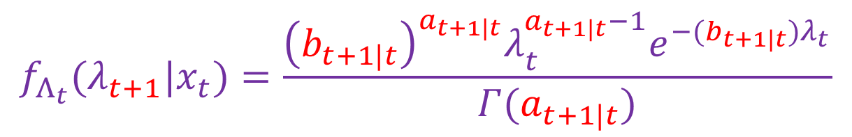
Séries de contagens: poisson
Equações de atualização:
$$a_{t+1}={a_{t+1|t}+x}_{t}$$
$$b_{t+1}=b_{t+1|t}+1$$
$$f_{Λ_{t}}(λ_{t+1}|x_{t})=\frac{{\left(b_{t+1|t}\right)}^{a_{t+1|t}}λ_{t}^{a_{t+1|t}−1}e^{−(b_{t+1|t})λ_{t}}}{Γ(a_{t+1|t})}$$

Slide 16

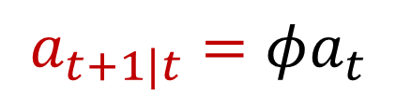
Séries de contagens: poisson
Equações de predição:
Equações de atualização:
$$a_{t+1}={a_{t+1|t}+x}_{t}$$
$$a_{t+1|t}=φa_{t}$$
$$b_{t+1|t}=φb_{t}$$
$$b_{t+1}=b_{t+1|t}+1$$
$$f_{Λ_{t}}(λ_{t+1}|x_{t})=\frac{{\left(b_{t+1|t}\right)}^{a_{t+1|t}}λ_{t}^{a_{t+1|t}−1}e^{−(b_{t+1|t})λ_{t}}}{Γ(a_{t+1|t})}$$

Slide 17
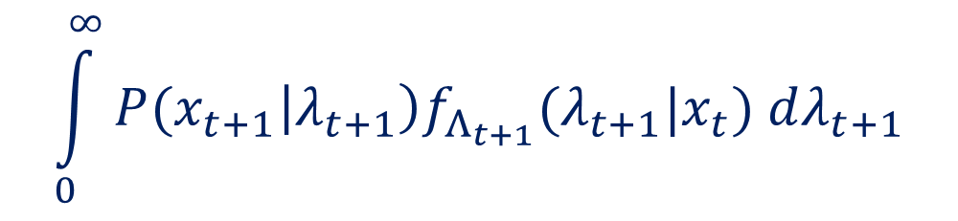

Séries de contagens: Poisson
Distribuição preditiva:
$$\int_{0}^{∞}{{P(x}_{t+1}\left|λ_{t+1}\right)f_{Λ_{t+1}}(λ_{t+1}|x_{t}) dλ_{t+1}}$$
$${P(X}_{t+1}=x_{t+1}|X_{t}=x_{t})=$$

Slide 18
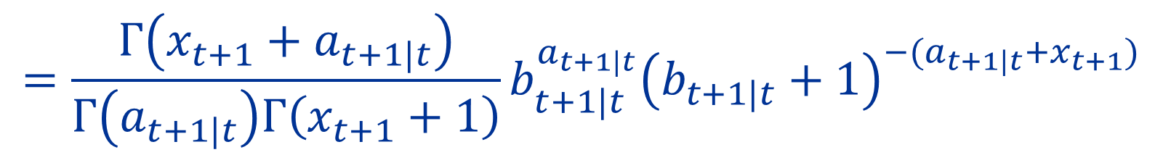
Séries de contagens: Poisson
Distribuição preditiva:
$$\int_{0}^{∞}{{P(x}_{t+1}\left|λ_{t+1}\right)f_{Λ_{t+1}}(λ_{t+1}|x_{t}) dλ_{t+1}}$$
$${P(X}_{t+1}=x_{t+1}|X_{t}=x_{t})=$$
$$=\frac{Γ\left(x_{t+1}+a_{t+1|t}\right)}{Γ\left(a_{t+1|t}\right)Γ\left(x_{t+1}+1\right)}b_{t+1|t}^{a_{t+1|t}}{\left(b_{t+1|t}+1\right)}^{−(a_{t+1|t}+x_{t+1})}$$

Slide 19
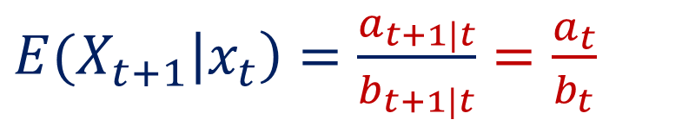
Séries de contagens: Poisson
Distribuição preditiva:
$$\int_{0}^{∞}{{P(x}_{t+1}\left|λ_{t+1}\right)f_{Λ_{t+1}}(λ_{t+1}|x_{t}) dλ_{t+1}}$$
$${P(X}_{t+1}=x_{t+1}|X_{t}=x_{t})=$$
$$=\frac{Γ\left(x_{t+1}+a_{t+1|t}\right)}{Γ\left(a_{t+1|t}\right)Γ\left(x_{t+1}+1\right)}b_{t+1|t}^{a_{t+1|t}}{\left(b_{t+1|t}+1\right)}^{−(a_{t+1|t}+x_{t+1})}$$
${E(X}_{t+1}\left|x_{t}\right)=$ $\frac{a_{t+1|t}}{b_{t+1|t}}=\frac{a_{t}}{b_{t}}$
Preditor Linear:

Slide 20
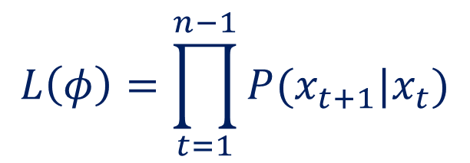
Séries de contagens: BernoulLi
Estimação do hiperparâmetro $φ$
$$L\left(φ\right)=\prod_{t=1}^{n−1}{{P(x}_{t+1}|x_{t})}$$

Slide 21
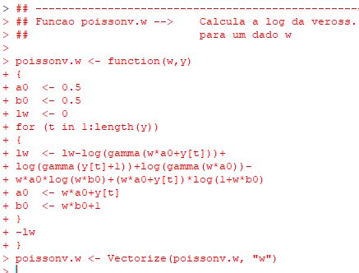

Slide 22
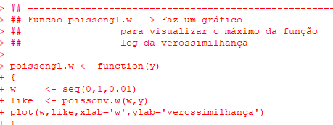

Slide 23
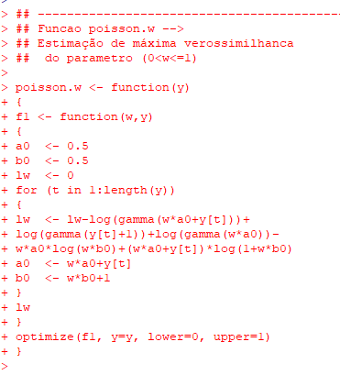

Slide 24
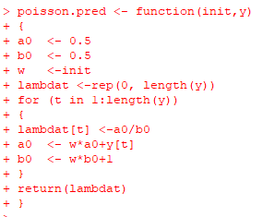

Slide 26
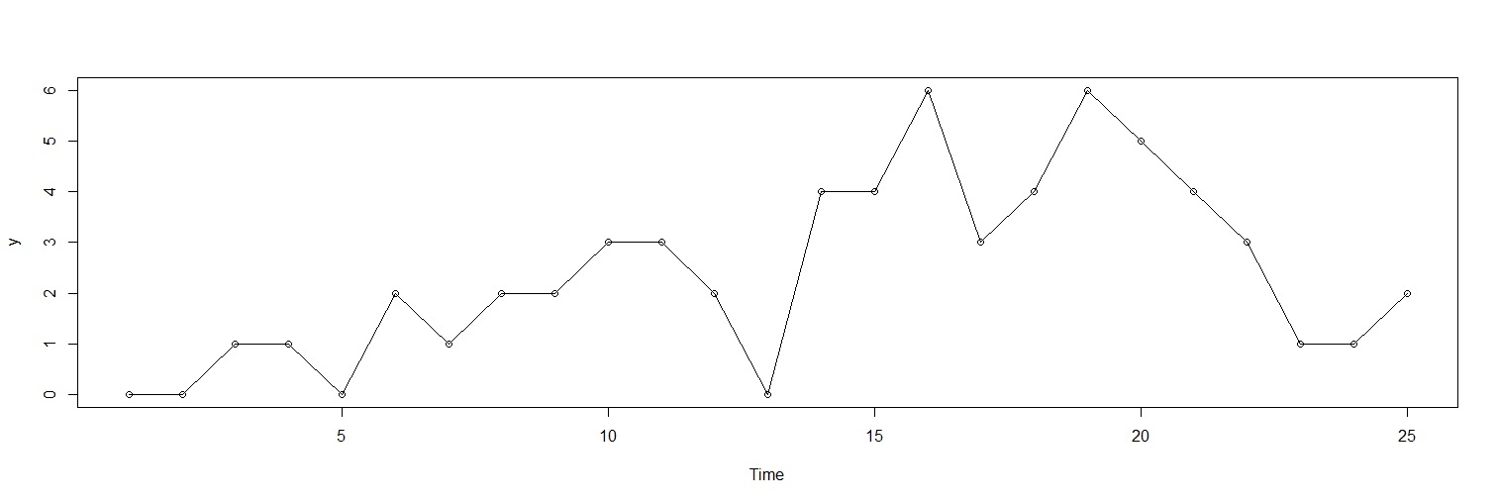

Slide 27
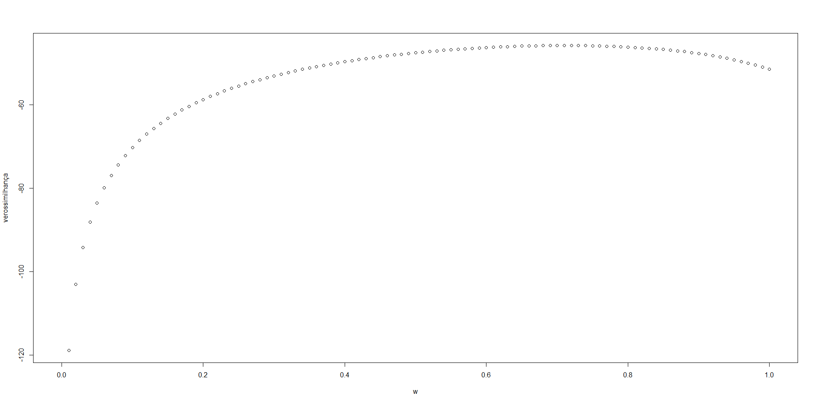
Séries de contagens: BernoulLi
Exemplo:
y <-c(0,0,0,0,0,0,1,0,0,1,1,0,0,1,1,1,1,1,1,1,1,1,1,0,1)

Slide 28
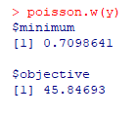
Séries de contagens: BernoulLi
Exemplo:
y <-c(0,0,0,0,0,0,1,0,0,1,1,0,0,1,1,1,1,1,1,1,1,1,1,0,1)
0.71

Slide 29


Slide 30
