Slide 2
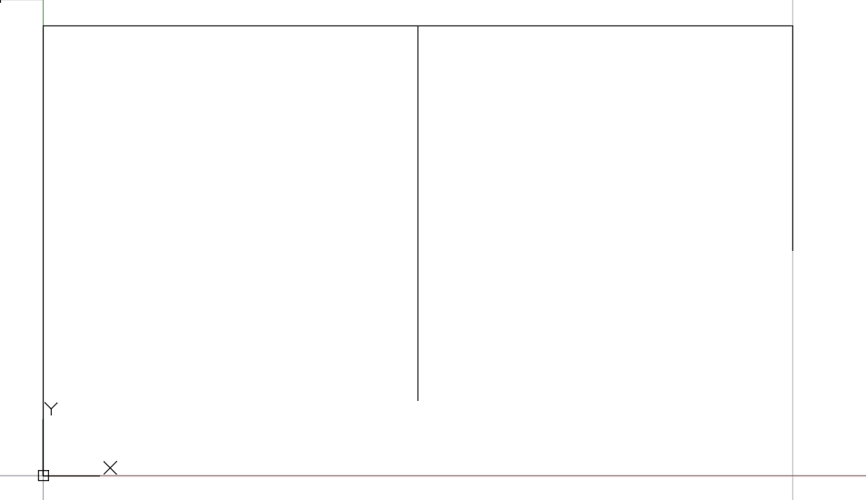
5 m
5 m
70 kN
50 kN
100 Kn/m
488.4 kN
I
C
J
F
K
1.5 m
3 m
2.5 m
H
1.5 m
E
G
0.40 m
B
0.40 m
2.5 m
3 m
0.60 m
D
0.40 m
A
Columna
Viga
2.5 m
2.5 m
2.5 m
2.5 m

Slide 3
V₁
q₁
V₂
H₁
I
C
J
F
K
H
l₃
l₂
E
G
b
l₁
B
a
c
a
D
Y
A
l₅
Columna
Viga
l₄
Z
X

