Slide 1
Introduction to PC-A
“Pencil Code with Astaroth inside”

Slide 2
Mindset
two different codes, although sharing some numerics,
in two different repositories
two different computers, although GPU dependent on CPU
→ everything needed for advancing the PDE variables
needs to be in GPU memory (parameters and initial conditions)
and in kernel code (recipes for right hand sides and boundary conditions)
f-array is updated on CPU only when needed, df-array does not exist
PC-A tries to use all resources on a node with maximum concurrency!

Slide 3
How to get the codes
both codes together with a fresh pull:
git clone -b gputestv6 --recurse-submodules https://<username>@github.com/pencil-code/pencil-code.git
or
git clone -b gputestv6 --recurse-submodules https://<username>@pencil-code.org/git/ pencil-code
source sourceme.sh
cd $PENCIL_HOME
cd src/astaroth/submodule
git checkout PCinterface_2019-8-12
or add Astaroth to an existing PC installation:
cd $PENCIL_HOME
git checkout gputestv6
git submodule update --init –recursive
cd src/astaroth/submodule
git checkout PCinterface_2019-8-12 BRANCHES MATTER!

Slide 4
How To build with PC-A
on Clusters, load appropriate CUDA (NVIDIA) or HIP (AMD) and MPI modules, perhaps cmake
set in Makefile.local
GPU = gpu_astaroth
GPU_VENDOR = [nvidia|amd] # nvidia is default
MULTITHREADING = openmp
if you haven't used PC-A before in work directory, execute pc_setupsrc
-> new symbolic links and directories in
src/astaroth, esp. src/astaroth/submodule (consider black box)
build Pencil Code as usual:
make: set MODULE_[PRE|IN|SUF]FIX environment variables as given in config file
for chosen compiler + given machine
pc_build: use flag -s|--serial for safety
gfortran: set flag -std95 to f2003,
set LDFLAGS_MAIN = -Bdynamic -Wl,--export-dynamic in Makefile.src
CRAY: set LDFLAGS_MAIN = -h dynamic -Wl,--export-dynamic in Makefile.src

Slide 5
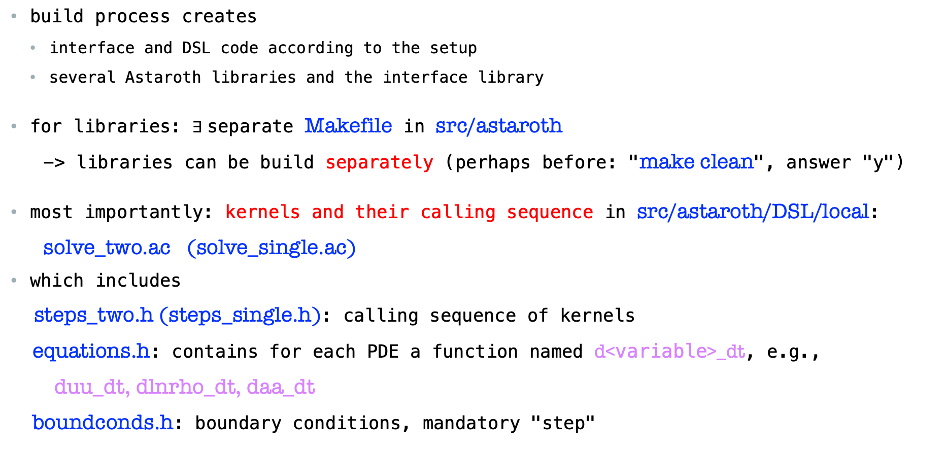
HOW TO BUILD PC-A
build process creates
interface and DSL code according to the setup
several Astaroth libraries and the interface library
for libraries: $∃$separate Makefile in src/astaroth
-> libraries can be build separately (perhaps before: "make clean", answer "y")
most importantly: kernels and their calling sequence in src/astaroth/DSL/local:
solve_two.ac (solve_single.ac)
which includes
steps_two.h (steps_single.h): calling sequence of kernels
equations.h: contains for each PDE a function named d<variable>_dt, e.g.,
duu_dt, dlnrho_dt, daa_dt
boundconds.h: boundary conditions, mandatory "step"

Slide 6
WHAT iS DSL CODE?
DSL="Domain-specific language" for conveniently formulating rhss of PDEs for GPU kernels
C-like, with some Python-like features
to be understood pointwise on grid
Example: continuity equation
rhs=0.
glnrho = gradient(LNRHO) // grad(rho) or grad(lnrho)!
if (ldensity_nolog){
return rhs - dot(UU, glnrho) - RHO*divergence(UU)
}
else {
return rhs - dot(UU, glnrho) - divergence(UU)
}

Slide 7
WHAT THE BUILD YIELDS
virgin build -> void rhs functions in equations.h -> user intervention needed:
inspect directories in src/astaroth/DSL/
density
entropy
forcing
hydro
magnetic
shock
supernova
for useful code snippets
indicate, which physics modules are supported presently
differential operators etc. are in src/astaroth/DSL/stdlib

Slide 8
CusTOMIZE RHS
to specify a rhs, modify e.g., function dlnrho_dt of src/astaroth/DSL/local/equations.h
dlnrho_dt(int step_num){ return 0. }
to
dlnrho_dt(int step_num){
#include "../density/continuity.h"
}
or
duu_dt(int step_num){ return real3(0.,0.,0.) }
to
duu_dt(int step_num){
#include "../hydro/momentum.h”
}

Slide 9
CUSTOMIZE RHS
"physics branches" in DSL code can be selected by preprocessor statements like
#if LMAGNETIC
...
#endif
for each enabled physics module, a flag is predefined in src/astaroth/PC_moduleflags.h
or conditionals in DSL syntax, like
if (ltemperature) {
...
}
all switches from src/cparam.inc available
changes to equations.h are permanent = not overwritten by future builds
(additional physics -> new empty rhs functions appear,
no longer needed functions do not disappear but are idle)
equations.h is considered by pc_newrun and cvsci_run

Slide 10
Customize RHS
Caveat: it is advisable to check predefined DSL code in the beginning,
at least more complex functions like denergy_dt
Note: to enable an additional physics module, the block in
src/gpu_astaroth.f90 has to be released;
can require some non-standard code development
Limitations:
particles/pointmasses/radiation/solid cells/self-gravity/testfields
presently not supported
modifications of f-array in *before/*after_boundary routines not supported
if needed every timestep
diagnostics, which are not only from pencil_case/f-array not calculated
not all boundary conditions "transpiled" yet (coming soon)

Slide 11
ADD missing PARAMETERS to rhs
if additional parameters of a physics module needed,
they have to be pushed to the GPU, for that
find subroutine pushpars2c(p_par) near the end of the physics module
add lines
call copy_addr(<parameter>,p_par(<running index>))
for integer parameter: add ! int at line end
for real 1D array parameter: add ! (<dimension>) at line end
increase n_pars accordingly
Note: manipulations of parameters, which can be performed in module
initialization should not be coded in DSL
-> push derived parameters!
parameters from src/cparam.h, src/cdata.h: all available

Slide 12
RUNNING PC-A
Example SLURM batch script:
#SBATCH --nodes=2 # Total number of nodes
#SBATCH --ntasks-per-node=8
CRAY (LUMI, Dardel, Frontier):
#SBATCH --gpus-per-node=8 # Allocate one gpu per MPI rank
CSC machines:
#SBATCH --gres=gpu:v100:4
#SBATCH --cpus-per-task=7 # multithreading
source src/.moduleinfo
export LD_LIBRARY_PATH=${CRAY_LD_LIBRARY_PATH}:$LD_LIBRARY_PATH
export OMP_NUM_THREADS= =${SLURM_CPUS_PER_TASK}
export OMP_PROC_BIND=close,spread
export OMP_MAX_ACTIVE_LEVELS=2
export OMP_WAIT_POLICY=PASSIVE
./start.csh
export MPICH_GPU_SUPPORT_ENABLED=1 (MPICH on CRAY)
./run.csh

Slide 13
TROUBLESHOOTING
enforce re-creation of interface code by
rm src/astaroth/PC_moduleflags.h (tb improved)
pc_build …
obey DSL syntax meticulously - consult:
https://bitbucket.org/jpekkila/astaroth/src/PCinterface_2019-8-12/acc-runtime/README.md
consult samples/gputest
consult touko.puro@aalto.fi or matthias.rheinhardt@aalto.fi
DSL compiler can be A DIVA !

Slide 14
Outlook
in preparation:
run-time compilation -> all variables constant during time-loop,
esp. logical variables, are replaced by their values from start.in/run.in
performance!
full transpilation of the rhss to DSL -> manual DSL coding no longer needed!

