Slide 1

Blue One Options
Joel Nave, Shankar Muthan, Siva Dandibhotla, Michael Ma, Stephen Van Lare
2-5-2008

Slide 2
Blue One and 9.3 options
Blue One goes forward into 9.3
  Setting up A9 apps unlimited success for 3-5 yrs
    Decreased maintenance cost
    Increase customer adoption of more modern UI
  Accelerate date
    Cut back scope where possible
    Bring in more short term resources
9.3 Focuses on features, start work on Fusion Edge Apps
  9.2 “good enough”, focus on industry and feature expansion
  Abandon Blue One controls
    Keep frame changes (top and left bar)
    Deal with some long standing requests
  Move Design staff to Fusion Edge Apps

Slide 3
Alignment with Division Goals
Apps Unlimited Goals and 9.3 Goals | 9.3 with Blue One | 9.3 w/o Blue One
Customer driven enhancements that do not destabilize the releases OR result in high upgrade cost for customers | M | H
Packaged integrations across product lines and industries | N/A | N/A
BI applications across product lines | N/A | N/A
Fusion Edge Applications (instead of Fusion Apps) | L | L
Adopt Fusion middleware | L | L
Provide an upgrade path to Fusion | L | L
Drive 2X PLM revenue in the next 2 years | H | H
Must be competitive for 3-5 years after release | H | M
Must enable new use case and market expansions | M | L

Slide 4
Why Blue One Was Started
Reduce customer need for Java Client
  Only 2 of 6 products exist in Java Client
  Java Client has slow WAN performance requiring complete communication rewrite (30+ man months engg)
Reduce future maintenance
  Remove old web code and modernize
  Prepare for one client (Web Client)
Unlock revenue
  8.5 Upgrades
  New sales with exciting new client
Best UX in PLM
  Customer satisfaction
  Eliminate many, many customer defects for Web Client

Slide 5
Some on Blue One’s Scope
UX Improvements
  Top Pane
  Left Pane with Navigator
  Configurable Divs from tables / linked object fields
  Configurable Preview Pane
  Ctrl N / Email launch
  Context Sensitive Help / UPK
  Repair Productivity Component
  Fix Redline Table like Java Client
Other infrastructure
  Journaling fields
  Large Text Fields
  Linked Lists
  Better I18N Support

Slide 6
What Can be Changed
Scope
  Half a UI doesn’t make sense
  Cut UI scope across functional boundaries, but no regression
    Cut Java Client replacement plans (Advance Features)
      Requires added scope for adding back Java Client
    Leave some complete Apps with old UI while others have new UI
Resources
  Resources are tied to scope
Schedule
  Take advantage of period between 9.2.2.4 and 9.3 to staff up
  Get “ahead” and then staff down in May
Quality
  Lowering quality will mean longer maintenance cycle and slower product adoption, not deemed acceptable

Slide 7
Option 1: 9.3 with Blue One
Scenario 1: No Advanced Features, 9224 UI for PCM
Module | UX estimates (man-months) UX team | Server estimates (man-months) Product Teams | Code complete dates with additional resources (+3 until 9.3 GA, +7 until 04/30/08) | Code complete dates with additional resources (+3 until 9.3 GA)
PC, PQM, PGC, CS | 36 | 6 | 05/31/08 | 06/30/08
Reports, Web Admin | 15 | 2 | 07/31/08 | 08/30/08
PPM | 25 | 3 | 09/30/08 | 10/31/08
PCM (9224 UI) | 6 | 0 | 10/31/08 | 11/30/08
Total | 82 | 11 | 10/31/08 | 11/30/08
Scenario 2: No Advanced Features
Module | UX estimates (man-months) UX team | Server estimates (man-months) Product Teams | Code complete dates with additional resources (+3 until 9.3 GA, +7 until 04/30/08) | Code complete dates with additional resources (+3 until 9.3 GA)
PC, PQM, PGC, CS | 36 | 6 | 05/31/08 | 06/30/08
Reports, Web Admin | 15 | 2 | 07/31/08 | 08/30/08
PPM | 25 | 3 | 09/30/08 | 10/31/08
PCM | 16 | 6 | 11/30/08 | 12/31/08
Total | 92 | 17 | 11/30/08 | 12/31/08
Note: Estimates for 9.3 new features not included (Thumbnails, MDR, SOA, AIA, PPM)

Slide 8
Option 2: 9.3 w/o Blue One
Only a small set of features can be ported from Blue One to 9.3 (use re-factor + 9224 as base)
Feature | UX estimates (man-months)
Left Pane | 2
Top Pane | 1
Total | 3
Potential UI enhancements on the new code base
Feature | UX estimates (man-months)
Attribute Grouping | 1
Configurable Divs | 5
Configurable Preview Pane | 3
Reline table editing like Java Client | 2
File Productivity Fix | ?
Session maintenance with Ctrl-N | ?
Opening the app in the same browser from email link | ?
Total | 11 + ?

Slide 9
Option 1 vs. Option 2
Comparison of Option 1 vs. Option 2 including 9.3 estimates
 | Estimates for Option 1 (Blue One, 9224 UI for PCM, no Adv Features) | Estimates for Option 2 (no Blue One)
Blue One Features
Implementation | 93 | 3
Java Client | 3 | 3
Total | 96 + ? | 6 + ?
9.3 Features
Thumbnails & Metadata Redlining | Need final est. <5 | 6
Cross Object Search | Need final est. <3 | 3
Compliance Validation | 1 | 1
SOA, AIA, PPM, EC, UPK | ? | ?
Total | 9 + ? | 10 + ?

Slide 10
Hitachi Case Study
Steve to provide

Slide 11
Warren Example
Joel to provide

Slide 12
508 Compliance
Neither Blue One nor 9.2.x is 508 compliant
9.2.x is not HTML 4 compliant
Much of the Blue One clean-up will be required to get to 508 (work will need to be re-done in option 2)
Is Oracle going to mandate 508 at some point in the maintenance cycle of Apps Unlimited?

Slide 13
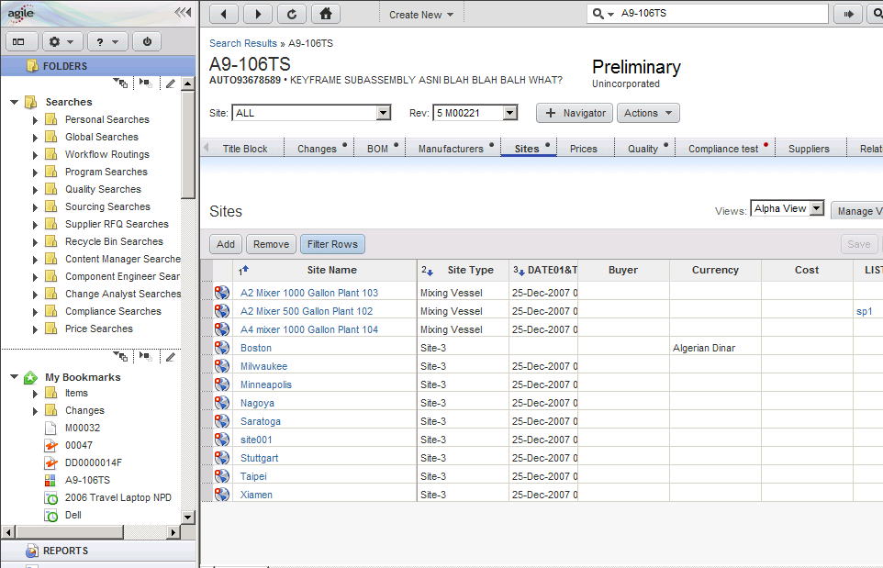
PC in 9.3 (new UI)

Slide 14
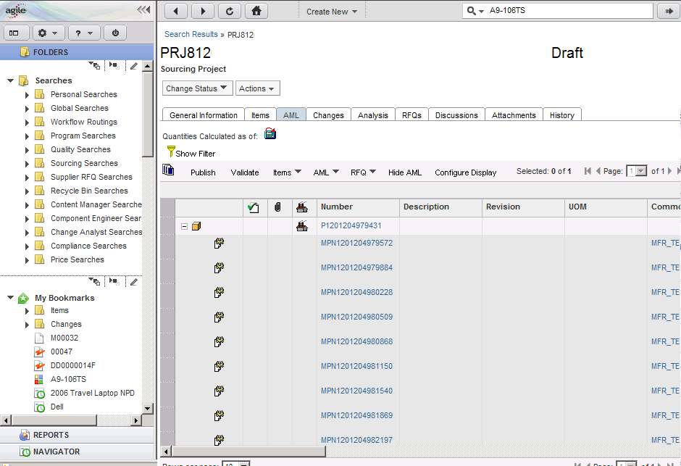
PCM in 93 (9224 UI)
New UI for left & top panes, 9224 UI for PCM objects

Slide 15
Resources
Current
  # of UI Resources → 6
  # of Server Resources → 1.5
    Chunyang – full time
    Shalini – part time
Resource Additions
  3 additional Full Time resources until 9.3 GA:
    Gopa, Weihong, Preeti
  7 additional Full Time resources until 04/30/08:
    Pat, Charong, Wei Li, Omp, Manoj, Murali, Girish
    To be leveraged to complete certain Action Dialogs

Slide 16
Staffing Assumptions
For the 7 additional resources (available between 02/01 - 04/30)
  21 man-months available among them
  Assuming that 12 man-months of work will be complete by this team, considering skill set, ramp-up, training etc.
For the 3 additional resources (available throughout the project)
  Gopa to be working only on UI.
  Weihong & Preeti on both UI & Server (depending on the need).
Naviscent Contract
  Possible replacement for Involution (works with Fusion team today)
  Impact not considered (would be positive)
  Risks
    Can Involution PO be converted to different contractor
    Can we get the right skill sets in time (pre-May) to matter

Slide 17
QA Risks
Availability of product QA team to do one full functional testing after their respective module’s code complete (~1 month).
Assuming 3 months of QA for 93 testing.
Availability of performance team to do benchmarking after each milestone.
QA Automation

Slide 18


Slide 19
UX estimates for other 9.3 features
Feature | UX estimates (man-months)
Thumbnails & Metadata redlining | 5
Cross Object Search | 3
Compliance Validation | 1
PPM Project lifecycle & Tactical Portfolio | High
Security Improvements | High
Compare BOM Use Cases | Medium
SOA enablement | Medium
Design Integration | Low
MS Office Integration | Low
UPK | Low
Variant Mgmt (AIA) | ?
As-built, As-service Quality Integration (AIA) | ?
Resource Mgmt Integration | ?
Demantra Integration | ?

Slide 20
Estimate Breakdown – PC, PQM, PGC, CS
Tasks | UX estimates (man-months)
Shell Framework | 2
Table Framework | 3
Standard Table Impl* | 1
Custom Table Impl | 7
Page Layout | 2
Notifications, Routings* | 1
Searches & Adv Searches | 3
Action Dialogs* | 10
Other Objects (CTO, Pkg…)* | 2
9221-9224 changes | 5
Total | 36
Note: * tasks can be accelerated with Product Team help

Slide 21
Estimate Breakdown – PPM
Tasks | UX estimates (man-months)
Standard Table Impl* | 2
Custom Table Impl | 7
Dashboard | 3
Assignments | 1
Action Dialogs* | 8
Timesheet | 1
Program Summary | 2
Total | 24
Note: * tasks can be accelerated with Product Team help

Slide 22
Estimate Breakdown – Reports, Web Admin
Tasks | UX estimates (man-months)
Reports | 10
Web Admin | 4
Saved Searches | 1
Total | 15

Slide 23
Java Client
Scope
  There will be no additional functions required for Java client in Blue One project.
  Java client will function minimum as 9.2.2.4
Estimates
  The serve side APIs implemented in Blue One are all new so most of the Java client should function as before.
  Estimated resource: 3 MM

Slide 24
Blue One w/o PCM (and/or PPM)
Slice UI work at application boundary
  1 install, 2 app servers, 1 DB
  9.3 PCM release will have 9224 UI
Impact to Customers
  Non-PCM Customers will use the new UI in 9.3
  PCM Customers
    Non-PCM → No Impact
    PCM users → Same UI as 9224
Constraints:
  Additional overhead for QA to do full functional testing on both apps
  Impact to Docs, Support & Educational Services
  Educating the field

Slide 25
Option 1: 9.3 with Blue One
Scenario 1: Full Support
Module | UX estimates (man-months) UX team | Server estimates (man-months) Product Teams | Code complete dates with additional resources (+3 until 9.3 GA, +7 until 04/30/08) | Code complete dates with additional resources (+3 until 9.3 GA)
PC, PQM, PGC, CS | 36 | 6 | 05/31/08 | 06/30/08
Reports, Web Admin | 15 | 2 | 07/31/08 | 08/30/08
PPM | 25 | 3 | 09/30/08 | 10/31/08
PCM | 16 | 6 | 11/30/08 | 12/31/08
Adv Features | 10 | 2 | 01/31/09 | 02/28/09
Total | 102 | 19 | 01/31/09 | 02/28/09
Note: Estimates for 9.3 new features not included (Thumbnails, MDR, SOA, AIA, PPM)
Note: Detail estimates by Module are in the backup slides
Note: Code drops every 2 months

Slide 26
Option 1: 9.3 with Blue One
Scenario 1: No Advanced Features, 9224 UI for PCM
Module | UX estimates (man-months) UX team | Server estimates (man-months) Product Teams | Code complete dates with additional resources (+3 until 9.3 GA, +7 until 04/30/08) | Code complete dates with additional resources (+3 until 9.3 GA)
PC, PQM, PGC, CS | 36 | 6 | 05/31/08 | 06/30/08
Reports, Web Admin | 15 | 2 | 07/31/08 | 08/30/08
PPM | 25 | 3 | 09/30/08 | 10/31/08
PCM (9224 UI) | 6 | 0 | 10/31/08 | 11/30/08
Total | 82 | 11 | 10/31/08 | 11/30/08
Scenario 2: No Advanced Features
Module | UX estimates (man-months) UX team | Server estimates (man-months) Product Teams | Code complete dates with additional resources (+3 until 9.3 GA, +7 until 04/30/08) | Code complete dates with additional resources (+3 until 9.3 GA)
PC, PQM, PGC, CS | 36 | 6 | 05/31/08 | 06/30/08
Reports, Web Admin | 15 | 2 | 07/31/08 | 08/30/08
PPM | 25 | 3 | 09/30/08 | 10/31/08
PCM | 16 | 6 | 11/30/08 | 12/31/08
Total | 92 | 17 | 11/30/08 | 12/31/08
Note: Estimates for 9.3 new features not included (Thumbnails, MDR, SOA, AIA, PPM)
Note: Detail estimates by Module are in the backup slides
Note: Code drops every 2 months

Slide 27
Option 1: 9.3 with Blue One
Scenario 4: No Advanced Features, 9224 UI for PCM & PPM
Module | UX estimates (man-months) UX team | Server estimates (man-months) Product Teams | Code complete dates with additional resources (+3 until 9.3 GA, +7 until 04/30/08) | Code complete dates with additional resources (+3 until 9.3 GA)
PC, PQM, PGC, CS | 36 | 6 | 05/31/08 | 06/30/08
Reports, Web Admin | 15 | 2 | 07/31/08 | 08/30/08
PPM (9224 UI) | 10 | 0 | 08/30/08 | 09/30/08
PCM (9224 UI) | 6 | 0 | 09/30/08 | 10/31/08
Total | 67 | 8 | 09/30/08 | 10/31/08
Scenario 5: PC + Advanced Features
Module | UX estimates (man-months) UX team | Server estimates (man-months) Product Teams | Code complete dates with additional resources (+3 until 9.3 GA, +7 until 04/30/08) | Code complete dates with additional resources (+3 until 9.3 GA)
PC, PQM, PGC, CS | 36 | 6 | 05/31/08 | 06/30/08
Reports, Web Admin | 15 | 2 | 07/31/08 | 08/30/08
Adv Features | 10 | 2 | 09/30/08 | 10/31/08
PPM (9224 UI) | 10 | 0 | 10/31/08 | 11/30/08
PCM (9224 UI) | 6 | 0 | 11/30/08 | 12/31/08
Total | 77 | 10 | 11/30/08 | 12/31/08
Note: Estimates for 9.3 new features not included (Thumbnails, MDR, SOA, AIA, PPM)
Note: Detail estimates by Module are in the backup slides
Note: Code drops every 2 months

Slide 28
Java Client Impacted Areas
Criteria changes/improvements in Admin - High
Search - High
Error and warning handling - Medium
Potential new settings added to the Admin - Medium
Add urgent in Send dialog - Low
Interface for integrating with web client, i.e. export/import/report etc. – Low
Others - TBD

