Slide 1
UX Discussion

Slide 2
Agenda
What is BlueOne
  Clean-Up
  Select Redesign
  User Productivity (Power User GUI)

Slide 3
BlueOne Goals
Immediate Revenue
Unlock 8.5 upgrades
Future Revenue
Initial step to Best UX in PLM (KonaBlue)
Increase Pace and Reduce Costs
Quicker to deliver UI’s
Supportability and reduced cost for cross-browser support

Slide 4
Fitting into UX Roadmap
Clean-Up
(Phase 1)
Design: Clean-up of visual presentation and create consistency
Technical: Clean-up of client facing code and mark-up (xHTML/CSS)
Benefit: Improved consistency, usability, accessibility & performance
Power User Experience
(Phase 2)
Design: Key power user use cases (comparisons, table interactivity, etc…)
Technical: Support AJAX-based TreeGrid, windowing, copy/paste, etc…
Benefit: Ease-of-use & increased productivity, across the WAN
Casual User Experience
(Phase 3)
Design: Key casual user use cases (role-based, task-driven…)
Technical: Role-based presentation support, special client support
Benefit: Targeted end-user experience, PLM Your (customer’s) Way
Full KonaBlue Experience
(Phase 4)
Design: Extend and apply above designs to RIA, SPA model
Technical: UI Framework to support Single-Page Rich Internet Application
Benefit: Highly productive, desktop application experience, best-in-class PLM
Notes:
Phase 1 & 2: will deliver equivalent or better-than 8.5 experience
Phase 3 & 4: will deliver role-based, rich client application using internet web browser
Phase 1 results (so far)
significant improvements in 922
reduced visual clutter, standardized on fonts & colors, more professional look/feel
2-3x faster client performance over WAN, vs. 921
new functionality:
PPM summary page
GANTT chart
drill-down UI (preview pane, pop-up information)

Slide 5
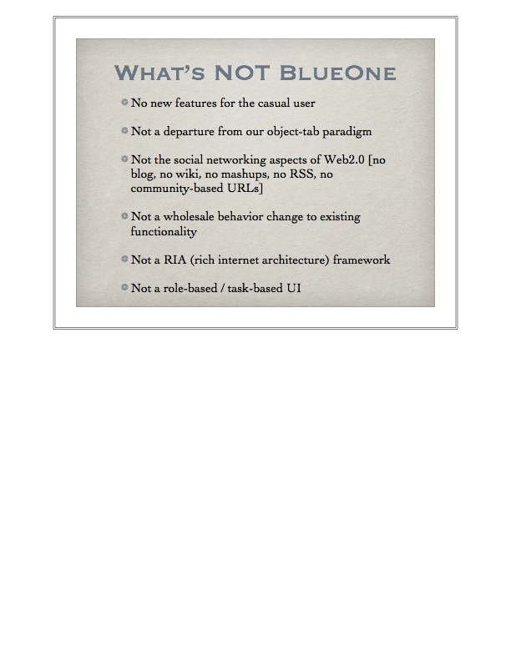
UI Clean-Up
ROI
  Robust experience (consistent, solid and professional)
  Improved performance and stability
  Sustainable and flexible code (increase our pace)
  Greater compatibility and accessibility
  Pride
What we will do
  Clean-up visual presentation thru purposeful design
  Semantic, standards-based xHTML / CSS coding
What we won’t be doing
  Changing application behavior

Slide 6
What’s not BlueOne
No new features for the casual user
Not a departure from our object-tab paradigm
Not the social networking aspect of Web2.0
[no blog, no wiki, no mashups, no RSS, no
community-based URLs]
Not a wholesale behavior change to existing
functionality
Not a RIA (rich internet architecture) framework
Not a role-based / task-based UI

Slide 7

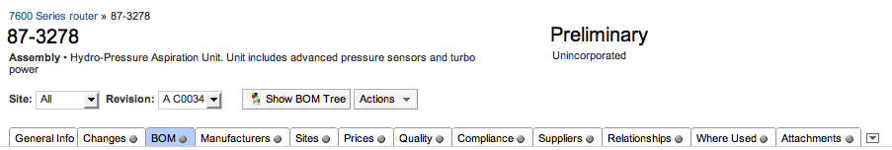
Clean-Up Process
Establish Components / Layouts
Design Components / Layouts
Prototype
Plug-in

Slide 8
User Productivity
21 customers interviewed by Brian and Shane (Michele and Joel)
Resulting productivity focus
  Windowing (compare and interact)
  Advanced table interaction (edit, pagination…)
  Copy and Paste, Drag and Drop
  Export to XLS
  Affected Items / Redline tables on same page
  Context Sensitive Help (hooks only)
  Attaching files

Slide 9
9.2.2.2?
Possible landing zone for MiniMe
Must have full QA (3 months)
Coding needs to finish June 1

Slide 10
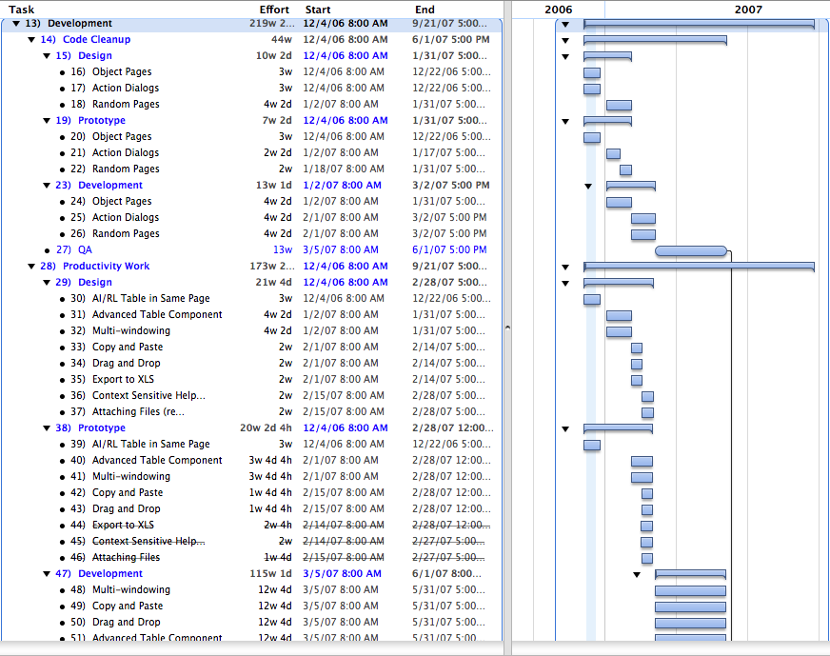
Project Plan

Slide 11
Phases and Milestones
Dec’06-
Jun’07
Dec’06-
Jun’07
Nov’06
Dec’06
Sep’07
Gate 1
Idea
Gate 2
Feasibility & Definition
Gate 3
Content & Capability
Gate 4
Test & Market
Gate 5
Produce / Operate
Preliminary
Investigation
Detailed
Investigation
Development
External
Validation
Full Product & Market Launch

Slide 12
Development Plan
Dec
Jan
Feb
Mar
Apr
May
Jun
Jul
Aug
Sep
Code Cleanup
(design, prototype, development)
Code Cleanup
(testing)
Productivity
(design, prototype)
Productivity
(development)
Productivity
(testing)
Productivity
(ongoing validation)
Code Cleanup
(validation)
Productivity
(validation)
Productivity
(summit)

Slide 13
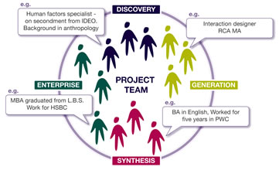
Project Team

Slide 14
Proposed Team
(1) Product Manager: Brian Cipresse
(1) Design Lead: Andrei Herasmachuk / Joel Nave
(3) Designers: Joel, Michele, Donna
(3) Prototypers: Anthony, Ralph, Tiffany
(1) Tech Writer: Contract
(4) UI Developers: Lead +3: (Siva, Phanee, Adler, Sean)
(2) Server Developers: Lead +1: (Chungyang, TBD)
(1) QA Lead: Lead +x: (TBD)

Slide 15
Status
Designs are currently in progress
TBH positions being identified
Identifying potential resources to leverage
Finalize productivity features
Engineering and QA review of plan

Slide 16

Validation

Slide 17

Validation Plan
When | What | Method | Vehicle
DONE | Point of View (POV) | Survey | Phone / Visits
DEC’06 | Visual Changes | Mockups | Email
DEC’06 | Use Case | List / Discussion | Email / Phone
Feb (19-21) | Productivity features | Prototypes | Email / Webex
Feb (22-23) | Upgradability | Survey | Phone / Email

Slide 18
Validation Panel
AMO
Ball Aerospace
Bally Technologies
(Cisco)
Conexant
CooperVision
Dell
Elcoteq
Harris (BCD)
Harris (RFCD)
Harris (CHQ)
Harris (GCSD)
Harris (MCD)
Hitachi OMD
HP ProCurve
Logitech
Micron
Phoenix
Spirent
Tyco Healthcare
WL Gore

Slide 19
Customer Types
EHT
(large)
EHT
(medium)
922
CAT/LA
Med Dev
PCM
(select)

Slide 20
User Types
Administrator
Change Analyst
Component Engineer
Configuration Engineer
Doc Control Analyst
Document Sys Mgr
Electrical Engineer
Hardware Engineer
Manager Config Mgmt
NPI Manager
Operations
Product Manager
Program Manager
Project Lead
Project Manager
QA Manager
Quote Coordinator
Strategic Supply Chain Mgr
Support Analyst
Software Engineer

