Slide 1


UX Training
UX Team

Slide 2
Agenda
Introduction to Blue One
  Goals, Accomplishments…
Phase 1 Deliverable (05/31/08)
  What to expect and what not to expect…
Introduction to new UI
  App Shell, New UI Controls, Action Dialogs…
What’s Changed
  Changes to existing functionalities
New Features
  Table Improvements, Search Improvements…
Design Patterns
  Page Layouts, Dialogs, Wizards, Messaging Styles…

Slide 3
Introduction

Slide 4
BlueOne Goals
Help drive revenue for next 3 - 5 years
Reduce cost of support and maintenance
Increase pace of new feature design and development
Increase pride of ownership
It must,
Significantly improve User Experience
Provide power users a viable solution over WAN
Deliver quality surpassing previous releases

Slide 5
Technical Accomplishments
Quicker to deliver new objects, tables and actions
Quicker to support new browser versions
1. Consolidated JSPs and APIs
  All tables and P1, P2, P3 (except activity GI)
  All table CRUD operations (no customizations)
  Table customizations (links, icons…) pushed to Tableconfig.xml
2. Modern presentation layer for improve flexibility and browser support
  xHTML 1.0 Standards Compliant Web Client (divs not tables)
  Object-based Javascript to ease maintenance
  Frames removed to support new interactions
3. New controls built as components
4. Common layouts to support global changes (action dialogs, page layouts…)

Slide 6
Design Principles
User Experience
Design for the probable, account for the possible
Establish patterns and design consistency
Reduce visual noise, focus on content
Let users keep their hands on the keyboard
Allow direct manipulation when possible
Implementation
Standardize
Modularize
Centralize

Slide 7
What to expect for the 05/31/08 delivery?

Slide 8
Drop 1 Expectations
Design
Core use cases have not changed
Way to accomplish use case has changed
Some features have been removed (e.g. creation wizards)
Implementation
Drop 1 is a code complete drop
A lot has changed!
  Presentation layer has been re-written
  New controls and major components
  New APIs for key areas
Performance improvements on login and some new features will be included in future drops

Slide 9
PC
Objects:
  Items, Mfr Parts, Mfrs, Changes, Sites and File Folders
  Tabs
    All tabs of above objects will be viewable
    All actions in all tabs of above tabs will be actionable.
Actions menu
  All actions in the actions menu of above objects will be actionable.
Import, Export of all PC objects
BOM Navigator (BOM Tree)
Exceptions
  Create Sourcing Project action from Item.
  Site coloring in tables.

Slide 10
PQM
Objects:
  PSR, QCR and Customer
  Tabs
    All tabs of above objects will be viewable
    All actions in all tabs of above tabs will be actionable.
Actions menu
  All actions in the actions menu of above objects will be actionable.
Import, Export of all PQM objects
Exceptions
    None.

Slide 11
PGC
Objects:
  Declarations, Substances, Specifications, Part Groups and Suppliers
  Tabs
    All tabs of above objects will be viewable
    All actions in all tabs of above tabs will be actionable.
Actions menu
  All actions in the actions menu of above objects will be actionable.
Import, Export of all PGC objects
Exceptions
  Simplified Supplier UI.

Slide 12
Generic
Searches
  Quick, Advanced & Parametric Search will be available
Notifications & Workflow Routings
  Viewable and actionable.
Exceptions
  Saved Searches
  Organize Folders (Searches, Bookmarks, Reports…)
  Adding to Table via adv search or shortcuts.
  Reports
  Web Admin

Slide 13
Common Controls
Application Shell (top, left, right panes)
New UI Controls for PC, PQM, PGC objects (Text, Date, Lists…)
Info-pop for links in all tables in PC, PQM, PGC objects.
View Personalization for all tabs in PC, PQM, PGC Objects.
Inline table editing for all editable tables in PC, PQM, PGC objects.
New Error/Warning dialogs and messages.

Slide 14
Application Shell

Slide 15
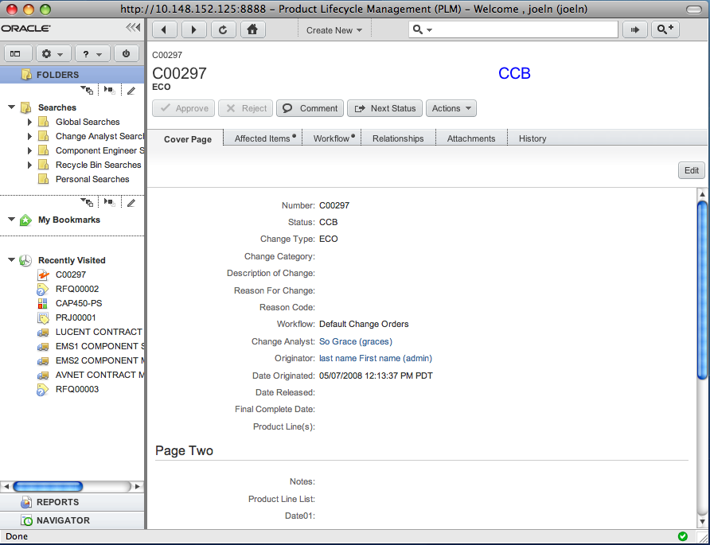
Application Shell
Top Pane
Navigation Pane
Content Pane

Slide 16
Top Pane
Search Controls
Navigation Controls
Create Menu

Slide 17
Navigation Pane
Branding Area
Folder Drawer
Courtesy Controls
Reports Drawer
Navigator Drawer

Slide 18
UI Controls

Slide 19
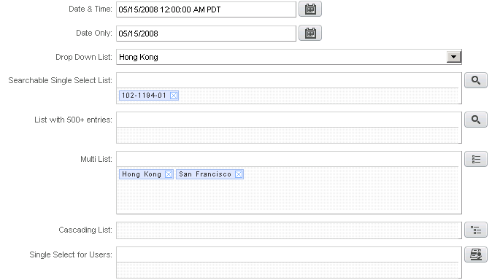
New UI Controls
Date Picker
Single Select Drop Down
Single Select “Search” Control
Multi List
Cascading List
User Control

Slide 20
List Controls
Single Select List Control
  Lists (static & dynamic) can be configured to be displayed in “drop-down” or through “search” in Java Client.
  All list attributes pointing to those lists will inherit the display behavior.
  Lists with more than 500 entries will be displayed only in search-mode even if it is configured to display in drop-down mode.
Multi Select List Control
  Support for drag/drop entries from multi-list box to the ML attribute.
  Support for using the ENTER key to add entries from multi-list box to the ML attribute.
  Support for removing entries by clicking on “x” corresponding to each entry.
Cascading List
  Support for tree-like structure
User Control
  More user attributes (same as quick search) will be displayed in the use selection pop-up.

Slide 21
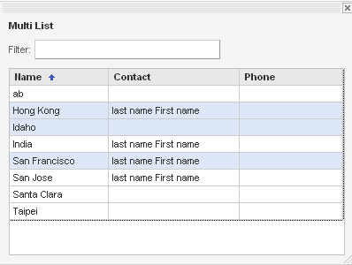
Working with Lists (SSL & MSL)
Select entries and Double-click
Select entries and hit ENTER
Select entries, drag & drop them into the list attribute

Slide 22
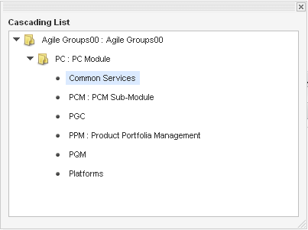
Working with Lists (Cascading)
Select an entry and Double-click
Select an entry and hit ENTER
Select an entry, drag & drop them into the list attribute

Slide 23
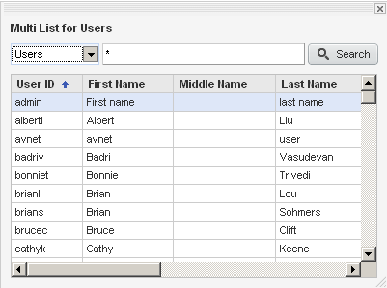
Working with User Controls

Slide 24
Other Controls…
Date Control
  Configurable in Java Client as “date only” or “date & time”.
  “Date & Time” attributes allow a time to be specified along with the date during data entry. The time is stored in GMT in the database.
  Auto Complete
Multi Text Control
  Support for character counter
  Support for defining width (medium, long) and height
Text, UOM, Money Controls
  Input Width – short, medium, Long
Tree Controls

Slide 25
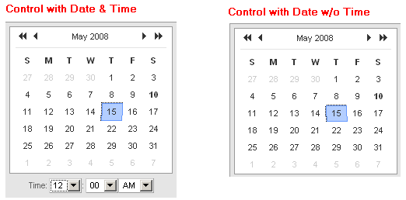
Working with Date Controls
Auto Complete
Double Click or hit ENTER to select a date

Slide 26
Dialogs

Slide 27
Dialogs
Action Dialogs
Wizard Dialogs
Palettes
Prompts
Exceptions…

Slide 28
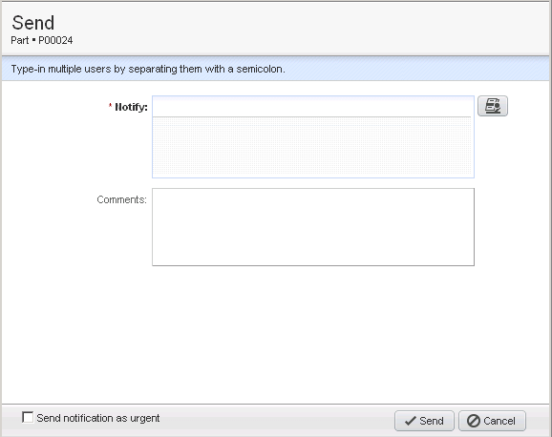
Action Dialogs
Title Area includes Title and Sub-title (e.g. sub-class and identifier)
Information area
Content area
Action Bar (main action on right and options on left)

Slide 29
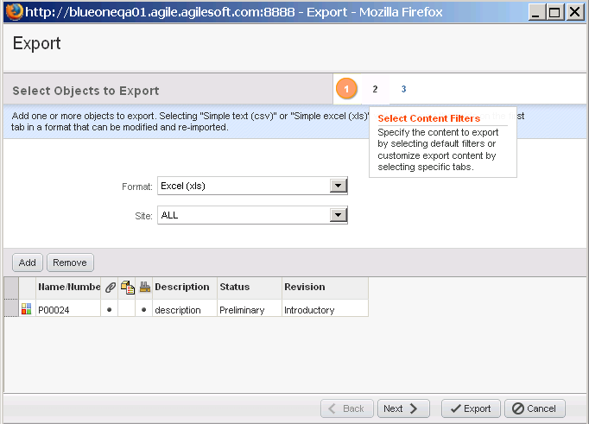
Wizard Dialogs (with more than 2 Steps)
“Multiple Step” indicator
Wizard Title
Mouse-over help for each step
Step Title
Action Bar (includes step navigation)

Slide 30
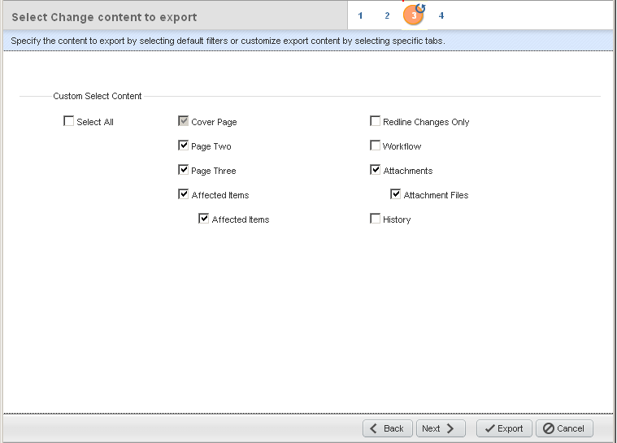
Wizard Dialogs – with recurring steps
“Recurring Step” indicator (e.g: choosing to export Items, BOM, AML when exporting a Change)

Slide 31
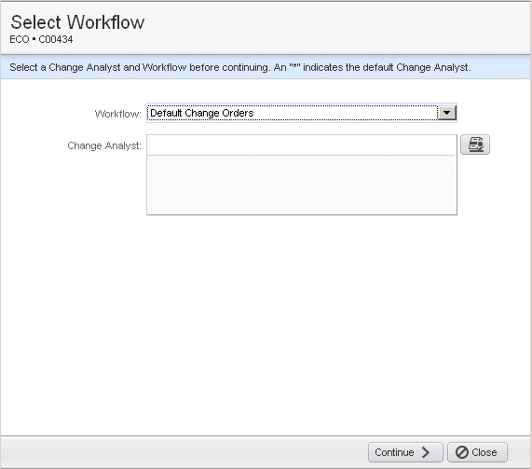
2 Step Action Dialog
Continue to the next step (when choosing a workflow and adding notifiers)…

Slide 32
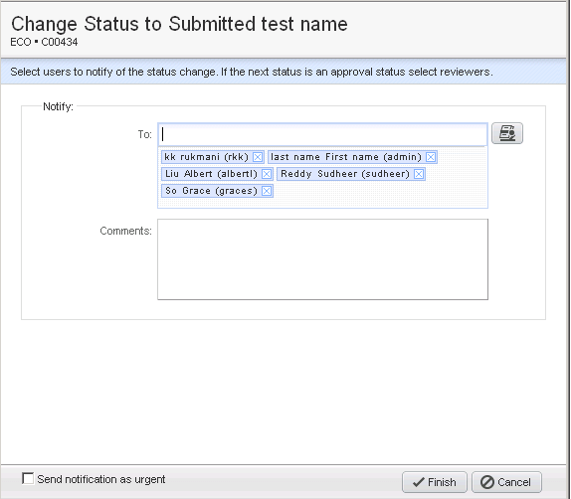
2 Step Action Dialog
2nd step of the Action Dialog

Slide 33
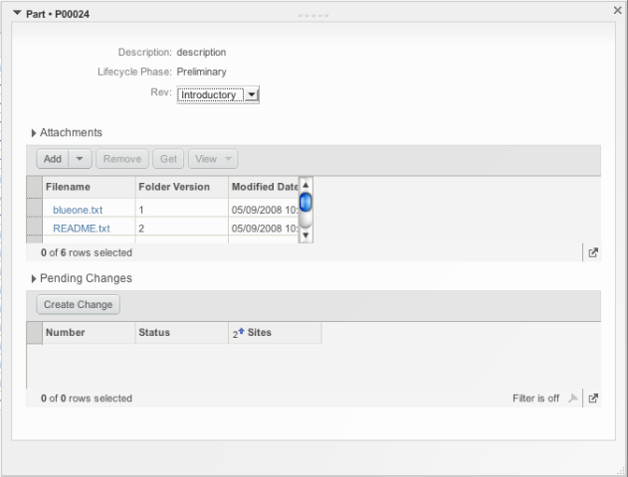
Palettes (Quick View)
Title
Content Area
Action Bar

Slide 34
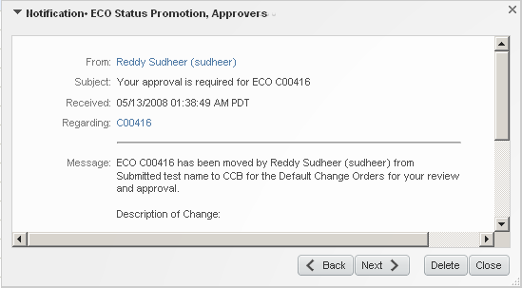
Palettes (Notifications)
Title
Content Area
Action Bar

Slide 35
What’s New…

Slide 36
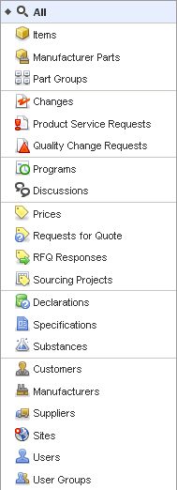
Search
New Search UI
Custom Search

Slide 37
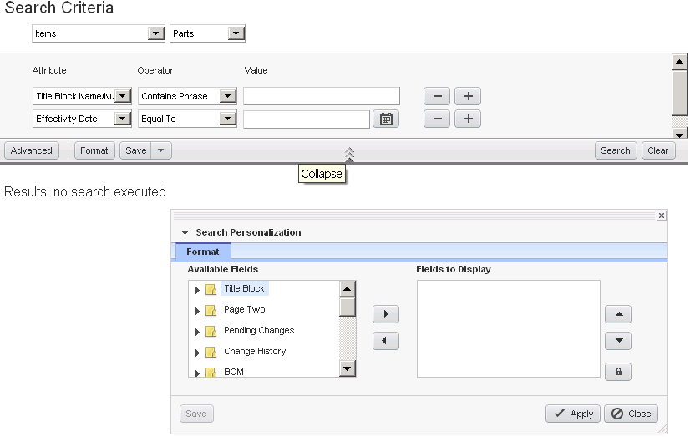
Parametric Search
Parametric Search Attributes
Expand/Collapse Pane
Switch to Adv Search
Configure Display grouped by Tables

Slide 38
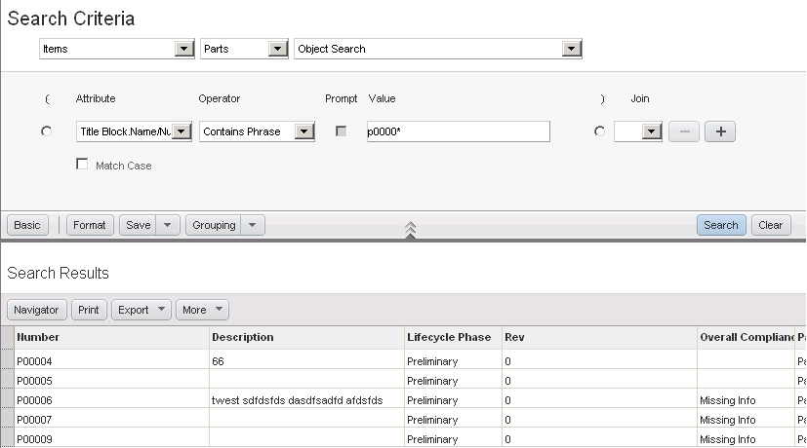
Advanced Search
Switch to Basic
Search Results Display

Slide 39
Tables
Personalization in Views
  Users can personalize data by filtering, sorting, freezing and hiding/unhiding multiple columns.
  Users can save their personalization as “views” specific to them.
  Admin users can propagate “views” to other users in the organization.
Add to Table
  Type-ahead.
  Usage of ENTER key or double-click to add rows from search results.
  Drag/drop, copy/paste rows from adv search to table.
  Copy/Paste rows from one table to another relevant table.
Edit rows
  Inline table editing – ENTER/double-click to edit a cell
  Support for keyboard navigation (TAB, ARROW keys)
  Meaningful error and warning messages
  Dynamic Messaging Strip (DMS) used to display error/warning messages.
Table Display
  Dynamic Pagination
  Quick View (similar to preview pane in Relationship tab) on any object link

Slide 40
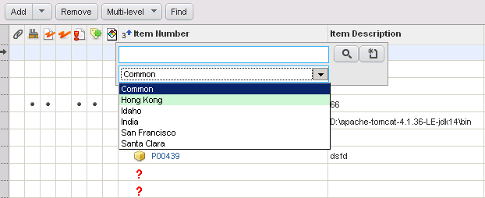
Add to Table
Add to Table dialog with Site option

Slide 41
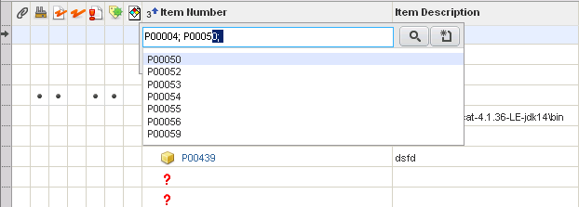
Add to Table through Type-ahead
Type-ahead to display similar data
Ability to search or create a new object

Slide 42
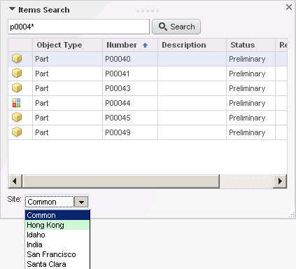
Add to Table through Search

Slide 43
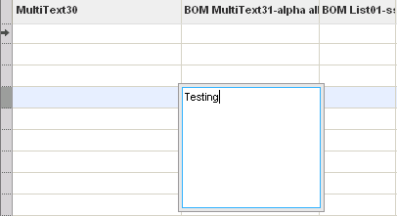
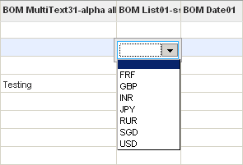

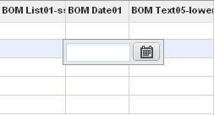
Editing Rows
Double Click or hit ENTER to edit a cell in a Table
List attribute
Expanded Multi List during Edit
Date attribute
All other fields

Slide 44
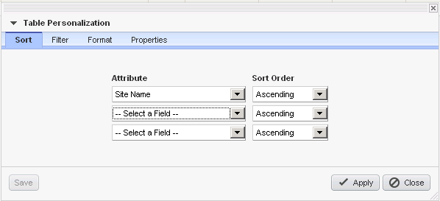
Working with Views

Slide 45
What’s Changed…

Slide 46
Changes to Existing Functionalities
Platform
  No support for IE6 (only IE7, FF2, Safari 3 are supported).
Search
  During search, no fields will be displayed unless a subclass is chosen (if there are multiple subclasses).
  No Advanced Search, Saved Searches, Shortcuts in “add by search” dialog (will be replaced by copy/paste, drag/drop features)
UI
  “Continue” option in Create-Object wizard won’t be available.
  User Address Book replaced by User Controls.
  No wizard steps on the left pane for actions that displayed wizard steps on the left pane (create object, import, supplier response…).
  Functionalities from Object-Actions menu (save-as, send, export…) use pop-ups.

Slide 47
Changes to Existing Functionalities (contd.)
Tables
  Edit Rows after adding not supported.
  On tabs with multiple tables, there won’t be links to navigate to the tables. No links in object cover pages as well.
  When adding rows to table, no explicit options in the “add” menu for “add by type in known numbers”, “add by search”, “add by create”. There will be only one “add” menu which will have the options.
  No option to search for “attachment content” when “add by search”.
  Get, Check-in/out, Cancel Checkout, Get Shortcut icons in Attachments table moved as “buttons”.
  No explicit pagination.
  Preview pane in “Relationship” tab replaced with “Quick View” option.

Slide 48
Changes to Existing Functionalities (contd.)
Tables
  “Show/Hide Sites” option in Item-Changes replaced by views.
  Active/Pending/Historical links in Item-Compliance tab replaced by views.
  Signoff Summary and Signoff History tables combined in Change-Workflow tab with views.
  Show hiding/pending options in Where Used tab not available.
  “Create Prices” button in Item-Prices tab moved to Actions menu.
  Create Users & Add Users in Supplier-Users tab will be replaced by “Add” option.

Slide 49
New Design Patterns

Slide 50
Design Patterns
Page Layouts
Icons
Error/Warning styles
Exceptions…

Slide 51
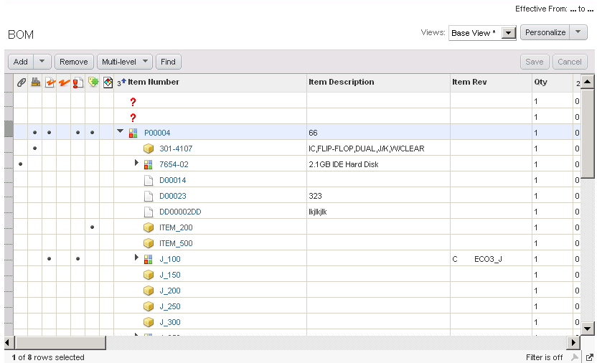
Page Layouts
Personalized Views
New Icon Indicators
Filter On/Off
Resize View

Slide 52
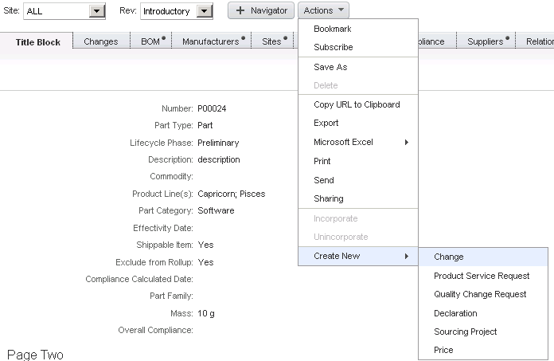
Page Layouts – Create New
New Grouping

Slide 53
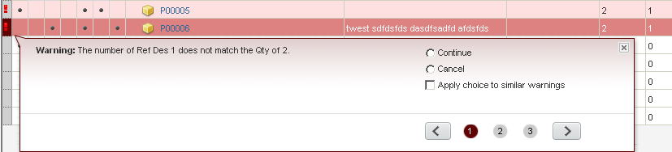
Error/Warning Pop-ups
Options for each error/warning
Icon to indicate the row with errors
Indicator of ERROR or WARNING
Navigating through the errors and warnings for each row and across rows
# of errors and warnings for each row.

Slide 54


