Slide 1
UX Discussion

Slide 2
Agenda
What is “MiniMe”?
  Clean-Up
  User Productivity (Power User GUI)
Proposal

Slide 3

What is MiniMe
MiniMe is the convergence of two efforts into a single project
Web Client Clean-up + Power User GUI
= “MiniMe”

Slide 4
MiniMe Goals
Immediate Revenue
Unlock 8.5 upgrades
Future Revenue
Initial step to Best UX in PLM (KonaBlue)
Increase Pace and Reduce Costs
Quicker to deliver UI’s
Supportability and reduced cost for cross-browser support

Slide 5
How it fits into UX roadmap
Clean-Up
(Phase 1)
Design: Clean-up of visual presentation and create consistency
Technical: Clean-up of client facing code and mark-up (xHTML/CSS)
Power User Experience
(Phase 2)
Design: Key power user use cases (comparisons, table interactivity, etc…)
Technical: Support AJAX-based TreeGrid, windowing, copy/paste, etc…
Casual User Experience
(Phase 3)
Design: Key casual user use cases (role-based, task-driven…)
Technical: Support for role-based presentation, UI extensibility, and integration to portals/desktop apps
RIA KonaBlue Experience
(Phase 4)
Design: Extend and apply above designs to a RIA, SPA model
Technical: UI Framework to support Single-Page Rich Internet Application

Slide 6
UI Clean-Up
ROI
  Robust experience (consistent, solid and professional)
  Improved performance and stability
  Sustainable and flexible code (increase our pace)
  Greater compatibility and accessibility
  Pride
What we will do
  Clean-up visual presentation thru purposeful design
  Semantic, standards-based xHTML / CSS coding
What we won’t be doing
  Changing major behavior

Slide 7

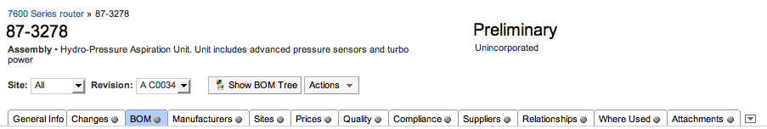
Clean-Up Process
Establish Components / Layouts
Design Components / Layouts
Prototype
Plug-in

Slide 8
User Productivity
21 customers interviewed by Brian and Shane (Michele and Joel)
Resulting productivity focus
  Windowing (compare and interact)
  Advanced table interaction (edit, pagination…)
  Copy and Paste, Drag and Drop
  Export to XLS
  Affected Items / Redline tables on same page
  Context Sensitive Help (hooks only)
  Attaching files

Slide 9
9.2.2.2?
Possible landing zone for MiniMe
Must have full QA (3 months)
Coding needs to finish June 1

Slide 10
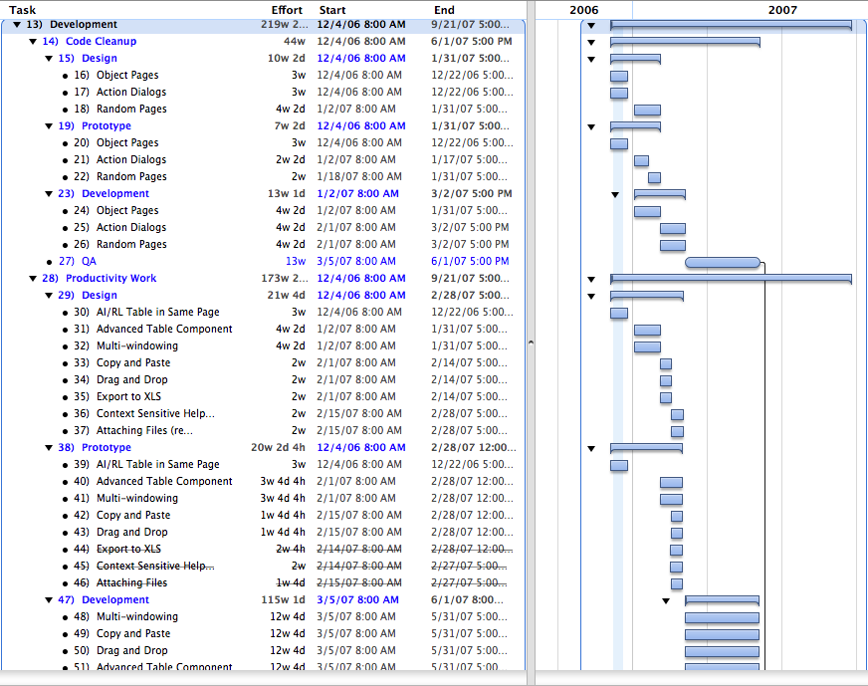
Project Plan

Slide 11
Phases and Milestones
Dec’06-
Jun’07
Dec’06-
Jun’07
Nov’06
Dec’06
Sep’07
Gate 1
Idea
Gate 2
Feasibility & Definition
Gate 3
Content & Capability
Gate 4
Test & Market
Gate 5
Produce / Operate
Preliminary
Investigation
Detailed
Investigation
Development
External
Validation
Full Product & Market Launch

Slide 12
Development Plan
Dec
Jan
Feb
Mar
Apr
May
Jun
Jul
Aug
Sep
Code Cleanup
(design, prototype, development)
Code Cleanup
(testing)
Productivity
(design, prototype)
Productivity
(development)
Productivity
(testing)
Productivity
(ongoing validation)
Code Cleanup
(validation)
Productivity
(validation)
Productivity
(summit)

Slide 13
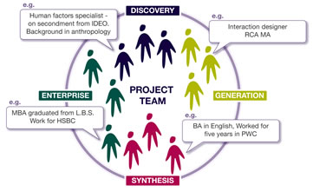
Project Team

Slide 14
Proposed Team
(1) Product Manager: Brian Cipresse
(1) Design Lead: Andrei Herasmachuk / Joel Nave
(3) Designers: Joel, Michele, Donna
(3) Prototypers: Anthony, Ralph, Tiffany
(1) Tech Writer: Contract
(4) UI Developers: Lead +3: (Siva, Phanee, Adler, Sean)
(2) Server Developers: Lead +1: (Chungyang, TBD)
(1) QA Lead: Lead +x: (TBD)

Slide 15
Status
Designs are currently in progress
TBH positions being identified
Identifying potential resources to leverage
Finalize productivity features
Engineering and QA review of plan

Slide 16

Validation

Slide 17

Validation Plan
When | What | Method | Vehicle
DONE | Point of View (POV) | Survey | Phone / Visits
DEC’06 | Visual Changes | Mockups | Email
DEC’06 | Use Case | List / Discussion | Email / Phone
Feb (19-21) | Productivity features | Prototypes | Email / Webex
Feb (22-23) | Upgradability | Survey | Phone / Email

Slide 18
Validation Panel
AMO
Ball Aerospace
Bally Technologies
(Cisco)
Conexant
CooperVision
Dell
Elcoteq
Harris (BCD)
Harris (RFCD)
Harris (CHQ)
Harris (GCSD)
Harris (MCD)
Hitachi OMD
HP ProCurve
Logitech
Micron
Phoenix
Spirent
Tyco Healthcare
WL Gore

Slide 19
Customer Types
EHT
(large)
EHT
(medium)
922
CAT/LA
Med Dev
PCM
(select)

Slide 20
User Types
Administrator
Change Analyst
Component Engineer
Configuration Engineer
Doc Control Analyst
Document Sys Mgr
Electrical Engineer
Hardware Engineer
Manager Config Mgmt
NPI Manager
Operations
Product Manager
Program Manager
Project Lead
Project Manager
QA Manager
Quote Coordinator
Strategic Supply Chain Mgr
Support Analyst
Software Engineer

