Slide 1

Agile 9.3 UX GTM Plan
Joel Nave, Madhuri Kolhatkar, Misha Vaughan, Kathy Miedema

Slide 2
GTM Plan Potentials
Audiences
  Internal (Strategists, Sales Consultants, Sales Reps)
  External (Partners / SIs, Customers)
Channels
  PPT of Agile 9.3 Messages
    Messages
    Screen shots with callouts
    Customer testimonials (TBD)
    Productivity assessment
    Competitive information – Against existing product
      Against BofB – Strategy: Gayle Hayes, Sarvesh Jagamivath (TBD)
  ADS Storyboards
    1-2 UX value propositions, UX variations
  Viewlet (prototypers?)
  Articles & Blogs on Usableapps
  Events
    Openworld, others?
  Webinar (Product Briefings)
  Strategy Councils, CABs, Analyst Events, Sales Events
  Internal newsletters?
    Monthly all hands
  O.com newsletters, Profit, Profit Online
    Customer success story
  Sales cheat sheet
    Possible, but may be a resourcing issue – def not committed.
  Mailing list for anybody who wants updates on ux collateral
  Productivity analysis (using time on task and/or Jeff’s method)

Slide 3
Steps
Create UX messages for Agile 9.3 & Blog
  1:1 with Kathy
  PPTs with messages
  ADS storyboards review
  Agile 9.3 blog
  Agile 9.3 articles
Sales Support
  ADS – Mini campaign on Agile
    ADS channel for promotion
    Apps UX portal on my.oracle.com
    Link from marketing portal

Slide 4
Overarching UX message for Agile PLM 9.3
Armed with a deep understanding of user needs and continued user participation throughout the project, Agile 9.3 introduces new controls, components and productivity features to drive a dramatic improvement in user productivity

Slide 5
Agile PLM 9.3 User Experience Messages
Key Point | PP 1 | PP 2 | PP 3 | PP 4 | PP 5
1. Continuous customer involvement has resulted in a greatly improved product | 22 site visits helped inform us on customer needs and provided a basis for our designs | “Customer Design Program”. Consistent involvement throughout design helped us refine our designs | Formative Usability tests using live app guided our investment on our Phase 2 iterations | 2 weeks of customers executing their tasks using their config and data validated designs | Navigator, Error handling and inline editing were the results of heavy customer involvement
2. A simplified design quickly ramps users to greater productivity | Redesigned top pane allows users to quickly access primary controls without having to hunt for them | Layering has been used to reduce simplify pages and interaction exposing complexity only as needed (e.g. Flow from Quick to Advanced Search) | Visual design dramatically simplified to allow content to take prominence (icons per page cut in half, color and font variations dramatically reduced) | Introduced table personalization to allow users to simplify and save their view of a table

Slide 6
Agile PLM 9.3 User Experience Messages
Key Point | PP 1 | PP 2 | PP 3 | PP 4 | PP 5
3. Introduced direct manipulation allowing users to complete tasks in a more natural and efficient way, while reducing the likelihood of errors | Type-ahead suggestions for lists dramatically expedites the selection of list values. Start typing, and quickly add them. | Inline table editing allows users to quickly edit table values | Drag / drop, copy / paste, and fill-up / down allow users to add / copy data with zero chance of data entry errors in a dramatically more efficient manner | Keyboard controls for selecting and adding data reduces jumps from keyboard to mouse and increases user efficiency (ctrl-a, shift-arrow-down, delete, double clicks…)
4. Immediate access to primary controls, content and components increases user efficiency and reduces page navigation | An actionable QuickView allows users to view and action primary content of an object, without having to navigate to the object itself | Search dialog launched by keyboard shortcut provides access to advanced search from any page in the application | New Navigator feature allows user to view the details of a list of objects without losing the context of the list | Keyboard shortcuts for copy/paste, fills, save, selections and navigating to home, search and other key pages

Slide 7
Agile PLM 9.3 User Experience Messages
Key Point | PP 1 | PP 2 | PP 3 | PP 4 | PP 5
5. Improved consistency across the Agile PLM Suite reduces training and allows users to ramp their productivity quickly | Habituation supported through consistent interactions throughout suite, including keyboard controls and control and component interactions | Consistent page layouts and control positioning allows users to quickly understand the application layout and leverage spatial memory | Common input controls and components used throughout the suite | Common visual design applied across the suite

Slide 8
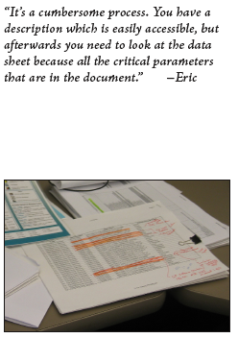
Customer Involvement:
Customers engaged before design and throughout the release
22 site visits prior to design
Consistent user involvement throughout design
Formative Usability testing on live code prior to phase 2 iterations
2 weeks of end-users executing their tasks on their config and their data on live code
Navigator, error handling, inline table editing heavily influenced by users

Slide 9
Simplified Design:
A drive to simplicity helps users quickly ramp to productivity
Redesigned top pane
Layering to reduce complexity
Simplified visual design
Table personalization

Slide 10
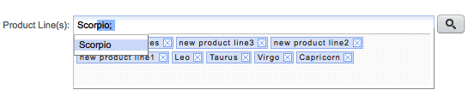

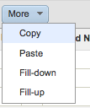
Direct Manipulation:
Users can complete task more efficiently with reduced errors
Type-ahead suggestions
Inline table editing
Drag and Drop
Copy / Paste
Fill-up / down
Keyboard controls

Slide 11
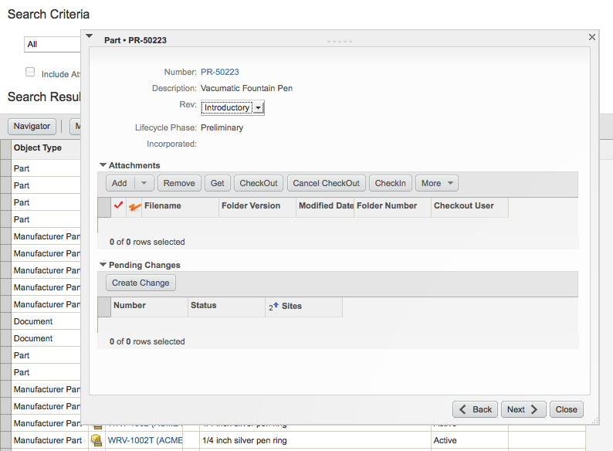
Immediate Access:
Primary controls, components and content at your finger tips
Actionable QuickView
Advanced Search accessed from any page in the application
Navigator provides efficient navigation of object lists
Keyboard shortcuts

Slide 12

Consistency:
Cross Suite consistency reduces training and increases productivity
Habituation through consistent interaction across the suite
Consistent Page layouts and control positioning allows users to leverage spatial memory
Common visual design throughout the suite

Slide 13
Improved Productivity:
Results from Flextronics Productivity Testing
Time on Task

Slide 14
Agile PLM 9.3 User Experience Messages
Key Point | Proof Pt. 1 | Proof Pt. 2 | Proof Pt. 3
1. Improved ease of use | A. Refined visual simplicity in the user interface allows users to learn the application faster and work more quickly. | B. Added interactive features such as copy, paste, and drag and drop makes tasks more efficient. | C. A UX productivity survey shows increased speed in completing tasks.
2. Increased consistency | A. Tasks and task responses have been redesigned to be uniform across Agile products, using, for example, dialogues instead of inline text. | B. Icon usage has been cut in half and variation in fonts, colors and other visual elements have been dramatically reduced. | C. Core products now have a new user interface that provides cross-product consistency, meaning less training overall.
3. Improved data entry | A. The new auto-complete feature helps reduce errors in data entry. | B. Import and export speeds have increased by up to 50 percent. | C. An advanced table component supports new features such as inline editing, freeze column, filtering, and formatting.

Slide 15
Agile PLM 9.3 User Experience Messages
Key Point | Proof Pt. 1 | Proof Pt. 2 | Proof Pt. 3
4. Improved navigation | A. Quickview speeds up navigation of screens and tasks by flattening, or jumping through, the layers of the user interface. | B. The Navigator feature …
5. Keyboard improvements | A. Power users are now able to navigate more efficiently with keyboard strokes. | B. Keyboard shortcuts provide quick access to tools used most frequently.

