Slide 1
BlueOne Project Development Goals and Approach
03/13/2007

Slide 2
BlueOne Development Goals
Have fun and be proud
Deliver superior quality
Ensure future success
Expand our design and technical skills
Pay attention to detail

Slide 3
Apply Lean Philosophies
Continuous improvement
Reduce risk up front
Quality at the source
Make internal customers successful

Slide 4
Approach
Deliver multiple mini-releases (Cycles) throughout the project
Small cross-functional teams jointly responsible for Cycle success
Allotted “Framework” cycles
Allotted “Clean-up” cycles
Learn capacity and plan appropriately

Slide 5
What is a Cycle
A cycle is a “mini-release” that delivers a set of objectives
Cycle objectives will be a combination of:
  Feature requirements
  Questions that need to be answered
  Solutions that need to be proven
Feature requirements must be complete, tested and deliverable to a customer
Questions or POCs must result in a demo that provides an answer

Slide 6
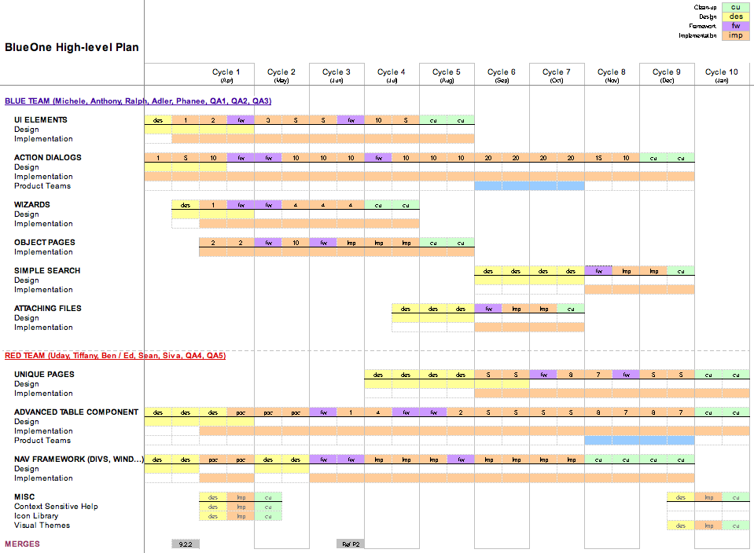
2006 Investment Strategy
Project Cycles
Project Tracks

