Slide 1
Scrum Process
Overview

Slide 2
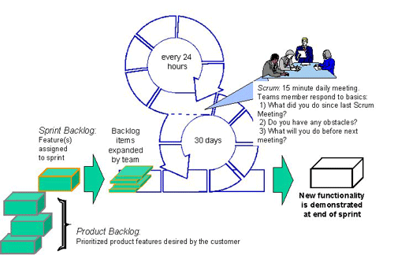
Product Backlog
what we need to do
PM owns

Slide 3
Product Backlog
Cleanup
Overall look & feel
Top/Left pane
Object pages layouts
Unique page layouts
Actions & dialogs
UI elements
UI controls
Productivity
MDI
Tree grid
Export to Excel
Drag and Drop
Copy and Paste
File handling
minimal behavior change
significant behavior change

Slide 4
Sprint Backlog
when we are going to do it
PM owns

Slide 5
Sprint Backlog
Sprint 1
  Complete multi-select list
  Complete date picker
  Object header - header, buttons, tabs, menus
  POC table pagination, complete
  Design Message Area
  Design & Proto Single Select Search
  Design Object Form
  Design & Proto Multi-Select Cascade List
  Design Multi-Select User Search
  Proto Top Pane
  Proto Left Pane
  Proto Action Dialog
  POC Styling of COQSoft Tree Grid
Engineering
Design

Slide 6
Sprint Planning
how long we need to do it
Team owns

Slide 7
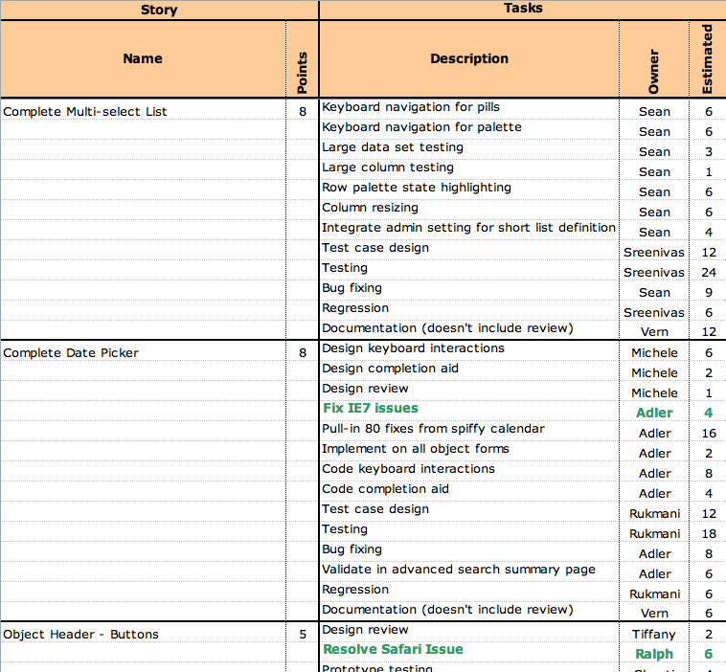
Sprint Planning

Slide 8
Monitor
are we on-track or off

Slide 9
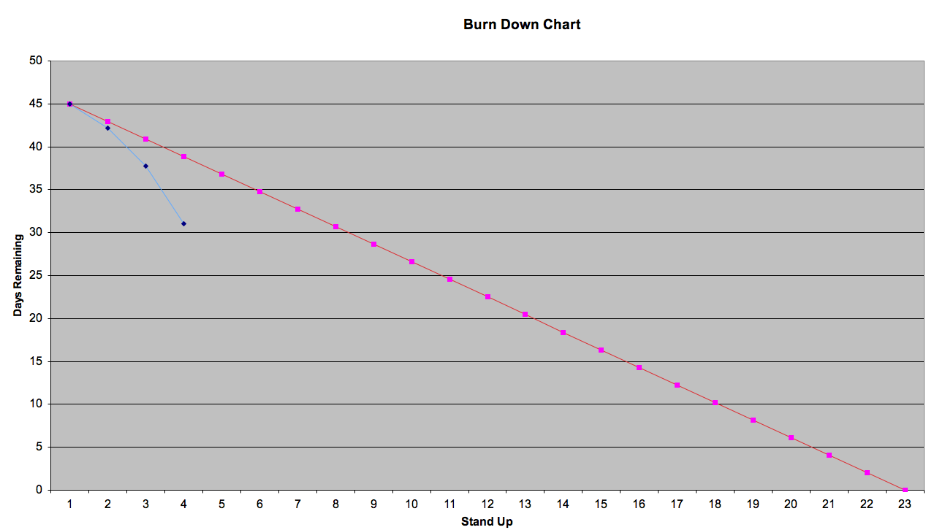
Burn Down Chart
actual
plan

Slide 10
Sprint Reviews
show and tell; how did we do

Slide 11
Sprint Reviews
Planned meeting after each Sprint
All stakeholders welcome
(starting 25th of May)
Only TEAM participates and can talk
Demonstration of work
Retrospective Open Discussion
  what went well, poorly
  corrective action

Slide 12
Velocity
what is our throughput - predicts completion date

Slide 13
Velocity
example only for illustrative purposes - not real numbers
For the past 4 sprints we averaged 80 units of work per sprint
Per the backlog we have 1000 units of work
We can complete this project in 25 weeks (eg: 1000u/40u per wk)

Slide 14
Scoping Process
Many inputs
  CQs via SLA process
  SCs 922 Feedback PPT
    eg: Dual column presentation, thumbnails
Suggested process
  If request is already in backlog, we add and commit
  If request is not in backlog, PM team determines relative priority
    if IN: Scrum process will adjust backlog as necessary
    if OUT: Product Teams communicate non intention to customer

