Slide 1
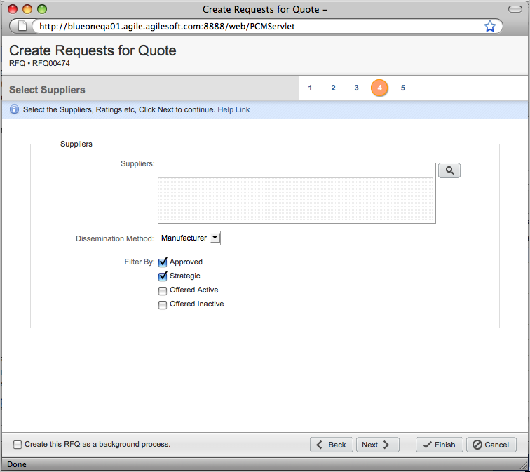
To add suppliers:
• Type in suppliers names
• Click on search button to launch the search dialog

Slide 2
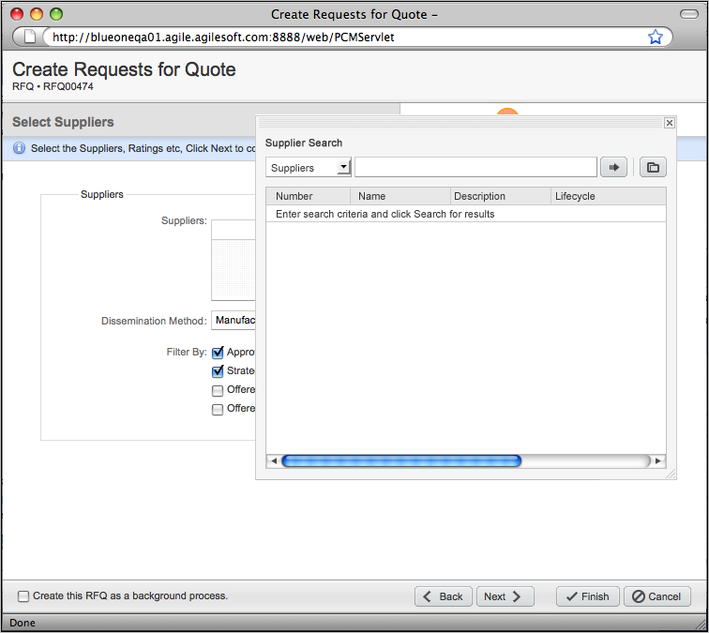
A Saved Search button is added within the Search Dialog to access Saved Searches

Slide 3
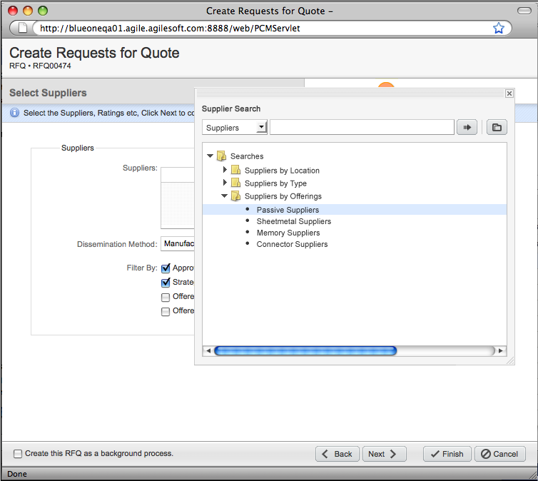
• Saved Search folder structure is displayed within the Search Dialog.
Searches are limited to Supplier Searches
• User clicks on the desired Saved Search

Slide 4
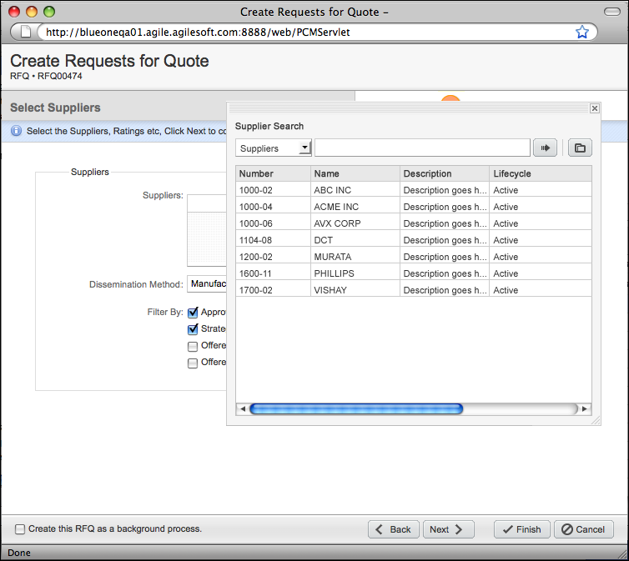
Saved Search results are displayed in the dialog
User can select from the saved search results and add them to the control
• double click to add
• enter key to add
• drag and drop to add

