Slide 1


Oracle | Agile PLM User Experience Update
Joel Nave

Slide 2
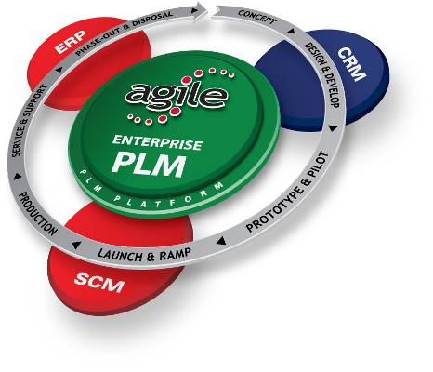
PLM completes the enterprise application picture
Resources
Customers
PLM is all about Products
Suppliers
Notes:
The Agile solutions are mapped directly to the 7 major processes that are driving the business imperatives that we reviewed earlier:
Specification Mgt
Supplier Mgt
Formulation Mgt
Packaging & Labeling Mgt
Compliance and Quality Mgt
Data Syndication
New Product Development & Introduction

Slide 3
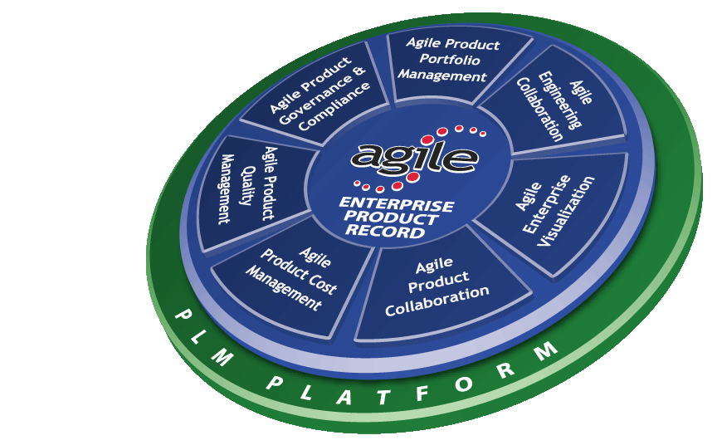
Agile PLM Solutions
Product Governance
& Compliance
Product Portfolio Management
Engineering
`Collaboration
Compliance
Office
Executives & Program Office
Development
& Engineering
Integrated product, program, resource & portfolio management
Engineering desktop integration & collaboration
Product & program compliance against standards & regulatory requirements
Enterprise
Visualization
Cross-Enterprise
Native document collaborative visualization across the global enterprise
Product Quality
Management
Quality
Professionals
Product
Collaboration
Operations &
Supply Chain
Product Cost Management
Procurement Professionals
Closed-loop product quality management across the extended enterprise
Enterprise product record visibility, management & collaboration
Product sourcing and lifecycle cost & risk management

Slide 4






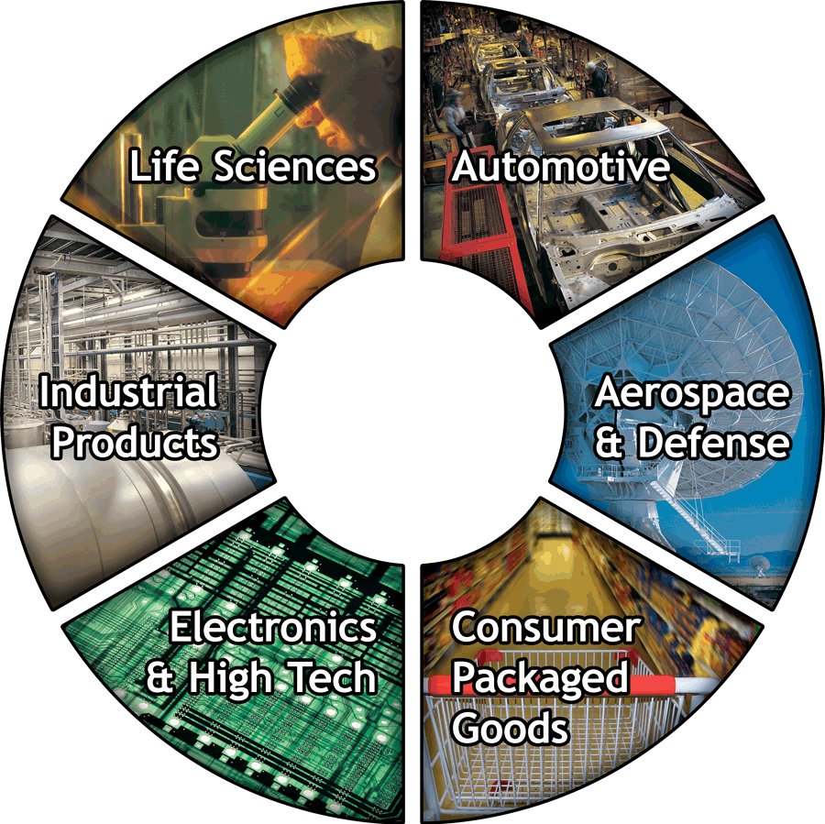












































1,300+ Enterprise PLM Customers
Philip
Morris
International
Notes:
Key points:
Strong presence with Blue Chip, marquee customers in 6 industry verticals
Enterprise PLM leader in Electronics & High Tech, Life Sciences; Emerging leader in CPG/Food & Beverage
Strongest customer referenceability in enterprise PLM with best track record for customer success

Slide 5
Where are we now - BlueOne project
BlueOne Code Complete Friday!
  UX lead redesign project
    Establish consistency across Agile PLM products
    Increase user productivity
    Simplify visual design
    Modernize code (xHTML 1.0 compliant)
  1.5 years of parallel design and development (Scrum)
Next few months
  Continue to lead through Code Freeze
  Participate in Customer Acceptance Program
  Prioritize UI / UX bugs
  Resolve any design issues and assist in fixing mark-up / css related issues

Slide 6
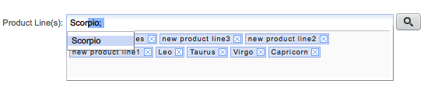

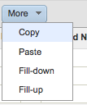
A few BlueOne examples
New data entry controls
  Auto-complete
  Drag and Drop
  Reduced errors
Advanced table component
  Inline editing
  Freeze column, filtering, formatting
  Fill-up / down
  Dynamic pagination
Adding to tables
  Auto-complete
  Drag and Drop
  Copy / Paste

Slide 7
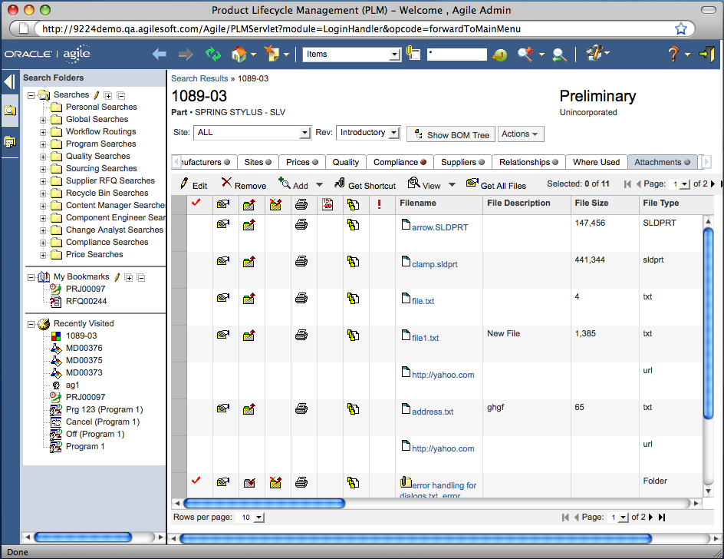
Visual Design Before

Slide 8
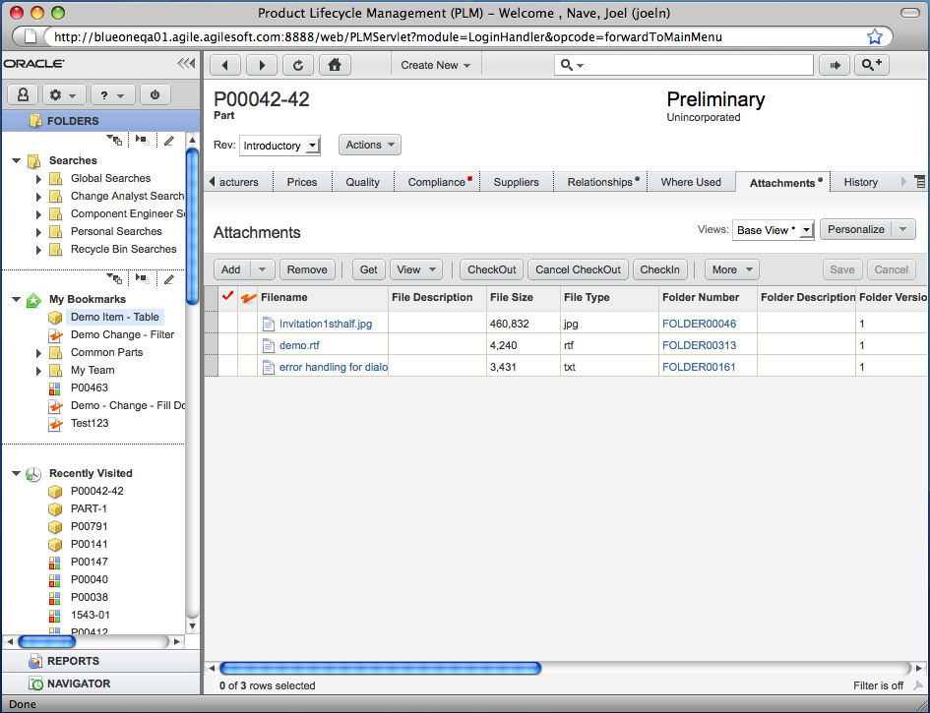
Simplified Visual Design

Slide 9
Where are we now - Customer Needs Management
Customer Needs Management is a new Agile PLM product
Product is targeted at ETO companies supporting the bidding process for complex custom products
This product is intended to be a Fusion Edge Application
Next few months
  Initial user interviews completed, analysis in process
  Initial Design and Usability Studies

Slide 10
Coming Initiatives
People / Process
  Training on Apps UX process, design guidelines and patterns and tools
Product
  Agile PLM 9.3.1 RPS sign-off end of November with design beginning soon after with likely design tasks:
    Comparison and interaction between multiple records (MDI)
    Data Import Templates
    Configurable “Quickview”
    Role-based Folder Structures
    Tactical Portfolio Management
    Specification Management
    Cause and Effect Diagrams (Ishikawa Fishbone)

Slide 11
Open Questions / Issues
General Fusion Edge Application Questions
  Are there guidelines and patterns for Fusion Edge Applications
  Should Fusion Edge Applications try to adopt the Fusion App Shell
  Any other guidance on Fusion Edge apps

