Slide 1


Customer Needs Management
Abhijit Kakhandiki

Slide 2
Consumers need products that are relevant to their needs
  Transmit needs / ideas to product managers
  Minimal work
Product Managers need quick access to comprehensive data on customer needs
  All sources – formal or informal
  Categorize and Prioritize to form a ‘virtual mindmap’

Slide 3
Intended Users
Intended Users
  Product Managers

Slide 4
CNM Phase 1
Customer Needs Management Phase 1
Collect
Analyze
Act
Solicit:
Surveys (surveymonkey)
Idea Mashups (dell ideastorm)
Communities (mix.oracle.com)
Idea Marketplace
Aggregate:
Informal (brainstorming sessions, phone calls etc.)
  Wikis with smart tags
  Category labels (google bookmarks)
Formal (enterprise systems)
  CRM - Enhancements
  PLM - Quality
Categorize:
Individual Categorization
Consensus Categorization
(Collaborative process)
Prioritize:
Individual Priorities
Social Prioritization
Search:
Keywords, Page Rank
Traceability (products, projects)
Ideation:
Informal: Blogs, Discussions
Formal: PC-PPM (next slide)
Requirement Management:
Feasibility (PC-PQM)
Definition (PC-PQM)
Portfolio Management::
Budget Allocation / Feasibility
Project Scorecard / Ranking
What-if Analysis

Slide 5
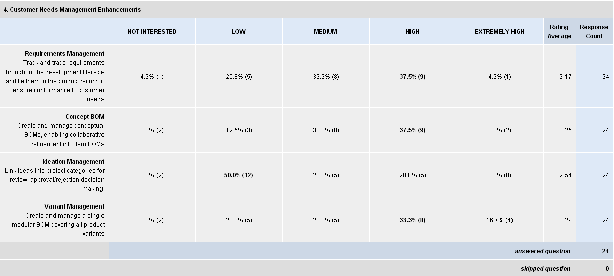
Customer Feedback

Slide 6
Customer Feedback
Customers who ranked it high in strategy council:
  Viasat
  Phoenix
  Elcoteq
  Alcatel-Lucent
  Motorola
  ZF Friedrichshafen AG

Slide 7
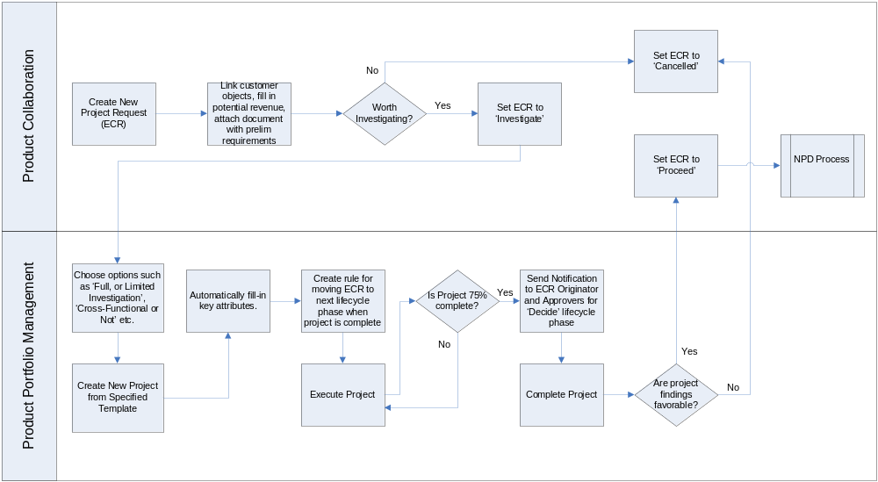
Ideation

Slide 8
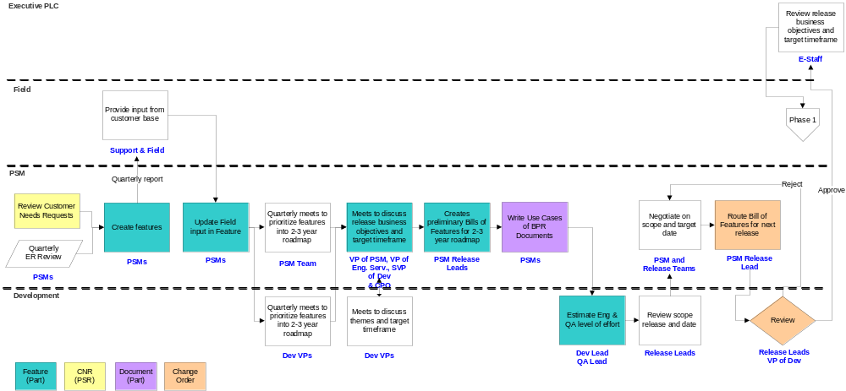
Requirements Management - Feasibility
For Next
Release

Slide 9
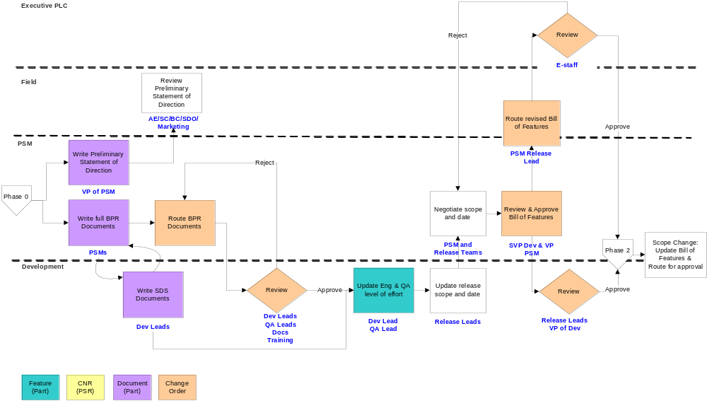
Requirements Management - Definition

Slide 10
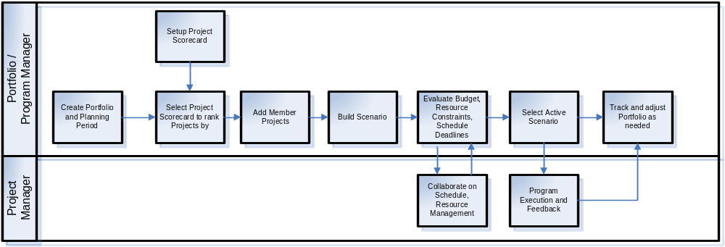
Portfolio Management

Slide 11
Collect
Issues to address
  What to collect
  Where to collect from
  What to do with the data
Sources
  Surveys (surveymonkey)
    Link survey results to other survey results - such as "customers who answered Yes to this question in the past also answered Yes to …"
  Idea Mashups (dell ideastorm)
  Communities (mix.oracle.com)
  Wikis
  Blogs
  Email

Slide 12
Collect
  RSS Feeds
  Idea Marketplace
  Crawler - gets information from public domains
    URL (for traceability), text content (indexed). Collect ideas, similar products, problems reported, patents filed.
  CRM, MES, ERP, Financials systems
    Business Intelligence, such as what geographies are my orders coming from, where are my shipping delays, what have I been doing writeoffs on, etc
  Internal quality/defect database
  Manual ad-hoc posts (brain-dumps, mindmaps, etc)
  Audio visual media (webinars, newscasts)
    URL (for traceability), transcript
    Use text matching with transcript, or even audio matching for audio clips
  Internal files
  Public files

Slide 13
Aggregate
Be able to transform data from a form that the information source presented to a form that it can be stored in (e.g. put in wiki content on Mindmap or on an index card), and then have traceability back to the original source directly (be able to get back to that wiki site from that mindmap entry or index card)
Index cards - each card holds a piece of information from a given source, and provides traceability to that source. Can be organized into folders or buckets.
Mind-map type organization

Slide 14


