Slide 1

DWPE 2.0 Beta Test Kick-off
Roy Selig, Lydia Naylor
November 8, 2026
Oracle Confidential

Slide 2
Agenda
Introductions
Strategy
Project Schedule
Development Process
Beta Schedule
Dreamweaver Testing Setup
Beta Test Procedures
Tips & Techniques
Resources
Oracle Confidential

Slide 3
DWPE 2.0
Strategy
Oracle Confidential

Slide 4
DWPE 2 is…
An update to…
  reflect Fusion standards
  fill in key component gaps
  enhance the usability of the tool
  improve support for prototype extensions
A complete re-write of code
Based on a jQuery runtime architecture
Incorporates a generic UI skin to lower maintenance costs
Oracle Confidential

Slide 5
DWPE 2 is not…
Compatible with DWPE 1.0 or its prototypes
A perfect emulation of Fusion look and behavior
A tool for design specification (just demonstration)
Oracle Confidential

Slide 6
DWPE 2.0
Project Schedule
Oracle Confidential

Slide 7
DWPE 2 Project Schedule
Feb
Mar
Apr
May
Jun
Jul
Aug
ALPHA
BETA
PILOT
2.0 GA
Components
Shell
Integration
Patterns
QA
Release Prep
Rollout
Oracle Confidential

Slide 8
Tasks
Components: build the runtime instances of toolbar,table,tree, etc.
Shell: build the runtime instances of global,regional and contextual areas
Integration: connect runtime instance of components and shell to DWPE bundle
QA: bug identification and fixing
Patterns: build out of pattern content
Training Prep: preparation of documentation and training materials
Pilot: small-group run-through of training materials and tool
Oracle Confidential

Slide 9
DWPE 2.0
Development Process
Oracle Confidential

Slide 10
Development Process
Proceed on a component by component basis
Group components to maximize productivity
Build each component through four stages
  Functional
  Dressed
  Wired
  Integrated
Oracle Confidential

Slide 11
Component Logical Groupings
Toolbar
Iconic Button
Text Button
Iconic Text Button
Command Button
Toggle Button
Radio Button
Inline Selector
Toolbar
Form Elements
Checkbox
Single-Select Choice List
Multi-select Choice List
File Upload
Single-Select List Box
Multi-select List Box
Text Box and Area
Radio Group
Spin Box
Date Picker
Containers
Subheader
Sub-Subheader
Header
Page Header
Accordion
Tabs
Splitters
Windows
Modal Dialogs
Modeless Dialogs
Note Window
Menus
Table
Empty Table
Grid Lines
Column Groups
Column Subtotals
Column Totals
Column Grand Totals
QBE Bar
QBE Fields
Tree
Train
Carousel
Oracle Confidential

Slide 12
Component Stages of Development
Functional
  Component behaves as expected with dummy data
Dressed
  Component looks as expected compared to RCUX
Wired
  All user-settable attributes are hooked up to their component internals
  Component correctly consumes dynamic data
Integrated
  Component has an entry point in the DWPE
  Component renders correctly at runtime
Oracle Confidential

Slide 13
Integration Goals
Ensure that every component built has a point of entry in the DWPE 2 extension
Ensure that component dialogs work correctly at design time
Ensure that components display correctly at run time
Optimize design and run time performance
Validate build and release processes
Oracle Confidential

Slide 14
Beta Test Schedule
May
Jun
Jul
Aug
BETA
Forms
Toolbar
Containers
Windows
Tables
Trees
Specials
Shell
Oracle Confidential

Slide 15
Beta Testing
In this phase testers will primarily work in DW and focus on integration
Areas of interest will be:
  DWPE2 install
  DWPE2 component usage in isolation and combination
  DWPE2 runtime
  Shell
You will be asked to identify & report:
  bugs
  performance issues
  usability concerns
In early beta you will receive weekly drops of the DWPE bundle with instructions on what look at
In late beta you will be asked to create exemplar pages from your domain to put DWPE2 through its paces
A time commitment of about 8-10 hours a week is expected
Oracle Confidential

Slide 16
DWPE 2.0
Test Procedures
Oracle Confidential

Slide 17
Basic Drill
Receive the Weekly Test Plan in email on Wednesdays
Attend the weekly info meeting on Thursdays
Download the latest extension
In extension manager…
  Remove the last week’s extension
  Add this week’s extension
Launch Dreamweaver
Open your DWPE 2 Beta Site
Overlay Resources
Follow the individual test plans for that week
Feedback is due the following Tuesday at noon PT
Oracle Confidential

Slide 18
Installation & Test Demo
Oracle Confidential

Slide 19
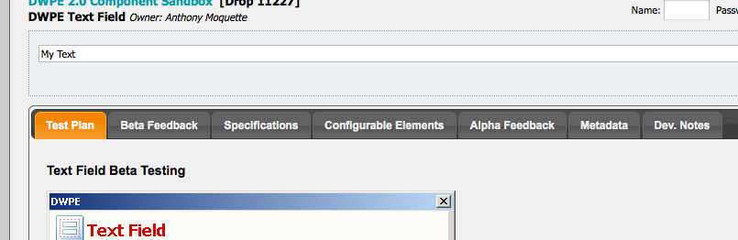
Questions on Component Look & Behavior
The component test page provides resources for understanding how a component should draw
Before logging bugs, visit these tabs:
  Specifications
  Configurable Elements
  Alpha Feedback
Oracle Confidential

Slide 20
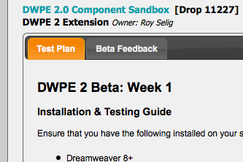
Installation Feedback
If you encounter a problem with installation, record the problem on the beta feedback tab for the DWPE 2 Extension
http://scout.us.oracle.com/DWPE/DWPE_Extension
Oracle Confidential

Slide 21
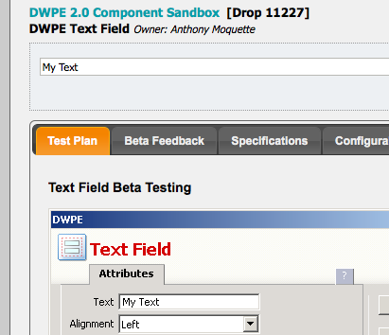
Component Feedback
If you encounter a problem with how a component works, record the problem on the beta feedback tab for that component
Oracle Confidential

Slide 22
DWPE 2.0
Tips & Techniques
Oracle Confidential

Slide 23
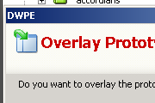
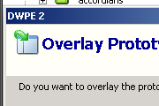

Running DWPE 1 & DWPE 2
You may run DWPE 1 and 2 from within the same instance of Dreamweaver
DWPE 2 is not backward compatible to DWPE 1
The DWPE 1 Insert Bar is labeled BLAF_PLUS
The DWPE 2 Insert Bar is labeled DWPE2
Dialogs from DWPE1 have red title text
Dialogs from DWPE2 have blue title text
Be careful not to use the tools from one framework on top of a site dedicated to the other framework…they won’t work at runtime
Oracle Confidential

Slide 24
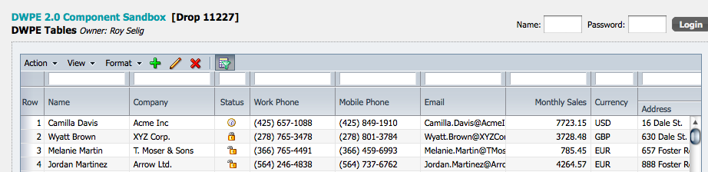
Component Sandbox on Scout
Owner
Name
Preview
Test Plan your guide for how to test this component
Beta Feedback where you enter your test feedback
Specifications read how a component should look and behave
Configurable Elements see a working demo of the DWPE component
Alpha Feedback read earlier feedback to understand decisions
Oracle Confidential

Slide 25


Enabling the Insert Bar
Disabled
Enabled
The Dreamweaver Insert Bar is disabled by default
You must have a valid document opened for editing for it to become enabled
A quick way to get the bar enabled is to press CTRL+N, which prompts you to create a new document
Oracle Confidential

Slide 26
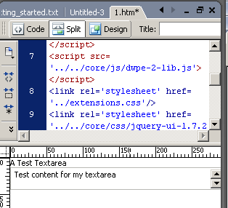
For Testing Try Split Mode
The Dreamweaver editor supports Design Mode, Code Mode and Split Mode
Design mode displays a visual approximation of the page
Code mode presents the HTML for the page
Split shows both at once and is useful for testing components
Oracle Confidential

Slide 27
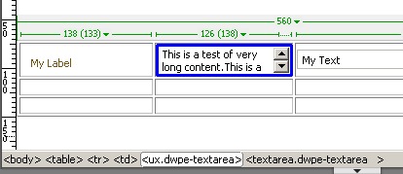
UX Component Tag
Every DWPE 2 component is wrapped in a ux tag
When targeting or removing a component, you must select its encompassing ux tag
A quick way to find the encompassing ux tag is through Dreamweaver’s tag breadcrumb
Oracle Confidential

Slide 28
Component Dialog Re-entry
DWPE 2 does not yet support dialog re-entry
This feature is under development
For now, to make a change in a component that is already present on the page you must delete it and recreate it via the appropriate dialog
Oracle Confidential

Slide 29
DWPE 2.0
Resources
Oracle Confidential

Slide 30
Resources
DWPE 2 Component Sandbox on Scout
  http://scout.us.oracle.com/DWPE
DWPE 2 FAQ
    http://scout.us.oracle.com/DWPE (see FAQ tab)
Lydia Naylor
  General project management questions
  Report weekly hours spent testing
Roy Selig
  Architecture Questions
  Extension Support
  Component support for the ones he or Medha owns
Anthony Moquette
  Component support for the ones he owns
Oracle Confidential

