Slide 1


Oracle | SCM User Experience
Madhuri Kolhatkar, Director, AUL and IS User Experience
Joel Nave, Senior Manager, AUL SCM User Experience

Slide 2
Agenda
Apps Unlimited SCM UX Team
Projects supported in FY09
Next 4 months
Guidance for remainder of FY10

Slide 3
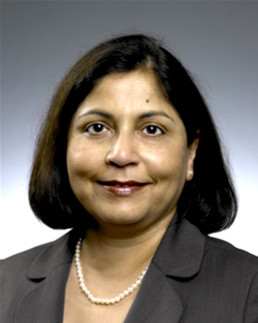


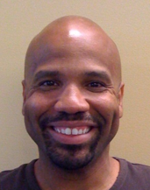

Apps Unlimited SCM UX Team
Madhuri Kolhatkar
Director, AU and IS User Experience
Joel Nave
Senior Manager, AU SCM User Experience
Ralph Garcia
Prototype Developer and Visual Designer
Anthony Moquette
Senior Prototype Developer
Patrick Stapleton
Principal Application Engineer

Slide 4
Projects Supported in FY09
Agile PLM 9.3
Agile Customer Needs Management (CNM)
Oracle Pedigree and Serialization Management (OPSM)

Slide 5
Agile 9.3 - Engagement Overview
UX Activity | Agile 9.3 | OPSM | Agile CNM
User research
Conceptual design
Patterns design
Application design
Visual design
Formative usability testing
Peer design review
Design Iteration
Summative usability testing |  | ?
Development support
Go-to-market package

Slide 6
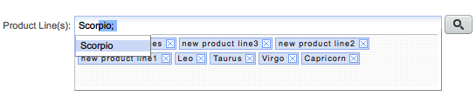

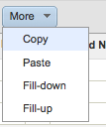
Agile 9.3 UX Highlights
New component and pattern design
Rich data entry controls
  Suggest / Auto-complete
  Drag and Drop
  Actionable QuickViews
Advanced table component
  Inline editing
  Freeze column, filtering, formatting
  Copy / Paste and Fill-up / down
  Drag and Drop
Simplified visual design
Design of new Product Offerings
Product Variant Management
Attribute Change Management
Thumbnails

Slide 7
Highlights Continued - Improved Productivity
Time on Task

Slide 8
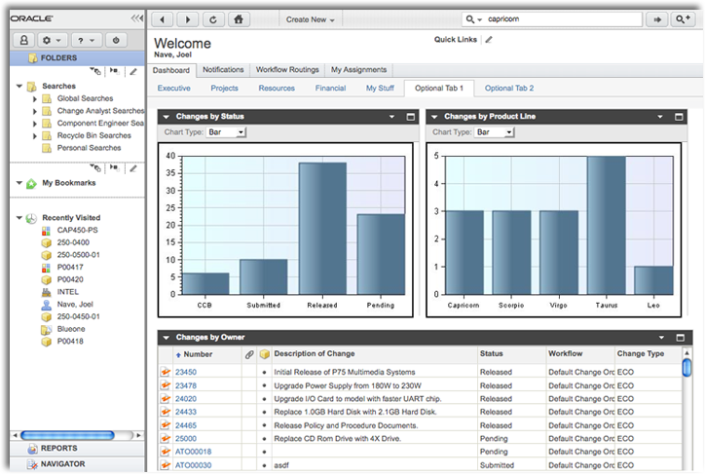
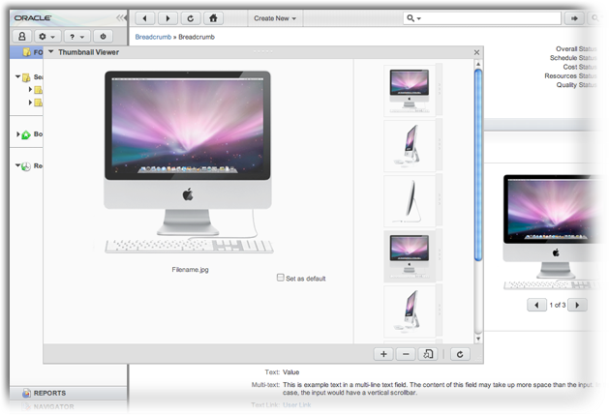
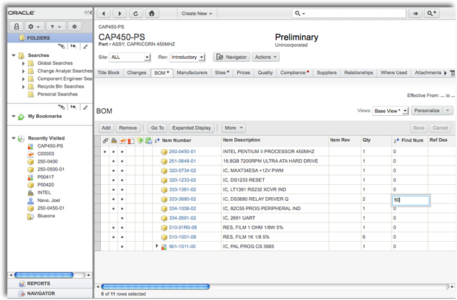
Agile 9.3 Screenshots

Slide 9
OPSM UX Highlights
Change in tech stack and product focus midstream
New application designed using Fusion and OBIEE Dashboard design patterns
Interaction benefits provided by Fusion
  Partial page refresh for single screen workflow
  Smart widgets that avoid server trips
  Drag and drop for intuitive data transfer (e.g. from pack list to package hierarchy)
  Layered dialogs - no window pop-ups

Slide 10
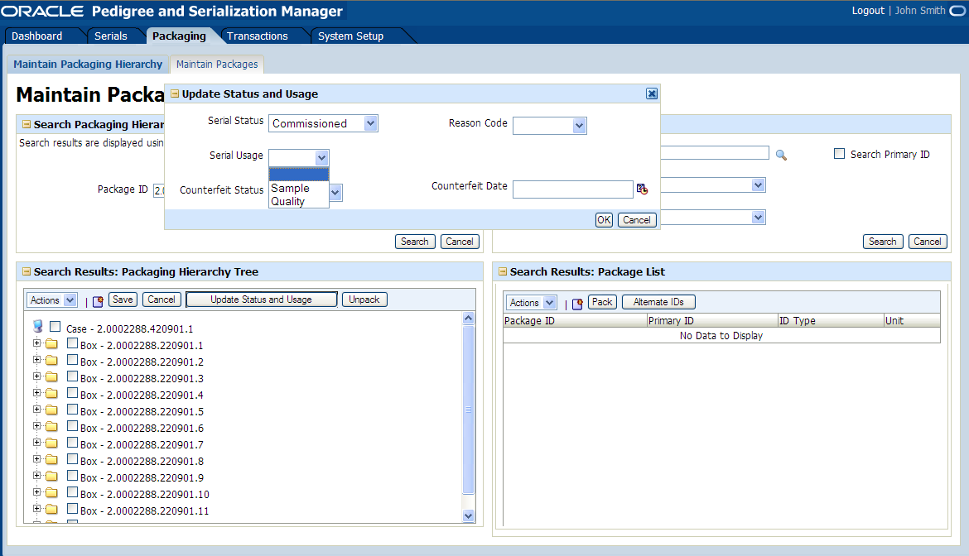
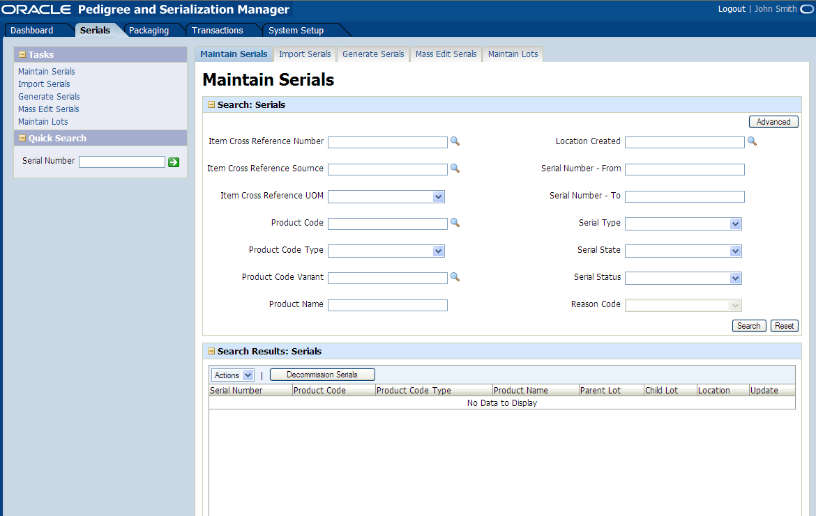
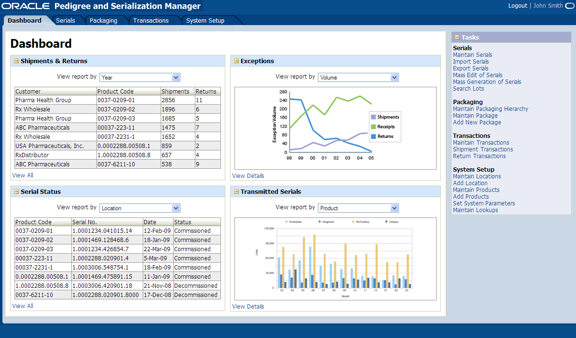
OPSM Screenshots

Slide 11
CNM Overview
New application design using Fusion and OBIEE design patterns
Modified Navigation model and some modified patterns
Initial confusion over use of Flex versus ADF
Uncertainty on visual and interaction design (Web 2.0 versus ADF / Fusion)

Slide 12
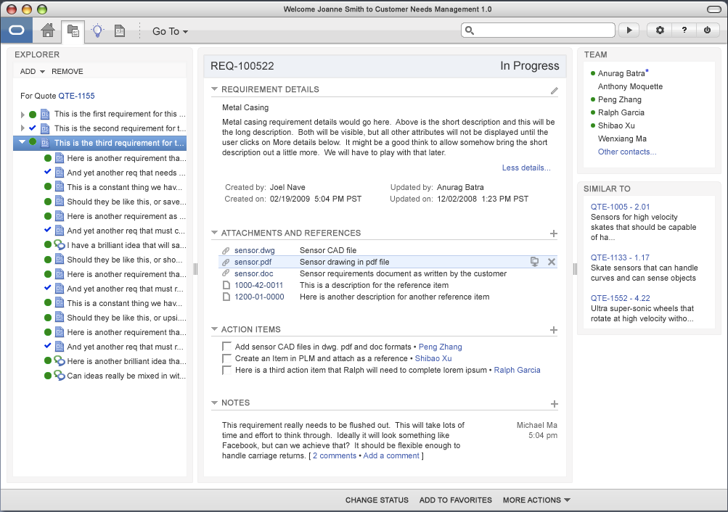
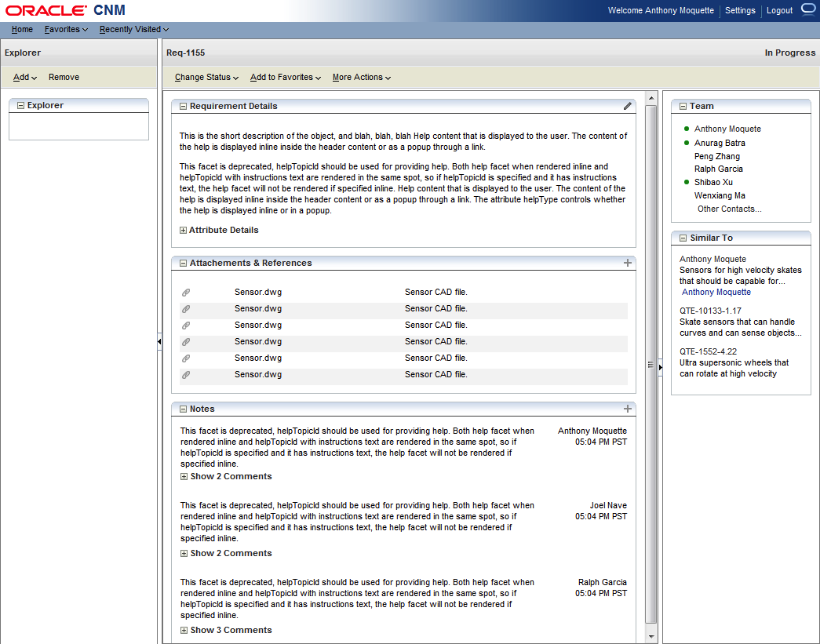
CNM Screenshots

Slide 13
SCM Edge Apps, Agile PLM– Priorities Set
Timelines
Mar 09 | Apr 09 | May 09 | Jun 09 | Jul 09 | Aug 09 | Sep 09 | Oct 09 | Nov 09 | Dec 09
Agile 9.3
Design, bug fix, code drop
Marketing & publish
CNM
Design & prototyping
Design iteration
Agile 9.3.1
Initiation, meetings
Design & prototyping (TBD)
OPSM
Design
Testing
Design iteration

Slide 14
How we can help your teams
Deliver better user experiences
Deliver consistent user experiences through defined patterns (Fusion, OBIEE, etc…)
Educate teams on tools available to them for designing consistent user experiences
Help establish new patterns for new technologies
  Mobile
  Desktop Gadgets
  Flex?

Slide 15
UX Guidance for FY10?
Technologies
  ADF versus Flex
Web 2.0
  Visual design
  Interaction design
  Features (e.g. Tagging)

Slide 16
Priority projects for FY10
SCM iPhone Apps?
Desktop Gadget and widgets EBZ 12.1.2?
Other?

Slide 17
Q & A

Slide 18
Thank You

