Slide 1


Oracle Pedigree and Serialization Manager (OPSM)
System Overview

Slide 2
Agenda
Why do we need OPSM
What does OPSM do?
Roles
Information architecture
Screen architecture
Design highlights
Dashboard
Serials
Packaging
System setup

Slide 3
Why do we need OPSM?
Counterfeit Drugs
  Total of 3.4B prescriptions annually in US with about 300B in revenues
  Counterfeit is in order of 1%, or 34M doses could be counterfeit
  China, N Korea, Mexico are examples of poorly regulated economies
Diversion
  Illicit use, resale
  Inability to track, measure or guess
  Bad for the manufacturers
Returns
  About $2B annually and increasing
  Safety issues increasing product returns
  Counterfeits are being discovered in returns
  Product revenues are increasing for non-blockbuster drugs (more potential for returns or withdrawals)
Legislation
  State by state regulations
  Florida, California
  FDA talk of Federal override

Slide 4
What does OPSM do?
Manage serials & lots
  Generate, Edit, Import, Export
Manage transactions
  Search, Reprocess, Retransmit, Update
Manage packaging
  Create, pack, unpack, edit status
Manage system setup
  Products, locations, serials etc

Slide 5
Roles
Some of the main roles:
System Administrator
  Manage system setup (products, locations, serials etc)
Inventory Control Manager
  Maintain lots
Production Manager
  Manage serials
Warehouse Manager
  Manage packaging
Shipping Manager
  Manage transactions

Slide 6
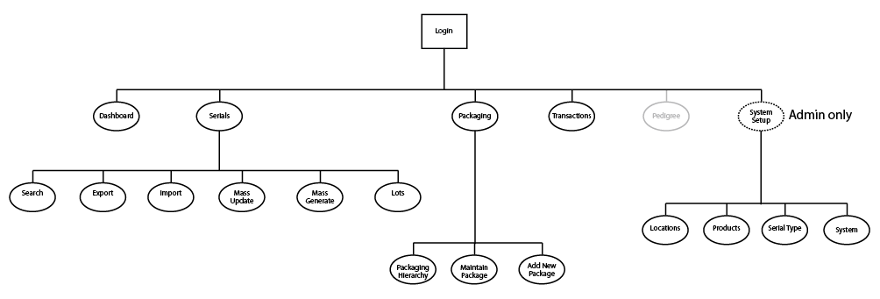
Information Architecture
Five main silos: Dashboard, Serials, Packaging Transactions & System Setup.
Pedigree silo is likely to added at a later date.

Slide 7
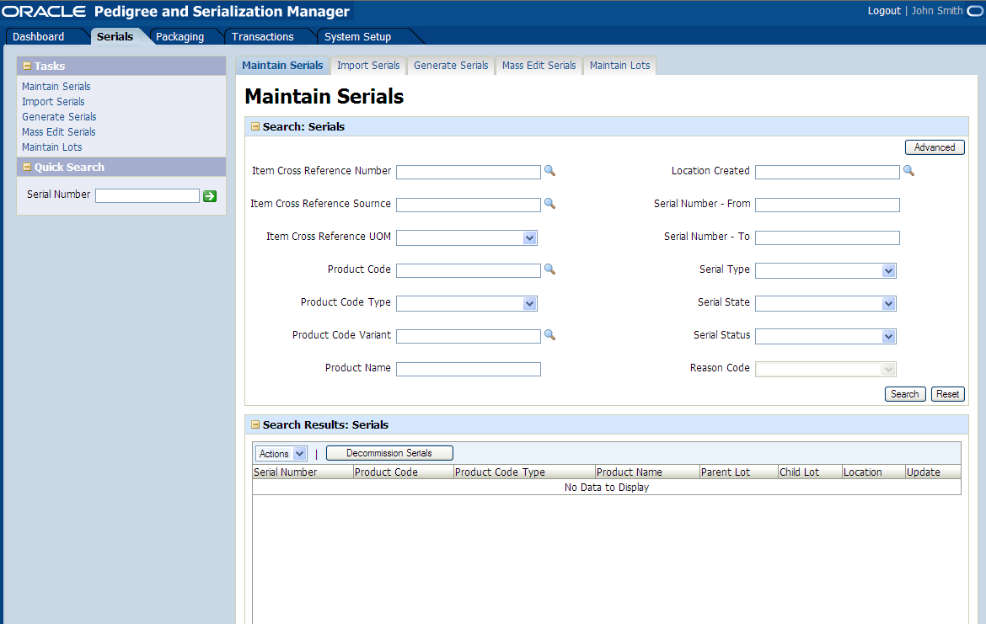
Screen Architecture
Global Area
Login info
High level tabs
Regional Area
Tasks
Quick Launch
Local Area
2nd level tabs
Page Name
Panel Content

Slide 8
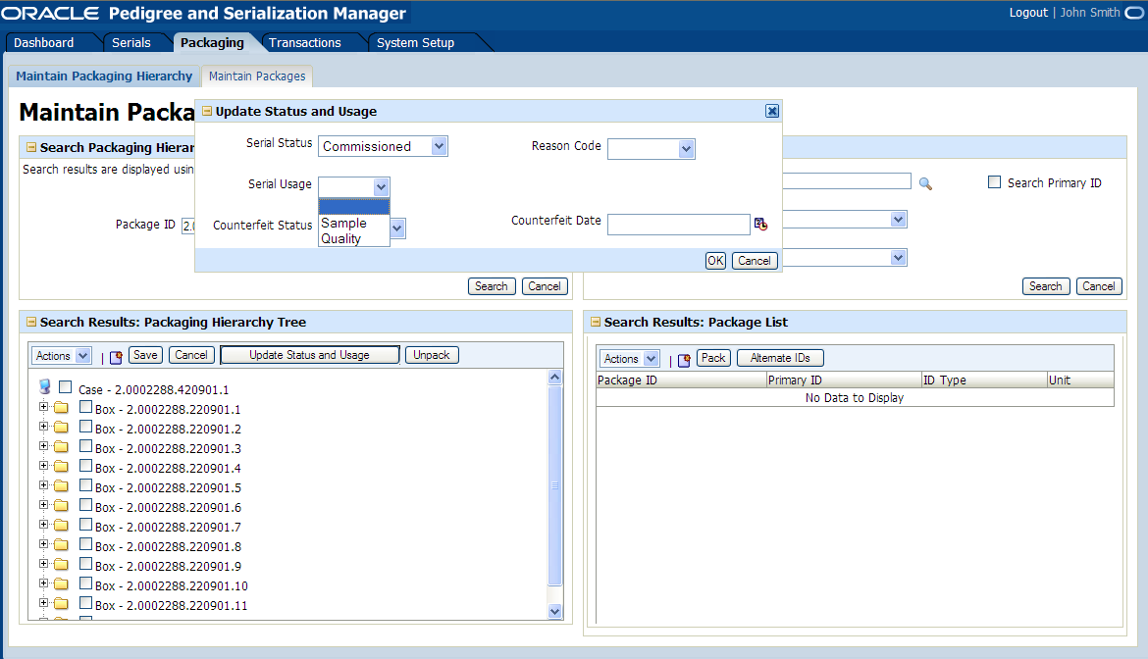
Design highlights
Highlights
Vertical expand & contract
Drag & drop
Partial page refresh
Inline dialogs
Smart widgets
Notes:
My team conducted many hours of user observations at customer sites and in our labs. We partnered with customers and recorded the sessions and heard what was most important to our users
We brought this info back to development and strategy and shared our findings. This impacted the new areas of enhancements as well as focused dev efforts for improving the toolset and the applications

Slide 9
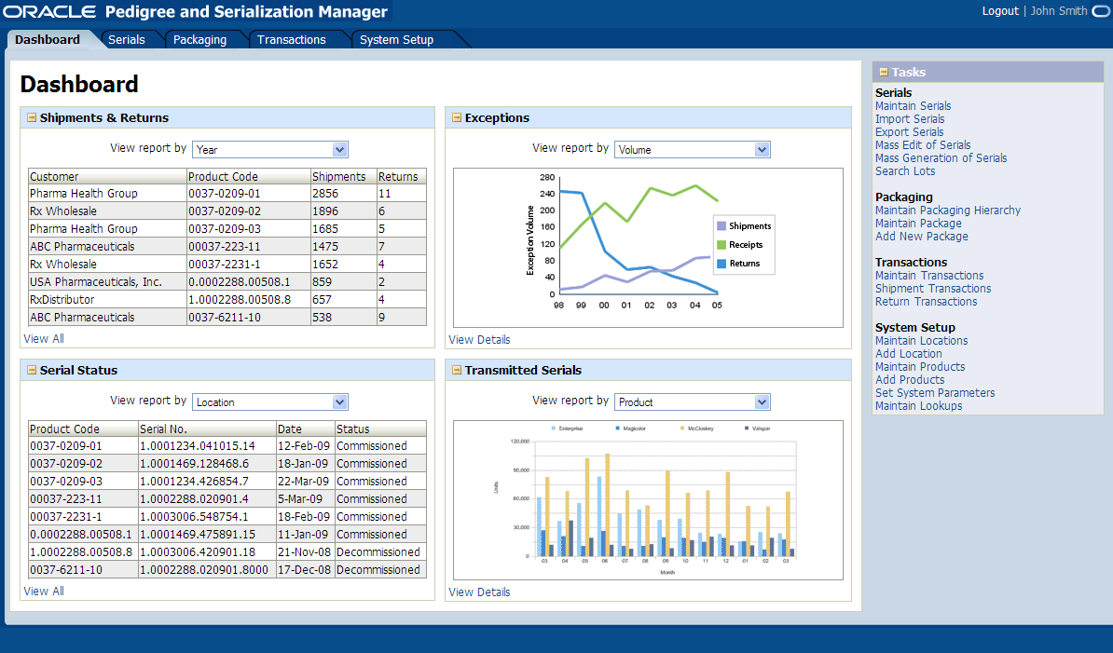
Dashboard
Dashboard developed using OBIEE Dashboard standards website
View All and View Details links take user from Summary Page Layout to Metric Details Layout

Slide 10
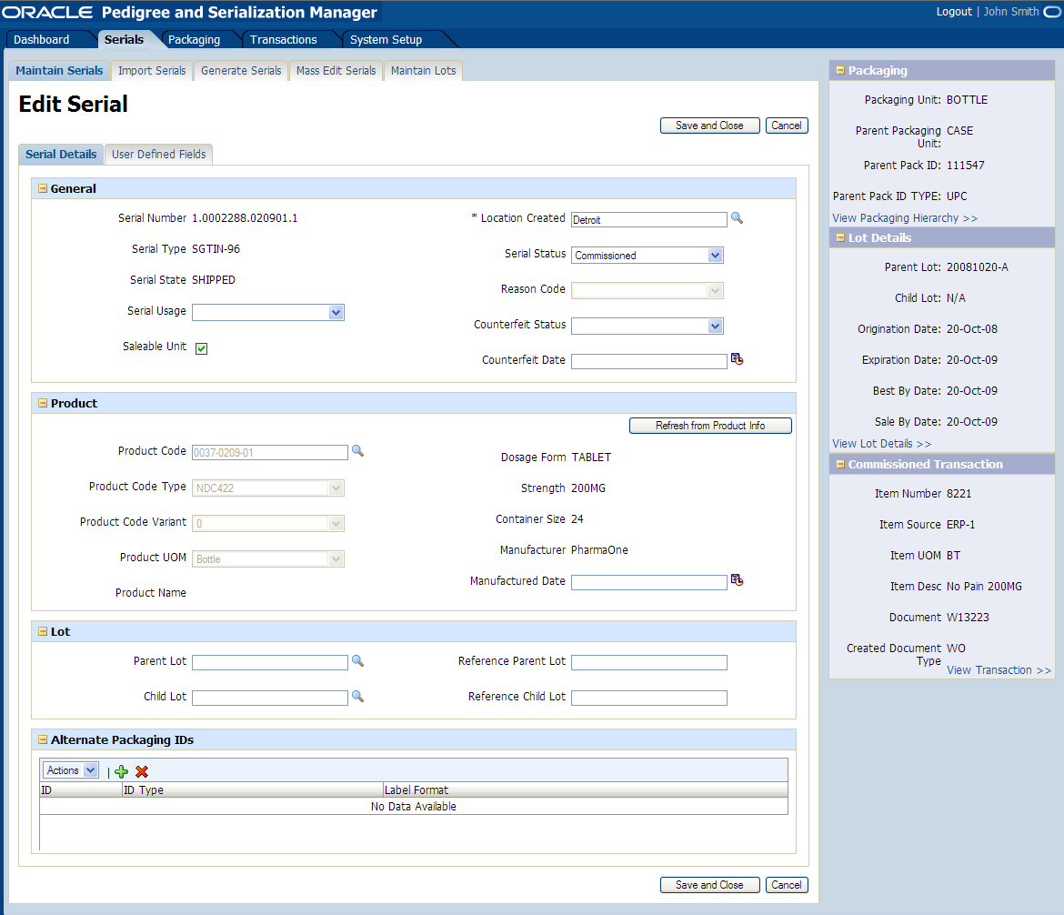
Serials
Tasks: Generation, importing, exporting and editing of serials and lots

Slide 11
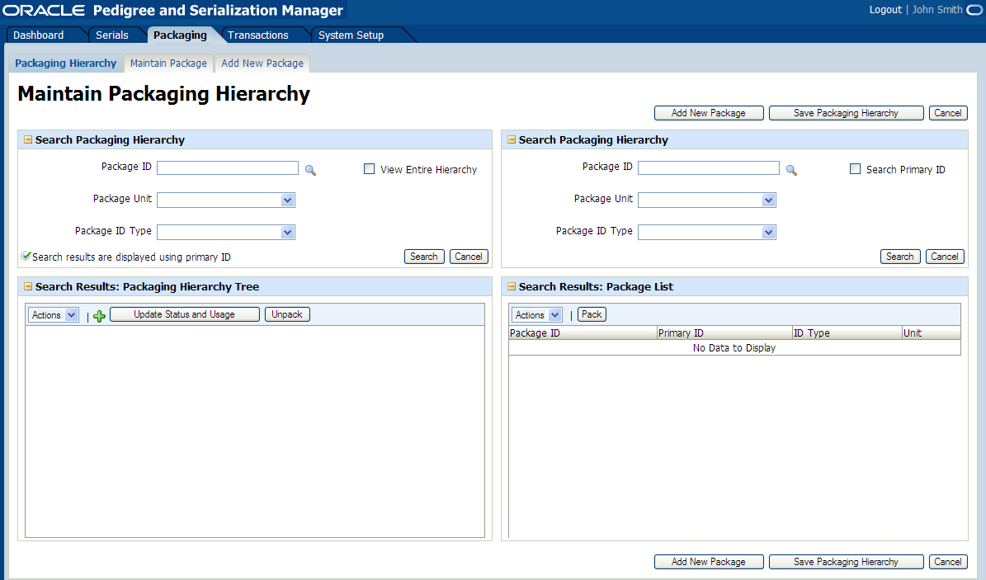
Packaging
Tasks: Create, edit & delete packaging

Slide 12
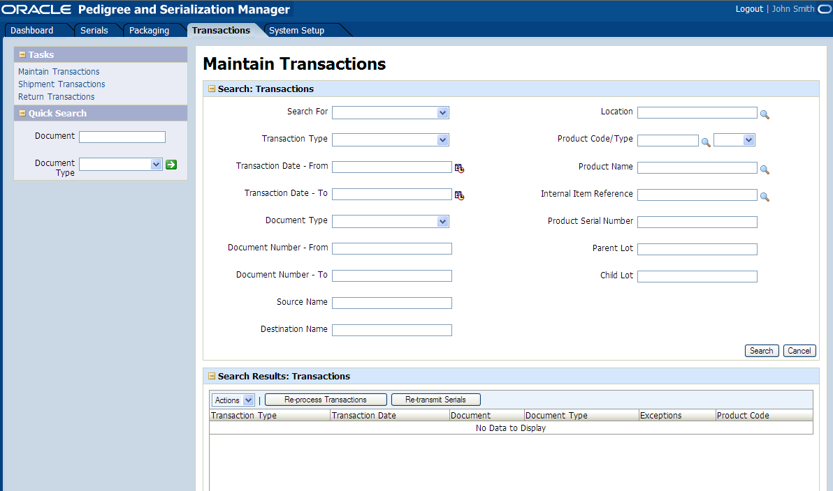
Transactions
Tasks: Search and view transaction details
Details include links to associated serials

Slide 13
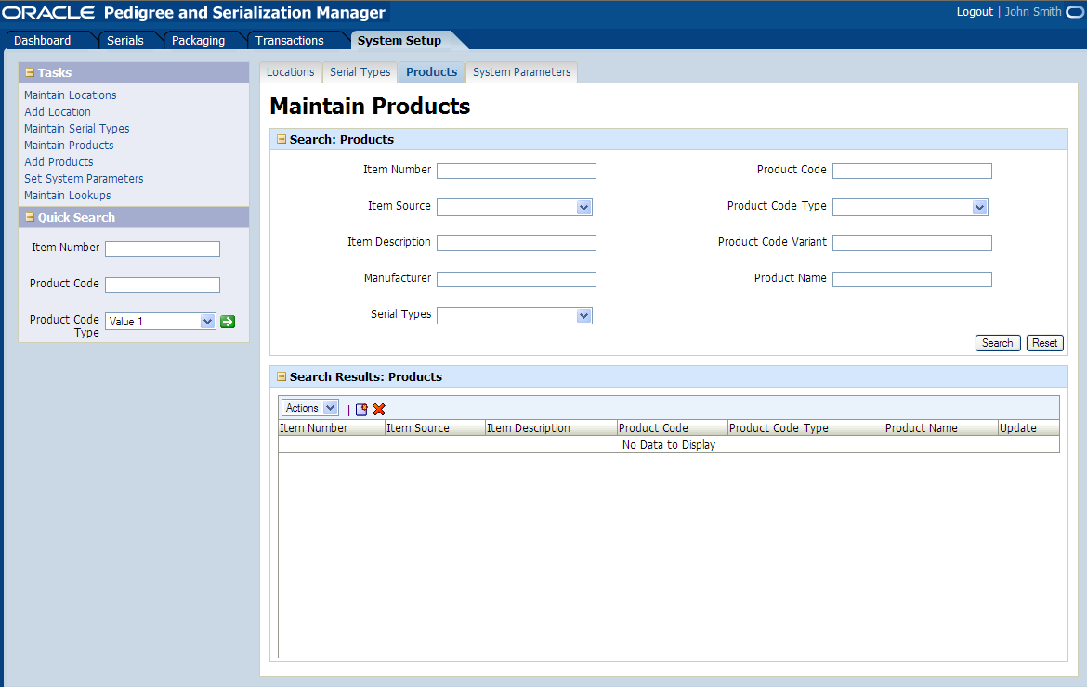
System Setup
Tasks: Manage locations, products, serial types and other preferences

Slide 14
Q+A
Q
&
A

