Slide 1

Applications Unlimited SCM User Experience
User Experience Update – Achievements & Priorities
Madhuri Kolhatkar: Director Applications Unlimited and Industries User Experience
Joel Nave: Senior Manager, Applications Unlimited SCM User Experience
November 7, 2026

Slide 2
Agenda
Overview of App UL SCM UX Team
SCM products supported in FY09
Highlights of FY09
SCM UI Objectives for FY10
Priority Projects for FY10

Slide 3
Applications User Experience – Applications Unlimited Team

Slide 4
Products areas we support
CRM on Demand Social Applications
  Deal Management
  Price Optimization
CRM on Demand for Life Sciences
  Sales on the Go – Tablet based PC
CRM on Demand Mobile Solutions
  MSA Blackberry Storm Edition
Agile PLM - PLM 9.3, 9.3.1 and CNM
PeopleSoft – 8.5 Tools and 9.1 Apps
SCM Edge Applications - ePedigree

Slide 5
Products areas we support (continued)
AU BI Applications
  Dashboards – Design Patterns for BI Dashboards
  iPhone apps
HSGBU product suites
  EHI
  RDC
JDE Edwards EnterpriseOne 9.0 (on need basis)
  Web 2.0 Collaboration
Oracle E-Business Suite 12.1 (on need basis)

Slide 6
Strategic Visions for AU and Industries UX Team
PROTECT Our Customer’s Existing Investment
  Maintain quality of user experience
EXTEND the Value of their Applications
  Continue to support current and NEW products
EVOLVE them to the Next-Generation
  Provide user experience path for Fusion
Our Goals:
Drive UX innovations where it matters most to end users
Deliver on-time and provide a quality user experience
Make UX the competitive advantage in closing sales deals

Slide 7


<Insert Picture Here>
Product Updates
Agile – Joel Nave

Slide 8
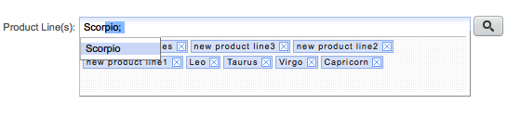

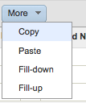
Agile- UX 2008 Highlights
Design of new Product Offerings
Product Variant Management
Attribute Change Management
Thumbnails
Redesign of 5 core PLM Products
New rich data entry controls
  Suggest / Auto-complete
  Drag and Drop
  Reduced errors (live feedback)
Advanced table component
  Inline editing
  Freeze column, filtering, formatting
  Copy / Paste and Fill-up / down
  Drag and Drop
New Look and Feel

Slide 9
Agile- UX 2008 Highlights
Design of new Agile PLM product offerings
  Attribute Change Management
  Variant Management
  Thumbnails
Re-design of 5 core Agile PLM applications
  New rich data entry controls
    Suggest / Auto-Complete
    Drag and Drop
    Reduce errors (live feedback)
  New rich table component
    Inline editing
    Freeze column, column formatting, and row filtering
    Copy / Paste and Fill-up / down
    Drag and Drop
  New Visual Design

Slide 10
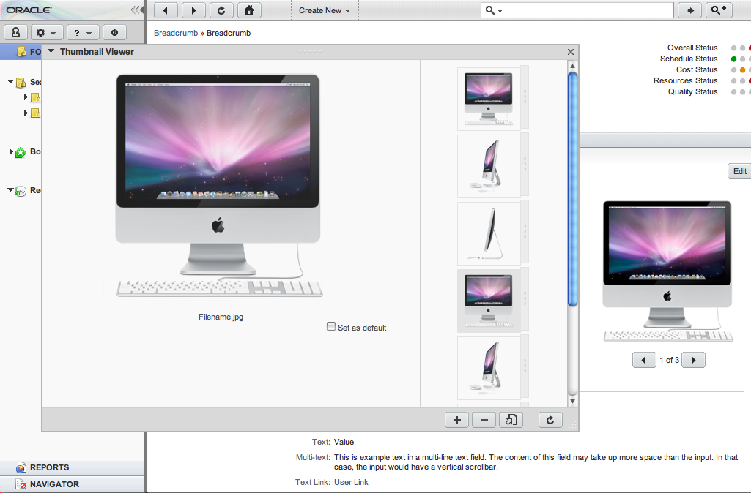
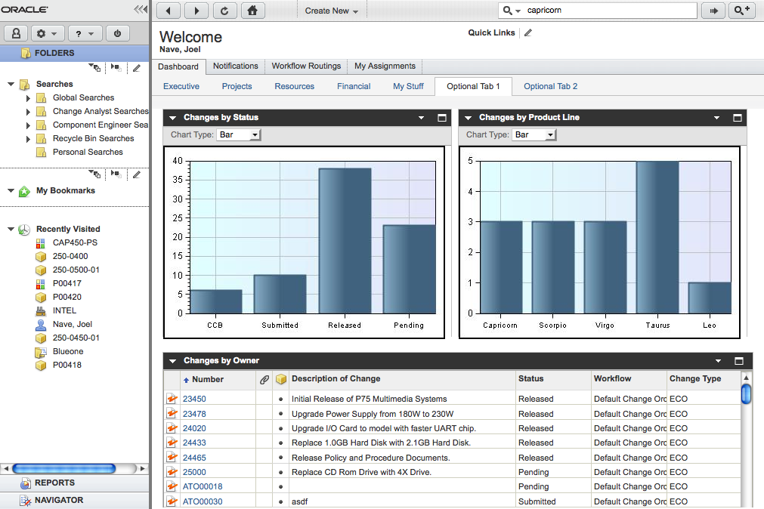
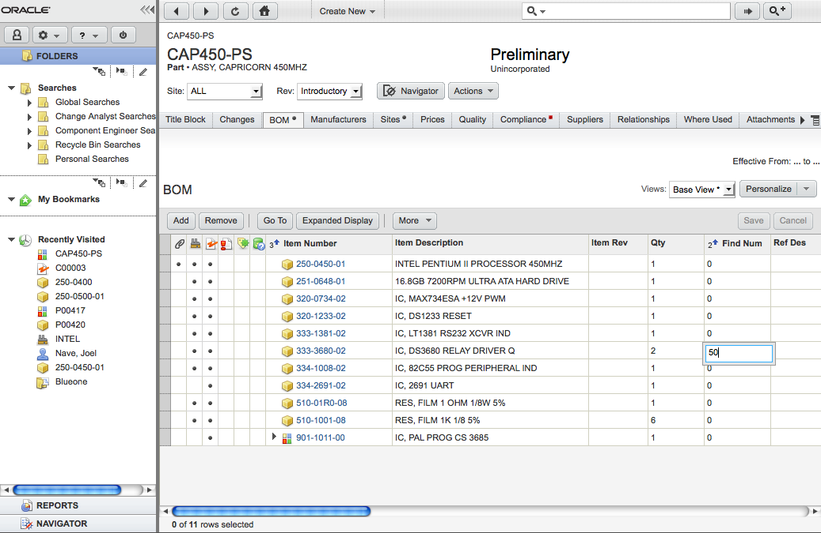
Agile PLM Screenshots

Slide 11
Agile 2009 Priorities
Complete Agile PLM 9.3
  Dev support on design and implementation issues
  Market new User Experience
Design Customer Needs Management
  Navigation model
  Object Detail pages
  Home and Search pages
  Visual Design
Design key Agile PLM 9.3.1 Features
  Bill of Materials (BOM) Grading
  Matrix BOM
  Cost Management Price Models
  Document Publishing

