Slide 1


Oracle | Agile PLM 9.3 User Experience
Joel Nave, Shankar Muthan

Slide 2
Agenda
Background
9.3 Objectives
9.3 Results
9.3 Demonstration
Summary

Slide 3
Why Invest in User Experience
Exceptional user experiences increase customer satisfaction, leading to trust and loyalty, resulting in increased revenue and cost savings.
User productivity hit in transition from Windows to Web
The bar has been raised (Google, Facebook…)
Investing in multiple clients was stunting growth

Slide 4
BlueOne Background
Transition from Windows client to Web / Java Clients
  Significant user productivity hit
  Investment in multiple clients stunting growth
The bar had been raised
  Users expecting experience of Gmail and other consumer apps
  Losing sales and sales cycles getting extended due to better experiences from smaller competitors
Web Client was out-dated and did not follow any standards

Slide 5
9.3 User Experience Objectives
Increase user productivity
Create consistency across Agile products
Simplify visual design
Modernize code - xHTML 1.0 compliant

Slide 6
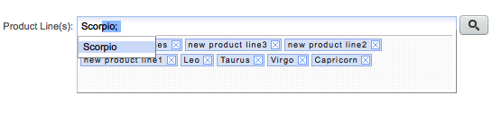

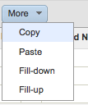
9.3 Examples
New data entry controls
  Auto-complete
  Drag and Drop
  Reduced errors (live feedback)
Advanced table component
  Inline editing
  Freeze column, filtering, formatting
  Fill-up / down
  Dynamic pagination
Adding to tables
  Auto-complete
  Drag and Drop
  Copy / Paste

Slide 7
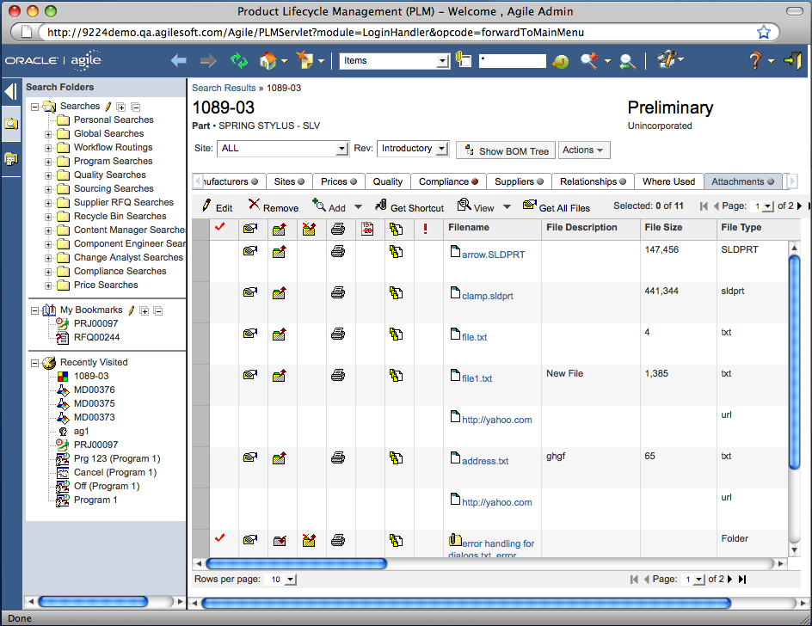
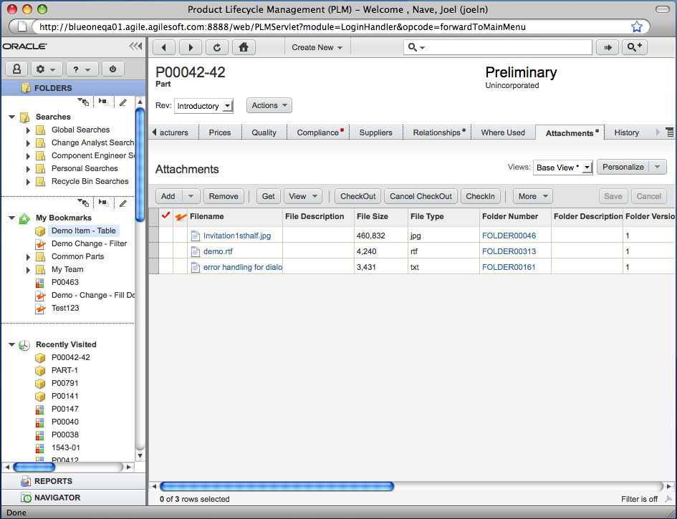
Visual Design Example

Slide 8
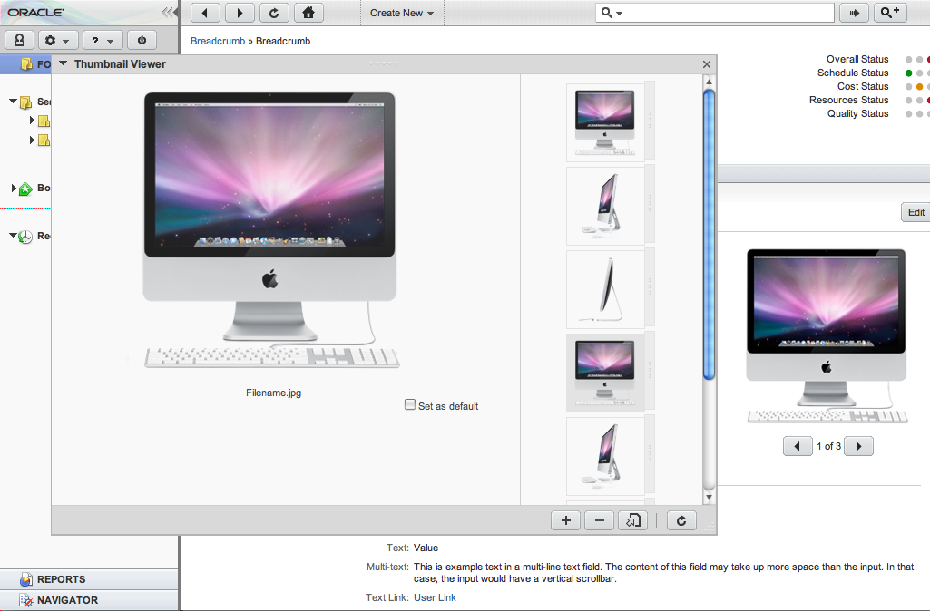
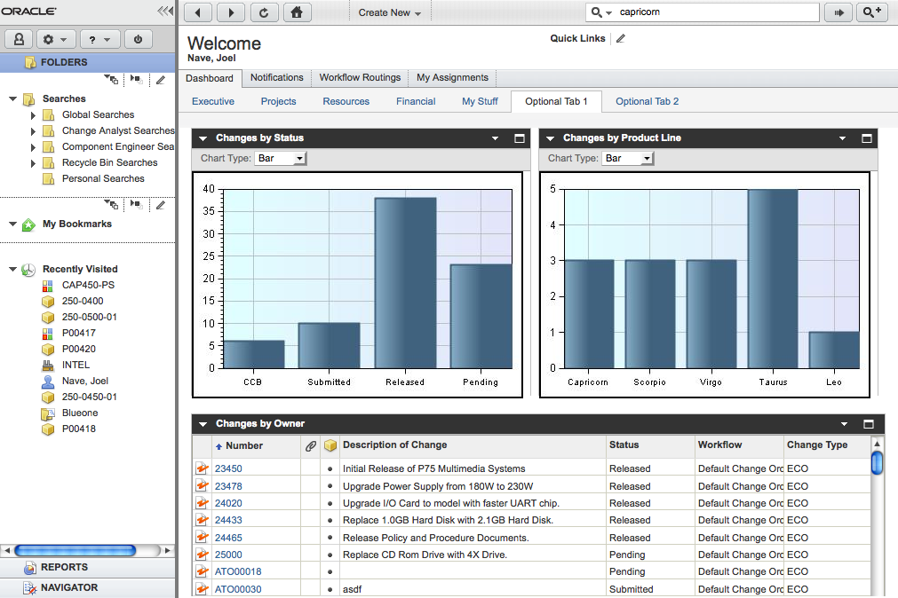
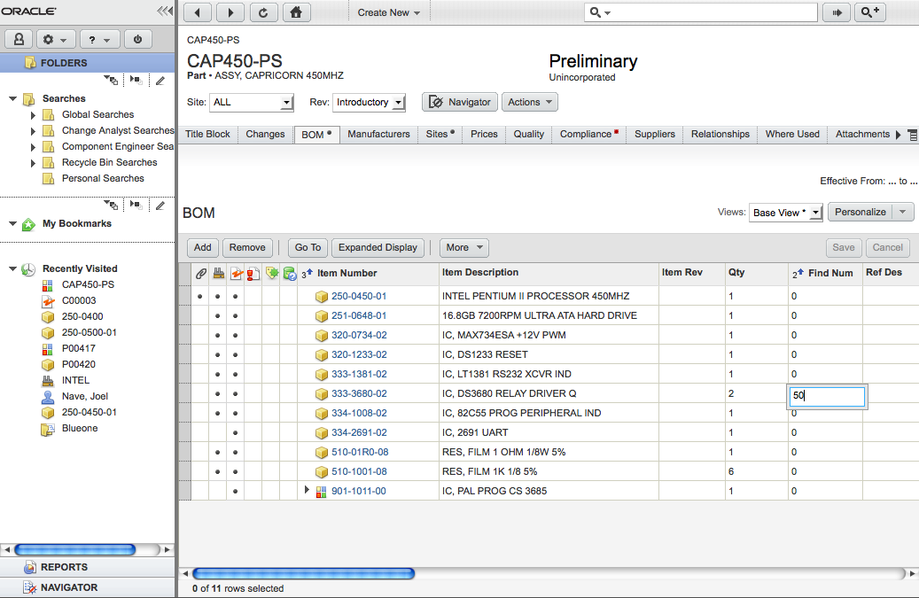
Agile PLM Screenshots

Slide 9
Performance Challenge
Agile 9.2.2.6
Agile 9.3
Server
Processing
Server
Processing
25% faster responses, but more calls
5% more throughput overall
Network
Latency
30% less data transferred
Network
Latency
HTML
Rendering
Faster
HTML
Rendering
JavaScript
Processing
Slower
JavaScript
Processing
Bad News - Web 2.0 client JavaScript slower, in particular table loading and pagination
Good News - Server processing and HTML rendering is faster, bandwidth is less and user productivity improved. Table performance to be addressed in 9.3.0.1

Slide 10
Results from Flextronics Productivity Testing
Time on Task

Slide 11
9.3 Demo

Slide 12
New Feature / Product Design
Product Variant Management
Attribute Change Management
Thumbnails

Slide 13
9.3 UX Objectives Revisited
Increase user productivity
  Dramatic improvement in user productivity due to new controls, components and productivity features.
Create consistency across Agile products
  5 core Agile PLM products have been upgraded with new User Interface
Simplify visual design
  Icon usage has been cut in half and variation in fonts, colors and other visual elements have been dramatically reduced
Modernize code - xHTML 1.0 compliant
  Agile 9.3 declares and follows the xHTML 1.0 doc type. This has helped to improve throughput by 30%

Slide 14
Customer / User Involvement
User and Stakeholder Interviews
  Interviews with end-users to understand their usage of Agile
  Interviews with Agile stakeholders
Customer Design Program
  Small set of customers
  Ping on consistent basis
  Very informal… questions, surveys, wire frame or prototype reviews, etc…
Usability Testing
  Formative usability tests
  Focused on new controls, components and design patterns
  Done on production prior to final iteration (we used Scrum)

Slide 15
Customer / User Involvement
Customer Program 1
  Customer databases upgraded
  End-users executed their workflows live system
  Sessions were observed via web conference by PM / UX
Customer Program 2
  Customer databases upgraded
  End-users testing over a period of a month
  UX and PM onsite occasionally with end users
Flextronics Performance / Productivity Evaluation
  Flextronics database upgraded
  End-users ran through their workflows on 9.2.2.5 and 9.3
  PM / UX measured time on task

Slide 16
9.3 Launch
Coordinated by:
  Gayle Hayes - Senior Director, Product Strategy
  Sarvesh Jagannivas - SCM Product Mktg VP
Will begin working on collateral in May
Will launch in mid June

Slide 17
Current Priorities
Complete Agile PLM 9.3
  Production of 9.3 Introduction Tours
  Market new User Experience
Design Customer Needs Management
  Navigation model
  Object Detail pages
  Home and Search pages
  Visual Design
Design key Agile PLM 9.3.1 Features
  Bill of Materials (BOM) Grading
  Matrix BOM
  Cost Management Price Models
  Document Publishing
Pending Meeting with Rick Jewell and Jon Chorley

Slide 18
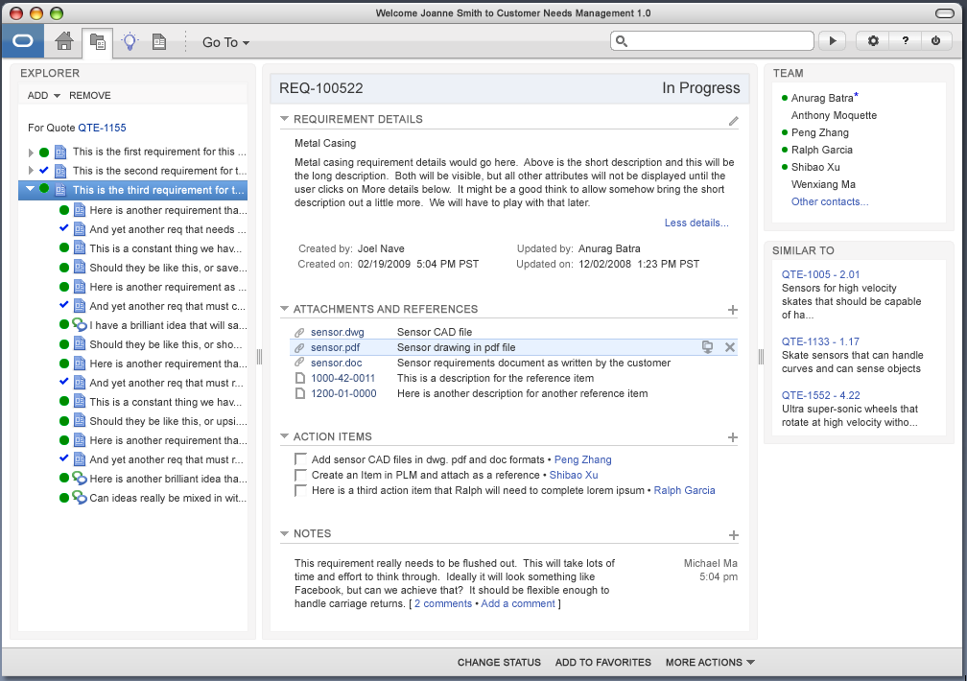
Original CNM Concept

