Slide 1
Vendavo Sales Advisor (VSA) Prototype
January 27, 2014

Slide 3
Feedback Session
Sample screens
Would it add value to you
Critique, suggest alternatives or provide new ideas

Slide 4
Product Overview
Mobile application for Sales Professionals
You can…
Look-up pricing for a customer or prospect
Receive customer specific recommendations and alerts to grow your accounts and penetrate prospects
Prepare for customer discussions

Slide 5
Look-up Pricing
Intelligence engine provides prices to win
New prices for a customer
New prices for a prospect
View current pricing

Slide 6
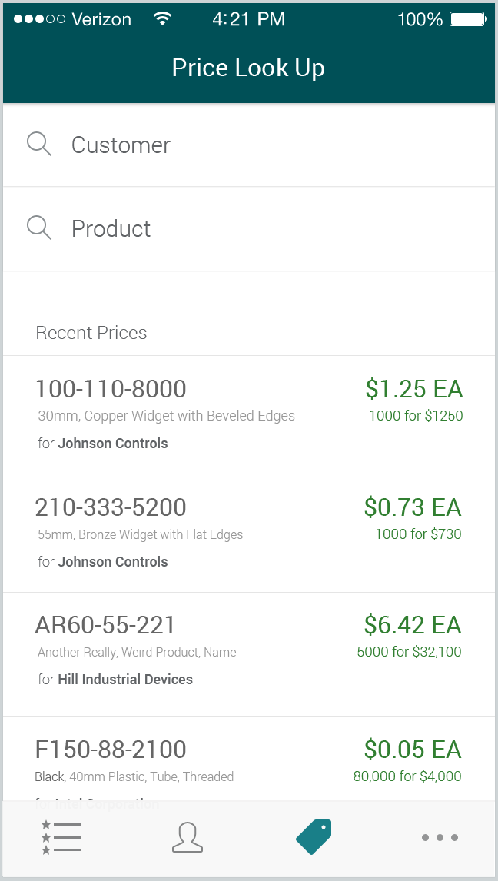
Additional Slides

Slide 7
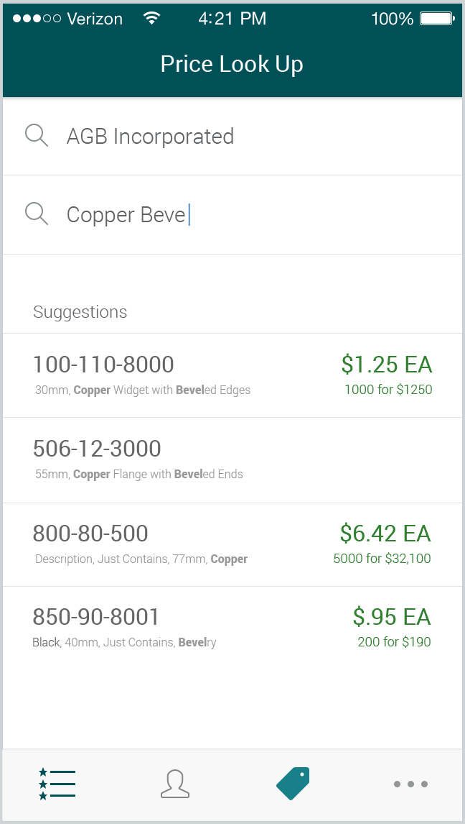

Slide 8
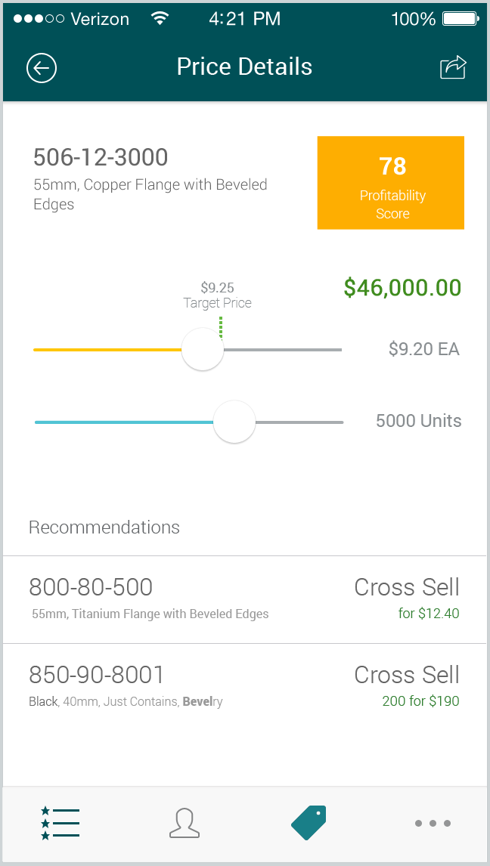
Notes:
Do you find this feature of value to you?
What kind of information would you want to know when you look up a price? (Date, quantity, location, segmentation)

Slide 9
Review Recommendations and Alerts
Intelligence engine analyzes transaction history
Provides recommendations and alerts
grow accounts
penetrate prospects
You decide what to follow-up on

Slide 10
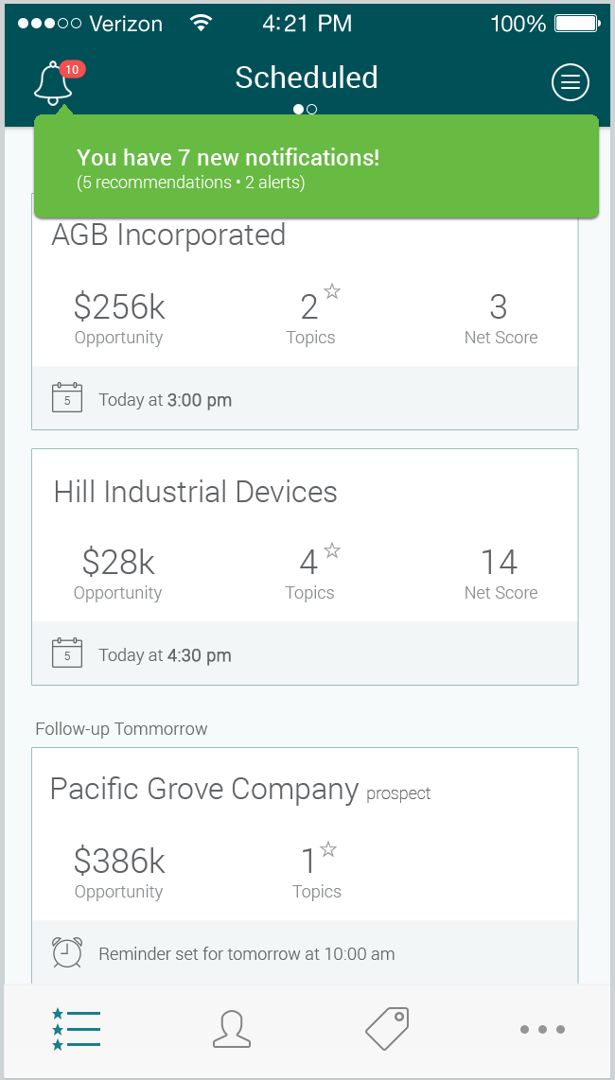

Slide 11
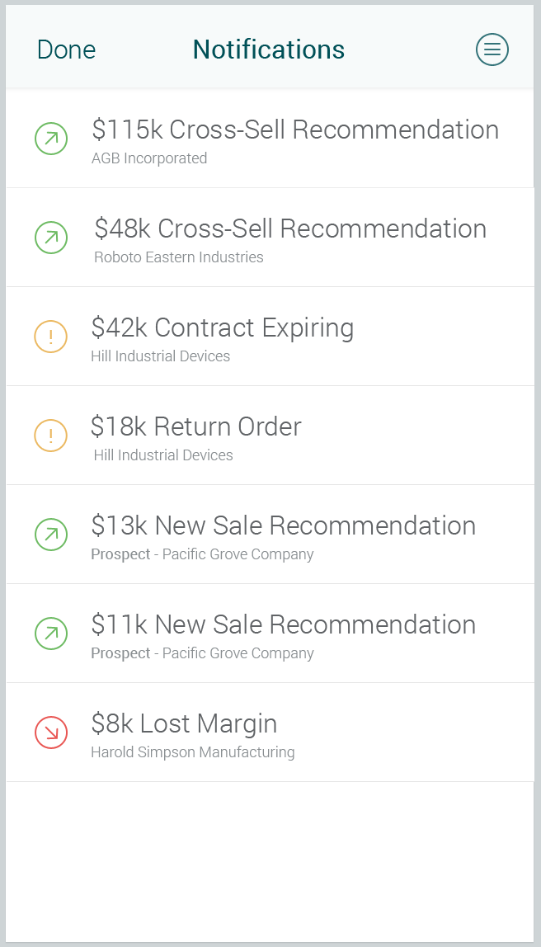
Additional Slides

Slide 12
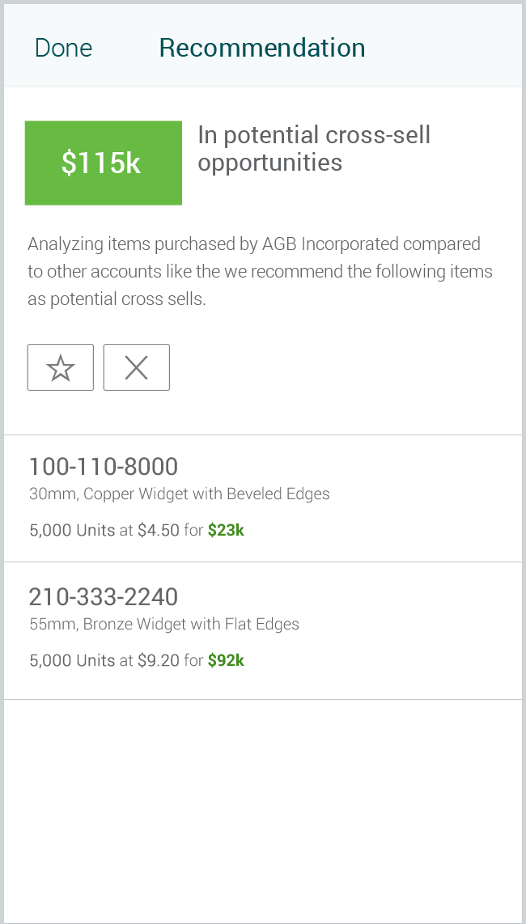
Additional Slides

Slide 13
Recommendations and Alerts
Cross sell recommendations
New sales recommendations
Hyper sales growth alerts
Hyper sales decline alerts
Defecting customer alerts
Expiring contract alerts
Large return alerts
Defection alerts
Low / negative margin alerts
Sub-optimal pricing

Slide 14
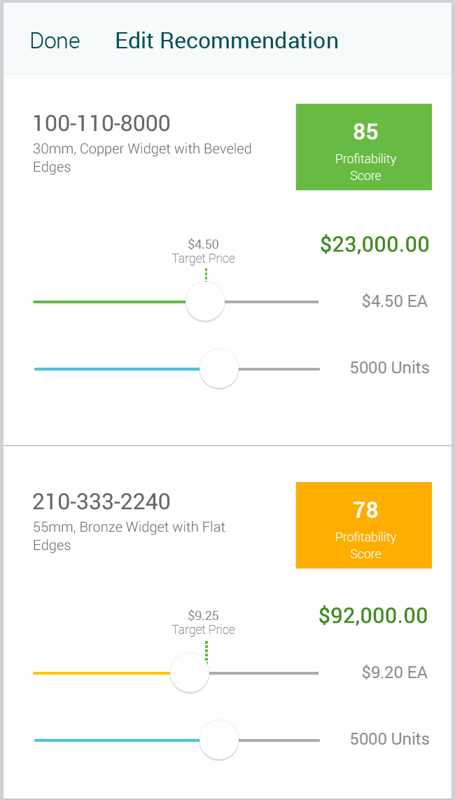
Additional Slides

Slide 15
Prepare for a Customer Call / Visit
Add recommendations and alerts as topics for customer calls
Schedule topics for follow-up
Review topics and customer health

Slide 16
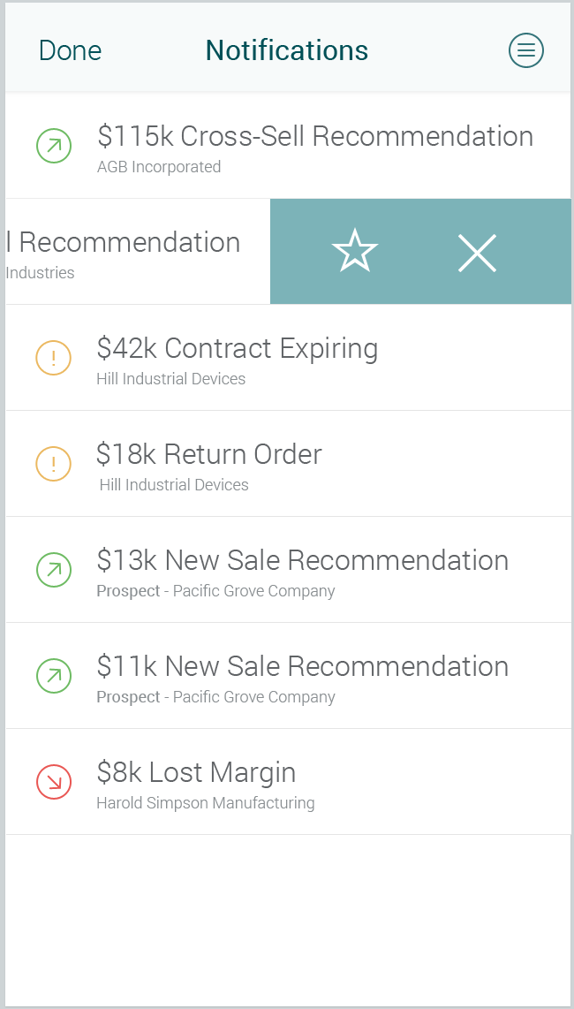
Additional Slides
Notes:
Is this type of information valuable to you?
Do you want to use an application that provides you with these alerts, recommendations and lost opportunity notifications?
Are there any in particular that are more valuable or less valuable than the others?
Target/contract price look up
Defecting customers
Hyper growth customers
Cross-sell opportunities
Up-sell opportunities
Expiring contracts
Large returns
Low/negative margins
Sales decline
Low pricing

Slide 17
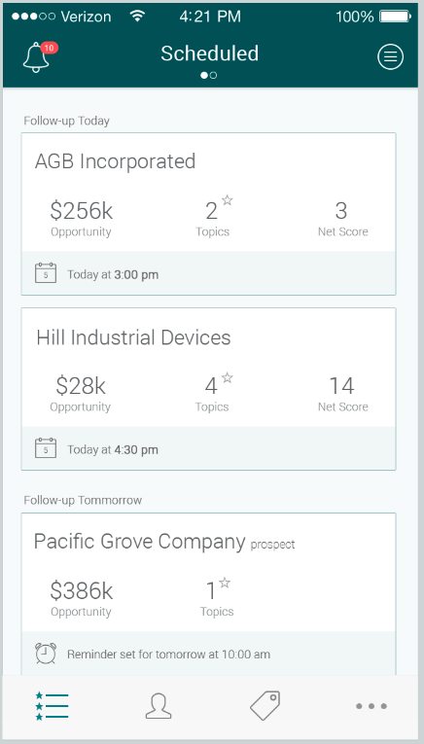

Slide 18
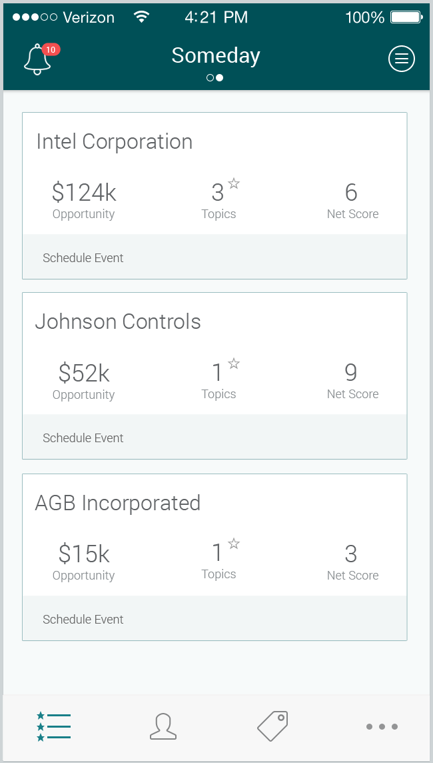
Additional Slides

Slide 19
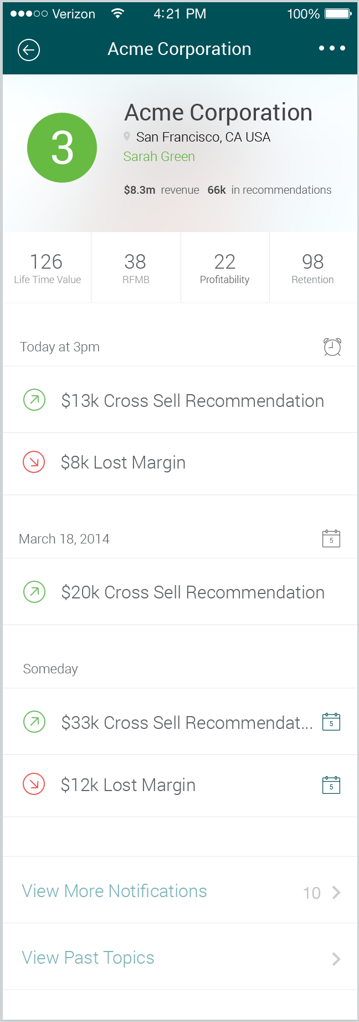
Notes:
Would you use this application to schedule events? Would this help you?

Slide 20
Notes:
Can you tell us what CLV, RFMB, Profitability, and Retention scores mean to you?
Would you look at this before visiting or calling an account?

Slide 21
Customer Health Metrics
Net Customer Score
Customer Lifetime Value
RFMB Score
Recency, Frequency, Monetary Value and Breadth
Profitability Score
Retention Score

Slide 22
Look-up Account / Prospect
Account Look-Up tab
View account details

Slide 23
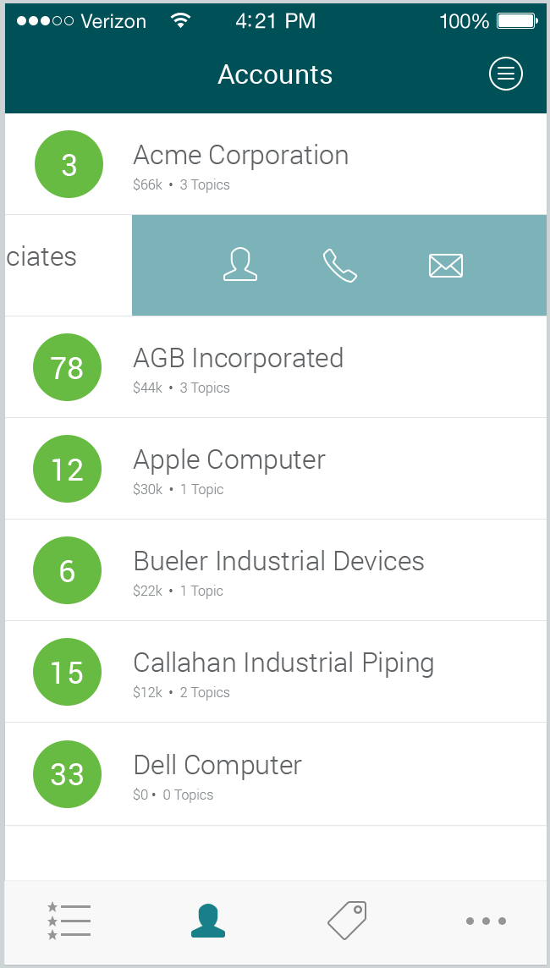

Slide 25
Follow-up Questions
Would you want this product?
What that we showed you would you not want?
What that we did not show you would you want?
Would you like a comparison of your sales performance compared to other sales reps in your company?
Would you like a comparison of your accounts to other accounts being sold-to by your company?
Would you want this product to send you email notifications?
Do you use a CRM solution today? How important is it to you?

Slide 27
Additional Slides

