Slide 1
How WPF lost and HTML won - the new wave of cross-platform, hybrid Desktop apps
Ian Pender

Slide 2

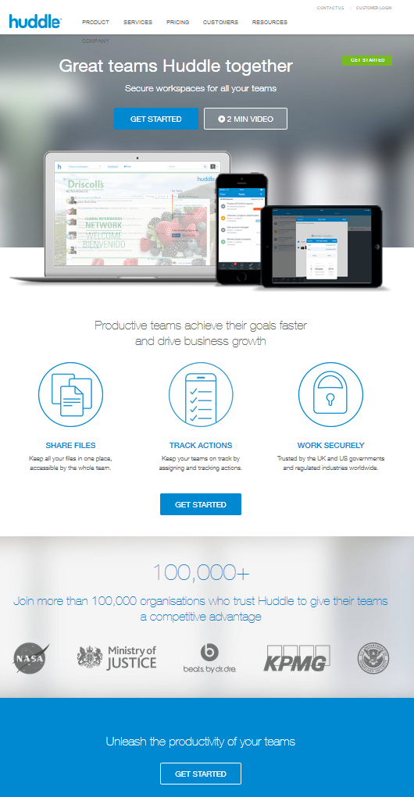


Who am I?
Ian Pender
is an Architect for Huddle’s Desktop Applications and Push Messaging Infrastructure. He’s been at Huddle for 2 ½ years.
Before joining Huddle Ian was an IT consultant designing and developing software solutions and architectures with over 15 years of commercial experience in insurance, investment banking, retail banking, engineering, government and telecoms industries.
ian.pender@huddle.com ian_pender@hotmail.com
huddle
ian pender
@penderi

Slide 3




Who are ?
Established in 2006, with offices in London and San Francisco, Huddle is the leader in cloud collaboration and content management for the enterprise.

Slide 4

There will be code ….
Never work with children or animals
Never Live Code Whilst Speaking at a Conference (unless you are )
https://github.com/penderi/ndc2014London

Slide 5
Agenda
Intro
Create Windows Container
Create Common.UI assets
1
2
3
4
5
6
Initialise PC dev env
Create OSX Container
Add Common Commands & Events
7
Cross-Platform UI

Slide 6
Agenda - checkpoints
Html5 hosted in CEF
Cross-Platform, html5 web page hosted in memory
1
2
3
4
5
6
VS Solution
Html in WebKit / CEF
7
cross-platform Html5 Web app hosted in-memory, and integrated with c# application

Slide 7
How WPF lost and HTML won - the new wave of cross-platform, hybrid Desktop apps
Intro
1

Slide 8
WPF HTML
Pros
Powerful binding/templating
Amazing animation
Vector driven high DPI support
Cons
WPF has doubtful future
Uncommon bespoke skillset
Few LOB applications
Pros
Ubiquitous design/dev skills
JS performance near native
Html5/CCS3 animation
Cons
We need a little plumbing for binding/templating
?
This is hopefully not the controversial part…. (if it is lets discuss afterwards!)

Slide 9
Cross-Platform Html on Desktop
WPF - Windows only
Spring/gwt/xwt – uneven look and feel
Xamarin Forms – new and reliant on custom / duplciated Designs
Can the UI be written once?
Native calls via UI controls
MVVM libraries / coding style ensure abstraction
There’s a multitude of JS binding/SPA frameworks you may have heard of
Yes!
Aim: To use html5 as a cross-platform Desktop UI

Slide 10
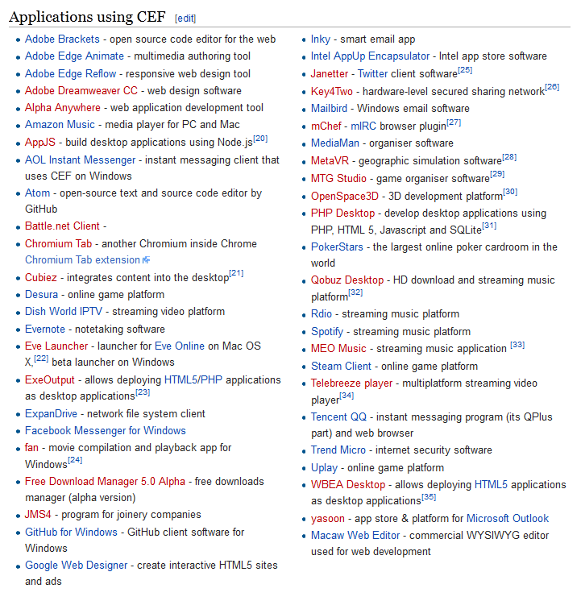






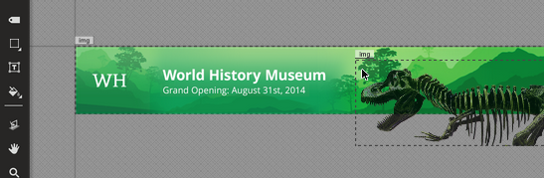
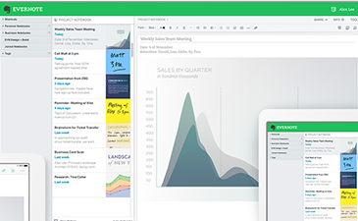
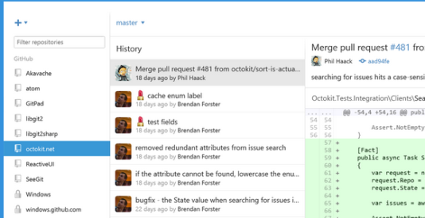
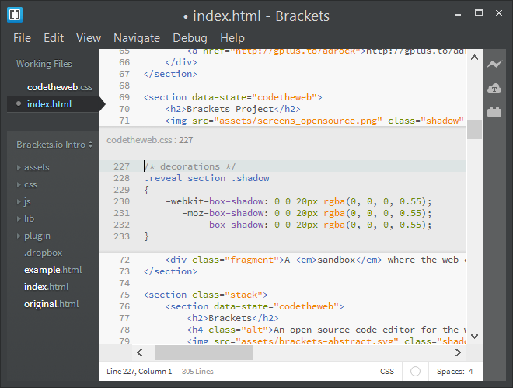
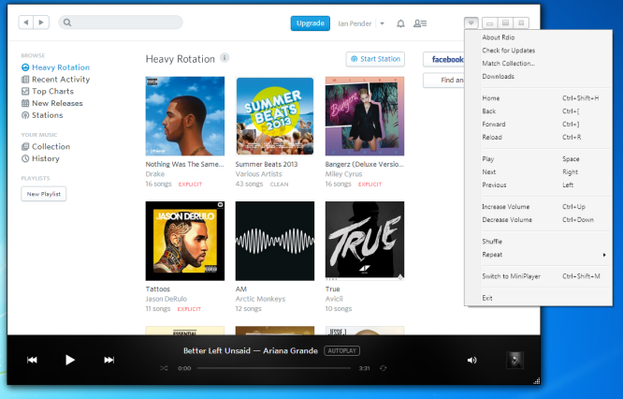
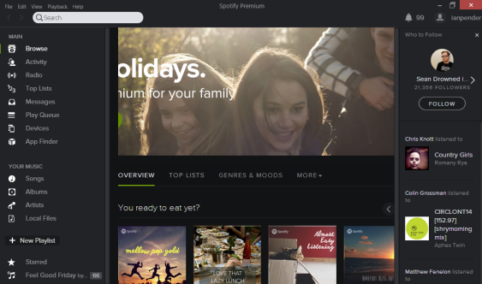
‘Hybrid’ Desktop Applications
It’s quite the fashion….

Slide 11
Design Concerns for a Desktop app
Cross platform (>90% code-once)
Templating / Data-binding
De-coupled Commands (out) / Events (incoming)
Name here
Explanation here
Explanation here
Explanation here

Slide 12
Proposed Design – Windows Container
Win7 will be the new XP. 5 – 10 Year life
Win 7 shipped with IE8
IE 8 != html5 / CSS3
Name here
Explanation here
Explanation here
Explanation here

Slide 13

Proposed Design – cefSharp
Chromium - open-source browser project
Chromium Embedded Framework (CEF) - a simple framework for embedding Chromium-based browsers in other applications.
cefSharp -.NET CLR bindings for CEF
Name here
Explanation here
Explanation here
Explanation here
www.chromium.org/Home
http://code.google.com/p/chromiumembedded/
https://github.com/cefsharp/CefSharp

Slide 14
Proposed Design - Containers
MyApp.Win
CEF
MyApp.OSX
WebKit

Slide 15
Proposed Design – Access Html5 sites
MyApp.Win
CEF
Internet
Location : Uri
MyApp.OSX
Uri
WebKit
Internet

Slide 16
Proposed Design – Local HTML
MyApp.Win
CEF
Internet
SchemeHandler ISchemeHandler
string
Location : Uri
Html : string
MyApp.OSX
Uri
WebKit
ProtocolHandler : NSUrlProtocol
Internet

Slide 17
Proposed Design – Local Resources
MyApp.Win
CEF
Internet
SchemeHandler ISchemeHandler
scheme://uri
string
Stream << string, “text/css”
Location : Uri
Html : string
Stream << string, “text/js”
MyApp.OSX
Stream << byte[], “image/jpg”
Uri
WebKit
scheme://uri
ProtocolHandler : NSUrlProtocol
Internet

Slide 18
Proposed Design – local example
MyApp.Win
CEF
Internet
SchemeHandler ISchemeHandler
<html><head> <link rel=“stylesheet” type=“text/css”
href=“myscheme://local.css”
> </head><body> <h1>GO!</h1> </body></html>
myscheme://local.css
{color:red;}, “text/css”
Location : Uri
Stream << string, “text/js”
MyApp.OSX
Stream << byte[], “image/jpg”
Uri
WebKit
myscheme://local.css
ProtocolHandler : NSUrlProtocol
Internet

Slide 19
Proposed Design – Common UI Assets
MyApp.Win
CEF
Internet
SchemeHandler ISchemeHandler
Common Assets
string
Stream << string, “text/css”
Location : Uri
Html : string
Stream << string, “text/js”
MyApp.OSX
Stream << byte[], “image/jpg”
Uri
WebKit
ProtocolHandler : NSUrlProtocol
Internet

Slide 20
Proposed Design – Idealised
MyApp.Win
CEF
Internet
SchemeHandler ISchemeHandler
Common Assets
string
Router
Stream << string, “text/css”
Location : Uri
Html : string
Dispatcher
Stream << string, “text/js”
View Model Provider
MyApp.OSX
Stream << byte[], “image/jpg”
Uri
WebKit
ProtocolHandler : NSUrlProtocol
Internet

Slide 21

CODE TIME

Slide 22

Coding #1 –Windows Container
Intro
Create Windows Container
Create Common.UI assets
Create VS Solution
Nuget references
CEF (Windows Forms)
Initialise CEF
Dock/Arrange control
SHOW some html5!
1
2
3
4
5
6
Initialise PC dev env
Create OSX Container
Add Common Commands & Events
7
Cross-Platform UI

Slide 23
Coding #2 – Initialise OSX Container
Create Xamarin.Mac solution
WindowController
Add WebView
Dock
Initialise WebKit
SHOW some html5!
Create OSX routing
To own scheme protocol
Intro
Create Windows Container
Create Common.UI assets
1
2
3
4
5
6
Initialise PC dev env
Create OSX Container
Add Common Commands & Events
7
Cross-Platform UI

Slide 24
Coding #3 – Create Common Assets
Add Common.UI dll
Add folder for assets
Add image
Embedded resources
Add routing
Cook the path
Return stream when required
Change starting location
Intro
Windows Container
Create Common.UI assets
1
2
3
4
5
6
Initialise PC dev env
Create OSX Container
Add Common Commands & Events
7
Cross-Platform UI

Slide 25
Coding #4 – Add UI Commands
Add Command code
Implement JSON returned
Change UI js to call common code in c#
Show json result, bound to a template??
UI can now drive C# / your process
Intro
Windows Container
Create Common.UI assets
1
2
3
4
5
6
Initialise PC dev env
Create OSX Container
Add Common Commands …
7
Cross-Platform UI

Slide 26
Coding #4 – Add UI Events
Change UI js to register / declare function
Raise c# Event / Call from c# code and show html from js fucntion
Your process can now invoke the UI.
Intro
Windows Container
Create Common.UI assets
1
2
3
4
5
6
Initialise PC dev env
Create OSX Container
… Add Common Events
7
Cross-Platform UI

Slide 27
We have a complex HTML application working cross-platform, on the Desktop
Intro
Windows Container
Create Common.UI assets
Cross platform (>90% code-once)
Templating / Data-binding
De-coupled Commands (out) / Events (incoming)
Render Performance < 50ms
…. Impossible using WPF …
1
2
3
4
5
6
Initialise PC dev env
Create OSX Container
… Add Common Events
7
Cross-Platform UI

Slide 28
Thanks to…
My wife – her patience whilst preparing this talk!
David Espley and Ian Cooper - for inspiring and reminding me to write quality code
Abdul Baruwa, Zi Makki, Francesco Pighi, Bob Gregory, and David James who have inspired, helped and made work a hobby not a chore
Liam Westley for helping this happen
Everyone @Huddle - for continual support and inspiration
The continual committers and maintainers of cefSharp
Alesandra Blakeston who published an awesome Powerpoint style

Slide 29
Questions
www.company.com

