Slide 1
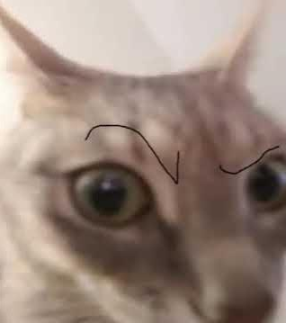
The Problem
People coming from outside of the Rochester area are not familiar with all it has to offer.
International students must extensively research places to get necessities.
The Solution?

Slide 2
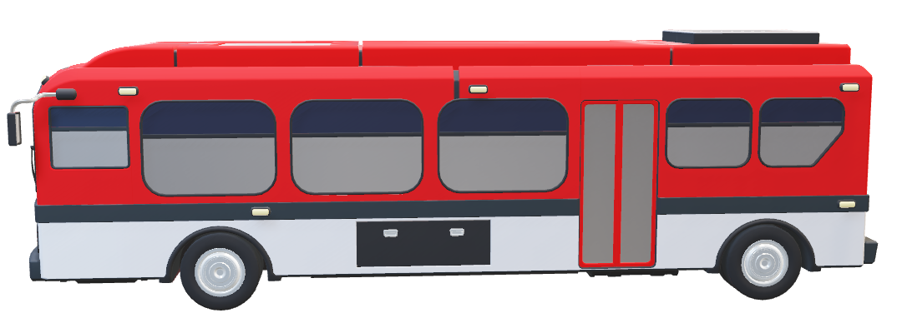
DIRECTOROC
DIRECTOROC
DIRECTOROC

Slide 3
Our Focus
Familiarizing people with Rochester
Food
International resources
Transportation
Where to get the essentials
Schools
Streamlining all of the information people coming to the area could ever need to ensure they have a safe and enjoyable time in Rochester.

