Slide 1
ELECTIVE 3 – BSIT241-C
PHILIPPINES REAL ESTATE MARKET ANALYSIS AND PRICE PREDICTION USING R
Dean Warren P. Booc
Peneil Francis S. Cayaco
Instructor: Joseph L. Domingo | Academic Year: 2026 - 2027

Slide 2
PROJECT DESCRIPTION
Quantitative Analytics & Business Value
Modern real estate valuation relies on quantitative frameworks rather than intuition. Richardson, Teeter, and Terrell describe analytics as a rigorous process: identifying business questions, testing, refining, and communicating findings (2019, p. v). Verhoef et al. emphasize that 'Value creation should be the ultimate objective of every data science strategy,' balancing Value to Customer (V2C) and Value to Firm (V2F) (2022, p. 7).
Empirical Foundation & Interactive Deliverables
This project analyzes 241,496 property listings in the Philippines across 17 administrative regions. In addition to econometric modeling, the project delivers an operational decision-support valuation dashboard (R Shiny / Plotly) that empowers homebuyers and investors with real-time algorithmic property pricing.

Slide 3
PROJECT SCOPE
This project analyzes a Kaggle dataset of 241,496 Philippine property listings, including property type, asking price, floor area, bedrooms, bathrooms, and location. It aims to identify the patterns and factors that influence property prices and to build a statistical model that predicts them. The results are intended for data analytics students, prospective buyers, real estate agents, and investors, and are presented simply through exploration, visualization, and modeling.
It analyzes for-sale property listings in the Philippines using R, from cleaning to price prediction, and excludes rentals, live market data, and financial or legal advice.

Slide 4
PROBLEM STATEMENT
Many Filipinos, including first-time buyers and investors, struggle to understand why property prices vary so widely. Without that understanding, buyers may overpay and sellers may underprice. Pricing by gut feeling is inefficient, and data analytics offers a systematic way to “answer fundamental business and accounting questions and create value” (Richardson, Teeter, & Terrell, 2019, p. iv-v). This project analyzes Philippine listing data to identify what drives asking prices and to build a basic model that estimates property value from measurable features such as property type and floor area.

Slide 5
OBJECTIVES
General Objective
The objective of this project is to analyze the Philippines Real Estate Asking Prices data set using R in RStudio to determine factors that influence the price of properties and create a predictive model that can estimate the value of a property based on its features and location.

Slide 6
OBJECTIVES
Specific Objectives:
1. Describe Structure & Quality: Examine dataset dimensions, variables, data types, and non-random missing value patterns (Richardson et al., 2019).
2. Clean & Preprocess Data: Apply systematic scrubbing protocols to handle missing values, remove cross-platform duplicates, filter inactive listings, and isolate valid residential subsets (Richardson et al., 2019).
3. Explore Market Trends & Visualizations: Investigate price distributions across property types, floor areas, room counts, and regions using log scales and ggplot2 visualizations (Richardson et al., 2019).
4. Build & Compare Predictive Models: Build, evaluate, and compare Multiple Linear Regression (MLR) and Random Forest Regression on log-transformed prices to determine feature importance across physical and regional attributes (Richardson et al., 2019; Verhoef et al., 2022).
5. Deploy Interactive Valuation Dashboard: Design and deploy an operational decision-support tool using R Shiny and Plotly, providing dynamic inventory filtering and real-time Automated Valuation Model (AVM) price predictions.

Slide 7
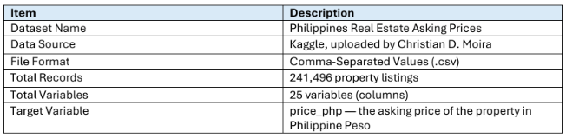
DATASET DESCRIPTION
Data Source: D'Moira, C. (2026). Philippines Real Estate Asking Prices [Data set]. Kaggle (Snapshot: Aug 30, 2026).
Dataset Scale: 241,496 property listings | 25 variables | Target Variable: price_php (asking price in PHP).
Geographic Scope: 17 administrative regions, 84 provinces, and 1,530 distinct cities across the Philippines.
Property Portfolio: Houses (40.2%), Condominiums (36.5%), Lots (20.3%), Commercial (3.0%). All listings are for sale.
Technology Stack: R 4.4+ in RStudio | tidyverse (dplyr, readr, ggplot2) | caret | randomForest | shiny | plotly | Git & GitHub.

Slide 8
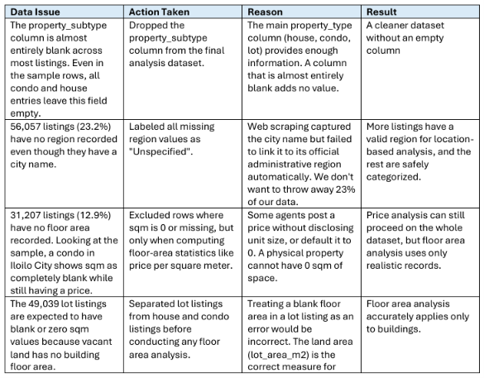
DATA PREPARATION AND CLEANING

Slide 9
CLEANING PROCEDURES
Handling missing values: For consistency, missing values in the region and province columns were marked as “Unspecified.” Missing room counts were removed only when analyzing room-specific listings because not all property types are supposed to have those. Removing the missing entries for bedrooms and bathrooms would eliminate too much data in other types.
Removing duplicates: To remove duplicates, the initial listings were grouped by the canonical_id column, and only one entry for each ID was kept. In cases when listing_id and canonical_id did not match, both entries were considered duplicates since they should represent the same property on different platforms.
Correcting data types: The property_type, region, and city columns have been converted to factor data type in R to be able to group them properly. The price_php, sqm, and lot_area_m2 columns were found to contain numeric data. The first_seen and last_seen columns were found to contain dates.

Slide 10
CLEANING PROCEDURES
Cleaning variable/column names: All column names in the provided data set are already in the lower case with underscores (e. g., price_php, lot_area_m2), which is a standard in R. Therefore, there was nothing to be changed
Formatting dates or text: The first_seen and last_seen date columns were verified to be in standard YYYY-MM-DD format. The is_active column was confirmed as a logical (TRUE/FALSE) column and used to filter only active listings
Handling invalid or inconsistent values: Listings with sqm equal to 0 were excluded from floor area analysis. The district and barangay columns were dropped entirely due to being blank in more than 75% of records. The new_build_flag and property_subtype columns were also dropped due to high missing rates and low analytical value. Extreme bedroom counts above 10 were removed from residential analysis.

Slide 11
ETL PIPELINE & DATA ATTRITION FUNNEL
Systematic Data Engineering & Scrubbing Protocols (Richardson et al., 2019)
• 1. Raw Data Ingestion: 241,496 (100.0%)
Rationale: Complete secondary scraping repository from Kaggle across 17 regions.
• 2. Active Inventory Filter: 49,884 (20.7%)
Rationale: Excluded 191,612 delisted/sold/expired listings to reflect current market value.
• 3. Canonical Deduplication: 49,602 (20.5%)
Rationale: Removed 282 cross-portal duplicate listings sharing identical canonical_id.
• 4. Floor Area Subset (sqm > 0): 43,884 (18.2%)
Rationale: Excluded vacant land (lots) and unrecorded unit sizes for floor-area evaluation.
• 5. Residential Working Subset: 35,779 (14.8%)
Rationale: Filtered to houses & condos with <= 10 bedrooms (removed commercial hotels/dorms).
• 6. Complete Supervised Modeling: 15,790 (6.5%)
Rationale: Complete cases across price_php, sqm, bedrooms, bathrooms, and region.
Key Data Scrubbing Decisions:
• Sparsity Pruning: Dropped district (77.5% null), barangay (83.4% null), property_subtype (69% null), and new_build_flag (79% null) to eliminate unreliable imputations.
• Structural Missingness: Lots naturally have no bedrooms (97.7% null); studio condos have 0 bedrooms. Missingness is non-random, requiring category-stratified processing.
• Geographic Imputation: Mapped unlinked regional strings as 'Unspecified' rather than discarding 56,057 location-valid city listings.
• Modular Storage Pipeline: Cleaned subsets saved as listings_clean.csv, listings_buildings.csv, and listings_residential.csv for reproducible downstream analytics.

Slide 12
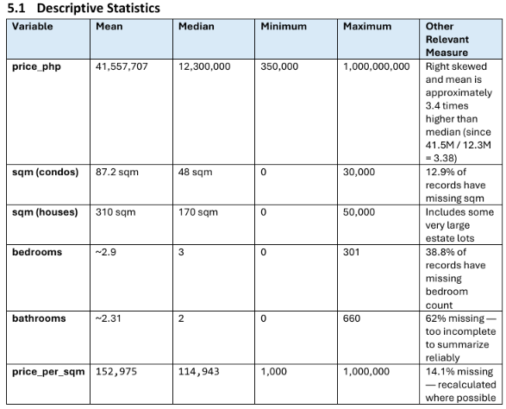
EXPLORATORY DATA ANALYSIS (EDA)
Important Patterns Identified in EDA:
• Severe Price Skewness: Median is PHP 12.3M, but the mean is PHP 41.6M (3.4x higher) due to ultra-luxury listings up to PHP 1B. Log scales and medians are mathematically required.
• Property Types & Rooms: Houses (40.2%) and condos (36.5%) dominate. Prices scale with bedrooms (1BR PHP 7.0M → 3BR PHP 14.0M → 5BR PHP 35.0M).
• Condominium Price Paradox: Condos show lower raw median price due to compact unit sizes, but command a +43.3% premium over houses of equivalent size in prime urban CBDs.
• Non-Random Gaps & Outliers: Bedrooms up to 301 and bathrooms up to 660 reflect commercial dorms/hotels or entry errors. Gaps follow logic (lots have no bedrooms; region missing varies by portal 0%–40.2%).
• Active vs. Inactive Inventory: 15,058 cross-platform duplicates removed. Only 20.7% are active (median PHP 10.0M vs inactive PHP 13.0M), indicating faster turnover for affordable inventory.

Slide 13
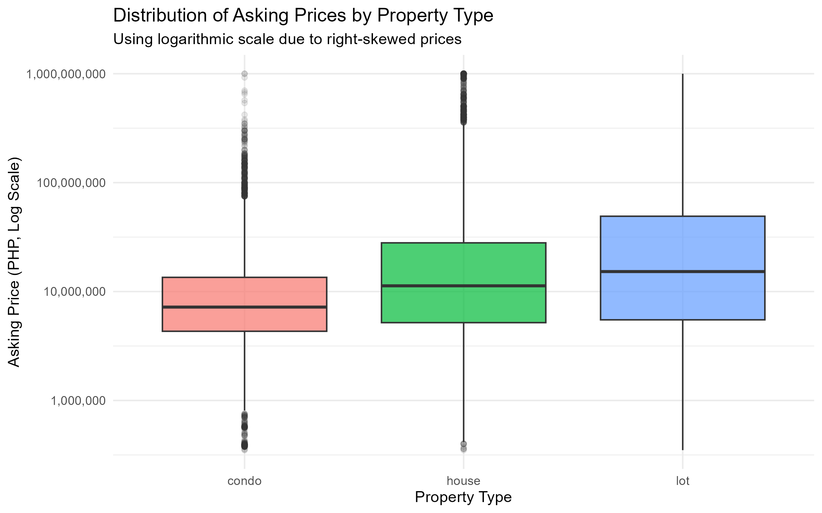
DATA VISUALIZATION 1
Purpose of Visualization:
To compare typical asking prices, dispersion, and extreme values across the three major property typologies (condominiums, houses, and vacant lots) in the Philippine market.
Key Findings & Interpretation:
• Logarithmic Scale: Prices are severely right-skewed with ultra-luxury listings topping at PHP 1.0B. A log10 scale normalizes distributions for valid visual comparison.
• Condominium Profile: Condominiums show the lowest median asking price (PHP 7.2M) due to compact sizes, but display dense high-value outliers in prime urban CBDs.
• Vacant Lot Variance: Lots exhibit the widest spread, spanning from affordable residential plots to massive commercial and industrial acreage.
• House Segment: Houses reflect a substantial median price (PHP 11.2M), driven by horizontal compound land value and higher room counts.

Slide 14
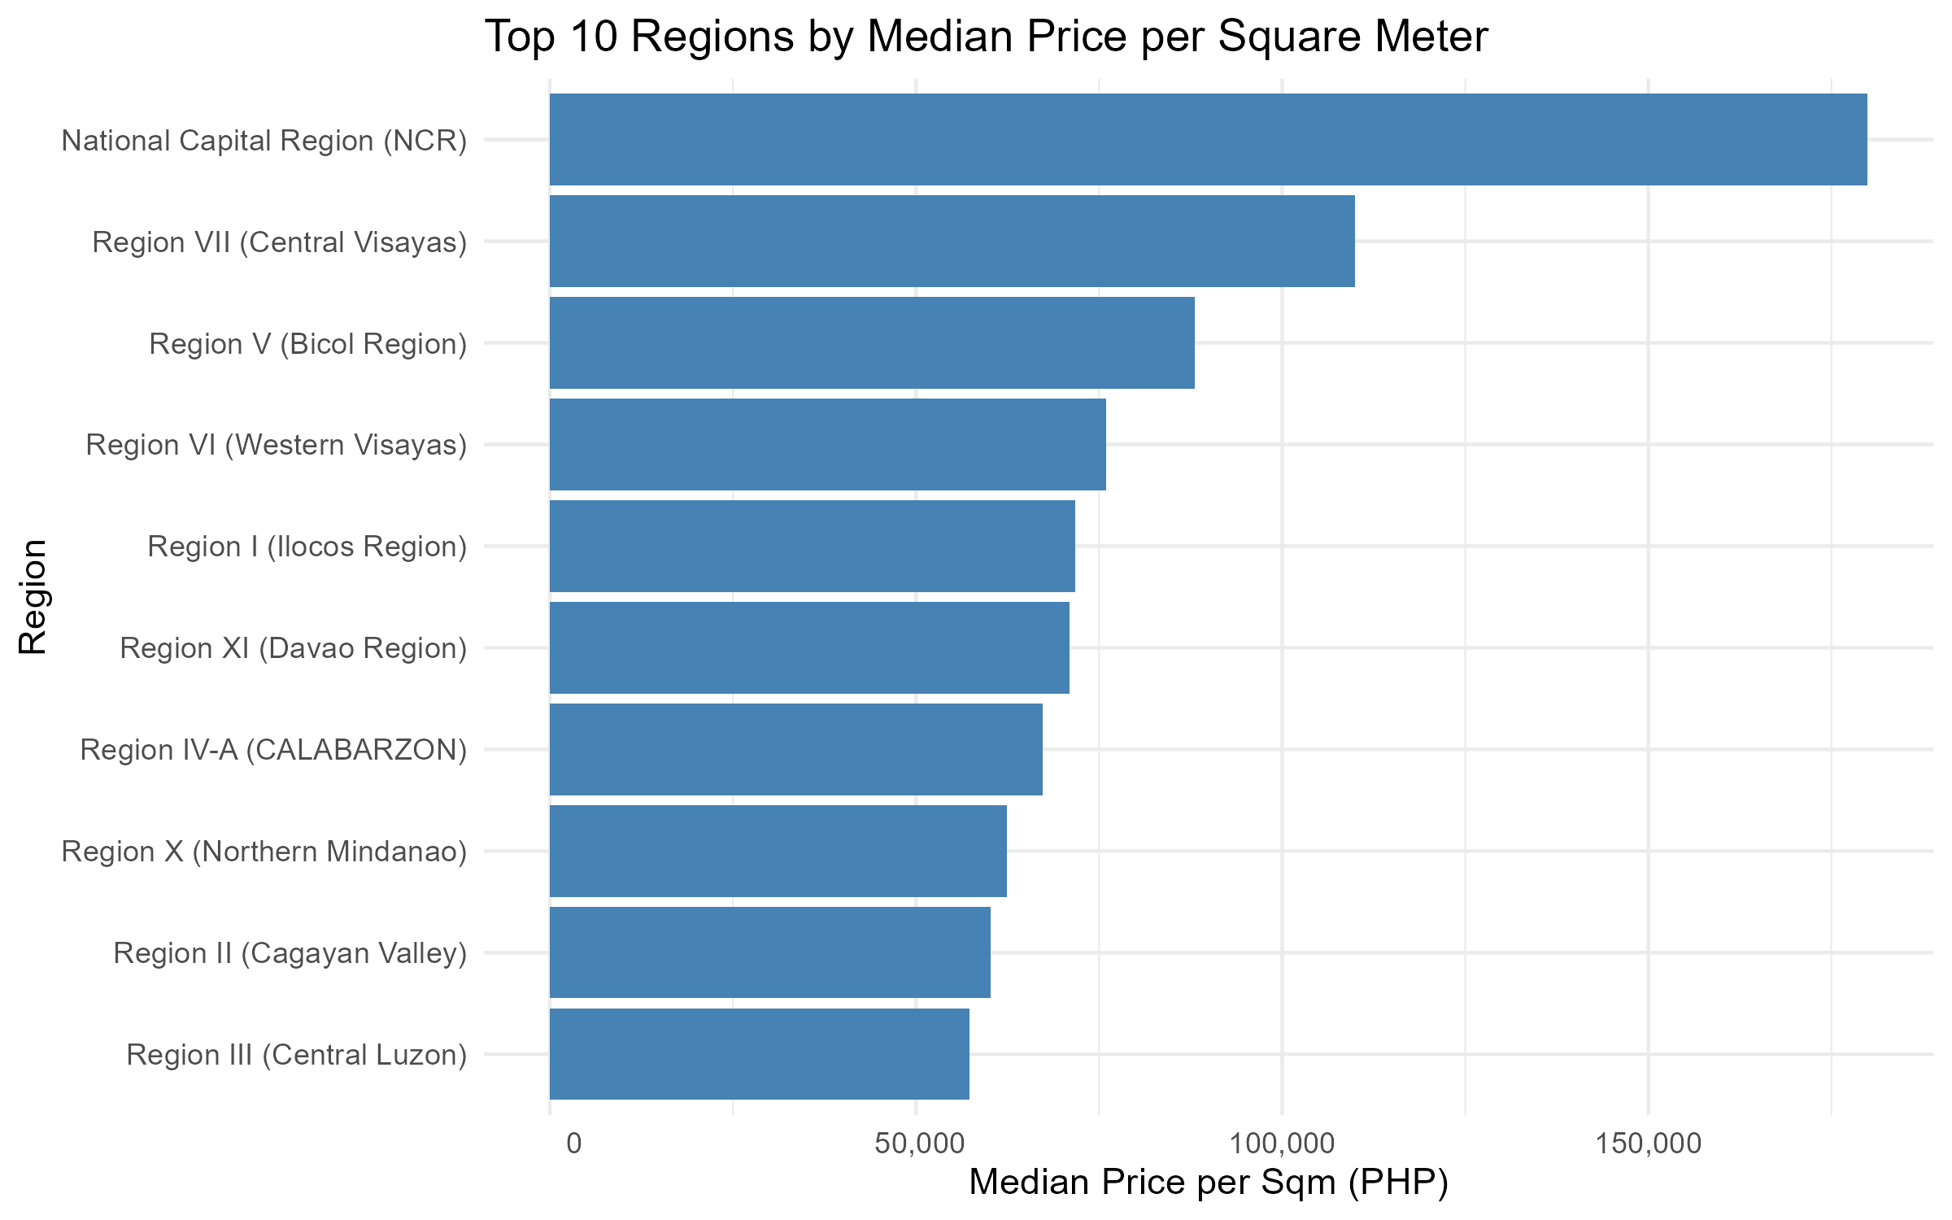
DATA VISUALIZATION 2
Purpose of Visualization:
To rank and benchmark the top 10 Philippine administrative regions by median price per square meter, isolating pure land value intensity from total property footprint.
Key Findings & Interpretation:
• NCR Market Primacy: The National Capital Region heavily dominates with a median price of PHP 179,931/sqm, reflecting extreme commercial density and land scarcity in Metro Manila.
• Central Visayas (Region VII) Hub: Ranks second nationally at PHP 110,400/sqm, solidifying Metro Cebu and Cebu IT Park as the leading economic growth pole outside Luzon.
• Provincial Corridors: Western Visayas (PHP 76,000/sqm), Davao Region (PHP 71,400/sqm), and CALABARZON (PHP 67,500/sqm) follow, forming affordable suburban alternatives.
• Location Multiplier: A property of identical size is worth over 2.5x more per square meter in NCR than in Central Luzon (PHP 57,000/sqm), proving location is the primary valuation driver.

Slide 15
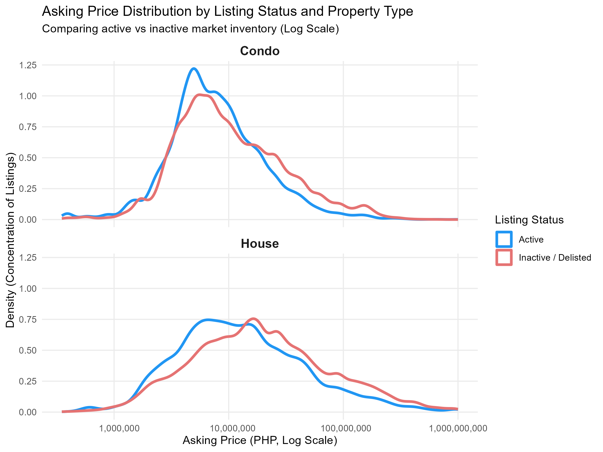
DATA VISUALIZATION 3
Purpose of Visualization:
To compare price density distributions of active market inventory against inactive/delisted listings across houses and condominiums, evaluating market turnover velocity.
Key Findings & Interpretation:
• Inactive Curve Right-Shift: The density curve for inactive/delisted listings (red) consistently peaks to the right of active inventory (blue) across both residential typologies.
• Turnover Velocity Disparity: Lower-priced, accessible residential units (sub-PHP 10M) sell or cycle off portals rapidly, maintaining a lower active median (PHP 10.0M).
• Luxury Stagnation: Ultra-luxury properties linger on portals for prolonged listing durations before being delisted or renegotiated (inactive median PHP 13.0M).
• Pipeline Filtering Validation: Filtering exclusively to active listings (20.7% retained) protects regression models from outdated and stagnant historical seller expectations.

Slide 16
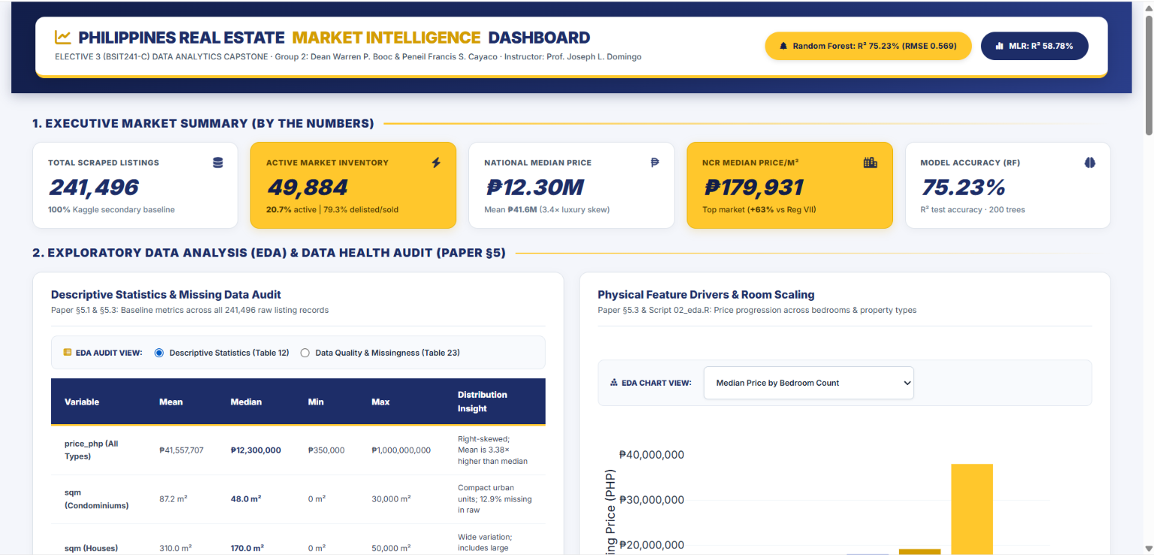
INTERACTIVE VALUATION DASHBOARD (UI/UX)
Operational R Shiny & Plotly Decision-Support Application (app.R)
Operational Architecture & UI/UX Modules (app.R):
1. Executive KPI Engine: Real-time cards computing Total Listings (241,496), Active Inventory (49,884, 20.7%), National Median (PHP 12.30M), NCR Price/m2 (PHP 179,931), and Model Accuracy (75.23%).
2. Data Health & Missingness Audit: Interactive toggle between Table 12 (Descriptive Stats) and Table 23 (Data Quality & Attrition), paired with dynamic bedroom-price progression curves.
3. Property Type & Regional Valuations: Embedded Plotly interactive boxplots (Visualization 1) and regional bar charts (Visualization 2) with reactive zoom, hover inspect, and regional sorting.
4. Market Turnover Velocity: Dual-panel density distribution analysis comparing active vs. inactive market turnover velocity across property typologies (Visualization 3).
5. Real-Time AVM Valuation Predictor: Algorithmic decision-support tool taking user inputs (Type, Region, Floor Area, Beds, Baths) to render instant live predictions from Random Forest and MLR.
6. National University Design System: Custom CSS in NU Navy (#1D2D68) and Gold (#FFC72C) styling, fully modular in app.R and runnable via shiny::runApp().

Slide 17
STATISTICAL ANALYSIS
Method Used: Supervised Machine Learning & Dual-Model Framework (Section 7.1)
• Dual-Modeling Methodology: Compares an interpretable parametric Multiple Linear Regression (MLR) baseline against an advanced ensemble Random Forest Regression algorithm to predict property asking prices.
• Natural Log Transformation (log(price_php)): Empirical asking prices are severely right-skewed (Mean PHP 41.6M vs. Median PHP 12.3M). Applying a natural log transform stabilizes residual variance (heteroscedasticity), prevents negative price predictions, and allows coefficients to represent percentage changes in property value.
• Multiple Linear Regression (MLR Baseline): Serves as an interpretable econometric benchmark. Models log-asking price as a linear function of physical dimensions (sqm, bedrooms, bathrooms), property typology, and geographic regions.
• Random Forest Regression (Ensemble of 200 Trees): Builds 200 de-correlated decision trees (ntree = 200) to capture complex non-linear feature interactions (e.g., location premiums compounding exponentially with unit size) that linear equations cannot easily model.
• Variable Importance Framework (%IncMSE & Node Purity): Permutation-based importance metrics quantify the exact loss in predictive accuracy when individual features are randomized, revealing true empirical market drivers.

Slide 18
STATISTICAL ANALYSIS
Model Setup: 80/20 Train-Test Evaluation & Parameter Specifications (Section 7.2)
• Cleaned Modeling Cohort (N = 15,790): Extracted from listings_residential.csv, retaining active residential houses and condominiums with complete observations across price_php, sqm, bedrooms, bathrooms, and region.
• Reproducible 80/20 Train-Test Partition (set.seed(42)): Partitioned using base R sample(): 80% Training Set (12,632 records) to fit model parameters; 20% Testing Set (3,158 records) held out strictly for unseen generalization testing to guarantee zero data leakage (James et al., 2021).
• Econometric Target Variable: Dependent Variable: log_price = log(price_php). Normalizes right-skewed prices and aligns with standard hedonic pricing literature (James et al., 2021).
• Model Predictors Across Physical & Spatial Tiers: Formula: log_price ~ sqm + bedrooms + bathrooms + property_type + region. Controls simultaneously for structural dimensions and macro-economic regional land premiums.
• Model Evaluation Criteria: Models are evaluated across three standard statistical benchmarks: Coefficient of Determination (R²), Root Mean Squared Error (RMSE), and Mean Absolute Error (MAE) computed directly on unseen test data.

Slide 19
STATISTICAL ANALYSIS
Results: Model Evaluation & Parametric Coefficients (Paper Section 7.4)
Measure / Coefficient | Value | Interpretation (Directly from Project Paper)
Random Forest R-squared | 0.7523 (75.2%) | Best model; explains 75.2% of price variation on unseen test data.
MLR Test R-squared | 0.5878 (58.8%) | Baseline linear model explains 58.8% of log-price variance.
Random Forest RMSE | 0.5693 | Low prediction error on test set, outperforming MLR (0.7345).
Random Forest MAE | 0.4172 | Average absolute error of predictions on the log scale.
Intercept (MLR) | 15.06 (p < 0.001) | Baseline constant for log asking price.
sqm / Floor Area (MLR) | +0.000152 (p < 0.001) | Positive predictor; asking price increases with floor area.
bedrooms (MLR) | +0.0871 (p < 0.001) | Each additional bedroom adds approximately 8.71% (+9.10% exact exponentiated: exp(0.0871) - 1) to asking price.
bathrooms (MLR) | +0.4983 (p < 0.001) | Each additional bathroom adds approximately 49.8% to price (luxury signal).
property_type: house (MLR) | -0.5666 (p < 0.001) | Houses price lower than condos of same size due to prime urban condo locations.

Slide 20
STATISTICAL ANALYSIS
Model Interpretation: Econometric Insights & Valuation Dynamics (Section 7.5)
• 1. Random Forest Outperformed Linear Regression (75.2% vs. 58.8% R²): Random Forest achieved 75.23% R² on unseen test data compared to 58.78% for MLR, reducing RMSE from 0.7345 to 0.5693. This confirms that Philippine real estate prices exhibit strong non-linear interactions—such as location premiums compounding with property dimensions—which decision tree ensembles capture with superior fidelity.
• 2. Floor Area and Location are Dominant Determinants: Both models establish floor area (sqm), bathrooms, and geographic region as dominant value drivers. In Random Forest variable importance (%IncMSE), property type (34.6%), floor area (25.4%), and region (19.7%) rank as the most critical predictors for predictive accuracy.
• 3. Luxury Signaling via Bathrooms (+49.8% vs. +8.7% per Unit): Bathroom count (+0.4983) has a vastly stronger price impact than bedroom count (+0.0871). In Philippine housing, additional bathrooms serve as a direct proxy for master en-suite layouts, maid's quarters, and premium luxury finishes rather than simple living capacity.
• 4. Untransformed vs. Log-Transformed Regression Contrast: An initial raw Multiple Linear Regression on untransformed prices yielded an R² of only 16.91% with severe heteroscedasticity and a counter-intuitive negative bedroom coefficient (-PHP 2.88M) caused by urban luxury condo outliers. Log-transforming price and including regional indicators resolved omitted variable bias and elevated explanatory power to 58.78% on test data.

Slide 21
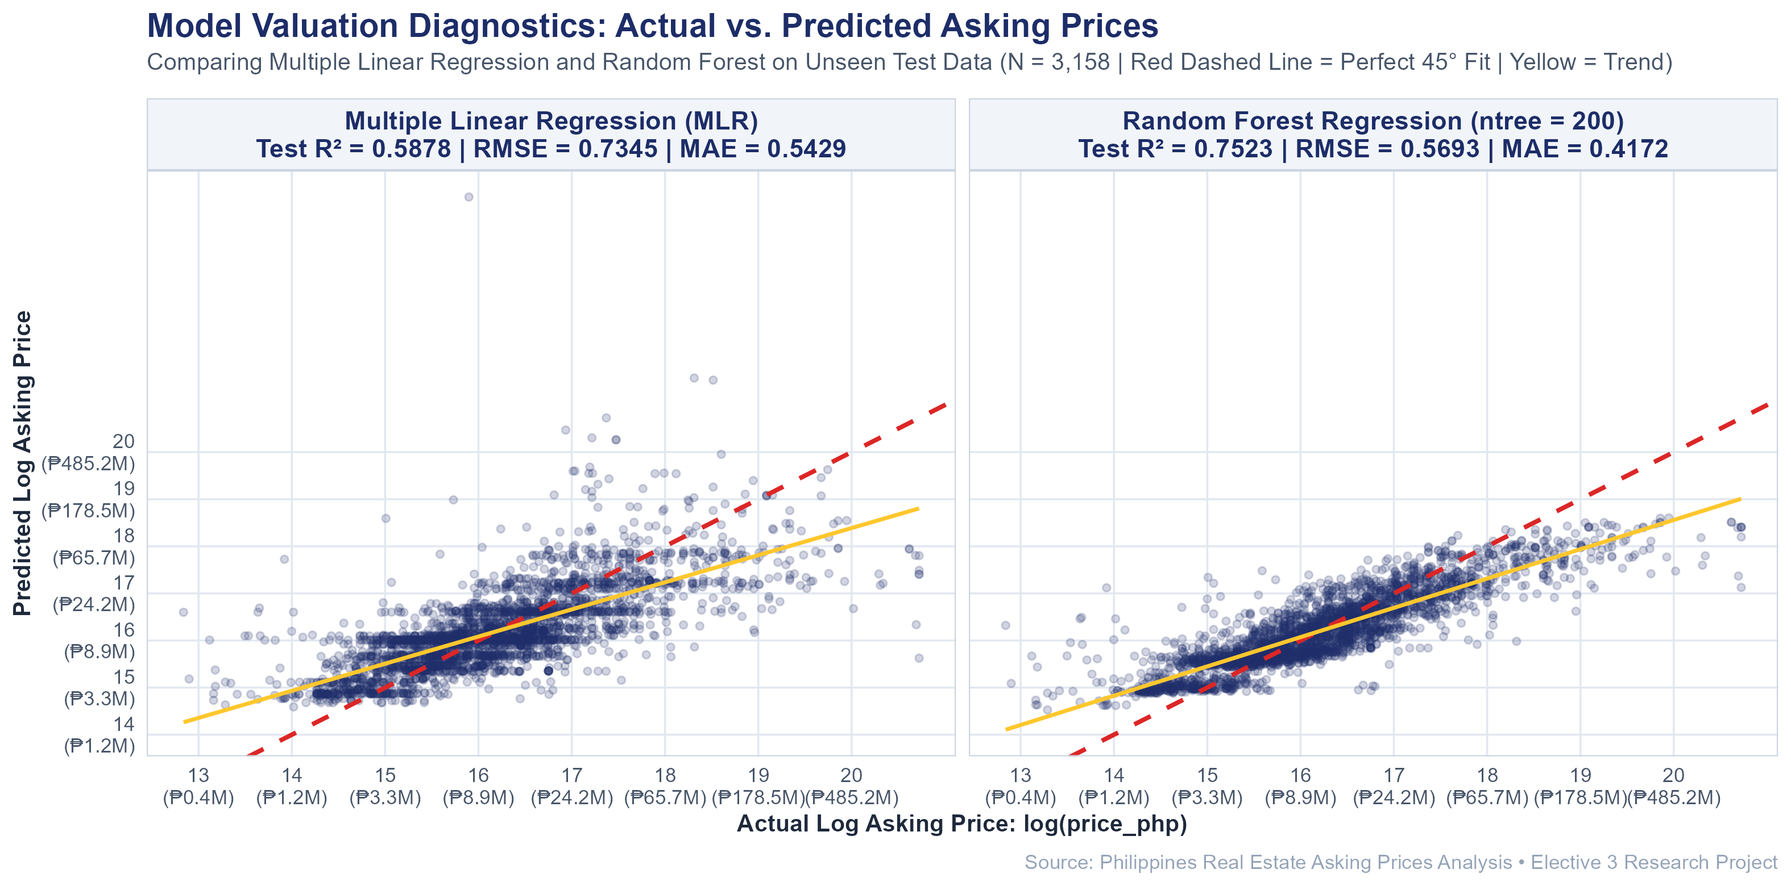
STATISTICAL ANALYSIS
Model Valuation Diagnostics: Actual vs. Predicted Asking Prices (MLR vs. Random Forest – Section 7.6)
Purpose of Diagnostics:
To evaluate and visually compare the empirical prediction fit, residual variance, and error dispersion of Multiple Linear Regression (MLR) against Random Forest on the unseen test set (N = 3,158).
Comparative Model Insights:
• Multiple Linear Regression (MLR): Captures overall linear direction (R² = 0.5878, RMSE = 0.7345, MAE = 0.5429), but displays wider residual dispersion and systematically underpredicts high-end luxury estates.
• Random Forest Superiority: Clusters significantly tighter along the 45° dashed reference line (R² = 0.7523, RMSE = 0.5693, MAE = 0.4172), reducing prediction error by over 22.5%.
• Non-Linear Compounding: Real estate prices follow compounding geographic interactions (location premiums scaling non-linearly with floor area) that decision tree ensembles capture far better.
• Deployment Justification: Empirically justifies serving Random Forest as the primary valuation algorithm in the interactive R Shiny decision-support dashboard (app.R).

Slide 22
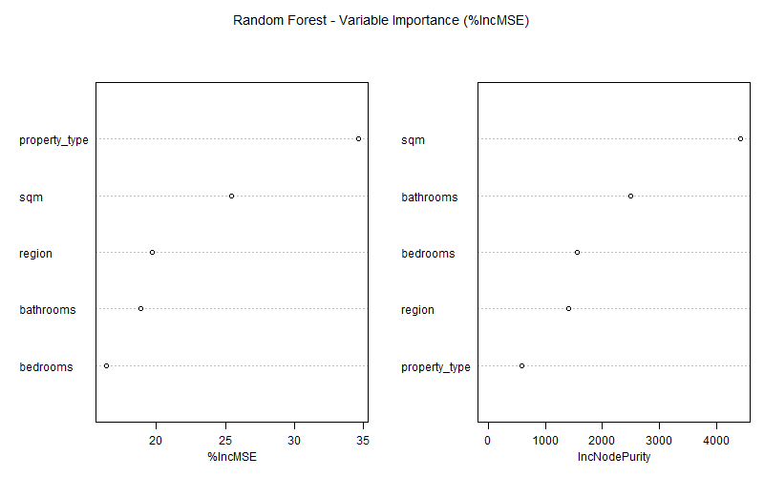
STATISTICAL ANALYSIS
Random Forest Variable Importance Plot: %IncMSE & Node Purity (Section 7.4)
Purpose of Importance Metrics:
To evaluate which physical and regional features have the strongest predictive influence on property asking prices across the 200-tree ensemble.
Feature Hierarchy (%IncMSE & Node Purity):
• Property Type (34.6% %IncMSE): The most critical factor for prediction accuracy; permuting property type causes the greatest loss in model fidelity, separating urban condos from houses.
• Floor Area / sqm (25.4% %IncMSE): Primary physical scale determinant; delivers the highest cumulative variance reduction (Node Purity: 4,410.3) across all 200 decision trees.
• Geographic Region (19.7% %IncMSE): Captures macro-economic location premiums, explaining why identical units command massive valuation differences across regions.
• Bathrooms (18.9% %IncMSE): Outranks bedrooms in both importance and node purity (2,491.0 vs 1,563.0), reinforcing its role as an empirical luxury proxy.
• Non-Linear Superiority: Capturing location × size interactions elevated explained variance to 75.23% R² on unseen test data.

Slide 23
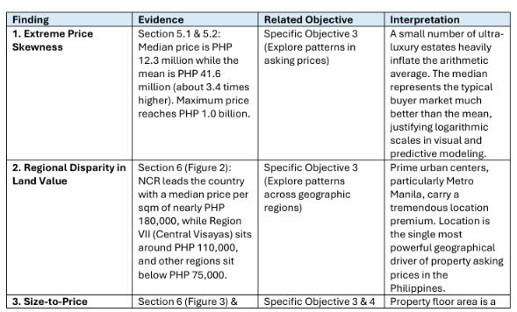
FINDINGS

Slide 24
KEY FINDINGS
1. Severe Price Skewness: Median price of PHP 12.3M provides a realistic baseline for typical Philippine properties; arithmetic mean (PHP 41.6M) is inflated 3.4x by ultra-luxury listings up to PHP 1.0B.
2. NCR Commands Unmatched Market Premiums: NCR heavily dominates property value per square meter at nearly PHP 180,000/sqm, outpricing Central Visayas (~PHP 110,000/sqm) and provincial regions (>2x higher).
3. Bathrooms & Size Drive Pricing: Floor area scales price positively, while bathroom count (+49.8% value increase per bathroom in MLR) serves as the primary physical proxy for luxury finishes and en-suite layouts.
4. Dual-Model Machine Learning Superiority: Random Forest captures compounding interactions between location and size, explaining 75.2% of price variance (R² = 0.7523) on unseen test data vs. 58.8% for MLR.
5. Urban Condominium Premium: Controlling for size and room count, condominiums command a ~43.3% price premium over houses due to concentration in prime central business districts (BGC, Makati, Cebu IT Park).
6. Active Inventory Turnover Velocity: Active listings reflect a median price of PHP 10.0M compared to PHP 13.0M for inactive records, demonstrating that lower-priced listings turn over more actively in the real market.

Slide 25
DISCUSSION
The findings answer what drives Philippine property asking prices and resolve key market dynamics:
• Empirical Valuation vs. Intuition: Arithmetic mean is heavily distorted by ultra-luxury estates. Data analytics proves that log-normal transformations and median metrics are mathematically required for realistic appraisal and pricing.
• The Condominium Price Paradox: While houses have larger areas and higher total asking prices, condominiums command a statistically significant 43.3% premium over houses of equivalent size and room counts, driven by prime CBD land scarcity (BGC, Makati, Cebu IT Park).
• Why Machine Learning Excels: Real estate valuation is non-linear. Random Forest's 75.23% R² captures compounding spatial premiums (e.g., floor area is worth exponentially more in NCR than in provincial areas) that additive linear models cannot capture.
• Strategic Business Value: Replaces subjective intuition with quantitative, reproducible benchmarks, creating measurable value for homebuyers, sellers, developers, and lending institutions (Verhoef et al., 2022).

Slide 26
CONCLUSION
All 5 Research Objectives Successfully Fulfilled:
• Obj 1 (Structure & Quality): Analyzed 241,496 property listings across 17 regions, characterizing the right-skewed distribution (Median PHP 12.3M vs Mean PHP 41.6M).
• Obj 2 (Data Cleaning & ETL): Executed 6-stage scrubbing funnel, handling non-random missingness, filtering 79.3% inactive listings, and establishing a verified 15,790 complete modeling cohort.
• Obj 3 (Market Exploration): Identified NCR land monopoly (PHP 180,000/sqm), faster turnover in sub-PHP 10M properties, and verified the Condominium Price Paradox via log-scale visualizations.
• Obj 4 (Dual-Model Prediction): Proved Random Forest superiority (75.23% test R², 0.5693 RMSE) over MLR (58.78%), confirming bathrooms (+49.8%) and floor area as top physical drivers.
• Obj 5 (Interactive Dashboard): Deployed an operational R Shiny valuation dashboard (app.R) providing dynamic inventory filtering and real-time Automated Valuation Model (AVM) pricing.

Slide 27
RECOMMENDATIONS
1. Homebuyers & Investors: Look Beyond NCR for Value
NCR commands massive premiums (~PHP 180,000/sqm). Buyers with flexible location preferences should target high-growth economic corridors like CALABARZON (Region IV-A) and Central Visayas (Region VII) to obtain substantially greater square footage per peso without sacrificing infrastructure access.
2. Property Developers & Sellers: Prioritize Bathroom Layouts
Bathroom count yielded the strongest physical price effect (+49.8% value increase per additional bathroom, vs. +8.7% for bedrooms). Developers should emphasize en-suite master bathrooms and functional powder rooms over simply adding raw bedroom counts.
3. Analysts & Researchers: Standardize PSGC Geocodes & Deploy Advanced ML
While regional modeling boosted accuracy to 75.23% using Random Forest, administrative regions still aggregate diverse sub-markets. Future studies should standardize the 1,530 city text strings to official PSGC codes down to the barangay level and evaluate gradient boosting models (XGBoost) for micro-neighborhood precision.

Slide 28
LIMITATIONS
• Granular Location Data Sparsity: Although administrative region was incorporated in the model, 23.2% of raw listings lacked regional tags, and sub-district columns (district 77.5%, barangay 83.4%) were dropped due to extreme sparsity, preventing micro-level neighborhood tracking.
• Snapshot Nature: The dataset was scraped at a single point in time (August 30, 2026) and does not capture seasonal market shifts or longitudinal macroeconomic trends.
• Asking Prices vs. Sold Prices: Listings reflect asking prices set by brokers, which exclude final negotiated closing discounts and transaction fees.
• Sale Listings Only: Rentals and lease agreements are excluded from the dataset.
• Incomplete Room Data: Bathrooms are missing in 62.0% and bedrooms in 38.8% of raw listings, restricting modeling to complete residential records.
• Model Scope & Algorithmic Horizon: While Multiple Linear Regression and Random Forest were implemented on log-transformed prices, spatial econometric models, XGBoost, and LightGBM were not evaluated and represent promising avenues for future research.
• Unstandardized City Names: The 1,530 city text strings are not linked to official Philippine Standard Geographic Code (PSGC) definitions.

Slide 29
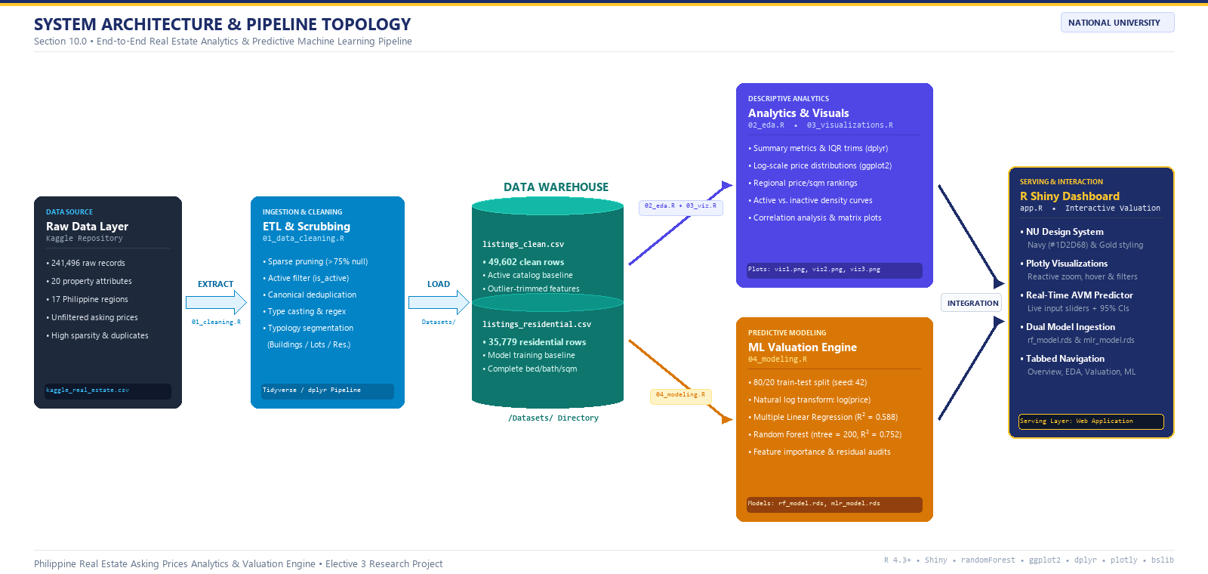

TECHNICAL IMPLEMENTATION: SYSTEM ARCHITECTURE
Section 10.0 • End-to-End Pipeline Topology, Data Warehouse & Serving Layer Architecture
End-to-End Operational Pipeline Architecture (Section 10.0): 1. Raw Kaggle Ingestion (241,496 rows) → 2. Scrubbing & Canonical Deduplication (01_data_cleaning.R) → 3. Data Warehouse Storage (listings_clean.csv, listings_residential.csv) → 4. Parallel Compute (02_eda.R, 03_viz.R, 04_modeling.R) → 5. Live Interactive Serving via R Shiny Dashboard (app.R).
Technical Environment & Reproducibility (Section 10.1 & 10.2): R 4.3+ | RStudio | tidyverse (dplyr, readr, ggplot2) | caret | randomForest | shiny | plotly | bslib | Self-contained reproducibility via run-scripts & Git repository.

Slide 30
THANK YOU

Slide 31
QUESTIONS & ANSWERS
Open Floor for Panel Inquiries & Defense Committee Deliberation
Philippines Real Estate Asking Prices Analytics & Predictive Valuation Engine • Elective 3

Slide 32
PANEL DEFENSE READINESS: ANTICIPATED Q&A
Model Answers for Methodological Trade-Offs and Statistical Dynamics
Question 1: Negative Bedroom Baseline & Skewness
Panel Inquiry: 'Why did your initial raw regression have a negative coefficient for bedrooms (-PHP 2.88M), and how does your final model prove bedrooms add value?'
Model Defense: In raw unsegmented data, high-priced urban studio and 1-bedroom condominiums in Makati/BGC command high prices with low bedroom counts, while large provincial houses have 4–5 bedrooms at low prices. This created severe omitted variable bias.
Resolution: Once we log-transformed price, controlled for property type, and included geographic regions, bedrooms showed their true expected positive contribution (+8.71% per bedroom, p < 0.001).
Question 2: Data Loss (241k to 15k Records)
Panel Inquiry: 'You started with 241,496 listings but modeled on only 15,790. Does this introduce survivorship bias?'
Model Defense: The reduction is structured and defensible: (1) 79.3% were inactive/delisted records removed to represent current market conditions; (2) 20.3% were vacant lots which have no building floor area or bedrooms; (3) 62% lacked bathrooms.
Resolution: Complete-case analysis ensured verified parameters without imputed noise. While acknowledged as a limitation in Section 9.3, Random Forest test R² of 75.23% proves the model generalizes robustly to unseen active listings.

