Slide 1

TECHNOLOGY & INNOVATION
Test Automation Platform
AI-powered end-to-end quality assurance solution
for web and API environments
DATE
DEPARTMENT
STATUS
January 9, 2026
Quality Engineering
Strategic Initiative
Internal Use Only | HSBC Group

Slide 2







Executive Summary
TEST AUTOMATION PLATFORM
Core Capabilities
Strategic Overview
An enterprise-grade platform designed to modernize HSBC's quality assurance landscape. By unifying test creation, AI-driven maintenance, and secure execution, we enable faster delivery cycles without compromising on compliance or security.
Recording & Generation
AI Enhancement
Chrome extension for auto-generating Playwright scripts in multiple languages.
Self-healing locators and smart selector optimization to reduce flakiness.
API Testing Suite
Enterprise Security
Comprehensive REST API testing with AI-assisted assertions.
JWT auth, RBAC, and secure handling of sensitive banking data.
Why it Matters
Accelerate Release Velocity: Move from manual validation to automated pipelines.
Risk Mitigation: Reduce human error and increase test coverage for critical paths.
Governance & Audit: Centralized reporting ensures traceability for regulatory compliance.
Expected Outcomes
Cost Efficiency: Lower maintenance overhead through AI self-healing capabilities.
60%
40%
24/7
100%
Confidential & Proprietary | HSBC Group Technology
FASTER AUTHORING
LESS MAINTENANCE
TEST AVAILABILITY
AUDIT TRAIL

Slide 3









Test Recording & Generation
CORE CAPABILITIES
Accelerate test creation with our Chrome extension that captures user journeys in real-time and converts them into robust, enterprise-grade Playwright scripts.
Browser Recording
Auto-Generation
Multi-Language Export
Seamlessly integrates with Chrome via Manifest V3 extension. Records complex interactions including hover states, frames, and dynamic content loading without leaving the browser environment.
Intelligent translation engine converts recorded actions into standardized Playwright test scripts. Applies best practices for wait strategies and selector prioritization automatically.
Support for diverse engineering teams with native code generation across the most popular testing frameworks and languages.
Captures Shadow DOM
Instant Script Preview
TypeScript
JavaScript
Python
Handles Iframes
Smart Wait Handling
Java
C#
Robot Framework
Confidential & Proprietary | HSBC Group Technology
Business Value
Rapid Authoring
Standardization
Low Code Entry
Reduce script creation time by 70%
Consistent coding patterns across teams
Enable manual testers to contribute code

Slide 4










AI-Powered Test Enhancement
INTELLIGENT ASSURANCE
Leverage advanced artificial intelligence to automatically heal broken tests, optimize selector strategies, and apply enterprise-grade quality patterns, reducing maintenance overhead.
Quality Enhancement
Self-Healing Locators
Smart Selectors
Automatically applies 24+ proven enhancement patterns to improve test reliability. Includes deep XPath analysis to replace brittle absolute paths with robust relative locators.
Tests adapt to UI changes automatically. When a primary locator fails, the system instantly attempts pre-calculated fallback strategies to keep execution running without manual intervention.
Context-aware generation prioritizes the most stable attributes. Automatically upgrades weak selectors to robust identifiers based on the application structure.
24+ Stability Patterns
Automatic Fallback
XPath Optimization
Runtime Recovery
TestID
ID
CSS
Confidential & Proprietary | HSBC Group Technology
Impact
Lower Flakiness
Resilience
Intelligence
Reduce false positives by >60%
Tests survive minor UI updates
Context-aware decision making

Slide 5










Test Management & Governance
PROCESS & WORKFLOW
Project-Based Organization
Batch Operations
Git Integration
Centralized repository structure ensures consistency across all testing assets. Features strict version control, script history tracking, and role-based permissions to maintain audit readiness at all times.
STANDARDIZED 6-STEP QA WORKFLOW
1
2
3
4
5
6
Generate
Enhance
Test Data
Validate
Execute
Finalize
Record & Create Script
AI Optimization
Bind Variables
Dry Run & Review
Run Cross-Browser
Report & Sign-off
Traceability
Approvals
Standardization
Full audit trail linking requirements to test execution and results.
Gated workflows requiring review before merging to master branch.
Enforced patterns and templates across all delivery teams.
Confidential & Proprietary | HSBC Group Technology

Slide 6








API Testing Suite
CORE CAPABILITIES
Unified interface for validating backend services with comprehensive REST support, ensuring data integrity and contract compliance before UI integration.
REST Interface
Smart Assertions
AI & Benchmarking
Visual request builder supporting all HTTP methods (GET, POST, PUT, DELETE). Includes environment variable substitution for seamless switching between dev, staging, and prod.
Validate status codes, response times, and JSON body structure. Contract testing ensures backend APIs adhere to defined Swagger/OpenAPI specifications.
AI analyzes response payloads to suggest relevant assertions automatically. Integrated performance benchmarking tracks latency trends over time.
SUPPORTED
// Example Assertion
Latency Tracking
GET
POST
PUT
DEL
expect(res.status).toBe(200);
Auto-Generated Tests
expect(res.body.id).toBeDefined();
Confidential & Proprietary | HSBC Group Technology
Key Advantages
Full Coverage
Contract Safety
History & Collections
Test UI and API in one platform
Prevent breaking changes early
Organize and replay requests

Slide 7




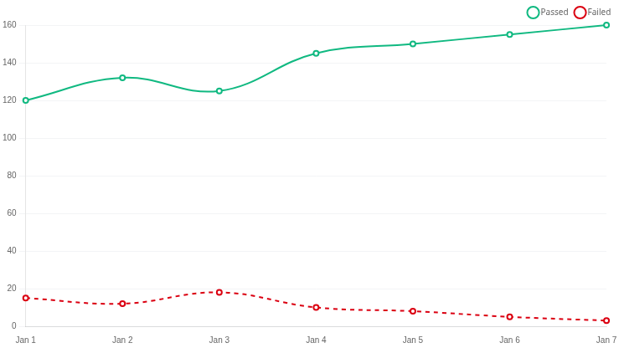






Advanced Reporting & Analytics
INSIGHTS & INTELLIGENCE
SUCCESS RATE
TOTAL TESTS
AVG DURATION
ACTIVE DEFECTS
98.5%
12,450
4m 12s
23
1.2%
Total Executions
15s
Critical: 2
Last 30 Days
Across all environments
Per test suite
Identified by automation
Execution Trends
Daily
Weekly
Language Distribution
Confidential & Proprietary | HSBC Group Technology
TypeScript (45%)
Java (30%)
Python (15%)
C# (10%)
Allure Test Reports Integration
Screenshots
Video Replay
Console Logs
Network Traces
Rich visualizations with timeline view, behaviors, and graphs

Slide 8








Test Execution Engine
INFRASTRUCTURE & SCALABILITY
A high-performance execution grid built on Playwright, capable of running thousands of tests in parallel across diverse environments with real-time observability.
Playwright Core Engine
Parallel & Multi-Browser
Real-Time Observability
Leverages the modern Playwright architecture for reliable, flaky-free execution. Supports environment-specific configurations to seamlessly switch between Dev, Staging, and Production.
Maximize throughput with intelligent test sharding and parallel execution across all modern browser engines. Ensure consistent behavior for all customer touchpoints.
Watch tests execute live via secure WebSocket connections. Access instant console logs, network traces, and video recordings for rapid debugging of failures.
Auto-wait Mechanism
Live Trace Viewer
Configurable Retries
Chromium
Firefox
WebKit
Video Replay
Confidential & Proprietary | HSBC Group Technology
Key Outcomes
Reduced Feedback Time
Total Coverage
Secure Execution
From hours to minutes via parallelism
Validate on all supported browsers
Isolated containers for data safety

Slide 9









Enterprise-Grade Security
PLATFORM PROTECTION
Built with banking standards in mind, our platform employs a multi-layered security approach ensuring data integrity, strict access control, and compliance with HSBC's security protocols.
Identity & Access
Data Protection
Network Defense
Robust identity management using JWT-based authentication with separate access and refresh tokens. Granular Role-Based Access Control (RBAC) ensures least-privilege access.
Industry-standard cryptography for all sensitive data. Passwords are secured using bcrypt hashing. Application security headers (Helmet) protect against common web vulnerabilities.
Comprehensive API protection including strict CORS policies, intelligent rate limiting to prevent abuse, and rigorous input validation to block injection attacks.
JWT + Refresh Tokens
Bcrypt Hashing
CORS
Rate Limiting
Granular RBAC
Helmet Security Headers
Input Sanitization
XSS Protection
Confidential & Proprietary | HSBC Group Technology
Compliance & Trust
Audit Ready
Zero Trust
Attack Prevention
Traceable logs for all actions
Identity-first security model
Proactive input scanning

Slide 10









Extension Integration
BROWSER TOOLS
Leverage the power of modern browser capabilities with a secure, performant Manifest V3 Chrome extension designed for seamless, zero-friction testing workflows.
Manifest V3 Core
Seamless Interface
Power Tools
Built on the latest Chrome extension standard using Service Workers for improved security and performance. Eliminates persistent background processes to reduce memory footprint.
Features a dedicated Side Panel UI that keeps recorder controls accessible without obstructing the application under test. Content scripts inject securely to capture precise DOM interactions.
Boost developer productivity with configurable keyboard shortcuts for rapid recording control, context menu integration for quick assertions, and custom locator builders.
Enhanced Security Model
Side Panel API
Custom Hotkeys
Event-Driven Workers
Shadow DOM Support
Context Menus
Confidential & Proprietary | HSBC Group Technology
Key Advantages
Enterprise Compliant
Non-Intrusive
Frictionless
Google Store Policy Ready
Zero impact on test app layout
No context switching required

Slide 11














High-Level Platform Architecture
SYSTEM DESIGN
EXPERIENCE
Chrome Extension
Web Portal
Manifest V3 • Recorder • Locator Builder
Dashboard • Management • Analytics
ECOSYSTEM INTEGRATIONS
CI/CD Pipelines
ENTERPRISE SECURITY & IDENTITY (SSO/JWT)
Jira / ALM
API GATEWAY / LOAD BALANCER
REST
WebSocket
Slack / Teams
SERVICES LAYER
GitHub / GitLab
Recording
AI Engine
Test Mgmt
Executor
Analytics
Interaction Capture & Translation
Self-Healing & Optimization
Versioning & Workflow
Playwright Orchestration
Reporting & Metrics
All services are containerized and deployed via Kubernetes with horizontal autoscaling.
DATA LAYER
Test Repository
Results Store
Vector DB
Confidential & Proprietary | HSBC Group Technology
PostgreSQL
S3 / MinIO
AI Context

Slide 12




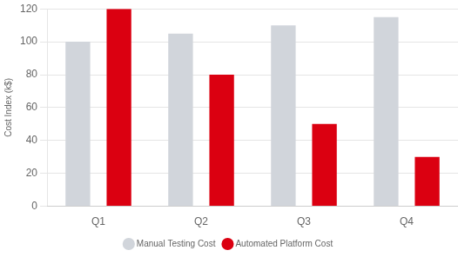
Business Value & ROI
STRATEGIC IMPACT
Delivery Velocity
Cost Efficiency
Risk & Compliance
Accelerate release cycles by reducing regression testing time from days to hours. Enable continuous delivery pipelines.
Reduce manual testing overhead and maintenance costs through AI-driven self-healing scripts and reusable components.
Ensure regulatory compliance with comprehensive audit trails, standardized reporting, and increased test coverage.
60% Faster Time-to-Market
40% Lower OpEx
100% Audit Readiness
Projected Annual Impact (Year 1)
Cost Projection: Manual vs. Automated
TOTAL SAVINGS
ROI
$2.4M
350%
Labor & Infrastructure
Break-even in Month 4
DEFECT PREVENTION
EFFICIENCY GAIN
$850k
12,000h
Cost Avoidance
Hours Repurposed
Confidential & Proprietary | HSBC Group Technology
Strategic Adoption Plan
Phase 1: Pilot
Phase 2: Core Banking
Phase 3: Global Rollout
Phase 4: Optimization
Q1 2026
Q2-Q3 2026
Q4 2026+
2027+
Deploy to 2 high-priority agile squads. Establish baseline metrics and refine governance workflows.
Scale to Retail & Wealth portfolios. Integrate with main CI/CD pipelines and standardize reporting.
Enterprise-wide adoption across all geographies. Enable cross-team component sharing and advanced AI features.
Full maturity. Focus on predictive quality analytics and autonomous test generation.

Slide 13









Next Steps & Execution Strategy
PATH FORWARD
Proposed Implementation Timeline
Discovery
Pilot Program
Scale-out
2 Weeks
4–6 Weeks
Quarterly Waves
• Stakeholder alignment
• Top 2 critical journeys
• Enterprise rollout
• Environment access
• Integration setup
• Team enablement
• Security review
• Initial KPI measurement
• Advanced AI adoption
Immediate Actions
Support & Enablement
Confirm Scope & Stakeholders
PRIMARY CONTACT
Identify key decision makers and pilot application owners.
Platform Enablement Team
Select Pilot Applications
Dedicated support for HSBC implementation
Choose 2-3 high-impact, medium-complexity user journeys.
test-automation@hsbc.com
Confidential & Proprietary | HSBC Group Technology
Define Success Metrics
Book a Technical Workshop
Establish baseline benchmarks for current testing efforts.
View Internal Documentation
Schedule Deep-Dive Demo
Technical session with architecture and security teams.
Security Review Status
Pre-Approved

