Slide 2
CPU
GPU
Interaction
Brushing Linking
Animation
Dynamic Query
Processing
Aggregation
Incremental query
Filtering
Visualization
Histogram
Parallel coordinate
Dynamic
Raw Data
Vertex Buffer Objects

Slide 3
Exclusive Filter
Negative
Exclusive Filter
Highlight Filter
Raw Data
Filtered Data
Highlight Filtered Data
Geometry Data
Highlight
Geometry Data
GPU Processing
Rendering Data
Highlight
Rendering Data
GPU Rendering
GPU Vertex Buffer Objects

Slide 4
Time Windows
Exclusive Filter
Negative
Exclusive Filter
Highlight Filter
Raw Data
Filtered Data
Highlight Filtered Data
GPU Processing
Geometry Data
Highlight
Geometry Data
Data Views
Rendering Data
Highlight
Rendering Data
GPU Rendering
GPU Vertex Buffer Objects

Slide 5
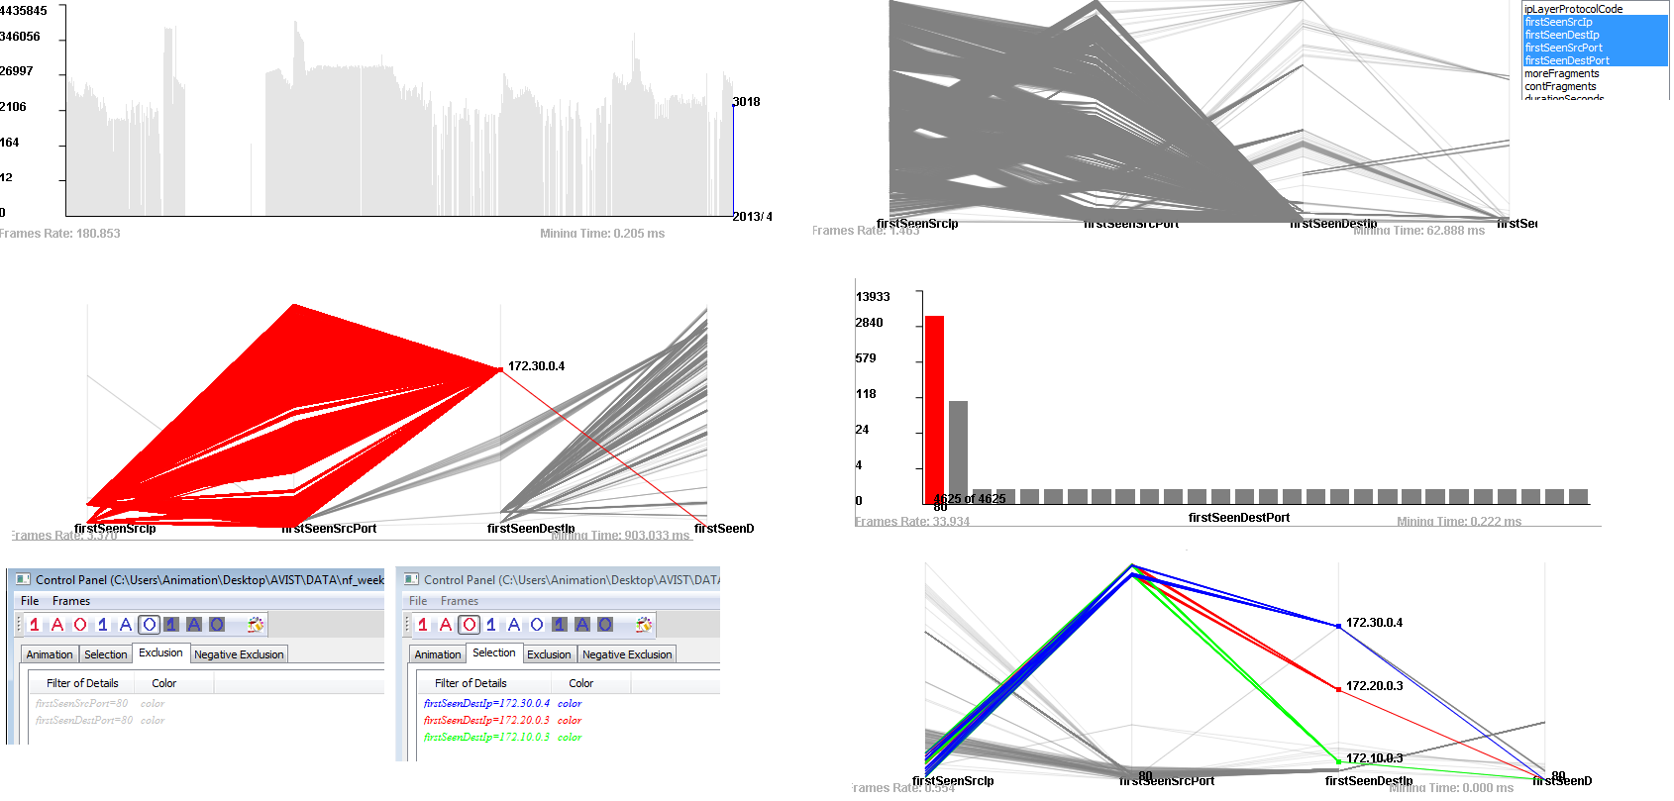
2
1
3
4
7
5
6

Slide 6
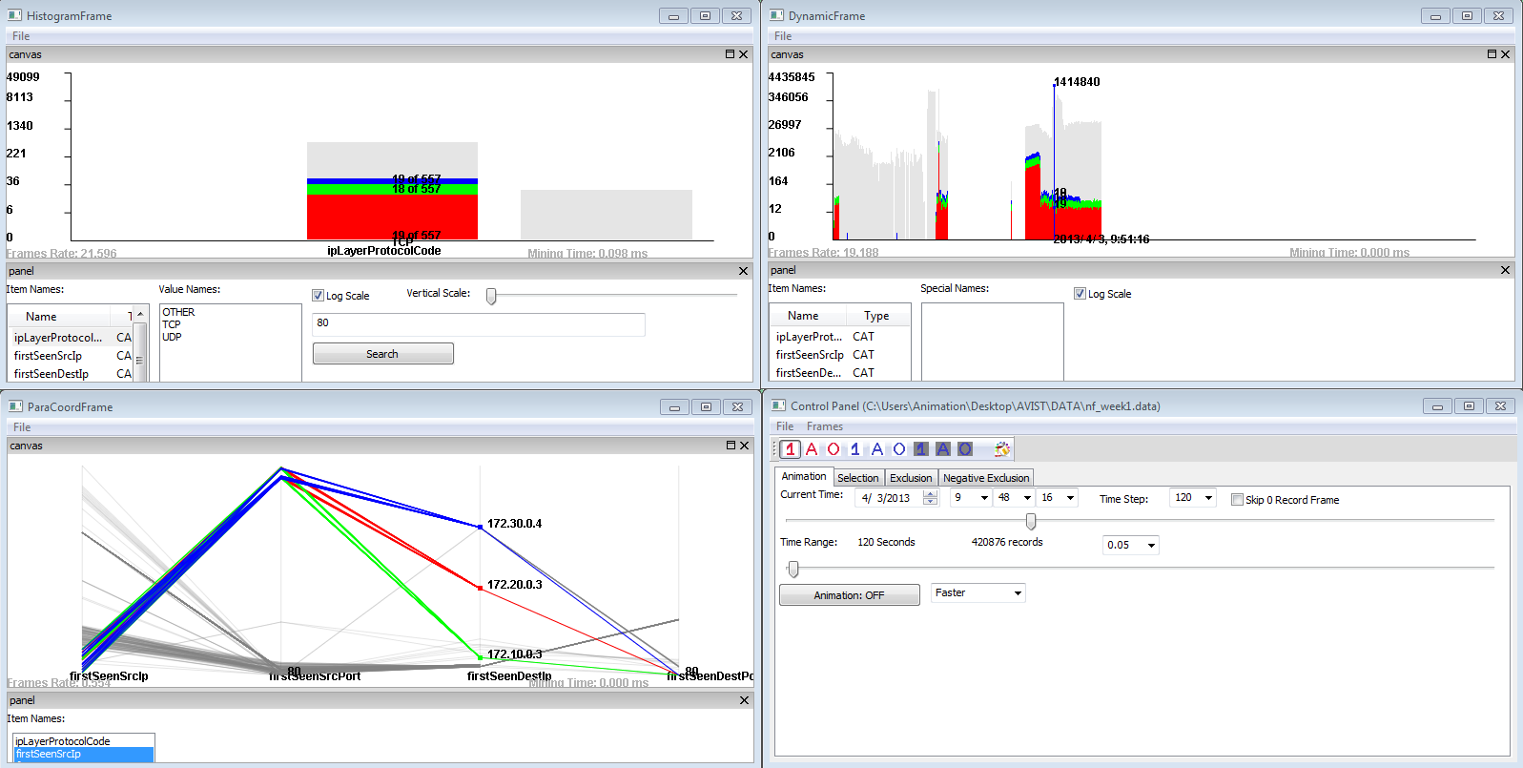
1
2
3
4
Highlight Filters
Exclusive Filters
Negative Exclusive Filters
Color Picker
Or Mode
And Mode
One Mode

Slide 7
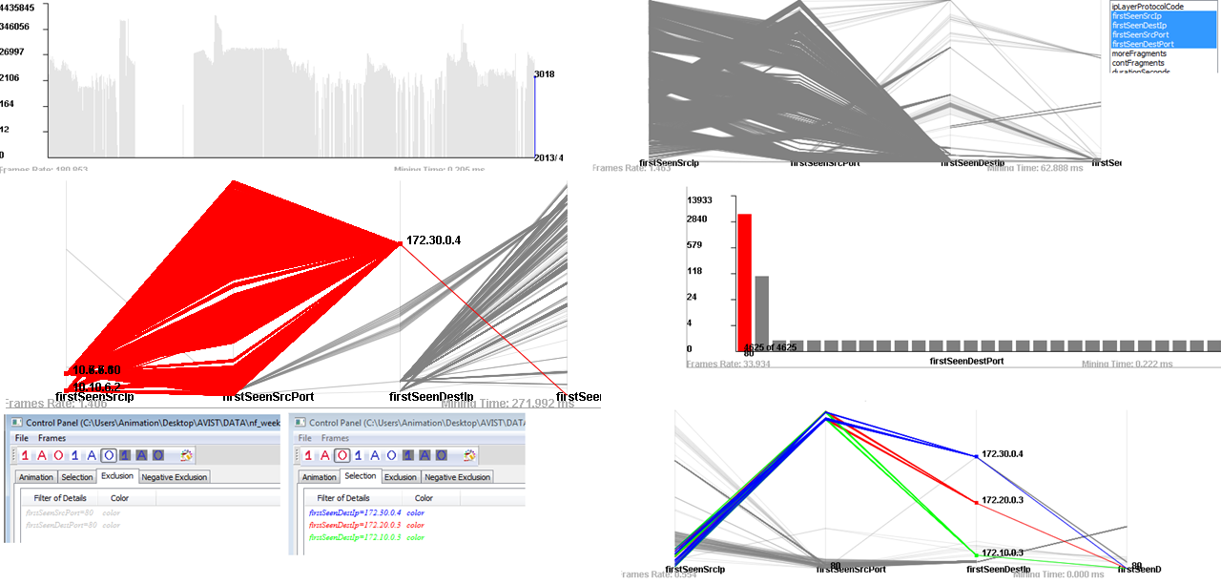
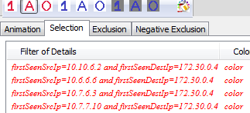

Slide 8
1
2
3
4
7
5
6

Slide 9
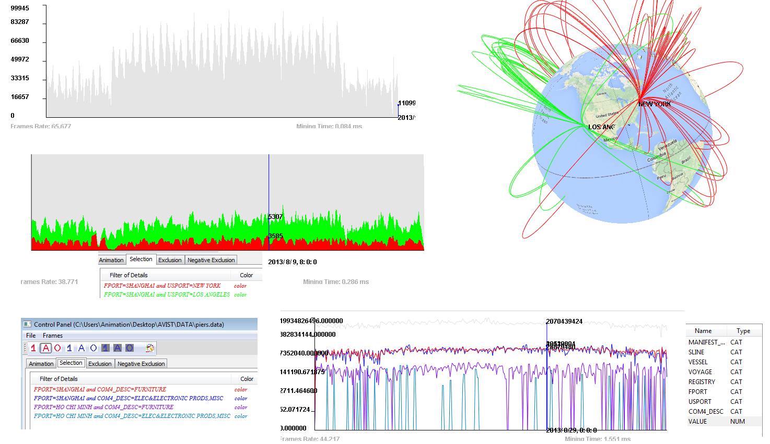
1
2
3
5
4

Slide 11
Time Windows
Exclusive Filter
Negative
Exclusive Filter
Highlight Filter
Raw Data
Filtered Data
Highlight Filtered Data
Geometry Data
Highlight
Geometry Data
GPU Processing
Data Views
Rendering Data
Highlight
Rendering Data
GPU Rendering
GPU Vertex Buffer Objects

