Slide 1
Developing a Solution for Multimedia Home Networking
Peng Liu
Supervisor: Prof. Raimo A. Kantola
Advisor: D.Sc. (Tech.) Mikko Valimaki
12-May-2015
Thesis work conducted at Tuxera Inc., Helsinki
12/05/2015 Otaniemi, Finland

Slide 2
Outline
Motivation and Aims
Background
Available standards
Implementation
Results
Conclusion
Future Work and Future of Home networking

Slide 3
Motivation and Aims

Slide 4
Motivation and Aims
People’s lives are being digitalized. This digitalization can be seen in the increasing number of home multimedia devices, such as digital TVs, smart phones, digital cameras, tablets, PCs, laptops and NAS (Network Attached Storage).
Networking is being rapidly adopted at homes. In a typical home scenario, most of these devices are connected to a local network, such as a Wi-Fi hot spot, in order to allow music, pictures, videos and other content to be ported across different devices.

Slide 5
Motivation and Aims
Although several widely used multimedia-streaming solutions have become available in the market, they are not compatible with each other. Moreover, even devices using the same standard are not always compatible with each other, since the implementation approaches may vary from device to device.
These compatibility issues have motivated the need to determine the technological features common to the popular standards and to develop a more easy-to-use multimedia home networking solution based on more advanced technologies.

Slide 6
Background

Slide 7
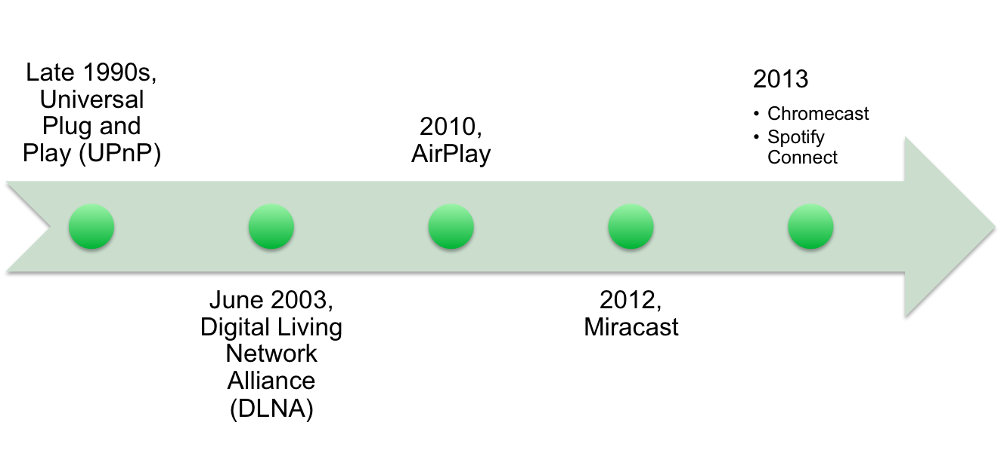
Background
History of home networking development and five most popular home networking solutions.

Slide 8
Available standards

Slide 9
Universal Plug and Play (UPnP)
UPnP Device Architecture
  Addressing
  Discovery
  Description
  Control
  Eventing
  Presentation

Slide 10
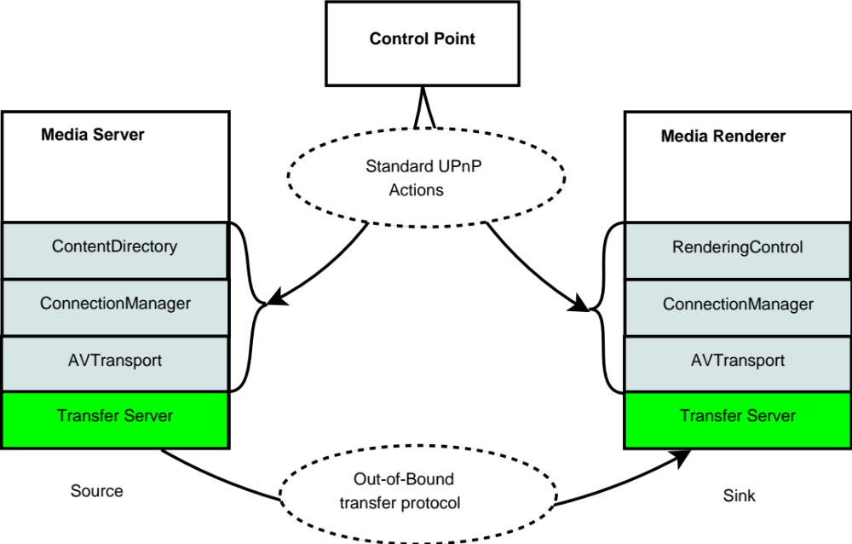
Universal Plug and Play (UPnP)
UPnP Audio/Video Architecture

Slide 11
Digital Living Network Alliance (DLNA)
Key Technology Ingredients
Functional Components | Technology Ingredients
Connectivity | Ethernet, 802.11 (including Wi-Fi Direct) MoCA, HPNA and Bluetooth
Networking | IPv4 Suite
Device Discovery and Control | UPnP* Device Architecture v1.0
Media Management and Control | UPnP AV and UPnP Printer:1
Media Formats | Required and Optional Format Profiles
Media Transport | HTTP(Mandatory), HTTP Adaptive Delivery(DASH) and RTP
Remote User Interface | CEA-2014-A

Slide 12
AirPlay
Service discovery
  Multicast DNS (RFC 6762)
Video streaming
  HTTP POST/GET for control channel
  HTTP / Adaptive HTTP for streaming
Photo streaming
  HTTP POST/GET for control channel
  HTTP PUT for sending image (photo as HTTP body)
Music streaming
  Remote Audio Output Protocol (RAOP) (RTP-like protocol)

Slide 13
AirPlay
Screen mirroring
  Transmitting an H.264 encoded video stream over a TCP connection
  Network time protocol (NTP) is used for synchronization
Authentication
  Implemented using standard HTTP Digest Authentication (RFC 2617), over RTSP for AirTunes, and HTTP for everything else.

Slide 14
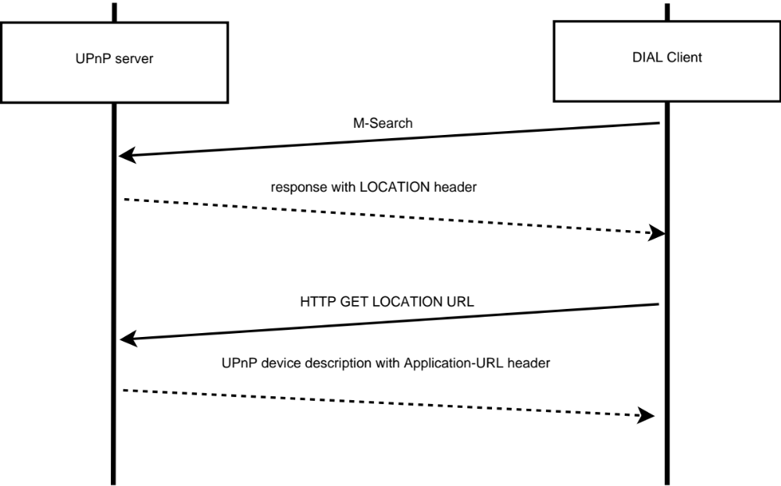
DIscovery And Launch (DIAL)
DIAL discovery service
  Based on Simple Service Discovery Protocol (SSDP)

Slide 15
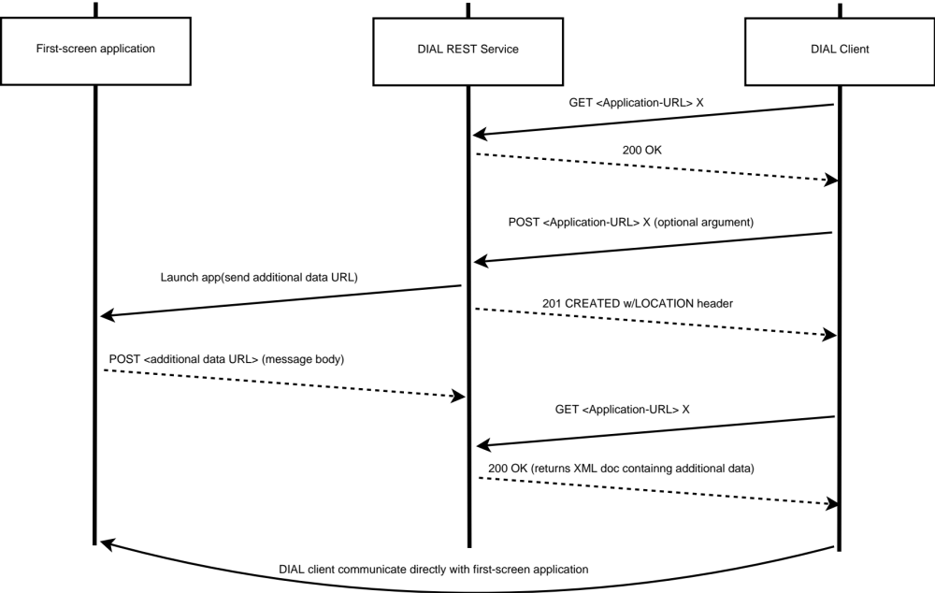
DIscovery And Launch (DIAL)
DIAL REST service

Slide 16
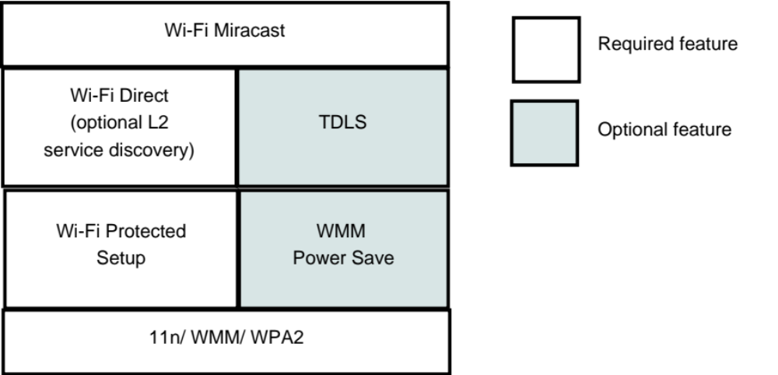
Miracast
Proposed by Wi-Fi Alliance in 2012
Utilize Wi-Fi alliance building blocks developed over the years

Slide 17
Comparison of four standards
- Technology used
Standards | Device discovery | Control Protocol | Streaming protocol
DLNA | SSDP | UPnP/HTTP | HTTP
AirPlay | Multicast DNS | HTTP/RTSP | HTTP/RTP
DIAL | SSDP | DIAL/HTTP | HTTP
Miracast | Wi-Fi direct | RTSP | RTP

Slide 18
Comparison of four standards
- Advanced features
Feature | DLNA | AirPlay | DIAL | Miracast
Screen mirroring | No | Yes | No | Yes
Multiple connection | Yes | No | No | No
Authentication | No | Yes | No | Yes

Slide 19
Implementation

Slide 20
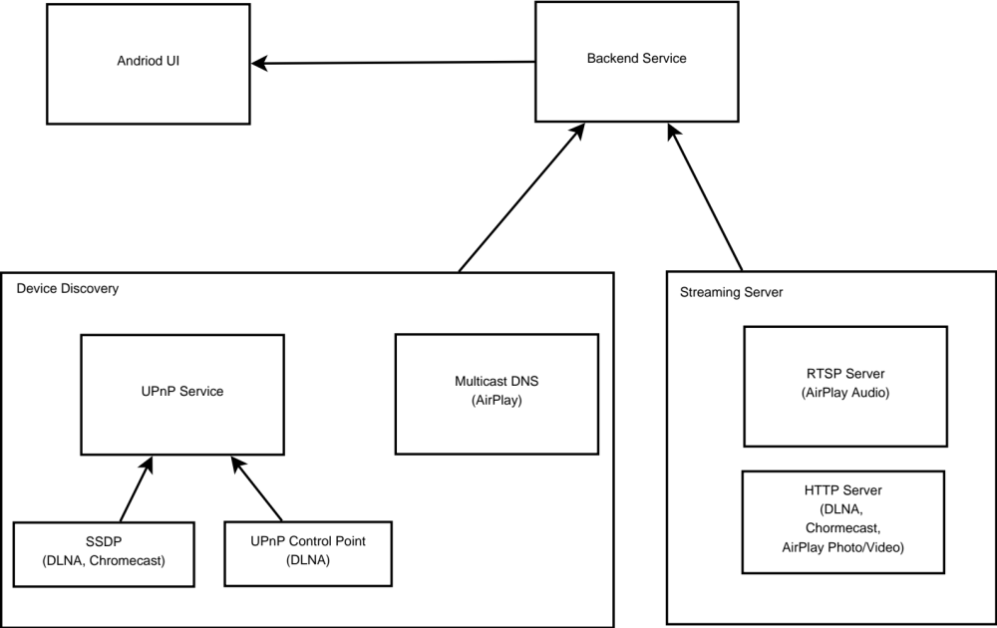
Architecture

Slide 21
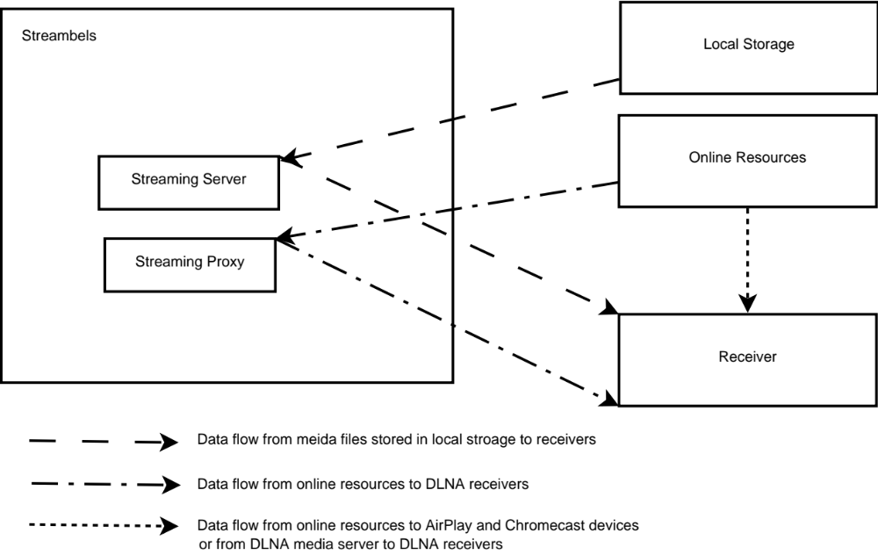
Data flow

Slide 22
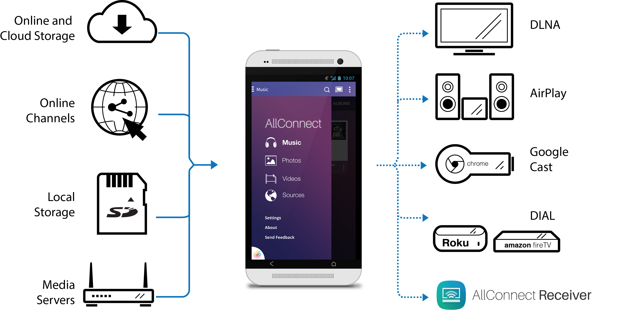
UX Design
Ref: http://www.allconnectapp.com

Slide 23
Features
Play local contents on phone (multimedia player).
Compatible with AirPlay, DLNA, Chromecast and FireTV receiver devices.
Stream from DLNA media server to any kind of receivers, regardless of their standard.
Stream from online channels, such as YouTube, Viemo, and Facebook.

Slide 24
Results

Slide 25
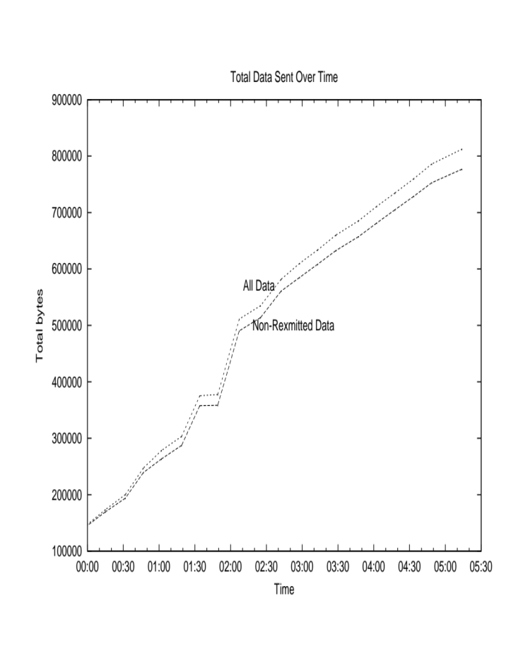
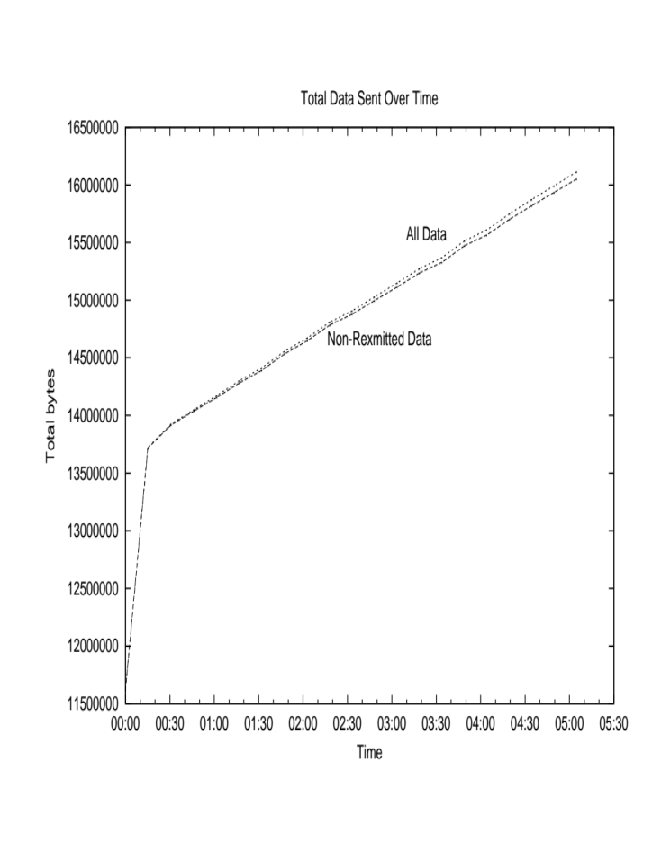
Streaming performance evaluation
DLNA(HTTP) and AirPlay(RAOP) Music streaming
AirPlay
DLNA

Slide 26
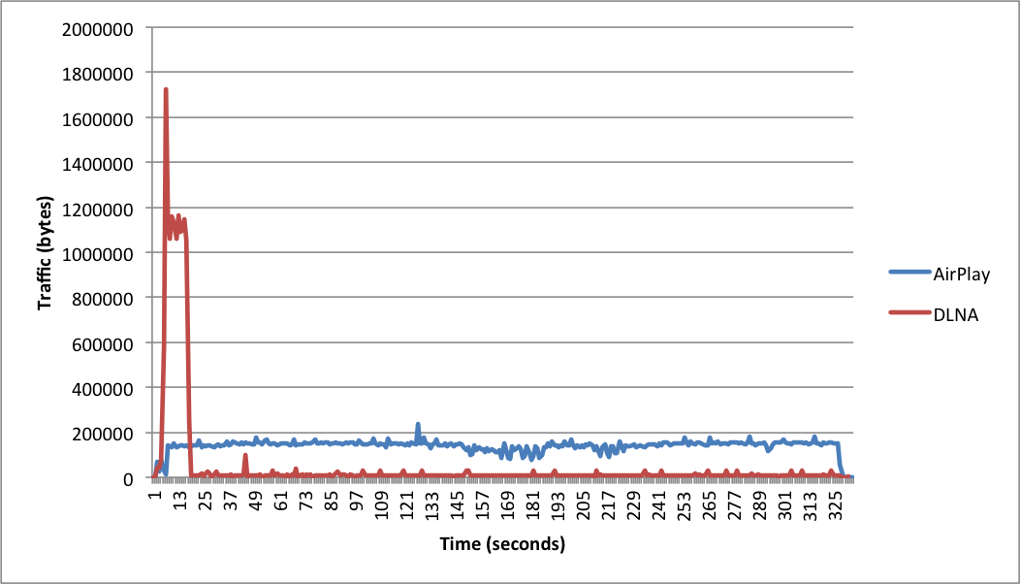
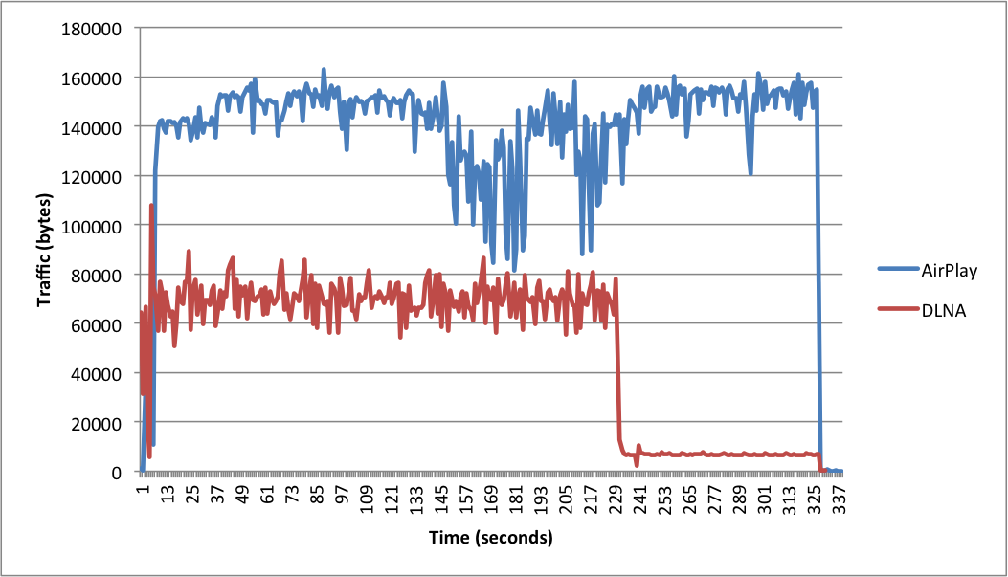
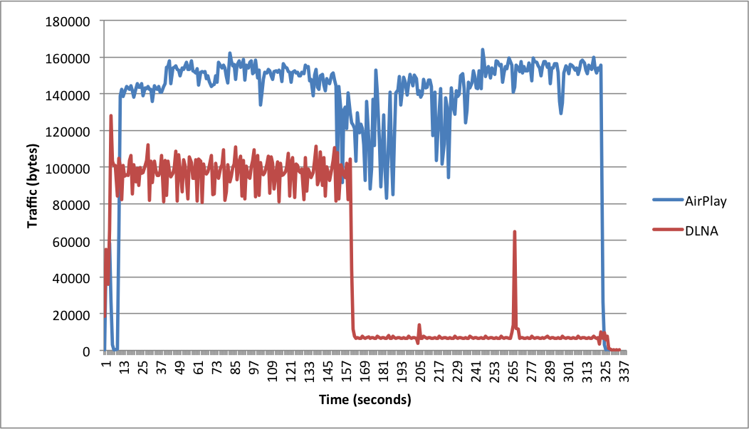
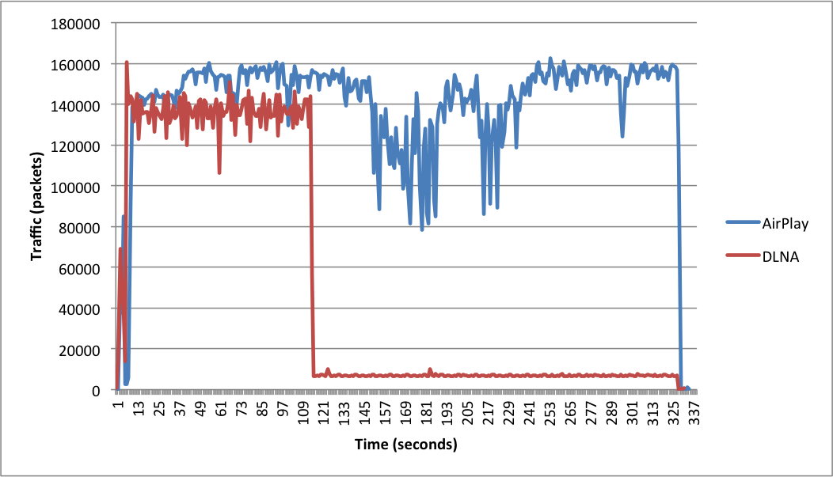
Streaming performance evaluation
Bandwidth limited scenario
No Limit
500kbps
700kbps
1000kbps

Slide 27
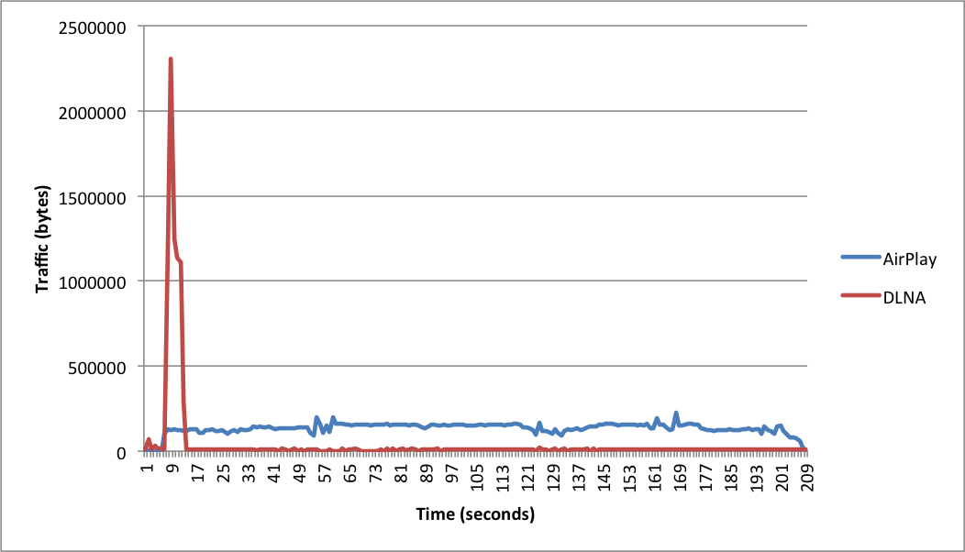
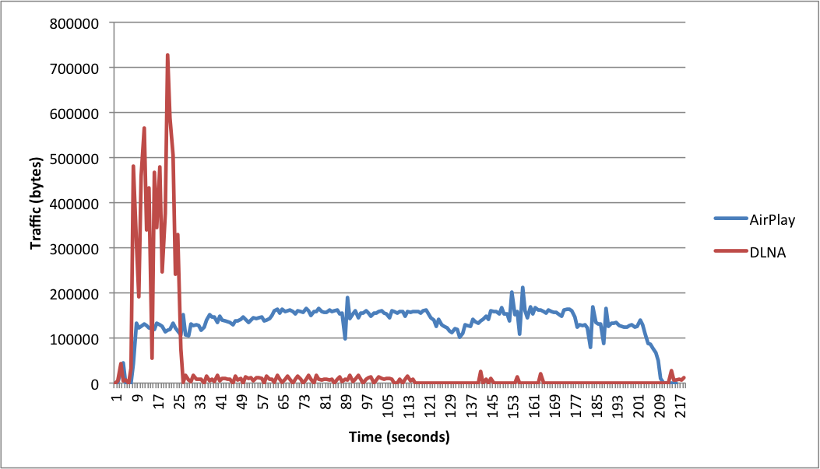
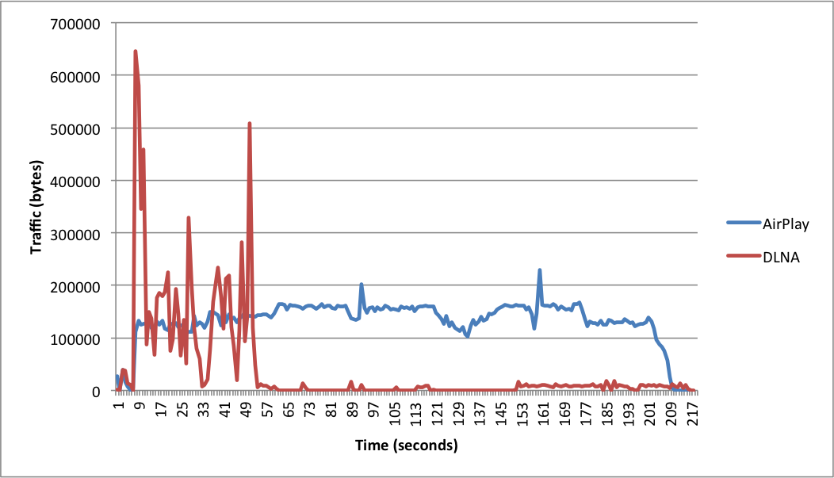
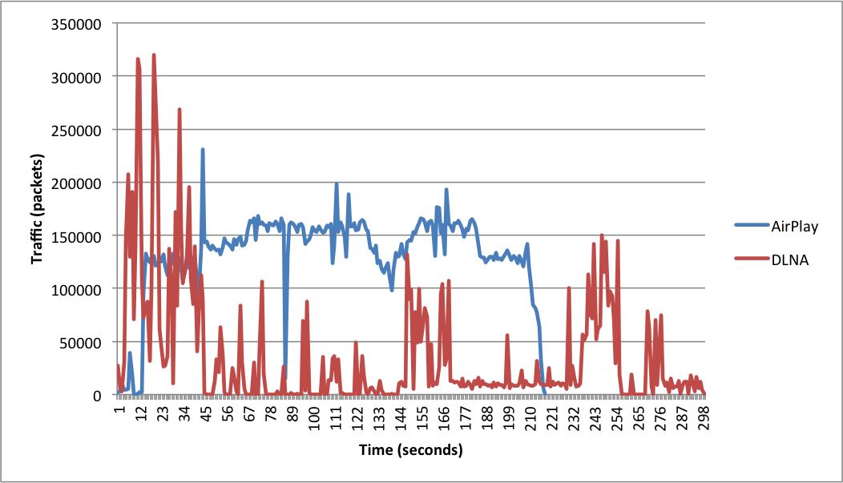
Streaming performance evaluation
Packet loss scenario
No Limit
5% packet loss
10% packet loss
15% packet loss

Slide 28
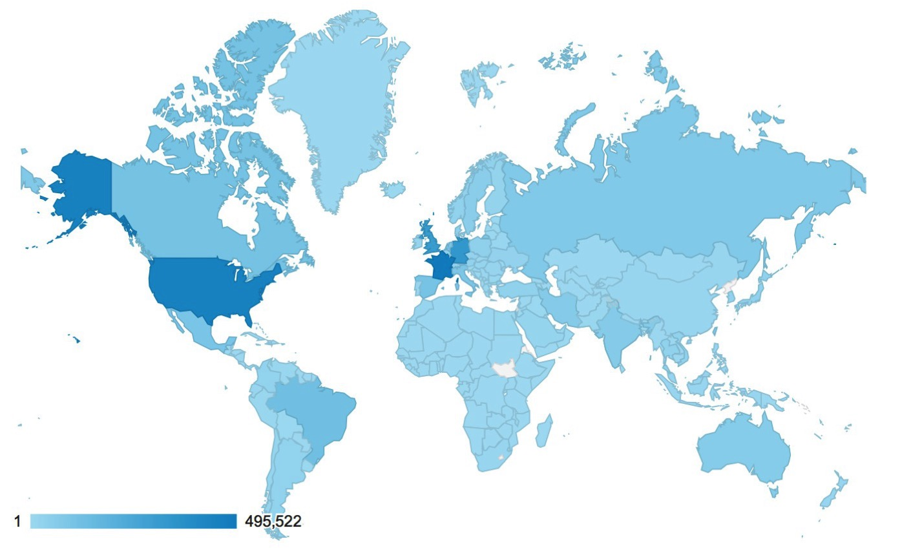
Statistics
User map
  One million Downloads over 16 months

Slide 29
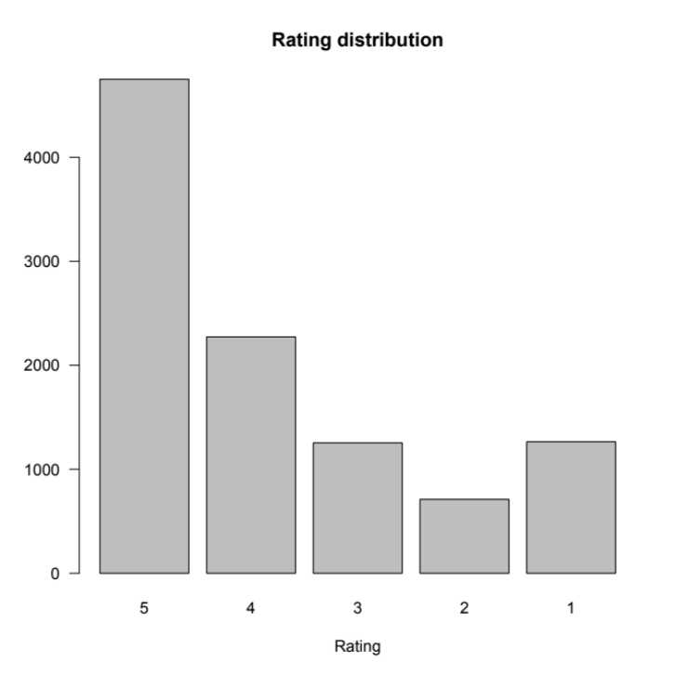
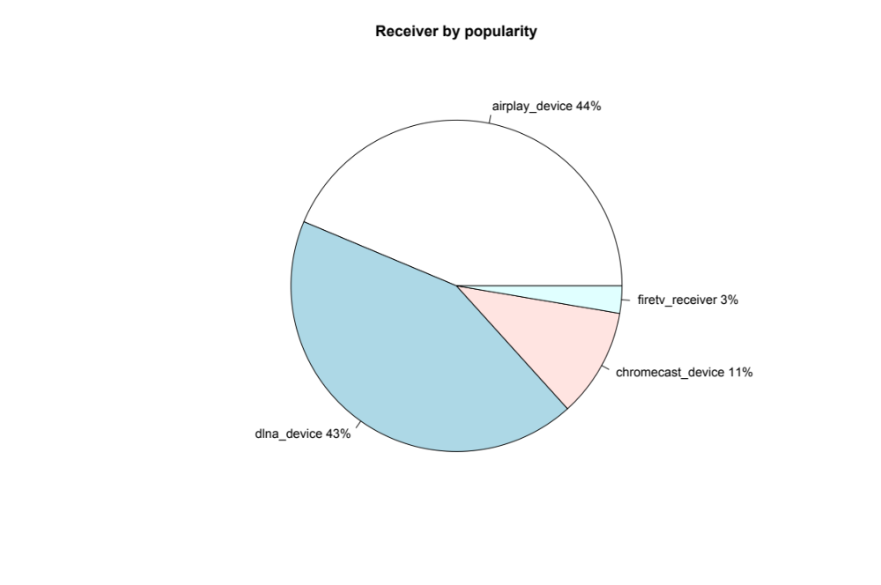
Statistics
User rating
  Average 3.9, with half of total users gave 5 stars
Receiver popularity

Slide 30
Conclusion

Slide 31
Conclusion
Since its initial launch, this application has received over one million downloads and a daily active user total of over 15000. People from 99% percent of all the countries worldwide have downloaded and tried this solution. All these statistics have proven that this solution is competitive for multimedia home networking.
As more manufacturers are involved in the development of home networking, new standards are being pushed on the market constantly. It may not be possible to develop a single system that support all future protocols. The problem of multimedia home networking is still not completely solved.

Slide 32
Future Work and Future of Home networking

Slide 33
Further development
Support for more platforms
Developing an Software Development Kit
Integration of receiver functionality
Support for multi-session
Optimization for codec
In-kernel media server

Slide 34
Future of multimedia home networking
Device discovery
  It seems mDNS will finally overtake SSDP due to its flexibility.
  There is still a long way to go since UPnP has a strong alliance, including hundreds of companies.
Information exchange
  Future development of a home networking solution might opt for RESTful rather than SOAP, in order to provide higher flexibility and lower overhead.

Slide 35
Future of multimedia home networking
Streaming protocol
  Both HTTP and RTSP will be used in future home networking. For the streaming of recorded media, HTTP streaming has an advantages over RTSP due to the buffer system. On the other hand, for screen mirroring and other usages where the content needs to be synchronized precisely, RTP would be a better solution.
Internet of Things
  The multimedia home networking might move towards the Internet of Things, and all the data could be aggregated and accessed anywhere in the world.

Slide 36
Thank you!
Questions and comments?

