Slide 1
Creating interactive vario-scale web maps
Dongliang Peng
Section GIS Technology, Delft University of Technology
Notes:
Hello everybody!
This talk is to introduce the gradual kip project.
I will talk about the background of the project and the technology we need to develop for the usability test.

Slide 2

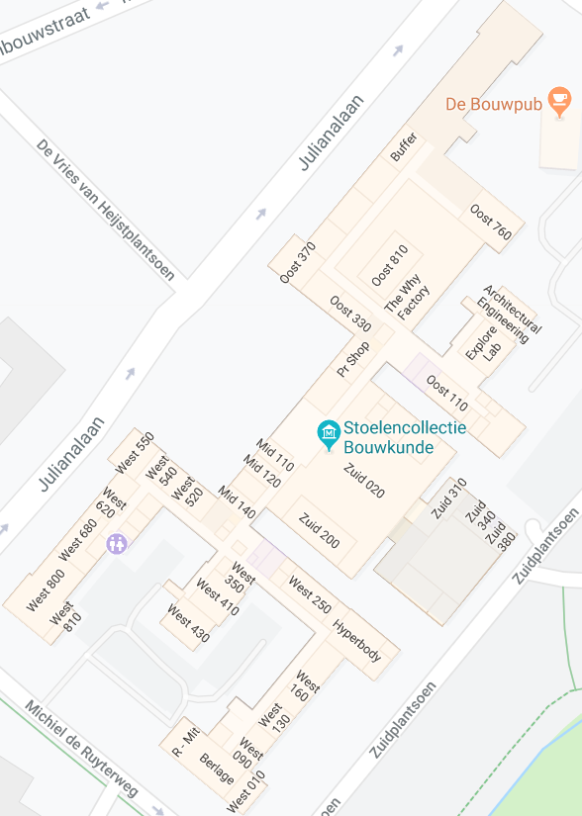
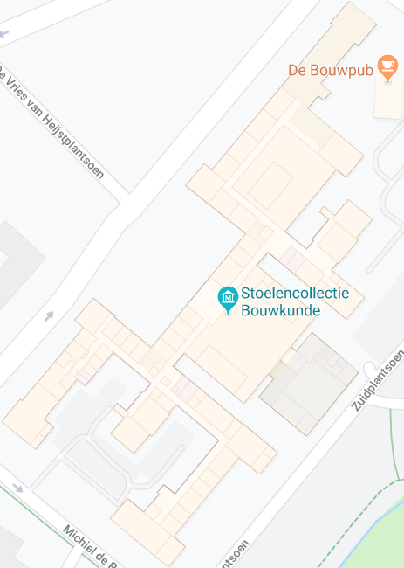
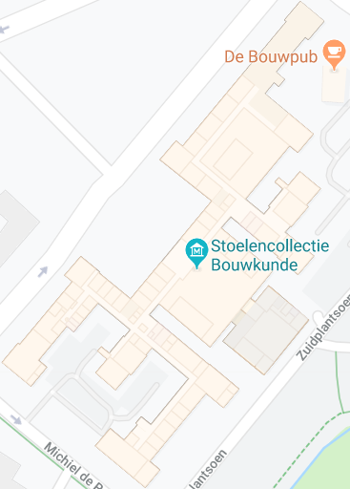
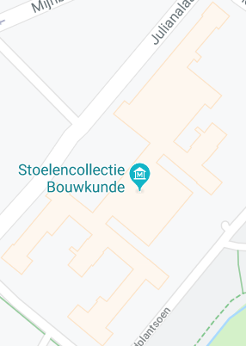
Smooth changes of maps allow users to follow zooming more easily [e.g., van Kreveld 2001]
Zooming of digital maps are more and more gradual
An example of gradual changes
Zoom out
Zoom out
Zoom out
[Google Maps]

Slide 3
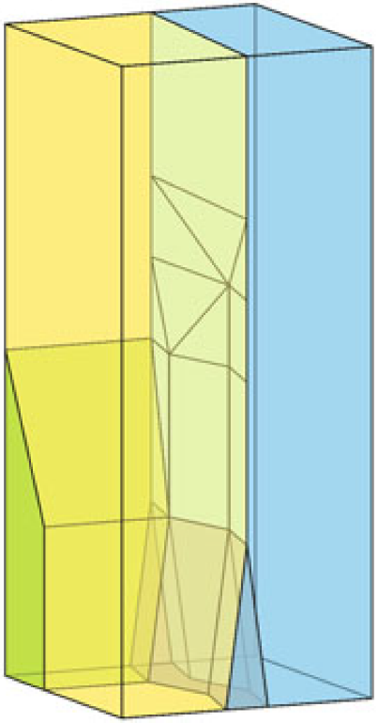
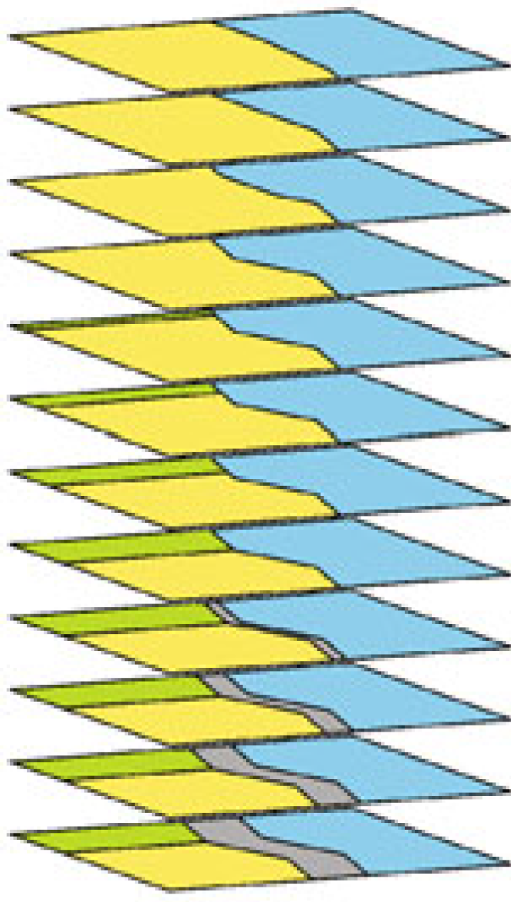
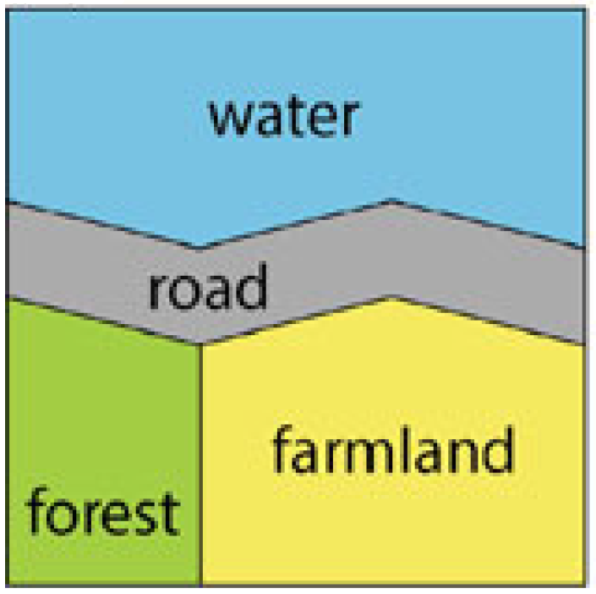
SSC and vario-scale map
Space scale cube (SSC): Data structure for encoding 2D map with generalization [van Oosterom et al. 2014]
Vario-scale map has the property that a change of scale results in a change of the map
Slice
Zoom
out
Map at a large scale
Space-scale cube
Outputs of vario-scale map

Slide 4
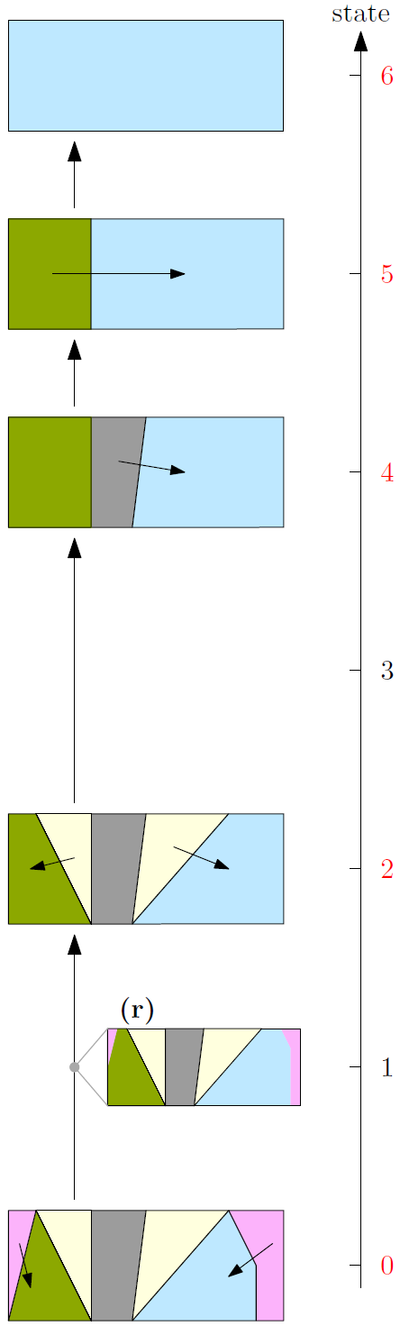
Implement the map
Python: prepare SSC data in the .obj file format
For example (v: vertex; f: face)
v 0.0 0.0 0.0 v 0.0 1.0 0.0 v 1.0 0.0 0.0 f 1 2 3
HTML: design web page of the map
JavaScript: implement map functionalities (e.g., zooming, panning, opacity)
WebGL: guide GPU to draw the map
Server Apache: host the web map
SSC (viewed by ParaView)

Slide 5
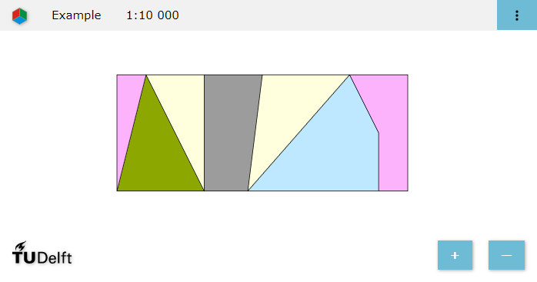
An instance
https://pengdlzn.github.io/webmaps/2020/10/merge/eg-7-parallel-merging.html

Slide 6
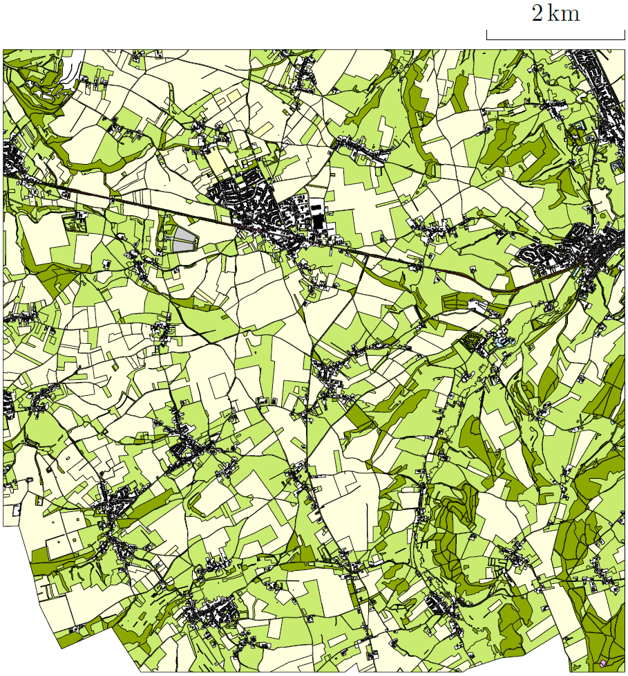
Real data set
Topographic map
Place: South of Limburg
Scale: 1: 10,000
Number: 13,238 areas
From Kadaster

Slide 7
Comparison
Comparison between single merging and parallel merging
Parallel merging provides a smoother animation
Left: single merging
Right: parallel merging
https://pengdlzn.github.io/webmaps/2020/10/merge/top10nl-0.1.html

Slide 8
Conclusion
Explained SSC and vario-scale maps
Showed how to implement a vario-scale map
Used a local server to host the vario-scale web map
Homework: use GitHub to host the vario-scale web map
More information: https://pengdlzn.github.io/events/interactive-online-maps/
Thanks for your attention!
Questions?
dr. Dongliang Peng d.l.peng@tudelft.nl http://www.gdmc.nl/staff/ tel.: +31618189295

