Slide 1
STA 311 Statistical Computing & Data Management
Instructor: Cheng Peng, Ph.D.
Department of Mathematics
West Chester University
West Chester, PA 19383
Office: 25 University Avenue, RM 111
Phone: 610.436.2369
Email: cpeng@wcupa.edu

Slide 2
Topics for This Week
Subsetting and Splitting
Subseeting Records
Partial Reading- FIRSTOBS, OBS
Conditional extraction: IF-THEN-ELSE, WHERE
Subsetting Variables
Selecting designate variables: SELECT
Dropping designate variables: DROP
Splitting
Conditional output of multiple data sets:
IF-THEN-OUTPUT, SELECT-WHEN-OUTPUT-END

Slide 3
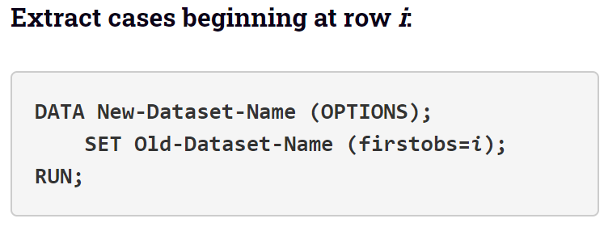
Extracting Records
Some Keywords: FIRSTOBS, OBS,

Slide 4
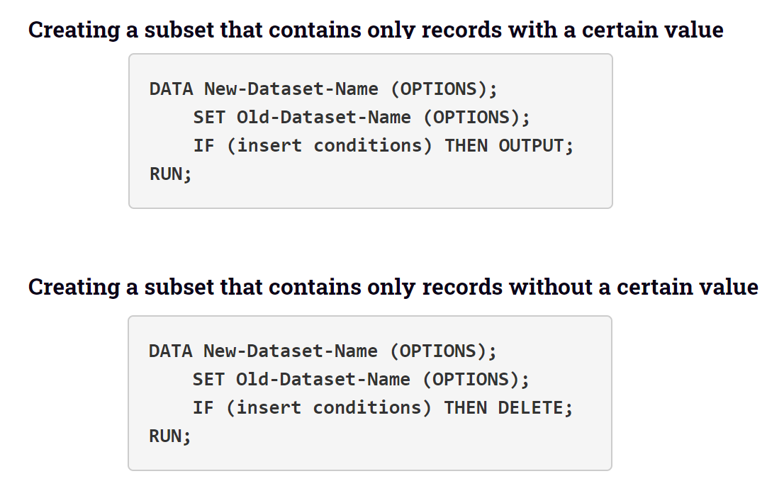
Subsetting Datasets by Conditions
Some Keywords: IF-THEN-ELSE, WHERE, IN

Slide 5
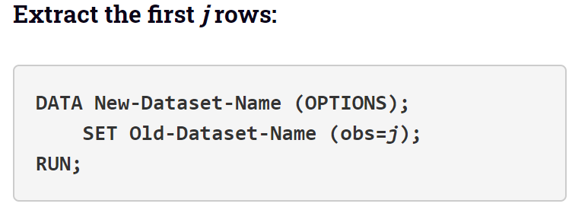
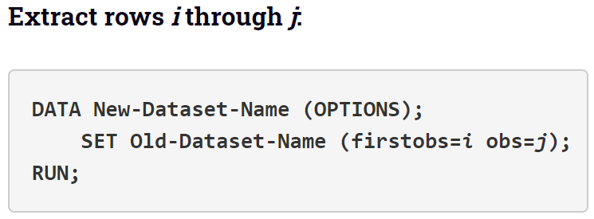
Extracting Records

Slide 6
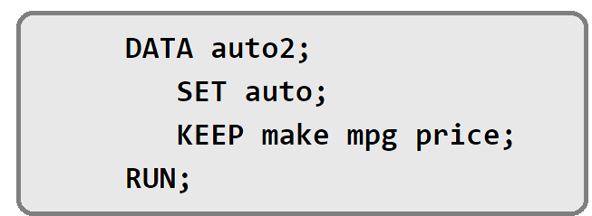
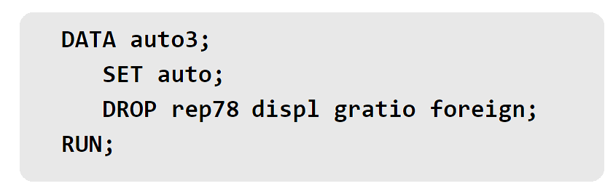
Extracting Variables

Slide 7
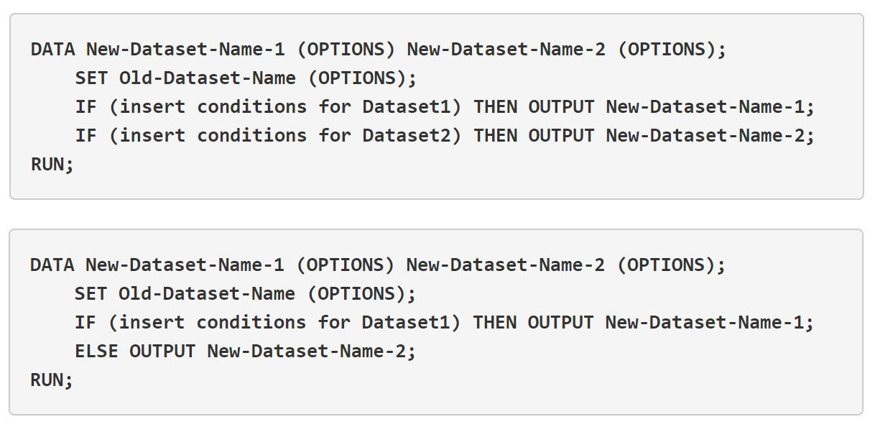
Splitting Data Sets

Slide 8
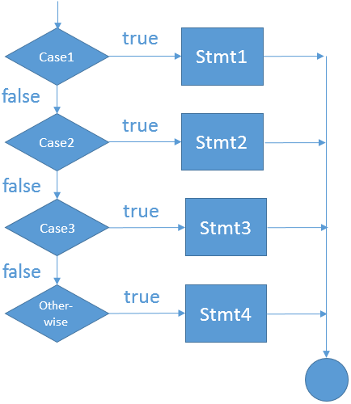
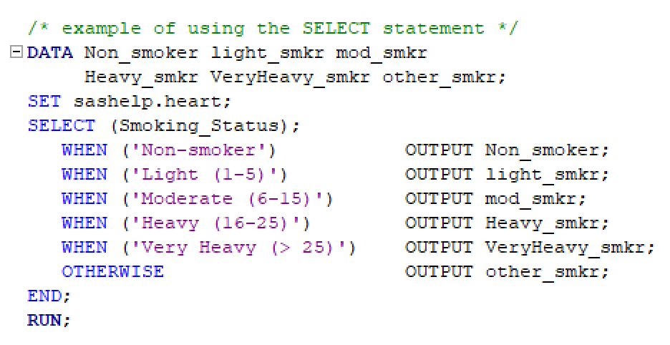
The SELECT statement in the SAS DATA step
Caution: the values of the selected variable MUST be exhausted with WHEN-OTHERWISE clauses

Slide 9
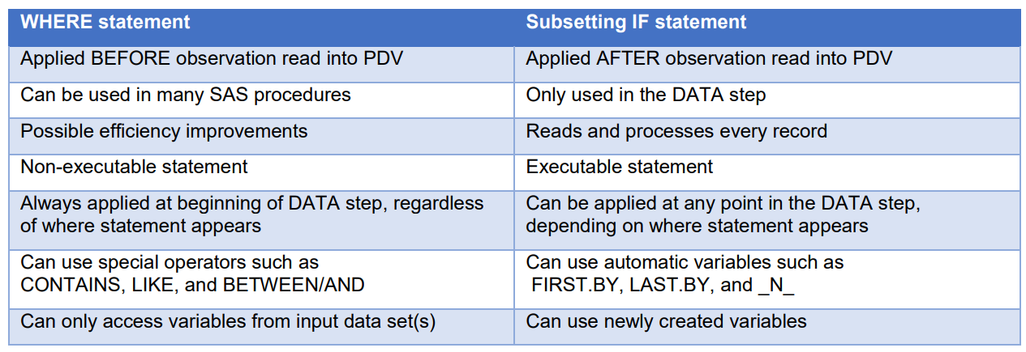
WHERE and IF Statements

