Slide 1
STA 311 Statistical Computing & Data Management
Instructor: Cheng Peng, Ph.D.
Department of Mathematics
West Chester University
West Chester, PA 19383
Office: 25 University Avenue, RM 111
Phone: 610.436.2369
Email: cpeng@wcupa.edu

Slide 2
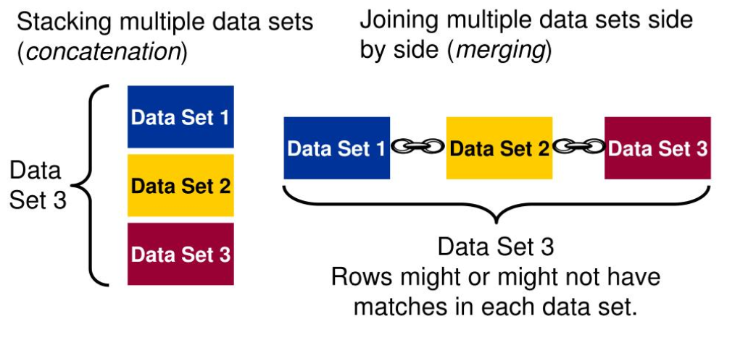
Topics for This Week

Slide 3
Topics for This Week
One-to-one Reading
one-to-one processing – using with caution
Concatenating
stacking with same variable names and types
Data Step options: RENAME, DROP and KEEK
Interleaving
BY statement with PROC SORT
Match Merging
BY statement with Sorting
IN option – Conditioning with “ghost” variables

Slide 4
One-to-One Reading
When performing one-to-one reading, the new data set contains all the variables from all the input data sets. If the data sets contain same-named variables, the values that are read in from the last data set replace those that were read in from earlier ones. The number of observations in the new data set is the number of observations in the smallest original data set.
DATA one2one;
SET dataset_a;
SET dataset_b; RUN;

Slide 5
Concatenating Data Sets
To append the observations from one data set to another data set, we concatenate them by specifying the data set names in the SET statement. When SAS concatenates, data sets in the SET statement are read sequentially, in the order in which they are listed. The new data set contains all the variables and the total number of observations from all input data sets.
DATA concat;
SET dataset_a dataset_b;
RUN;

Slide 6
Interleaving Data Sets
If we use a BY statement when you concatenate data sets, the result is interleaving. Interleaving intersperses observations from two or more data sets, based on one or more common variables. Each input data set must be sorted or indexed in ascending order based on the BY variable(s). Observations in each BY group in each data set in the SET statement are read sequentially, in the order in which the data sets and BY variables are listed, until all observations have been processed. The new data set contains all the variables and the total number of observations from all input data sets.
DATA interlv;
SET dataset_a dataset_b;
BY num;
RUN;

Slide 7
Match-Merge Data Sets
When we combine observations from two or more data sets into a single observation in a new data set according to the values of a same-named variable. This is match-merging, which uses a MERGE statement rather than a SET statement to combine data sets. Each input data set must be sorted or indexed in ascending order based on the BY variable(s). During match-merging, SAS sequentially checks each observation of each data set to see whether the BY values match, then writes the combined observation to the new data set.
DATA merged;
MERGE dataset_a dataset_b;
BY num;
RUN;

Slide 8
How SAS Processes Match-Merge
COMPILING
reads the descriptor portions (variable name, type, length) of the data sets that are listed in the MERGE statement
reads the rest of the DATA step program
creates the program data vector (PDV), an area of memory where SAS builds your data set one observation at a time
assigns a tracking pointer to each data set that is listed in the MERGE statement.
If variables with the same name appear in more than one data set, the variable from the first data set that contains the variable (in the order listed in the MERGE statement) determines the length of the variable.

Slide 9
How SAS Processes Match-Merge
Executing
After compiling the DATA step, SAS sequentially match-merges observations by moving the pointers down each observation of each data set and checking to see whether the BY values match.
If Yes, the observations are written to the PDV in the order in which the data sets appear in the MERGE statement. Values of any same-named variable are overwritten by values of the same-named variable in subsequent data sets. SAS writes the combined observation to the new data set and retains the values in the PDV until the BY value changes in all the data sets.
If No, SAS determines which of the values comes first and writes the observation that contains this value to the PDV. Then the observation is written to the new data set.
When the BY value changes in all the input data sets, the PDV is initialized to missing. The DATA step merge continues to process every observation in each data set until it has processed all observations in all data sets.

Slide 10
How SAS Processes Match-Merge
Handling Unmatched Observations and Missing Values
All observations that are written to the PDV, including observations that have missing data and no matching BY values, are written to the output data set.
If an observation contains missing values for a variable, then the observation in the output data set contains the missing values as well. Observations that have missing values for the BY variable appear at the top of the output data set.
If an input data set doesn't have a matching BY value, then the observation in the output data set contains missing values for the variables that are unique to that input data set.

Slide 11
Some Data Step Options
Renaming Variables
Sometimes you might have same-named variables in more than one input data set. In this case, match-merging overwrites values of the same-named variable in the first data set with values of the same-named variable in subsequent data sets.
To prevent overwriting, use the RENAME= data set option in the MERGE statement to rename variables

Slide 12
Some Data Step Options
Excluding Unmatched Observations
By default, match-merging combines all observations in all input data sets. However, you might want to select only observations that match for two or more input data sets.
To exclude unmatched observations, use the IN= data set option and the subsetting IF statement in your DATA step. The IN= data set option creates a variable (‘ghost’ variable because you cannot see it ☺) to indicate whether the data set contributed data to the current observation.
The subsetting IF statement then checks the IN= values and writes to the merged data set only observations that appear in the data sets for which IN= is specified.

Slide 13
Some Data Step Options
Selecting Variables
You can specify the variables you want to drop or keep by using the DROP = and KEEP= data set options.
When match-merging, you can specify these options in either the DATA statement or the MERGE statement, depending on whether or not you want to process values of the variables in that DATA step.
When used in the DATA statement, the DROP= option simply drops the variables from the new data set. However, they are still read from the original data set and are available within the DATA step.

Slide 14
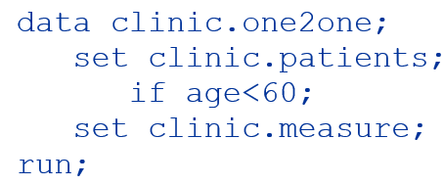
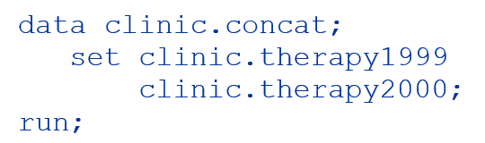
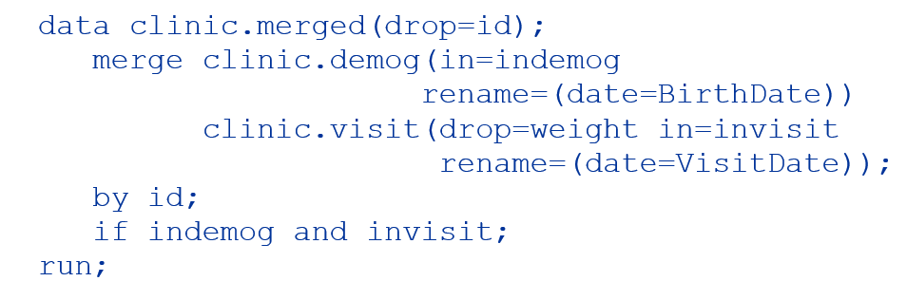
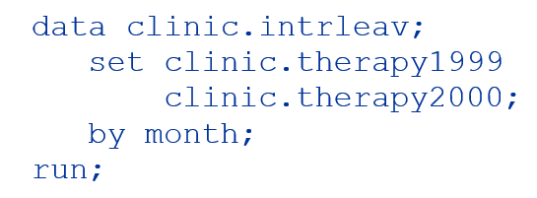
Some Sample Programs

Slide 15
Some Takeaways
You can rename any number of variables in each occurrence of the RENAME= option.
In match-merging, the IN= data set option can apply to any data set in the MERGE statement. The RENAME=, DROP=, and KEEP= options can apply to any data set in the DATA or MERGE statements.
Use the KEEP= option instead of the DROP= option if more variables are dropped than kept.
When you specify multiple data set options for a particular data set, enclose them in a single set of parentheses.

