Slide 1
STA 311 Statistical Computing and
Data Management
Instructor: Cheng Peng, Ph.D.
Department of Mathematics
West Chester University
West Chester, PA 19383
Office: 25 University Avenue, RM 111
Phone: 610-436-2369
Email: cpeng@wcupa.edu

Slide 2
List of Topics
More on Date and Time
Automatic Variables
Calculating New Variables
Logical Expressions
Operators with WHERE statement

Slide 3
More on Date Formats
Commonly used SAS informats for date. For example, September 19, 2007
Date informats
09/19/07 MMDDYY8.
09-19-07 MMDDYY8.
09+19,07 MMDDYY8.
19SEP07 DATE7.
091907 MMDDYY6.
09/19/2007 MMDDYY10.
19/09/07 DDMMYY8.
September 19, 2007 WORDDATE.
Wed, Sept, 19, 2007 WEEKDATE.

Slide 4
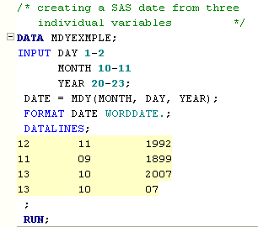
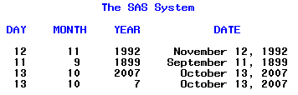
Define New Variables Using Date Functions
It is not uncommon that the sources data file contains three separate
variables representing day, month, and year respectively. Example:
Creating a SAS date from month, day, and year.
SAS Function
MDY( , , )

Slide 5
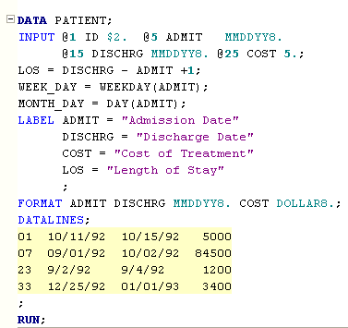
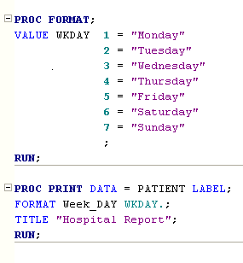
Define New Variables Using Date Functions
Extracting Day of the week (month) from a SAS Date: SAS functions DAY and WEEKDAY can be used to achieve this goal.

Slide 6
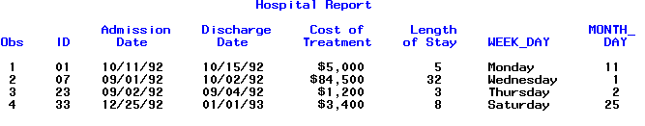
Define New Variables Using Date Functions

Slide 7
More on Date: Relevant Functions
Useful SAS functions commonly used with SAS Dates
INT() and ROUND() - Examples
a=int(5); 5 b=int(7.3); 7 c=int(7.6); 7 d=int(-3); -3 e=int(-9.2); -9 f=int(-9.8); -9
g=round(5); 5 h=round(7.3); 7 i=round(7.6); 8 j=round(-9.2); -9 k=round(-9.8); -10
l=round(2222,10); 2220 m=round(2222,100); 2200 n=round(2222,1000); 2000 o=round(15.125,.1); 15.1 p=round(15.125,.01); 15.13 q=round(15.125,.001); 15.125
2. Computing Date Intervals: INTCK() and INTNX()
Work_Yrs = INTCK(‘YEAR’, DATEHIRE, TODAY())
Followup = INTNX(‘MONTH’, VISIT, 10)
Caution: both functions works with internal boundaries (the 1st of each month or year depending on the number of months or the number of years to be computed.)

Slide 8
Automatic Variables
_N_ denotes the observation number.
_error_ equals to 0 if no error occurs when reading an observation and equal to 1 if an error occurs.
FIRST.var associated with the BY var; statement, equals 1 if the observation is the first observation with a particular value of the BY var, zero otherwise.
LAST.var associated with the BY var; statement, equals 1 if the observation is the last observation with a particular value of the BY var, zero otherwise.

Slide 9
Automatic Variables
DATA pets1;
INPUT @1 name $9. @10 time time5. @20 date mmddyy8. @30 species $;
mistakes=_error_; /* New variable mistakes=1 if error in reading obs*/
DATALINES;
Fluffy 9:00 02/13/98 cat
Tom 10:00 02/13/98 cat
Rex 13:00 02/31/98 dog
Fido 14:00 02/13/98 dog
Felix 9:30 02/13/98 cat
Spot 15:00 02/13/98 dog
;
PROC SORT data=pets1;
BY species time;
RUN;;
DATA pets1; /* Make changes to dataset PETS1. */
SET pets1;
BY species;
pet_num=_n_; /* Pet number equal to observation number */
firstgrp=first.species; /* firstgrp=1 if first obs of each species*/
lastgrp=last.species; /* lastgrp=1 if last obs of each species */
RUN;
PROC PRINT data=pets1;
VAR pet_num name species time date mistakes firstgrp lastgrp;
FORMAT time time5. date mmddyy8.;
RUN;

Slide 10
Automatic Variables
The SAS System
OBS PET_NUM NAME SPECIES TIME DATE MISTAKES FIRSTGRP LASTGRP
1 1 Fluffy cat 9:00 02/13/98 0 1 0
2 2 Felix cat 9:30 02/13/98 0 0 0
3 3 Tom cat 10:00 02/13/98 0 0 1
4 4 Rex dog 13:00 . 1 1 0
5 5 Fido dog 14:00 02/13/98 0 0 0
6 6 Spot dog 15:00 02/13/98 0 0 1
1 options ls=70 ps=200 nodate nocenter;
2 data pets1;
3 input @1 name $9. @10 time time5. @20 date mmddyy8. @30 species
$;
4 mistakes=_error_; /* New variable mistakes=1 if error in
reading obs*/
5 datalines;
NOTE: Invalid data for DATE in line 8 20-27.
RULE:----+----1----+----2----+----3----+----4----+----5----+----6----+
8 Rex 13:00 02/31/98 dog
NAME=Rex TIME=46800 DATE=. SPECIES=dog MISTAKES=1 _ERROR_=1 _N_=3
NOTE: The data set WORK.PETS1 has 6 observations and 5 variables.
NOTE: The DATA statement used 0.93 seconds.

Slide 11
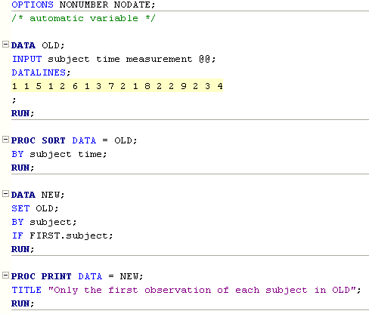
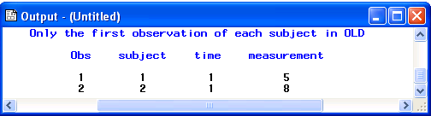
Automatic Variables
Creating a single observation from multiple observations
A cautionary note: don’t automatically accept _N_
as a true observation counter in all DATA steps.
Data steps that contain LOOPS and OUTPUT
statements may cause the relationship of the
observation number and the internal variable
_N_ to fall apart!

Slide 12
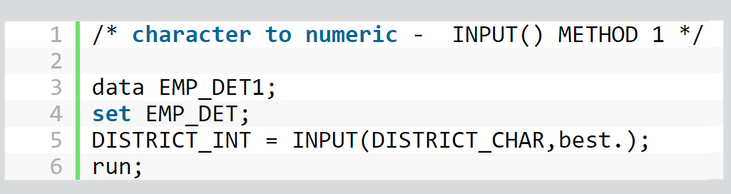
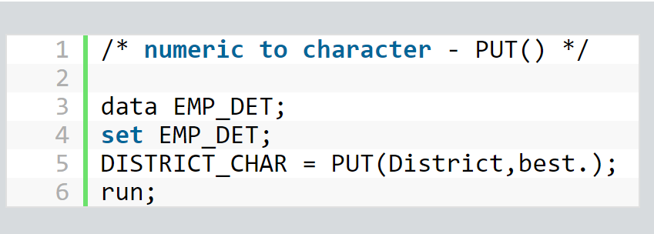
Converting Variable Types

Slide 13
Creating New Variables with Basic Mathematics Operations
New variables are created from input data values using standard algebraic expressions and mathematical functions.
Newvar = var1 + var2 ; addition
Newvar = var1 - var2; subtraction
Newvar = var1 * var2; multiplication
Newvar = var1 / var2; division
Newvar = var1 ** var2; exponentiation (var1^{var2})
Order of operation can be controlled by parenthesis.
Newvar = (var1 + var2) ** (var3 / (var4*var5)) - var6 ;
Gigabyte = harddriv/1e9 ;
kilobaud = modem / 1000;
perimeter = (2*(3/5)*monitor + 2*(4/5)*monitor)*2.54;
area = ((((3/5)*monitor)*((4/5)*monitor))/2)*(2.54**2);

Slide 14
Creating New Variables with Basic Mathematics Functions
Newvar = log(var1); value is natural logarithm of var1
Newvar = log10(var1); value is common logarithm of var1
Newvar = log2(var1); value is base 2 logarithm of var1
Newvar = sqrt(var1); value is square root of var1
Newvar = mdy(month, day, year); create SAS date variable from individual month, day and year values.
Newvar = abs(var1); value is the absolute value of var1

Slide 15
Logical Operators
IF logical_condition_true THEN action_1;
ELSE action_2;
Logical operators EQ equals (=)
NE not equal (~=, ^=)
GT greater than (>)
LT less than (<)
GE greater than or equal to (>=)
LE less than or equal to (<=)
AND all comparisons must be true (&)
OR only one comparison must be true (!, |)
Actions ANY SAS data or macro statement
(e.g. another assignment, IF, DO …)

Slide 16
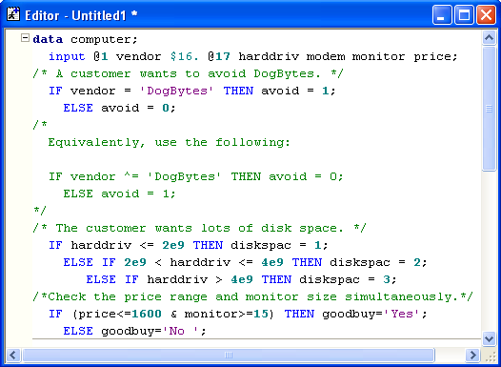
Logical Operators

Slide 17
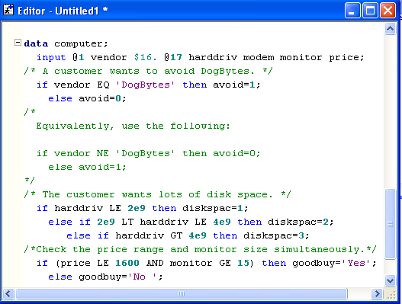
Logical Operators
RECOMMENDATION: Use logical operators EQ, LT, LE, GT, GE, AND, OR
Logical operator.
Assignment operator.

Slide 18
Why Use Logical Operators
1) To remove observations or otherwise subset the data set.
DATA cheap;
SET computer;
IF price LE 1600;
2) To differentially assign values.
IF age LE 21 THEN age_grp=1;
ELSE IF 21 LT age LE 55 THEN age_grp=2;
ELSE IF age GT 55 THEN age_grp=3;

Slide 19
WHERE Statement Operators
Operator:
BETWEEN – AND
Action:
Selects observations which fall (inclusively) within a specified range
Example(S):
WHERE AGE BETWEEN 20 AND 40;
(Selects age between 20 and 40 inclusively)

Slide 20
WHERE Statement Operators
Operator:
CONTAINS or ?
Action:
Used for character variable only, selects records that include or
contain the specified string.
NOTE: the string in the quote is CASE-SENSITIVE!!
Example(S):
WHERE NAME CONTAINS ‘eng’ ;
or
WHERE NAME ? ‘eng’ ;
(Selects all names that contain the string eng. This would
match my name Cheng Peng!)

Slide 21
WHERE Statement Operators
Operator:
IS MISSING or IS NULL
Action:
Selects observations for which the value of the variable is missing.
This is particularly useful since it works with both numeric and
character variable
Example(S):
WHERE AGE IS MISSING;
(Selects all observations where AGE is missing)
WHERE NAME IS NULL ;
(Selects all observations where NAME is missing)

Slide 22
WHERE Statement Operators
Operator:
LIKE
Action:
Allows you to select observations based on patterns using the
percent sign(%) and underscore(_) wildcard operators.
The percent sign (%) is a variable length wildcard (like * in DOS
or UNIX). It matches on any string (including a null string).
The underscore (_) wildcard operator is a patter matching for
one character only.
NOTE: The LIKE operator is only used with character variables
and is case sensitive!

Slide 23
WHERE Statement Operators
Operator:
LIKE
Example(S):
WHERE NAME LIKE ‘BOY%’ ;
(Examples of matches are: BOY BOYCE BOYXYZ, etc.)
WHERE NAME LIKE ‘A___’ ; * 3 underscores
(Selects all names of length 4, beginning with A)
WHERE NAME LIKE ‘A_%’ ;
(Selects all names that begin with A and are at least two
characters in length)

Slide 24
WHERE Statement Operators
Operator:
=*
Action:
A phonetic match (called a SOUNDEX operator) used for matches
that “sound like” the given expression. The =* operator attempts a
phonetic match based on a Soundex algorithm. It is a very powerful
operator and should be used with care. It is useful for “fuzzy matches”
where you suspect a name might be misspelled or you are not sure of
the correct spelling of a name.
NOTE: The SOUNDEX operator is NOT case-sensitive!

Slide 25
WHERE Statement Operators
Operator:
=*
Example(S):
WHERE NAME =* ‘CODY’ ;
(Given the names: CODY Coedy, Kody, COTY, and COOky,
the above code selects: CODY, Coedy, Kody and Koty,
but not COOky.)
WHERE NAME =* ‘MCHENRY’ ;
(Given the names: MCHENRY, MACHENRY, MCHENRI, and
MKHENRY, the above code selects all names. This is obviously
an operator to be used with considerable caution.)

Slide 26
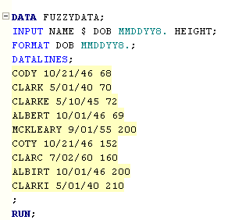
WHERE Statement Operators

Slide 27
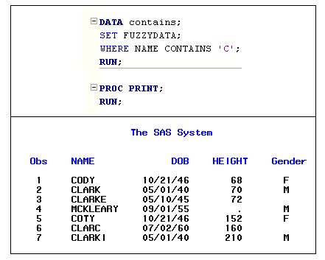
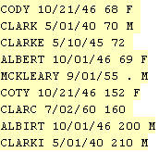
WHERE Statement Operators

Slide 28
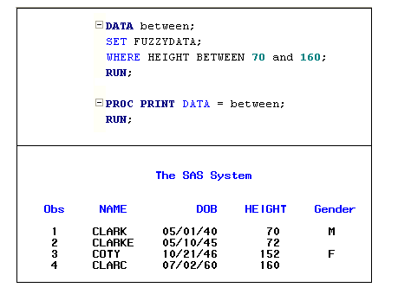
WHERE Statement Operators

Slide 29
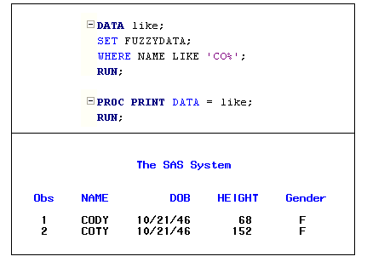
WHERE Statement Operators

Slide 30
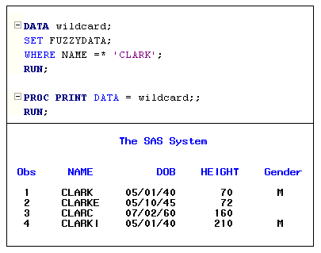
WHERE Statement Operators

