Slide 1
STA 311 Statistical Computing & Data Management
Instructor: Cheng Peng, Ph.D.
Department of Mathematics
West Chester University
West Chester, PA 19383
Office: 25 University Avenue, RM 111
Phone: 610.436.2369
Email: cpeng@wcupa.edu

Slide 2
Topics for This Week
Topics
SAS String Functions
SAS Loop
RETAIN statement
Operations within Groups in Longitudinal Data

Slide 3
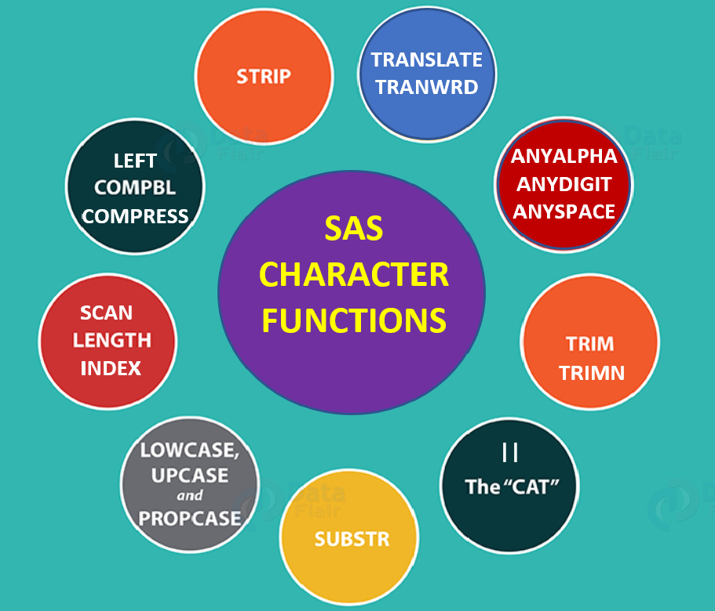
String Functions: Overview
There are many character functions in SAS for string manipulation. Here are a few commonly used ones.
Explanations and examples of using these function are given in the few slides

Slide 4
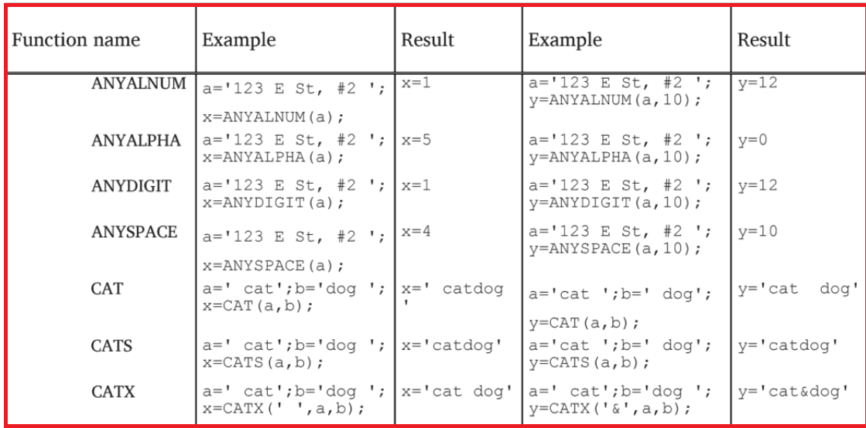
String Functions: Overview

Slide 5
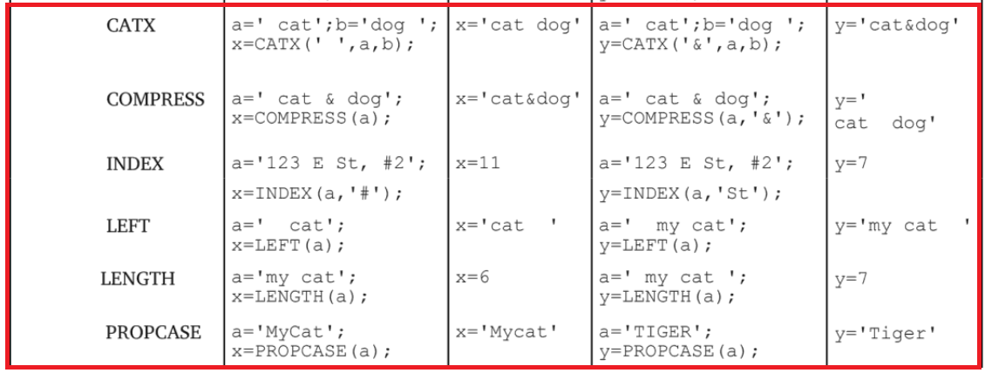
String Functions: Overview

Slide 6
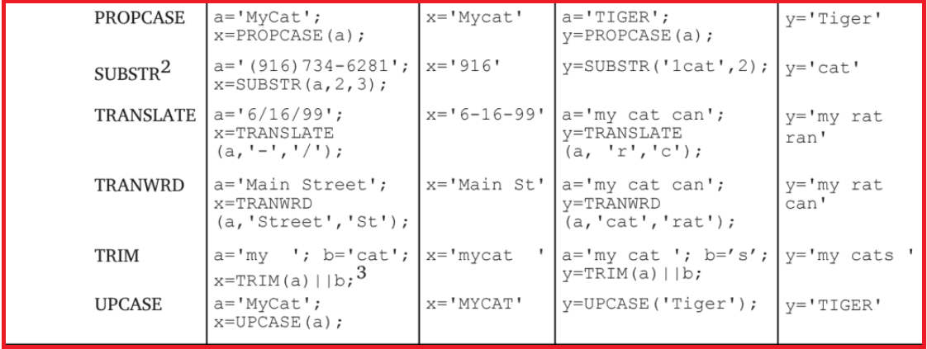
String Functions: Overview

Slide 7
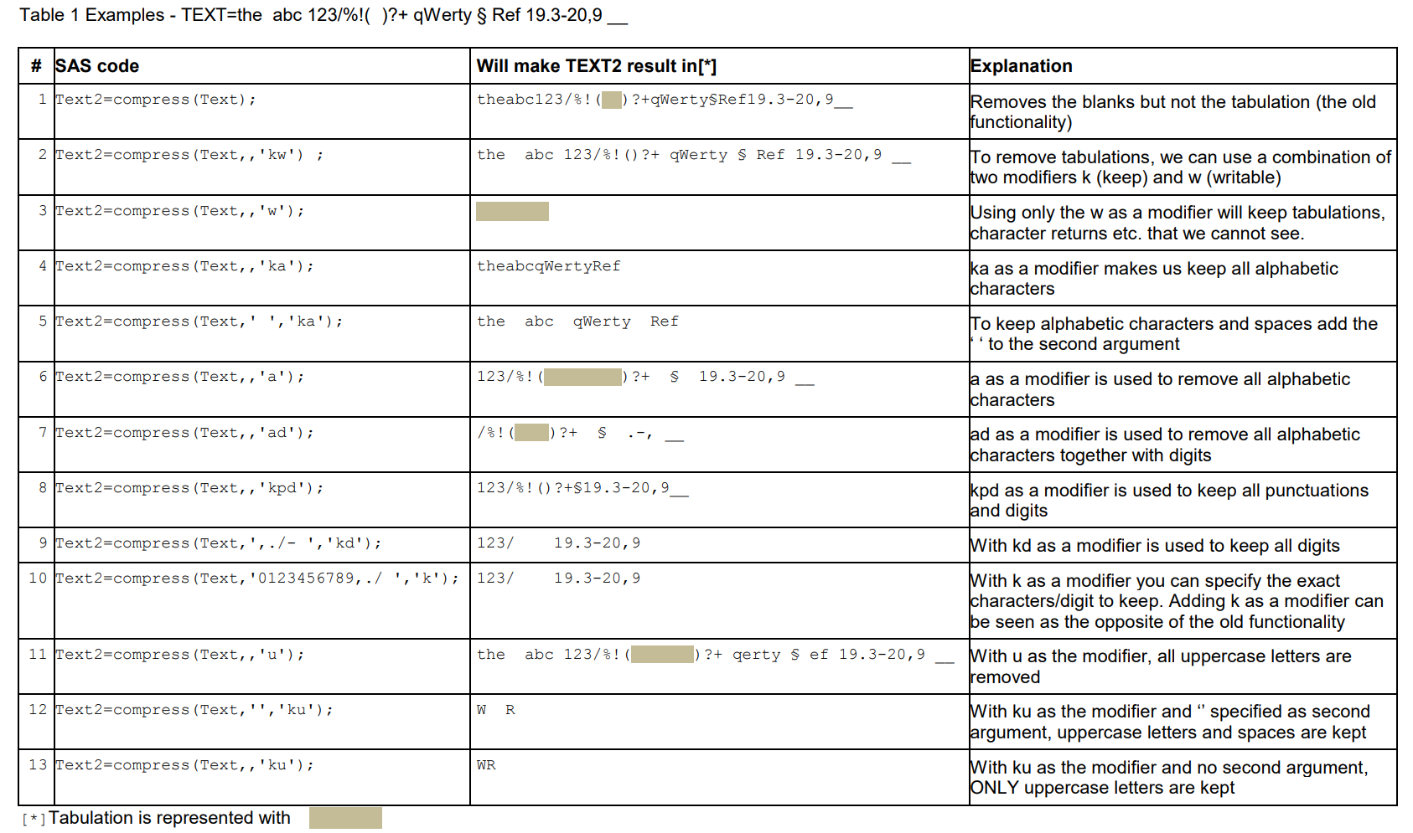
String Functions: Overview

Slide 8
SAS Loop: Overview
Designate a group of statements to be executed as a unit using a DO block. The following are general syntaxes
DO;
SAS Statements;
END;
DO var=1 TO x;
SAS Statements;
END;
DO UNITL ( condition);
SAS Statements;
END;
DO WHILE ( condition);
SAS Statements;
END;
The difference between the two DO loops is that DO UNTIL statement tests
At the bottom of the of the loop and DO WHILE statements tests at the top.

Slide 9
SAS Loop: Iterative Do Loops
DO index-variable=start TO stop BY increment; SAS statements END
DATA DOLoop; /* SAS dataset */ DO i = 1 to 5; /* I will be a variable in the SAS data set*/ Y = i**2; /* values are 1, 4, 9, 16, 25 , Y will be another variable in the data set.*/ OUTPUT; END; RUN;

Slide 10
SAS Loop: Iterative Do Loops
By default, each iteration of a DO statement increments the value of the counter by 1, but you can use the BY option to increment the counter by other amounts, including non-integer amounts. For example, each iteration of the following DATA step increments the value i by 0.5:
DATA DOLoopBy; /* SAS dataset */ DO i = 1 to 5 by 0.5; /* I will be a variable in the SAS data set*/ Y = i**2; /* values are 1, 1.5^2, 2^2 2.5^2,… Y will be another variable in the data set. */ OUTPUT; END; RUN;

Slide 11
SAS Loop: DO-WHILE Loop
By default, each iteration of a DO statement increments the value of the counter by 1, but you can use the BY option to increment the counter by other amounts, including non-integer amounts. For example, each iteration of the following DATA step increments the value i by 0.5:
DATA DOLoopBy; /* SAS dataset */ DO i = 1 to 5 WHILE (y < 20); /* I will be a variable in the SAS data set*/ Y = i**2; /* values are 1, 4, 9, 16, 25 , Y will be another variable in the data set. */ OUTPUT; END; RUN;

Slide 12
SAS Loop: DO-UNTIL Loop
Using a DO UNTIL loop, SAS executes the DO loop until the expression you've specified is true
DATA investment; DO UNTIL (value >= 50000); value + 1200; value + value * 0.05; year + 1; OUTPUT; END; RUN;

Slide 13
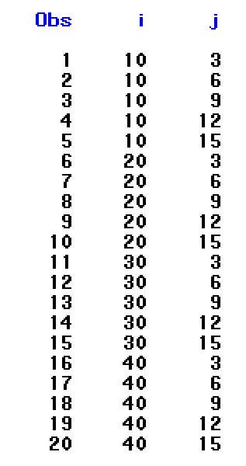
SAS Loop: Double Loop
Nested Loop – 3-by-5 factorial design
DATA design; DO i = 10 to 40 by 10; /* I = 10, 20, 30, 40 */ DO j = 3 to 15 BY 3; /* j = 3, 6, 9, 12,15 */ OUTPUT; /* output the value from END; each iteration */ END; RUN;

Slide 14
SAS RETAIN Statement
RETAIN in SAS
The RETAIN statement simply copies retaining values by telling the SAS not to reset the variables to missing at the beginning of each iteration of the DATA step.
If the RETAIN statement is NOT used, SAS will return a missing value at the beginning of each iteration.

Slide 15
RETAIN + DO-Loop
Operations Within Groups in Longitudinal Data
DATA base;
INPUT id $
sales
vis_date mmddyy10.;
DATALINES;
a 235 07/11/1997
a 324 11/12/1997
b 321 06/15/1998
b 319 09/21/1998
b 357 11/11/1998
c 279 07/21/1997
c 302 10/20/1997
c 314 11/19/1997
c 298 12/27/1997
;
RUN;
Typical Longitudinal
Data Set
3 salespersons in this data
DATA new;
SET base;
BY id;
RETAIN count total;
IF FIRST.id THEN DO;
count = 0;
total = 0;
END;
count = count + 1;
total = total + sales;
IF LAST.id THEN DO;
mean = total / count;
OUTPUT;
END;
PROC PRINT DATA=new; RUN;
Tasks
Count the number of sales
per person
Calculate the total sales
per person
Calculate average sales
per person

