Slide 1
STA 311 Statistical Computing and
Data Management
Instructor: Cheng Peng, Ph.D.
Department of Mathematics
West Chester University
West Chester, PA 19383
Fall 2020
Office: 25 University Avenue, RM 111
Phone: 610-436-2369
Email: cpeng@wcupa.edu

Slide 2
Topics to Be Covered
Review of Do Block & DO Loops
Concepts of SAS Arrays
PROC TRANSPOSE
Temporary Arrays
Restructuring Tables

Slide 3
DO Block & DO Loop
Designate a group of statements to be executed as a unit using
a DO block. The following are general syntaxes:
DO;
SAS Statements;
END;
DO var=1 TO x;
SAS Statements;
END;
DO UNITL ( condition);
SAS Statements;
END;
DO WHILE ( condition);
SAS Statements;
END;
The difference between the two DO loops is that DO UNTIL statement tests
At the bottom of the of the loop and DO WHILE statements tests at the top.

Slide 4
DO Block & DO Loop
DO loops can be used to create an ordered sequence of numbers.
DATA example;
DO q=1 TO 5;
qtimes2=q*2;
qsquared=q**2;
OUTPUT;
END;
PROC PRINT DATA =example;
RUN;
END statement important.
OBS Q QTIMES2 QSQUARED
1 1 2 1
2 2 4 4
3 3 6 9
4 4 8 16
5 5 10 25
No INPUT or DATALINES used!

Slide 5
DO Block & DO Loop
DATA deck;
FORMAT value $5. suit $8.;
DO value='ace','2','3','4','5','6','7','8','9',
'10','jack','queen','king';
DO suit='spades','hearts','clubs','diamonds';
OUTPUT;
END;
END;
PROC PRINT DATA =deck;
RUN;
Outer Loop
Inner Loop
1 ace spades
2 ace hearts
3 ace clubs
4 ace diamonds
5 2 spades
6 2 hearts
7 _ ________
What is next?

Slide 6
Concepts of SAS ARRAY
Suppose you have 105 variables (X1-X100, A, B, D, and E) in SAS dataset OLD, and a value of 999 is used to represent missing data. It is common practice in some other database systems to use values such as 99, 999, etc., to represent missing values. Suppose further that you want to substitute a SAS System missing value (.) for the values of 999. How to effectively accomplish this task?
DATA Hard_Way;
SET OLD;
IF X1 = 999 THEN X1 =.;
IF X2 = 999 THEN X2 =.;
.. .. .. .. .. .. ..
IF X100 = 999 THEN X100 =.;
IF A = 999 THEN A =.;
IF B = 999 THEN B =.;
IF C = 999 THEN C =.;
IF D = 999 THEN D =.;
IF E = 999 THEN E =.;
RUN;

Slide 7
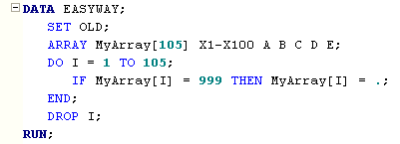
Concepts of SAS ARRAY
An array is a temporary holding site for a collection of variables upon which the same operations will be performed. It is often to find DO loops to be used jointly with ARRAY manipulation.

Slide 8
Concepts of SAS ARRAY
If the number of variables is NOT specified in the definition of ARRAY, you can use (*) instead. The SAS system will count the number of variables.
In the DO loop you need to use a system function DIM() to return the length of the one-dimensional ARRAY.
ARRAY MyArray[ * ] X1 – X100 A B C D E;
DO I = 1 TO DIM(MyArray);
The array name is followed by either a pair of parentheses ( ), braces { }, or square brackets [ ]. By specifying a value inside the bracket, we can assign the same number of variables to the array. We use square brackets [ ] in this course.

Slide 9
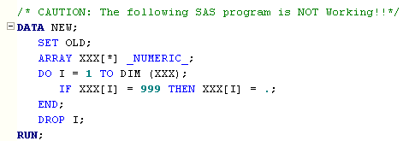
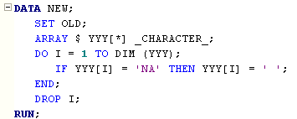
Concepts of SAS ARRAY
The internal variable _NUMERIC_ can be used to refer to all the numeric variables in a SAS dataset (either in a DATA step or PROC step). The terms _CHRACTER_ and _ALL_ are also available and represent all character variables and all variables respectively.
The DIM function is especially useful here because you don’t have to count the number of numeric variables. Caution: Don’t give your array the same name as a variable in your dataset!!

Slide 10
Concepts of SAS ARRAY
Rescale all numeric variables
DATA melons;
INPUT location $ ltpink pink salmon red;
nomelons=50-(ltpink+pink+salmon+red);
ltpink =ltpink/50;
pink =pink/50;
salmon =salmon/50;
red =red/50;
nomelons=nomelons/50;
DATALINES;
North 3 14 16 8
East 8 23 9 2
South 0 4 10 19
;
DATA melons;
INPUT location $ ltpink pink salmon red;
nomelons=50-(ltpink+pink+salmon+red);
ARRAY colors (5) ltpink pink salmon red nomelons;
DO i=1 TO 5;
colors(i)=colors(i)/50;
END;
DATALINES;
North 3 14 16 8
East 8 23 9 2
South 0 4 10 19
;
RUN;
PROC PRINT DATA =melons;
RUN;
Group response variables into a color array.
An observations is output only after the DO loop is completed. The DO loop is repeated for each observation.
The HARD way
The EASY way

Slide 11
Concepts of SAS ARRAY
nomelons=50-(ltpink+pink+salmon+red);
ltpink =ltpink/50;
pink =pink/50;
salmon =salmon/50;
red =red/50;
nomelons=nomelons/50;
North 3 14 16 8
East 8 23 9 2
South 0 4 10 19
Input Data
OBS LOCATION LTPINK PINK SALMON RED NOMELONS I
1 North 0.06 0.28 0.32 0.16 0.18 6
2 East 0.16 0.46 0.18 0.04 0.16 6
3 South 0.00 0.08 0.20 0.38 0.34 6
Note that grouping variables into a color array did nothing to variable names. The DO loop index variable, I, was added in the dataset. Note that I is always 6, since at the beginning of the sixth execution, the value of I is 6, exceeding the specified range of 1 TO 5, SAS stops processing the loop.

Slide 12
Concepts of SAS ARRAY
DATA melons;
INPUT location $ red1 red2 red3 red4;
red5=50-(sum(of red1-red4));
ARRAY colors (5) red1-red5;
DO i=1 TO 5;
colors(i)=colors(i)/50;
END;
DATALINES;
One dash needed if it variable names are numbered.
DATA melons;
INPUT location $ ltpink pink salmon red;
nomelons=50-(sum(of ltpink--red));
ARRAY colors (5) ltpink--nomelons;
DO i=1 TO 5;
colors(i)=colors(i)/50;
END;
DATALINES;
Two dashes needed if variable names not numbered.

Slide 13
Reshape Data Using SAS ARRAY
Name hw1 hw2 hw3 hw4 hw5
Amy 6 8 4 8 7 8
Bob 3 5 5 7 5 5
Carol 7 8 8 7 8 9
Dave 10 9 9 8 10 9
Eve 6 6 8 6 9 7
Long Table
Wide Table
OBS NAME Week Grade
1 Amy HW1 6
2 Amy HW2 8
3 Amy HW3 4
4 Amy HW4 8
5 Amy HW5 7
6 Amy HW6 8
(lines deleted)
25 Eve HW1 6
26 Eve HW2 6
27 Eve HW3 8
28 Eve HW4 6
29 Eve HW5 9
30 Eve HW6 7
Data in efficient input format.
TRANSPOSE
Data in format needed for data analysis.

Slide 14
Reshape Data Using SAS ARRAY
DATA grades1;
INPUT name $ hw1-hw6;
DATALINES;
Amy 6 8 4 8 7 8
Bob 3 5 5 7 5 5
Carol 7 8 8 7 8 9
Dave 10 9 9 8 10 9
Eve 6 6 8 6 9 7
;
DATA grades2;
SET grades1;
week=1; grade=hw1; OUTPUT;
week=2; grade=hw2; OUTPUT;
week=3; grade=hw3; OUTPUT;
week=4; grade=hw4; OUTPUT;
week=5; grade=hw5; OUTPUT;
week=6; grade=hw6; OUTPUT;
keep name week grade;
RUN;
PROC PRINT DATA =grades2;
RUN;
Brute Force
OBS NAME WEEK GRADE
1 Amy 1 6
2 Amy 2 8
3 Amy 3 4
4 Amy 4 8
5 Amy 5 7
6 Amy 6 8
7 Bob 1 3
8 Bob 2 5
9 Bob 3 5
10 Bob 4 7
11 Bob 5 5
12 Bob 6 5
13 Carol 1 7
............................

Slide 15
Reshape Data Using SAS ARRAY
DATA grades1;
INPUT name $ hw1-hw6;
DATALINES;
Amy 6 8 4 8 7 8
Bob 3 5 5 7 5 5
Carol 7 8 8 7 8 9
Dave 10 9 9 8 10 9
Eve 6 6 8 6 9 7
;
DATA grades2;
SET grades1;
ARRAY homework (6) hw1-hw6;
DO i=1 TO 6;
week=i;
grade=homework(i);
OUTPUT;
END;
KEEP name week grade;
RUN;
Array/DO Loop
OBS NAME WEEK GRADE
1 Amy 1 6
2 Amy 2 8
3 Amy 3 4
4 Amy 4 8
5 Amy 5 7
6 Amy 6 8
7 Bob 1 3
8 Bob 2 5
9 Bob 3 5
10 Bob 4 7
11 Bob 5 5
12 Bob 6 5
13 Carol 1 7
............................

Slide 16
PROC TRANSPOSE
DATA grades1;
INPUT name $ hw1-hw6;
DATALINES;
Amy 6 8 4 8 7 8
Bob 3 5 5 7 5 5
Carol 7 8 8 7 8 9
Dave 10 9 9 8 10 9
Eve 6 6 8 6 9 7
;
RPOC SORT DATA =grades1;
BY name;
RUN;
PROC TRANSPOSE DATA =grades1
OUT=grades2;
BY name;
VAR hw1-hw6;
RUN;
PROC PRINT DATA =grades2;
RUN;
OBS NAME _NAME_ COL1
1 Amy HW1 6
2 Amy HW2 8
3 Amy HW3 4
4 Amy HW4 8
5 Amy HW5 7
6 Amy HW6 8
(lines deleted)
25 Eve HW1 6
26 Eve HW2 6
27 Eve HW3 8
28 Eve HW4 6
29 Eve HW5 9
30 Eve HW6 7
All variables in the var statement are now placed in new rows.

Slide 17
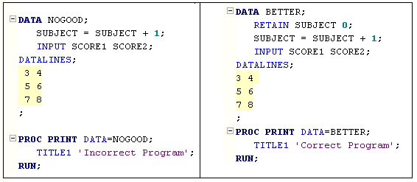
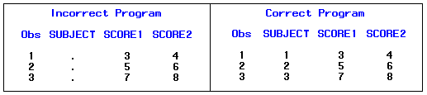
RETAIN:
“Remembering” Values from Previous Observations

Slide 18
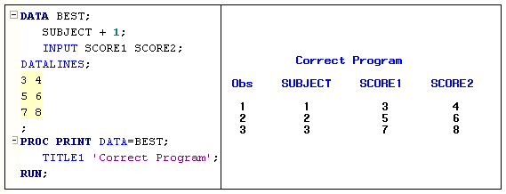
RETAIN: “Remembering” Values from Previous Observations
Implicit versus Explicit Retaining of Values
RETAIN Subject 0;
Subject = Subject +1
Subject +1

Slide 19
Temporary ARRAY
A temporary array does not actually refer to a list of variables at all! Instead, we can declare an array to be temporary and use the array elements in their subscripted form in the DATA step.
No real variables are created when you use a temporary array. You can also provide initial values for each of the array elements.
The most compelling reason to use temporary arrays is for efficiency. Also, you do not have to bother dropping useless variables

Slide 20
Renaming and Dropping
DATA grades2;
SET grades2(drop=_name_ rename=(col1=grade));
BY name;
RETAIN week;
IF first.name=1 THEN week=0;
week=week+1;
RUN;
PROC PRINT DATA = grades2;
RUN;
OBS NAME WEEK GRADE
1 Amy 1 6
2 Amy 2 8
3 Amy 3 4
4 Amy 4 8
5 Amy 5 7
6 Amy 6 8
7 Bob 1 3
8 Bob 2 5
9 Bob 3 5
10 Bob 4 7
11 Bob 5 5
12 Bob 6 5
13 Carol 1 7
............................
SAS Trick: Use of retain and IF-THEN to get a repeating sequence of week numbers.

Slide 21
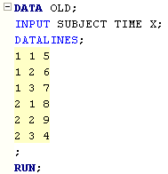
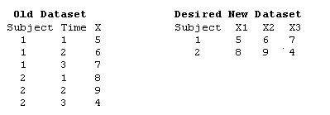
Making a Wide Table from a Long Table
Restructuring a SAS Dataset: creating a single
observation from multiple observations:
KEYWORDS: ARRAY, REATIN, SET,
PROC SORT, FIRST.Byvar, LAST.Byvar

Slide 22
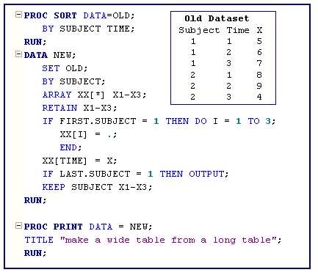
Making a Wide Table from a Long Table
Define an array XX[3] and
RETAIN the value of all
three variables: X1-X3.

Slide 23
Making a Wide Table from a Long Table
Initialize the array to missing (.).
Although this initialization is not
necessary here, if you are missing
an observation for one or more
times for a subject, you would retain
the values from the previous subject
If you did not initialize X1-X3 to
missing. This initialization is done
each time a new subject is read in.

Slide 24
Making a Wide Table from a Long Table
This statement tells the program to set the
element of XX with a subscript equal to the
current value of TIME, equal to the current
value X. For the first observation, TIME = 1
and X =5. Since TIME = 1, XX[TIME] is the
same as XX[1] which represents the variable
X1 (set equal to 5, the value of X).
The next observation from OLD is then read
(Subject =1, TIME =2, X=6, First.subject = 0,
and Last.subject = 0.) Values of X1-X3 are
Retained in the previous observation (X1 =5,
X2 = ., X3 = .) and XX[2], or X2, is set equal to
6, the current value of X in OLD. This happens
again for the next observation resulting in
X1 = 5, X2 =6, and X3=7. This time, however,
since Last.subject = 1 (is true), the observation
Is output to NEW. The process then repeated
For the next subject!

Slide 25
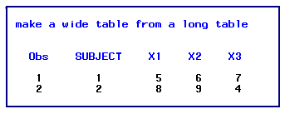
Making a Wide Table from a Long Table
Notes:
Permission to use this copyright protected note is ONLY granted to STUDENTS in STA574/MAT264 at USM
Copyrighted by C. Peng. Please do not distribute.

