Slide 1
STA 311 Statistical Computing and
Data Management
Instructor: Cheng Peng, Ph.D.
Department of Mathematics
West Chester University
West Chester, PA 19383
Office: 25 University Avenue, RM 111
Phone: 610-436-2369
Email: cpeng@wcupa.edu

Slide 2
Topics to Be Covered
What is ODS?
Benefit of ODS
ODS terminology
ODS Syntax
ODS parameter specification
ODS destinations
Multiple ODS destinations
ODS RTF enhancements: Styles

Slide 3
What is SAS ODS?
SAS Output Delivery System (ODS) is designed to overcome the limitations of traditional SAS output that is designed for line-printer.
ODS provides a method of delivering output in a variety of formats such as HTML, RTF and PDF.

Slide 4
Benefits of ODS
Through ODS, we can do the following:
1. Create HTML, RTF, PostScript, and PDF files.
2. Select SAS-supplied styles to enhance reports.
3. Create output objects from almost all SAS procedures.
4. Create SAS datasets from output objects.
5. Provide support for website navigation and management of HTML files.

Slide 5
ODS Basics
1. ODS creates your output in the form of output objects. Each output object is comprised of two components. The data component contains the results - think numbers - of a procedure or a DATA step. The table definition tells SAS how to render the results - think structure.
2. Once SAS creates all the output objects from an executed program, it then just needs to figure out where to send the objects.
SAS ODS destinations (i.e., file format)
(0). LISTING (SAS default ODS destination)
(1). HTML
(2). OUTPUT
(3). Printer Family format: PDF or PS
(4). RTF

Slide 6
Default ODS Destination: LISTING
1. The default ODS destination is LISTING. This is where SAS sends the output. This ODS destination is the standard output window.
2. If we choose a specific ODS destination other than LISTING and don’t want to print out anything in the output window. We should close this ODS destination using command ODS LISTING CLOSE before open other ODS destinations.
3. It is a good practice to keep LISTING open.

Slide 7
ODS Syntax
ODS output-type
PATH path-name
FILE = Filename-and-Path
STYLE = Style-Name;
PROC some proc;
ODS output type CLOSE;
PATH represents the statement used in case of HTML output. In other types of output we include the path in the filename.
Style represents one of the in-built styles available in the SAS environment.

Slide 8
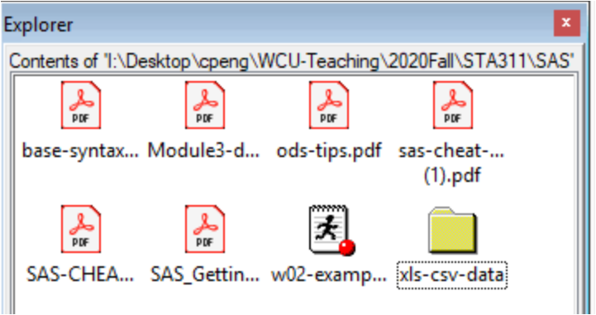
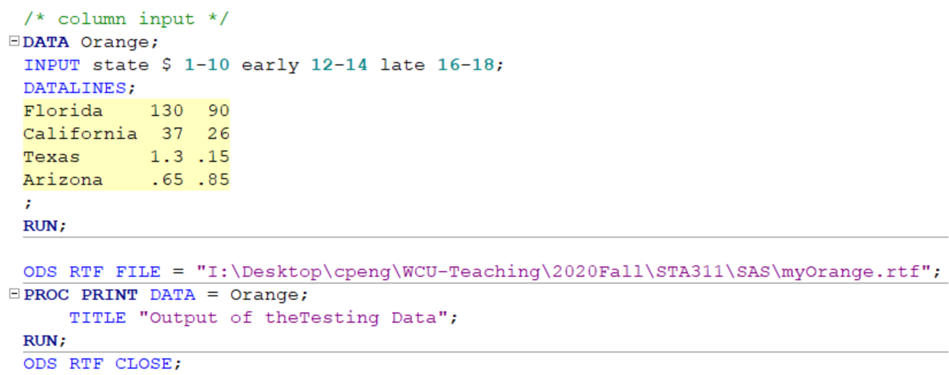
A Simple Example
Make sure SAS can access this folder and write output file with specified format to this folder.

Slide 9
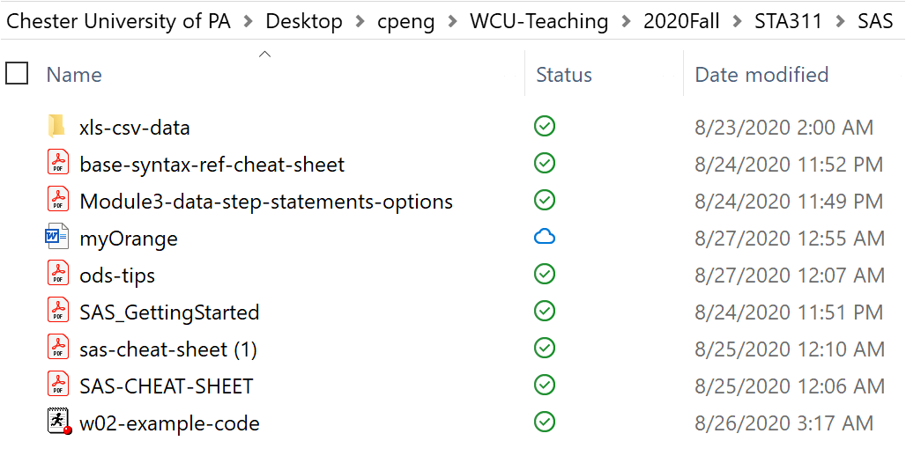
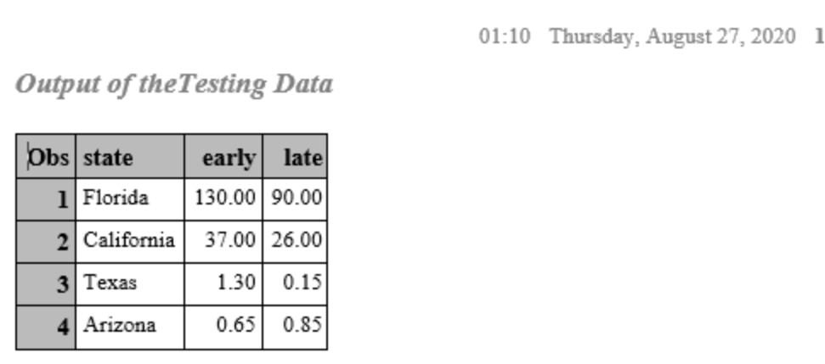
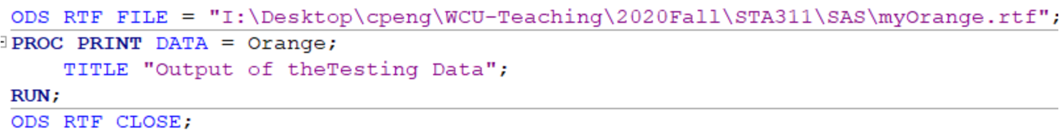
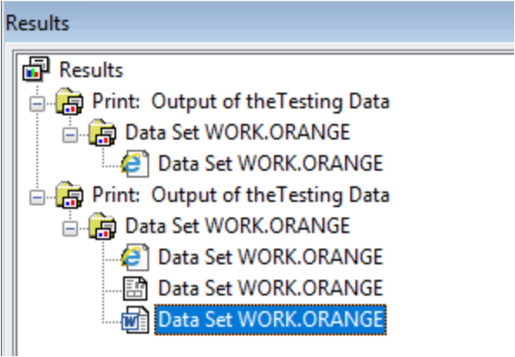
A Simple Example: File location

Slide 10
A Simple Example: file location

Slide 11
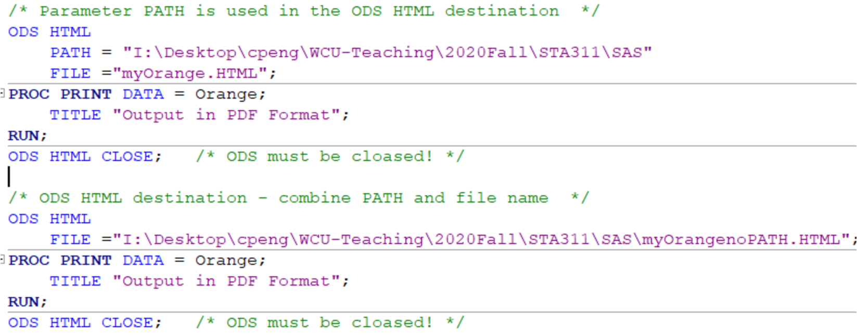
ODS HTML
ODS HTML with and without PATH

Slide 12
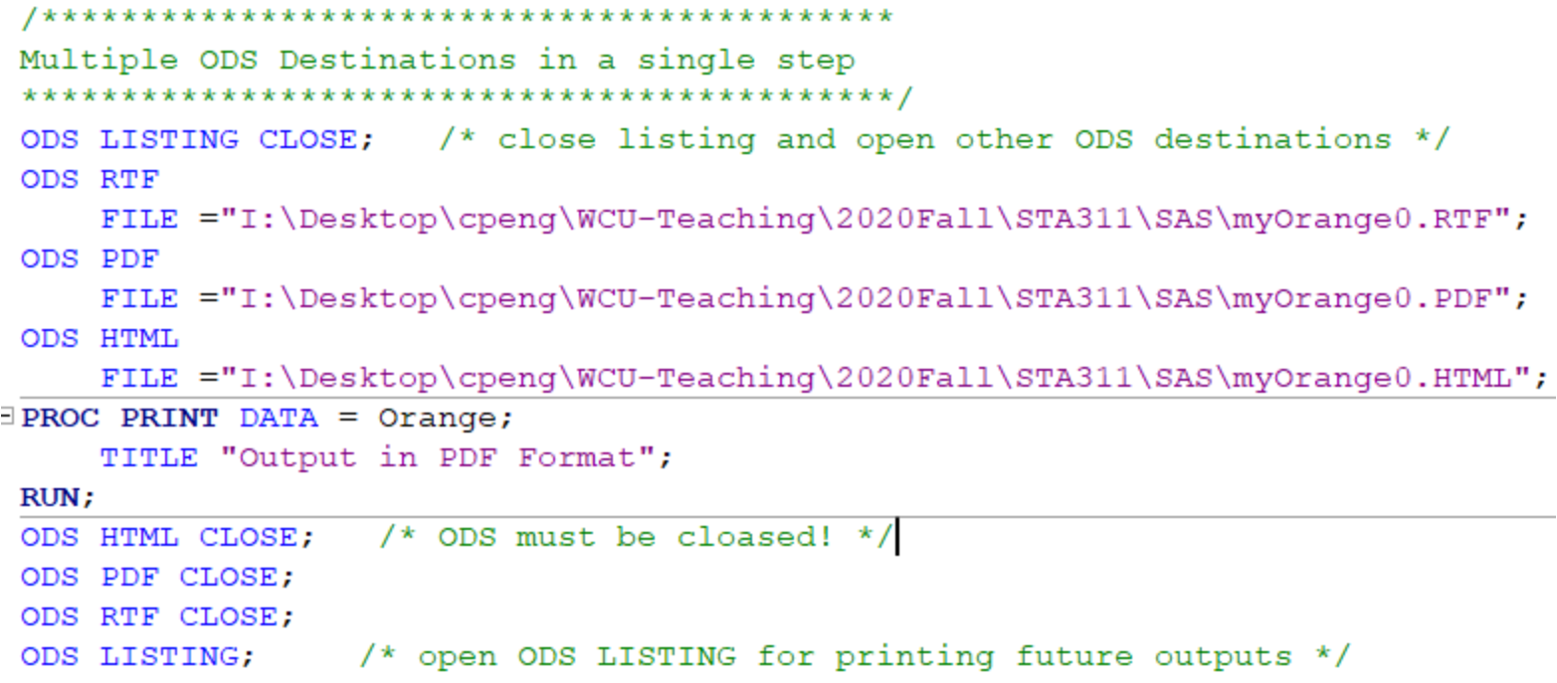
Multiple ODS Destinations In A Single Step

Slide 13
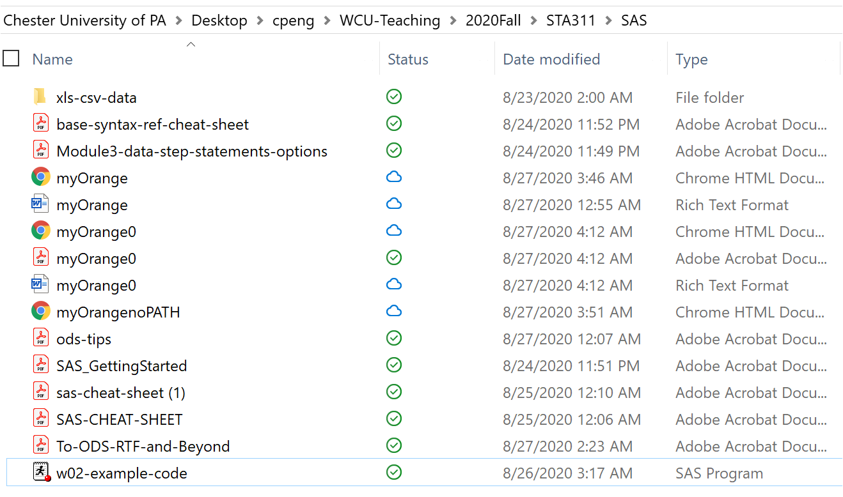
Multiple ODS Destinations: OUTPUT
Notes:
Copyrighted by C. Peng. Please do not distribute.
Permission to use this copyright protected note is ONLY granted to STUDENTS in STA574/MAT264 at USM

Slide 14
ODS Styles
When we output information to a SAS ODS format, the tables, graphs and text are defined with default colors and fonts. There are several built-in ODS styles that we can select. Each style is based on some theme or purpose.
Journal3
Listing
Magnify
Meadow
MeadowPrinter
Minimal
Money
NoFontDefault
Normal
NormalPrinter
Ocean
Printer
Built-in Styles(partial list):
EGDefault
Analysis
Astronomy
Banker
BarrettsBlue
Beige
Brick
Brown
Curve
Default
D3d
Education
Electronics
Default
D3d
Education
Electronics
Festival
FestivalPrinter
Gears
Harvest
HighContrast
Journal
Journal2
Rsvp
Rtf
Sasweb
Science
Seaside
SeasidePrinter
Sketch
Solutions
Statdoc
Statistical
Theme
Torn
Watercolor
blockPrint
fancyPrinter
grayscalePrinter
monochromePrinter
sansPrinter
sasdocPrinter
serifPrinter
PowerPointDark
PowerPointLight
Excel
Raven
Notes:
Copyrighted by C. Peng. Please do not distribute.
Permission to use this copyright protected note is ONLY granted to STUDENTS in STA574/MAT264 at USM

Slide 15
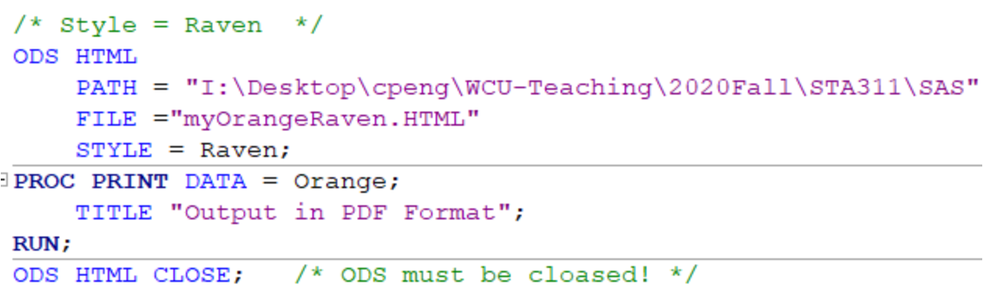
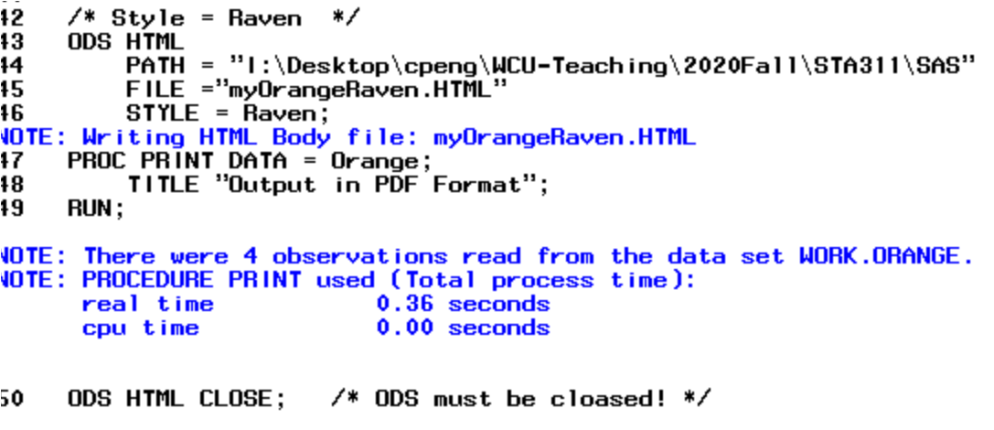
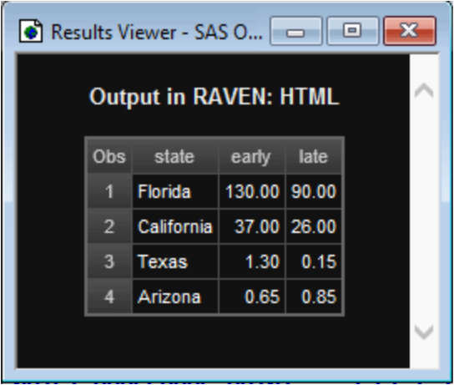
Example: Raven Style
Notes:
Copyrighted by C. Peng. Please do not distribute.
Permission to use this copyright protected note is ONLY granted to STUDENTS in STA574/MAT264 at USM

Slide 16
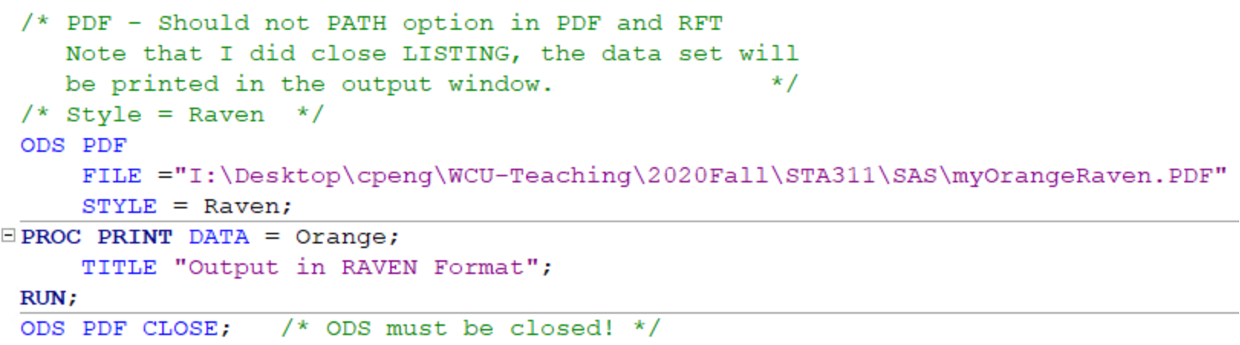
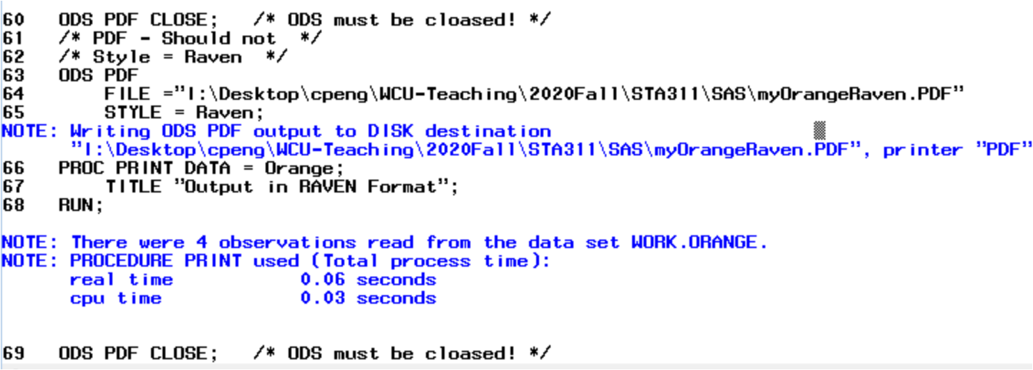
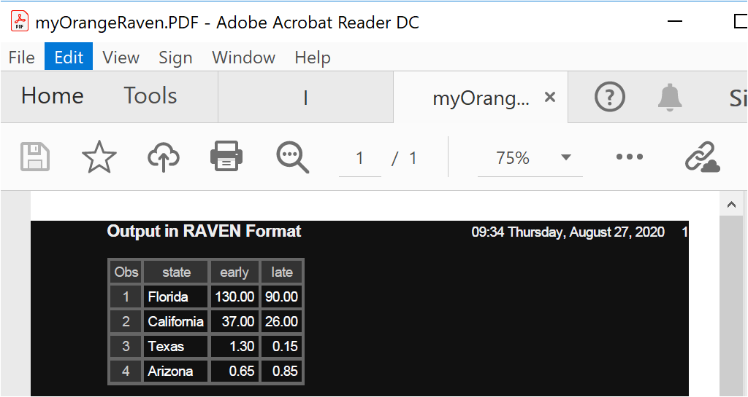
Example: Raven Style (PDF)
Notes:
Copyrighted by C. Peng. Please do not distribute.
Permission to use this copyright protected note is ONLY granted to STUDENTS in STA574/MAT264 at USM

Slide 17
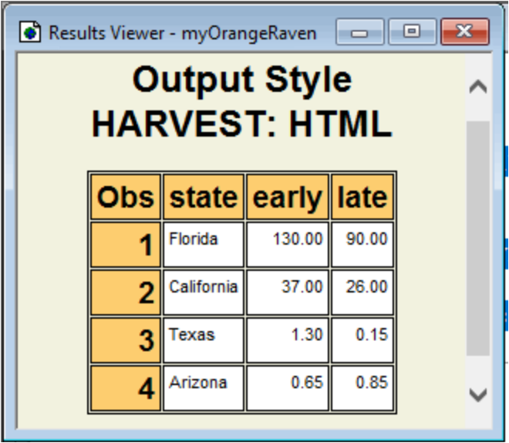
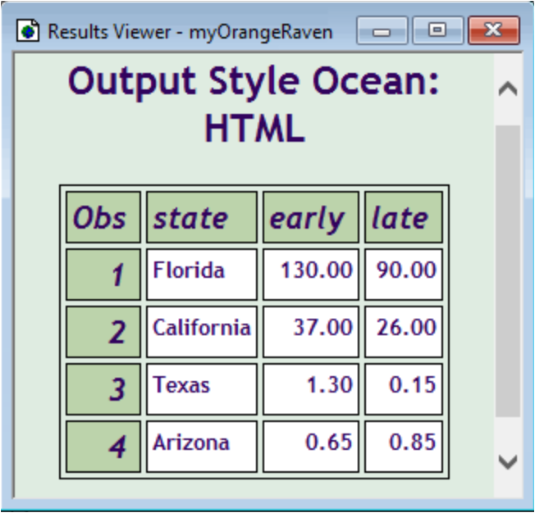
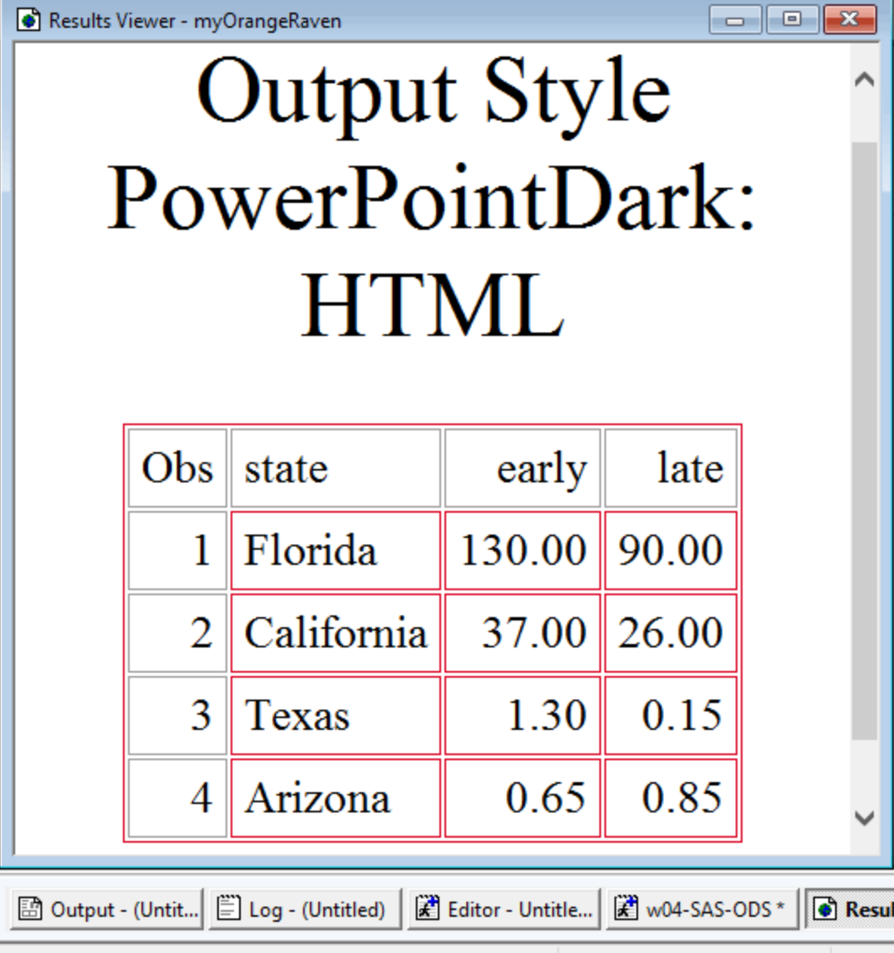
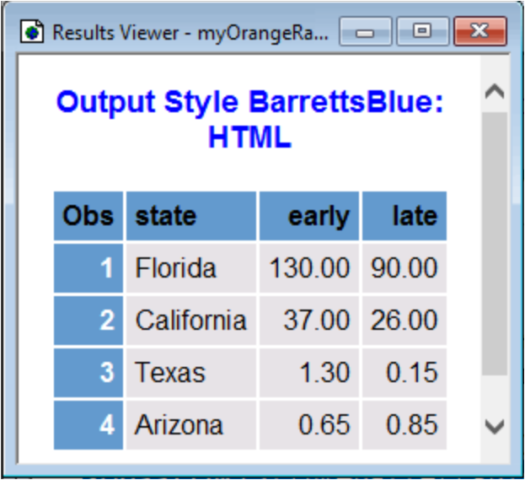
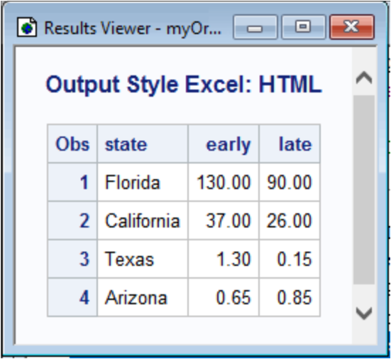
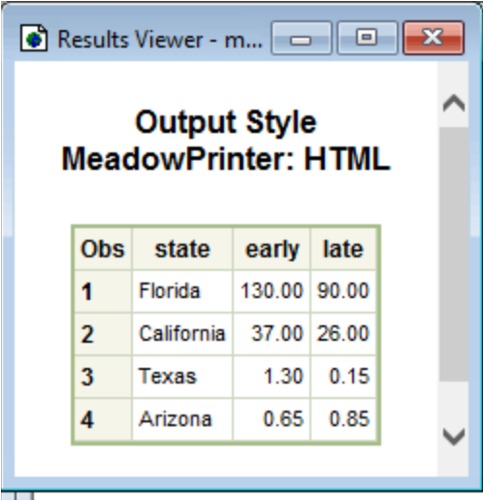
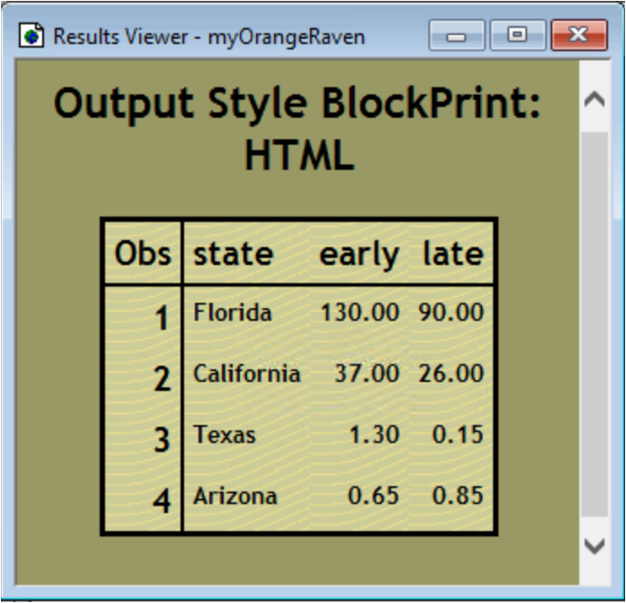
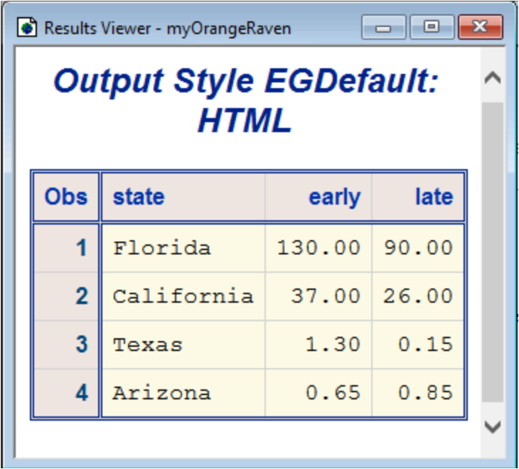
Some Sample Styles: HTML Format
Notes:
Copyrighted by C. Peng. Please do not distribute.
Permission to use this copyright protected note is ONLY granted to STUDENTS in STA574/MAT264 at USM

