Slide 1
STA 311 Statistical Computing and Data Management
Instructor: Cheng Peng, Ph.D.
Department of Mathematics
West Chester University
West Chester, PA 19383
Office: 25 University Avenue, RM 111
Phone: 610-436-2369
Email: cpeng@wcupa.edu

Slide 2
Topics to Be Covered
PROC REPORT- Syntax
DEFINE statement
Column Attributes
Column Formats
Compute Statement
Computed Variables
Summary Statistics
PROC REPORT with ODS

Slide 3
What SAS REPORT Can Do?
The REPORT procedure can create customized reports:
Assigning column formats
Defining column headings
Specifying the order of the contents the justification, width, and spacing of the columns.
Grouping the character variables in reports
Create statistical summaries such as subtotals, grand totals, and averages

Slide 4
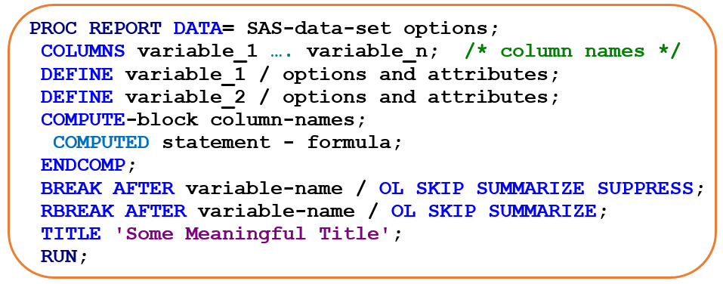
SAS REPORT: Syntax

Slide 5
SAS REPORT: DEFINE Statement
Notice the DEFINE statements. The term following the ‘/’ specifies the way the REPORT procedure uses the column. Columns can be defined as:
GROUP - puts observations into categories
DISPLAY - displays values for each observation
ANALYSIS - contributes values to a calculation or statistic
ORDER - defines the order of the report rows
ACROSS - creates columns for each of its values
COMPUTED - its values are created in a COMPUTE block.

Slide 6
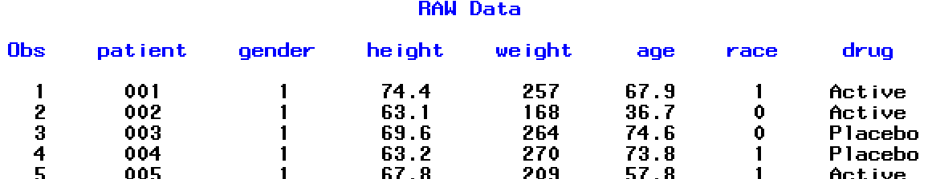
SAS REPORT: DEFINE
PROC REPORT DATA = DEMOGRAPHICS;
COLUMNS patient gender height weight age race drug;
DEFINE patient / DISPLAY 'PTID' WIDTH = 4; /* Rename patient as PTID, column width = 4 */
DEFINE gender / DISPLAY FORMAT = gendfmt.; /* Formatting the variable GENDER */
DEFINE height / ANALYSIS 'HT' FORMAT = 4.1; /* */
DEFINE weight / ANALYSIS 'WT' FORMAT = 4.;
DEFINE age / DISPLAY FORMAT = 3.1;
DEFINE race / DISPLAY FORMAT = racefmt.;
DEFINE drup / DISPLAY WIDTH = 8;
TITLE "Basic Report";
RUN;

Slide 7
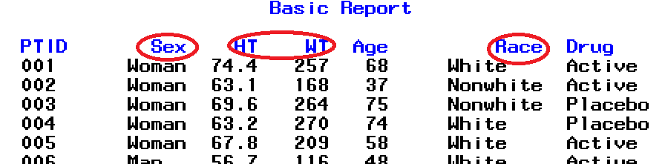
SAS REPORT: DEFINE Statement
Several changes from the raw data with PROC REPORT:
Variable names
Format of SEX and RACE
Width of columns in the report

Slide 8
SAS REPORT: Options in DEFINE
Some Important Options and Column Attributes you may to explore are:
GROUP -
ACROSS
COMPUTE Block – doing calculation

Slide 9
SAS REPORT ENHANCEMENT
Enhancement of Report Header
NOWINDOWS suppresses the REPORT window and directs the report to the output window
2. HEADLINE creates a horizontal line between the column headers and the body of the report
3. HEADSKIP creates a blank line between the column headers and the body of the report
4. STYLE(Column) component option is specified to instruct SAS to use the color "Blue" for the background and "White" for the foreground of each cell on the report output.

Slide 10
SAS REPORT with ODS
Enhancement of Report Header
We can generate REPORT with attributes and options.
Two STYLE options are particularly useful to create nice looking report.
STYLE(Column)
STYLE(Header)
Within PROC REPORT

Slide 11
SAS REPORT with ODS
We can also use the output STYLEs through ODS to create REPORTs with different ODS styles!
SAS has more 50 STYLES that can be used in ODS!
See the see tailed list of these STYLES on the next slide!

Slide 12
ODS Styles
When we output information to a SAS ODS format, the tables, graphs and text are defined with default colors and fonts. There are several built-in ODS styles that we can select. Each style is based on some theme or purpose.
Journal3
Listing
Magnify
Meadow
MeadowPrinter
Minimal
Money
NoFontDefault
Normal
NormalPrinter
Ocean
Printer
Built-in Styles(partial list):
EGDefault
Analysis
Astronomy
Banker
BarrettsBlue
Beige
Brick
Brown
Curve
Default
D3d
Education
Electronics
Default
D3d
Education
Electronics
Festival
FestivalPrinter
Gears
Harvest
HighContrast
Journal
Journal2
Rsvp
Rtf
Sasweb
Science
Seaside
SeasidePrinter
Sketch
Solutions
Statdoc
Statistical
Theme
Torn
Watercolor
blockPrint
fancyPrinter
grayscalePrinter
monochromePrinter
sansPrinter
sasdocPrinter
serifPrinter
PowerPointDark
PowerPointLight
Excel
Raven

Slide 13
PROC REPORT: Wrap-up
What PROC REPORT CAN DO?
SELECTING VARIABLES As probably not all variables are required in the output, the next step should be to choose the variables to be displayed. This is easily done by adding the COLUMNS statement to the code.
DEFINING VARIABLES Now that the required variables are selected, the appearance of the report can be enhanced. This can be achieved by adding DEFINE statements to the code. PROC REPORT uses the variable labels (if not available, the variable names) as column headers for the output.
DEFINE OPTIONS - WIDTH As default PROC REPORT uses the variable length as column width for character variables and 8 for numeric variables, if the variable in the source dataset has no format assigned. In the previous output the column Study ID was wider than needed, whereas the numeric Age column was smaller than needed (causing multiple line breaks in the column header). With the WIDTH option individual column widths can be specified for each variable

