Slide 1
STA 311 Statistical Computing & Data Management
Instructor: Cheng Peng
Department of Mathematics
West Chester University
West Chester, PA 19383
Office: 25 University Avenue, RM 111
Phone: 610.436.2369
Email: cpeng@wcupa.edu

Slide 2
Introduction
Course Objectives
Course Delivery Method
Software - SAS
Access SAS through Citrix Receiver
Install Citrix Receiver – Detailed Steps
Launch SAS Application
A Glance of SAS Windows
First SAS Program: “Hello World”

Slide 3
Course Objectives
To familiarize you with programming in the SAS language. After completing this course, you should be able to:
Create SAS data sets from multiple sources, including direct input, external text files, and dataset generated from other applications.
Write SAS data sets out in appropriate format and stored it in certain directory.
Use appropriate techniques to combine data sets, subset data sets, extract certain observations from datasets
Create basic SAS graphs and generate basic reports using appropriate procedures.
Perform basic statistical analyses of data.
Prepare for the Base SAS Programming Certification Exam

Slide 4
Course Delivery Method
This course will be delivered asynchronously
My Responsibilities
Provide learning materials (notes and videos) every week;
Assign weekly HW/Quiz to test your understanding;
Hold Zoom office hours to help you with the course materials.
Your Responsibilities and Expectations
Study the weekly materials as early as possible;
Code as much as possible - Learning by coding!
Complete the weekly quiz after finish weekly materials before you do the assignments and meet the deadlines;
Ask questions!

Slide 5
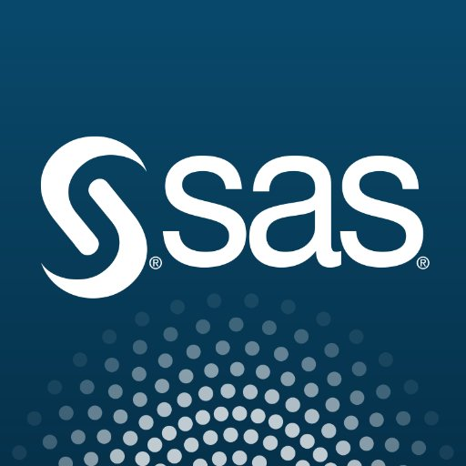
Software
SAS - Statistical Analysis System
SAS is a software suite developed by SAS Institute that offers advanced analytics, multivariate analyses, business intelligence, data management and numerous other tasks.

Slide 6
SAS License & Access at WCU
SAS was installed on a remote server that resides in the RamCloud at WCU
https://recap.wcupa.edu/infoServices/ramCloud/default.aspx
You
can access SAS via a client software called Citrix Receiver
to transfer data between SAS and your local computer.

Slide 7
What is Citrix Receiver
What Citrix Receiver is used for
Citrix Receiver is used primarily for connecting users to XenDesktops and XenApp desktops and applications.
Using Citrix StoreFront in conjunction with Receiver allows organizations to provide users with self-service access to their applications and services -- all with a common user interface, regardless of the endpoint device hardware, OS or form factor.
Xen Project (pronounced /ˈzɛn/) is a type-1 hypervisor, providing services that allow multiple computer operating systems to execute on the same computer hardware concurrently.

Slide 8
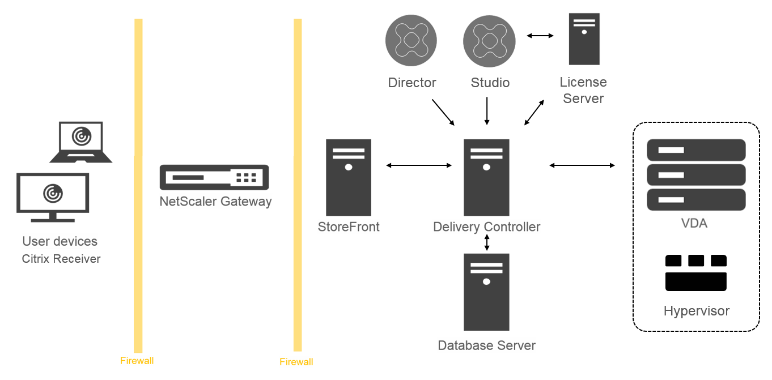
How Citrix Receiver Works

Slide 9
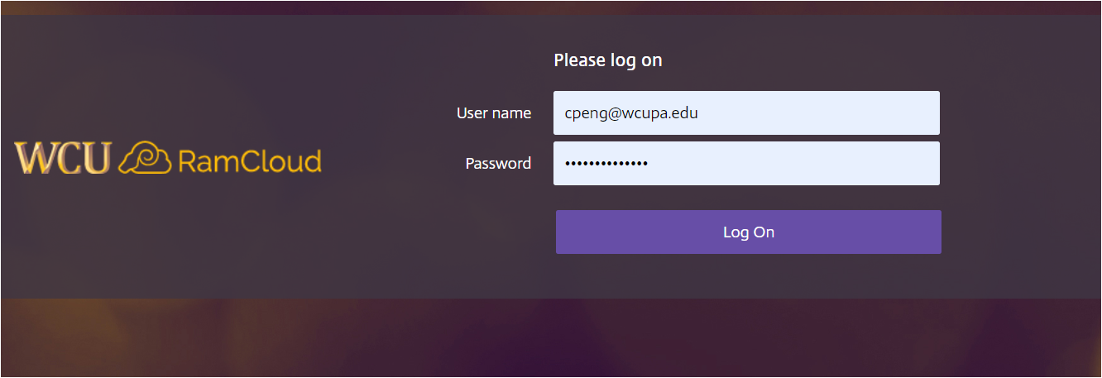
Install Citrix Receiver on A Local Machine
Go to ramcloud.wcupa.edu with Internet Explorer or Firefox

Slide 10
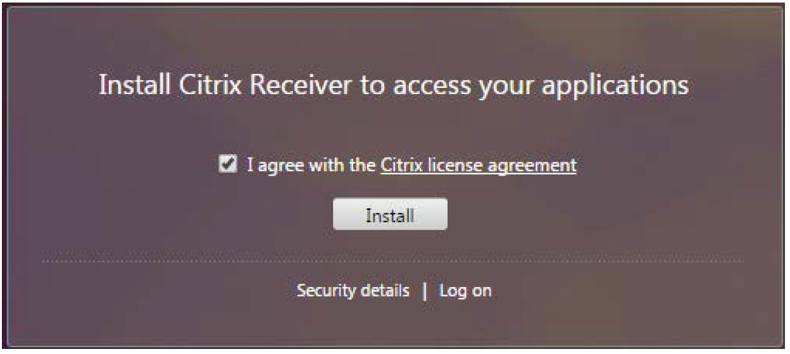
Install Citrix Receiver on A Local Machine
Download and Install Citrix Server

Slide 11
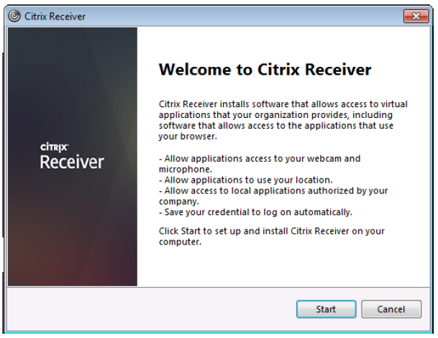
Install Citrix Receiver on A Local Machine
Click Start

Slide 12
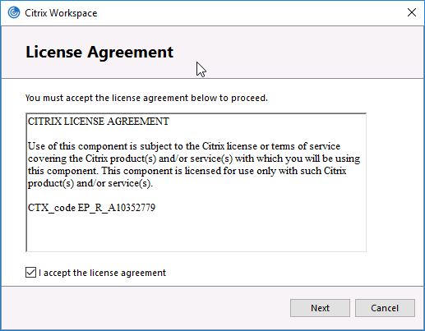
Install Citrix Receiver on A Local Machine
Check “I accept the license agreement” and then Click Start

Slide 13
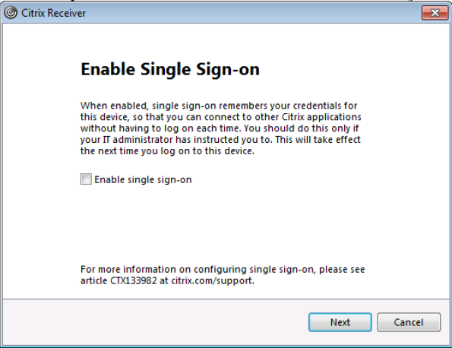
Install Citrix Receiver on A Local Machine
Do not Enable Single Sign-on. Just click Next

Slide 14
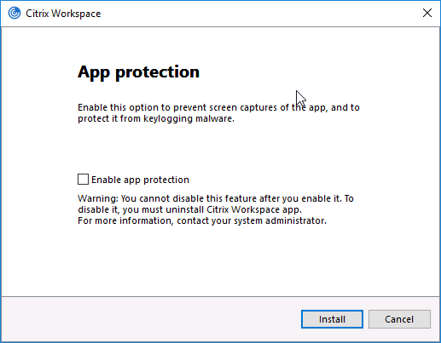
Install Citrix Receiver on A Local Machine
Click Install

Slide 15
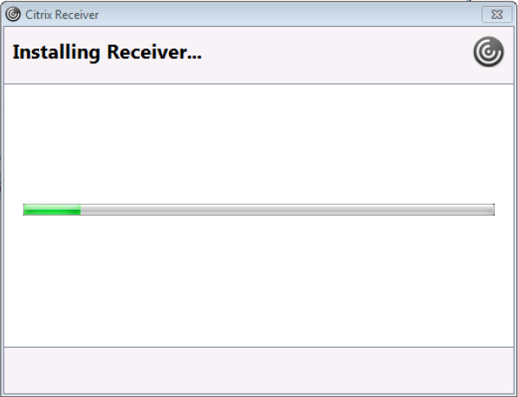
Install Citrix Receiver on A Local Machine
It takes a few seconds to install Citrix Receiver.

Slide 16
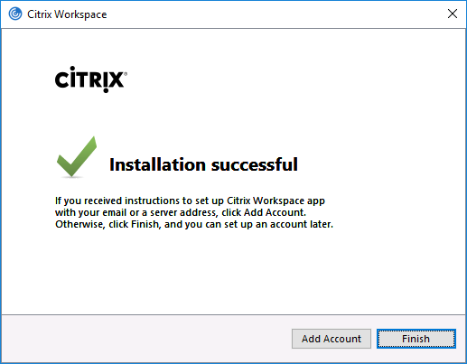
Install Citrix Receiver on A Local Machine
Click: Finish

Slide 17
Install Citrix Receiver on A Local Machine
Once the Citrix Receiver is installed on your machine, you will not need to do this step again.
How to access SAS and other Software?

Slide 18
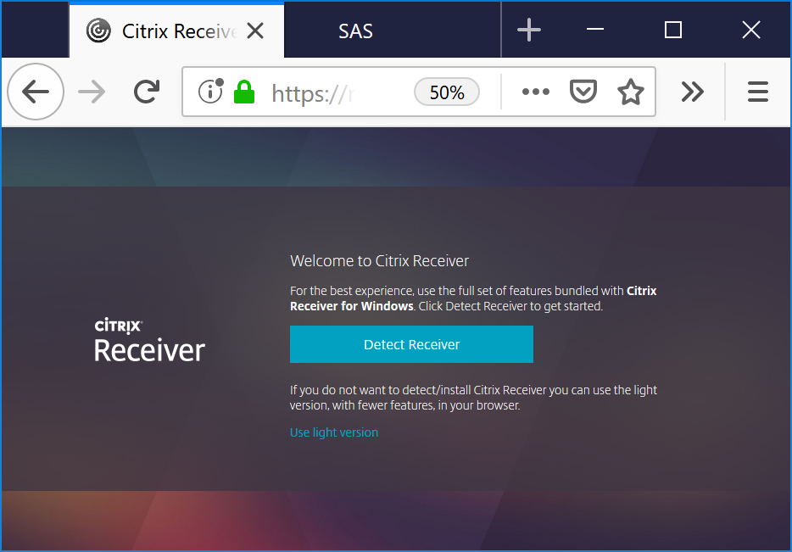
Install Citrix Receiver on A Local Machine
Logon RamCloud as usual
Suggest using light version

Slide 19
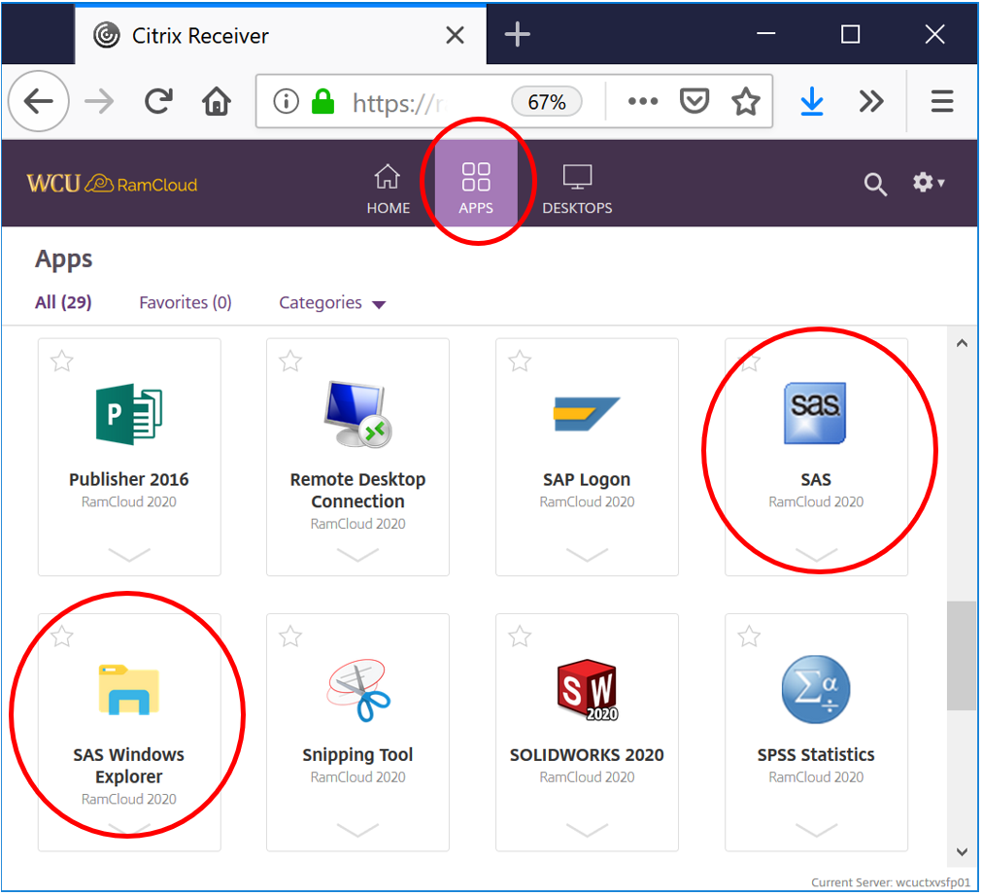
Launch Applications
Login your RamCloud account (same as you MyWCU and WCU email account login credential) to select software you want to use.

Slide 20
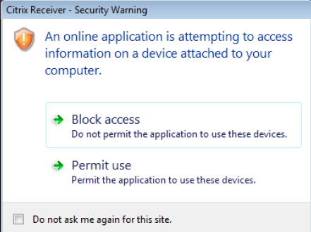
Launch Applications & Security
Click Permit use

Slide 21
Citrix on Mac
On a Mac, you can use Safari to download the Citrix Receiver dmg. Run it and complete the installation. When the install is complete, go back to Ramcloud in Safari and launch your applications

Slide 22
Downloading and Uploading File via Citrix
To save files,
select File > Save As from within the application. Browse to “Computer” and select your local drive.
To open files saved locally,
select File > Open from within the application and then browse to your local drives.

Slide 23
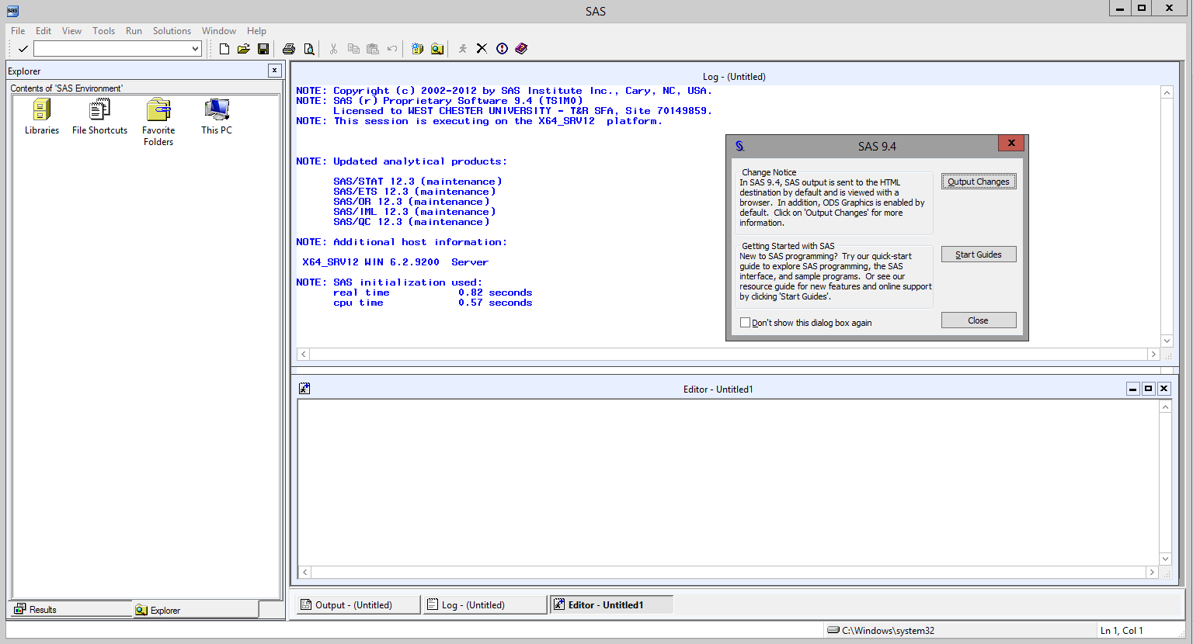
Launch SAS

Slide 24
Launch SAS
Asking access to your computer!

Slide 25
SAS Windows
Log Window: It is an execution window. Here, you can check the execution of your program. It also displays errors, warnings and notes.
Code Window: This window is also known as editor window. Consider it as a blank paper or a notepad, where you can write your SAS code.
Output Window: As the name suggests, this window displays the output of the program/ code which you write in the editor.
Result Window: It is an index that list all the outputs of programs that are run in one session. Since it holds the results of a particular session, if you close the software and restart it, the result window will be empty.
Explore Window: It holds the list of all the libraries in the system. You can also browse the system supported files here.

Slide 26
SAS Datasets and Variables
SAS Data Sets
SAS data sets are called as data files. Data files constitute of rows and columns. Rows hold observations and columns hold Variable names.
SAS Variables
SAS has two types of variables:
Numeric variables: This is the default variable type. These variables are used in mathematical expressions.
Character variables: Character variables are used for values that are not used in mathematical expressions.
They are treated as text or strings. A variable becomes a character variable by adding a ‘$’ sign at the end of the variable name.

Slide 27
SAS Code Structure
SAS programming is based on two building blocks
DATA Step: The DATA step creates a SAS data set and then passes the data onto a PROC step
PROC Step: The PROC step processes the data
A SAS program should follow below mentioned rules
Almost every code will begin with either DATA or a PROC Step
Every SAS statement ends with a semi colon
A SAS step ends with either RUN or QUIT
SAS codes are not case sensitive
You can write a SAS statement across different lines or you can write multiple statements in one line

Slide 28
SAS Datasets and Variables
SAS Libraries
SAS library is a collection of SAS data files that are stored in the same folder or directory on your computer or other storage such as USB drive or a space in the cloud.
Temporary Library: In this library, the data set gets deleted when the SAS session ends.
Permanent Library: Data sets are saved permanently. Hence, they can be accessed in the future SAS sessions.
Users can also create or define a new library known as user defined libraries by using the keyword LIBNAME. These are also permanent libraries.

Slide 29
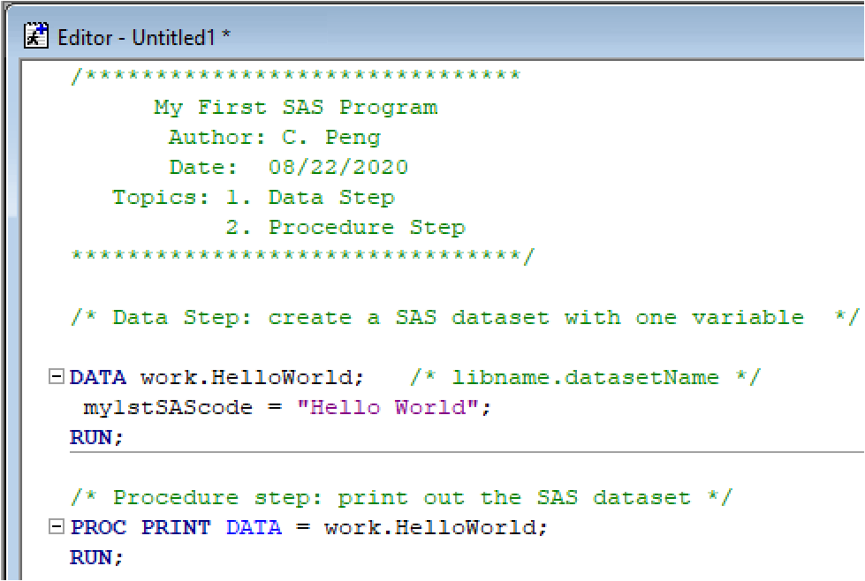
Your First Workable SAS Code “Hello World!”

Slide 30
Your First Workable SAS Code “Hello World!”
/*************************************
My First SAS Program
Author: C. Peng
Date: 08/22/2020
Topics: 1. Data Step
2. Procedure Step
***************************************/
/* Data Step: create a SAS dataset with one variable */
DATA work.HelloWorld; /* libname.datasetName */
my1stSAScode = "Hello World";
RUN;
/* Procedure step: print out the SAS dataset */
PROC PRINT DATA = work.HelloWorld;
RUN;

Slide 31
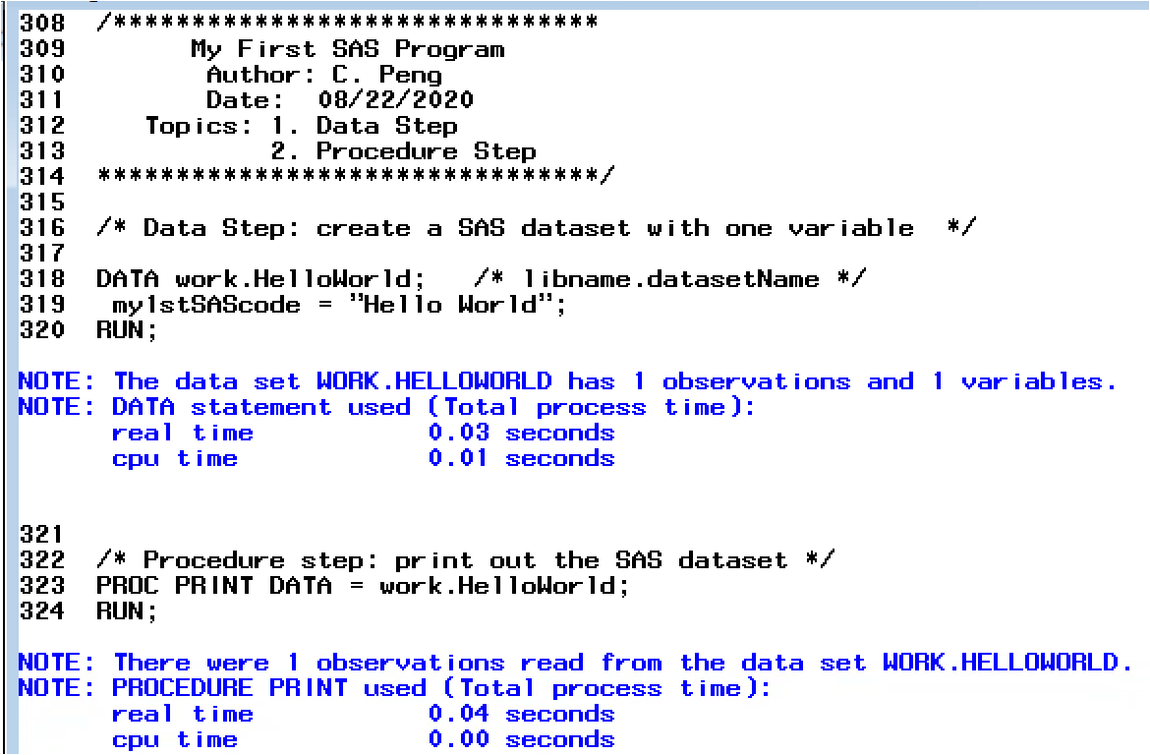
Your First Workable SAS Code “Hello World!”
Your First Workable SAS Code “Hello World!”

Slide 32
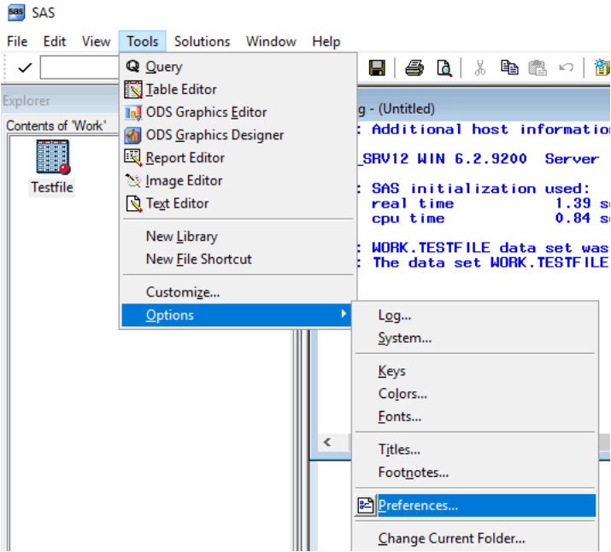
Your First Workable SAS Code “Hello World!”
Your First Workable SAS Code “Hello World!”
Select Output Formats: HTML and Listing

Slide 33
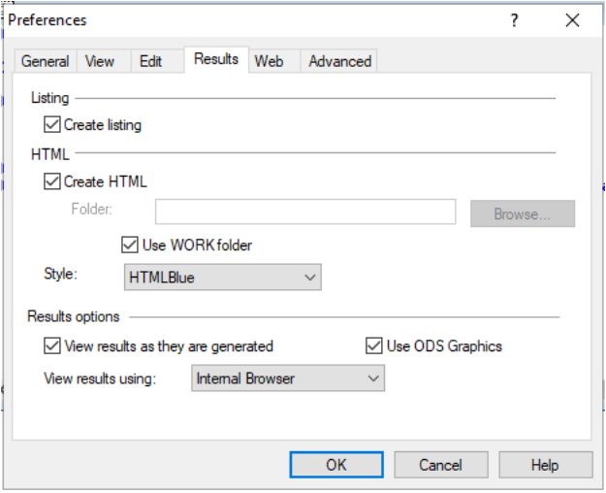
Your First Workable SAS Code “Hello World!”
Your First Workable SAS Code “Hello World!”
Select Output Formats: HTML and Listing

Slide 34
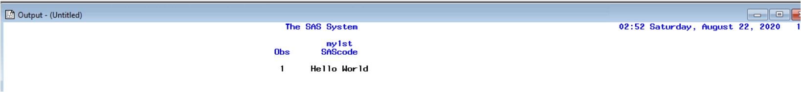

Your First Workable SAS Code “Hello World!”
Your First Workable SAS Code “Hello World!”
Listing Output
Interested in exploring more features of SAS window environment?

