Slide 1
STA 311 Statistical Computing & Data Management
Instructor: Cheng Peng
Department of Mathematics
West Chester University
West Chester, PA 19383
Office: 25 University Avenue, RM 111
Phone: 610.436.2369
Email: cpeng@wcupa.edu

Slide 2
Course Objectives
To familiarize you with programming in the SAS language. After completing this course, you should be able to:
Create SAS data sets from multiple sources, including direct input, external text files, and dataset generated from other applications.
Write SAS data sets out in appropriate format and stored it in certain directory.
Use appropriate techniques to combine data sets, subset data sets, extract certain observations from datasets
Create basic SAS graphs and generate basic reports using appropriate procedures.
Perform basic statistical analyses of data.
Prepare for the Base SAS Programming Certification Exam

Slide 3
What is SAS?
SAS® is a statistical analysis package. A collection of computer “procedures” and a very powerful data management tool that facilitates data and statistical analysis.
SAS® is not a menu-driven or command driven application. Rather it relies on user-written scripts or “programs” that are processed when requested to know what to do.
Because it is a script-based application, the key to being successful using SAS is learning the rule and tricks of writing scripts.

Slide 4
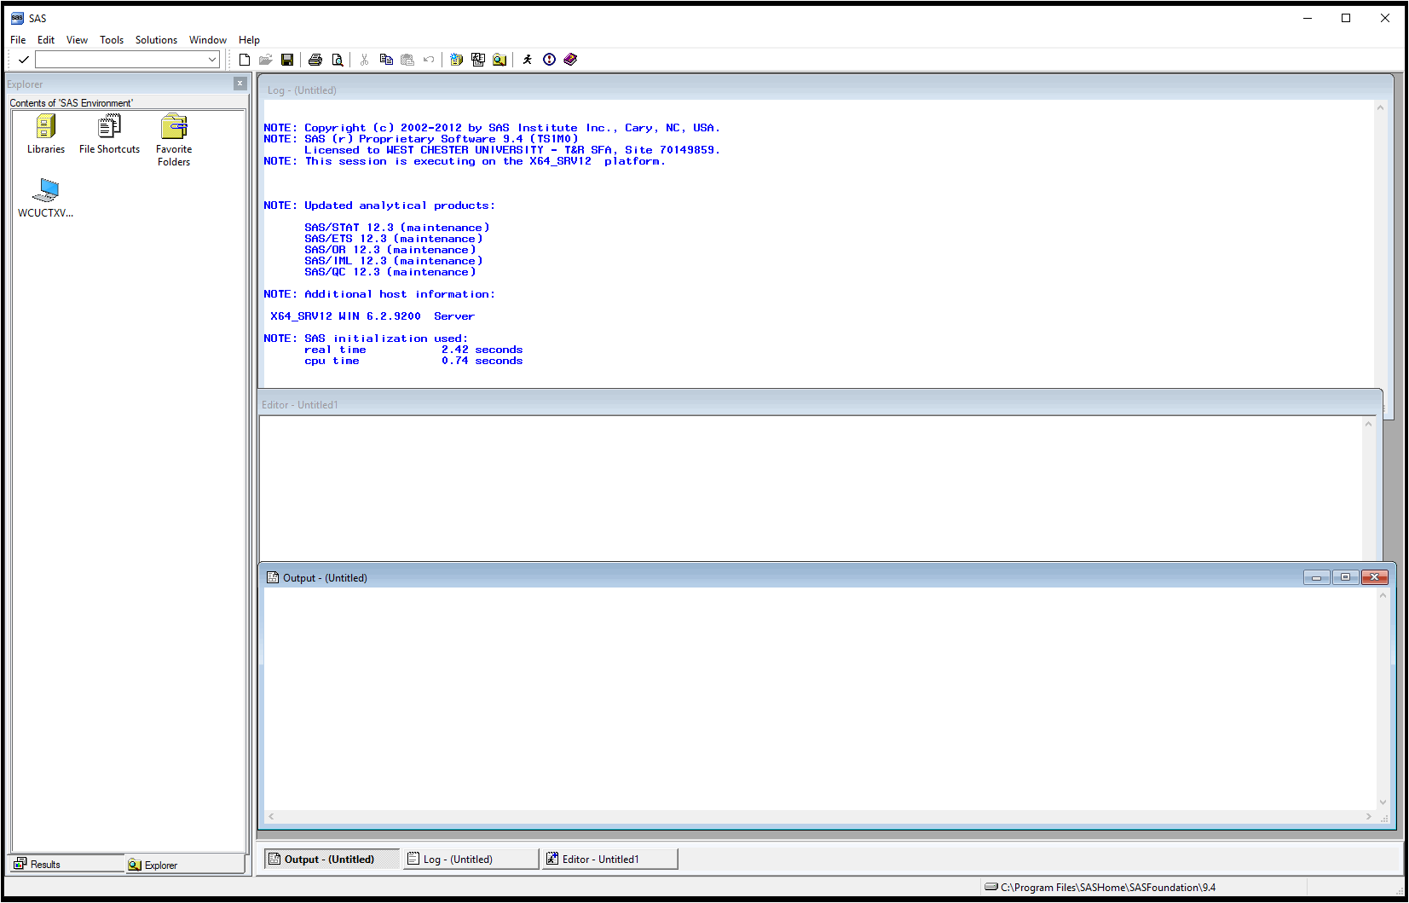

Slide 5
SAS Data Libraries
A SAS data library is a collection of SAS files that are recognized as a unit by SAS.
SAS Data Library
c:\mysasfiles
SAS File
SAS File
SAS File
A SAS data set is a type of SAS file.

Slide 6
SAS Data Libraries
You can think of a SAS data library as a drawer in a filing cabinet and a SAS data set as one of the file folders in the drawer.
FILES
LIBRARIES

Slide 7
Assigning a LIBREF
Regardless of which host operating system you use, you identify SAS data libraries by assigning each a library reference name (libref).
libref

Slide 8
SAS Data Libraries
When we invoke SAS, we automatically have access to a temporary and a permanent SAS data library.
work - temporary library
sasuser - permanent library
work
sasuser
cpeng - permanent library
cpeng
We can create and access our own permanent libraries.

Slide 9
Assigning a LIBREF
WE can use the LIBNAME statement to assign a libref to a SAS data library. General form of the LIBNAME statement:
LIBNAME libref 'SAS-data-library' <options>;
Rules for naming a libref
must be 8 characters or less
must begin with a letter or underscore
remaining characters are letters, numbers, or underscores.
libname cpeng ‘I:\cpeng\teaching\sta311\datasets’;
* I: is a network drive on the cloud (OneDrive);

Slide 10

Making the Connection
When you submit the LIBNAME statement, a connection is made between a libref in SAS and the physical location of files on your operating system.
libname cpeng 'C:\STA311\Fall2020’; /* local drive */

Slide 11
Assigning a LIBREF
Every SAS file has a two-level name: libref.filename
The data set cpeng.grades is a SAS file in the cpeng library.
The first name (libref)
refers to the library.
work
sasuser
grades
The second name (filename) refers to the file in the library.
cpeng

Slide 12
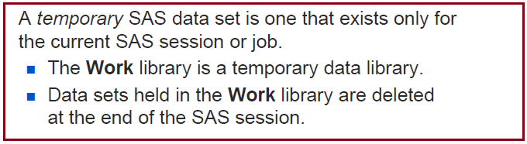
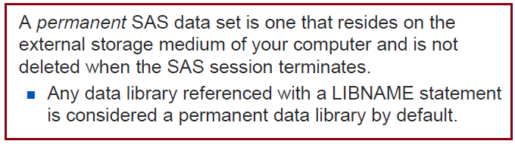
Temporary & Permanent SAS Filename
The libref work can be omitted when you refer to a file in the work library.
The default libref is work if the libref is omitted.
work.employee
employee

Slide 13
General Form of a SAS Program
DATA block consists of SAS statements telling the application
what to do with the data set (e.g input formats, variable names,
create new variables, etc.)
Raw Data
DATA Step
SAS Data Set
PROC Step
Report
SAS Data Set
PROC block consists of SAS statements telling the applications what to do to the data set (e.g print it out, create a cross-tabulation table, perform computations for a statistical analysis.

Slide 14
Some Naming Rules of SAS
Every SAS statement ends in a semicolon (;)!!!!!!!!
All variable and data set names must start with a letter or an underscore (_).
Names can contain only letters, numerals, and the underscore. No %$!*&#@.
SAS is case insensitive (e.g Body, body, boDY and BoDy are all the same name to SAS).
5. There are no restrictions on where in the line statements start or stop and commands may be wrapped onto multiple lines.
6. All variable and data set names must be thirty-two (32) or fewer characters in length (8 characters in SAS V6.12 or lower).
For this class in order to make SAS programs easier to read, we will
(require) attempt to have each new SAS statement start on a new line.

Slide 15
General Form of a SAS Program
SAS programs (scripts) are composed of DATA block and PROCedure Blocks.
DATA block consists of SAS statements telling the application what to do with the data set (e.g, input formats, variable names, create new variables, etc.)
2. PROC block consists of SAS statements telling the applications what to do to the data set (e.g, print it out, create a cross-tabulation table, perform computations for a statistical analysis.

Slide 16
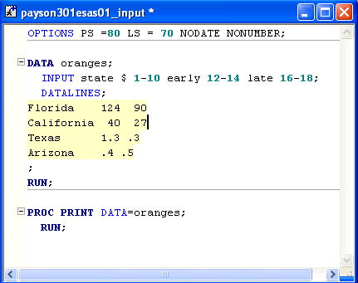
A Simple SAS Program
DATA
STEP
PROC
STEP

Slide 17
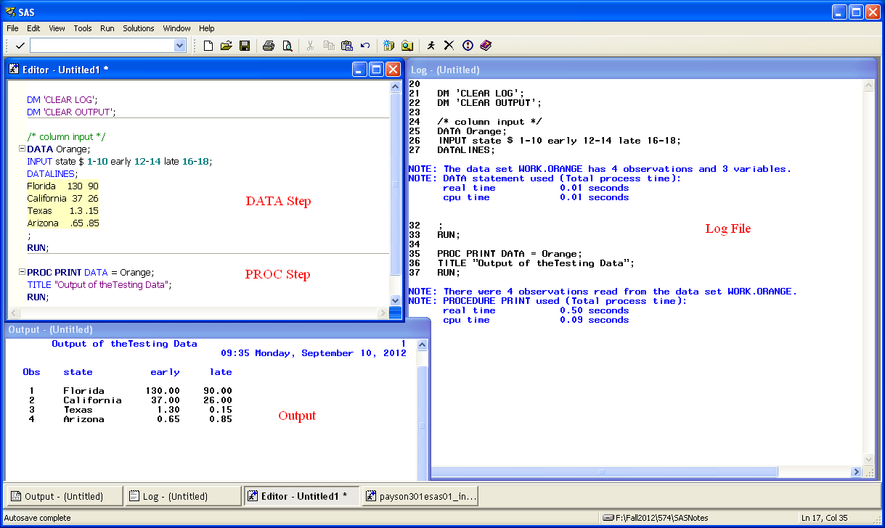

Slide 18
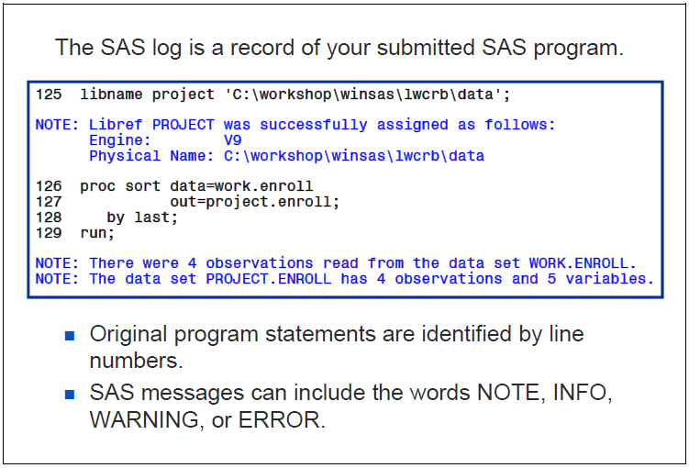
SAS Log

Slide 19
Creating SAS Datasets: Process and Structure
Other Software Files
Data Entry
External File
Conversion Process
SAS Data Set
Descriptor Portion
Data Portion

Slide 20
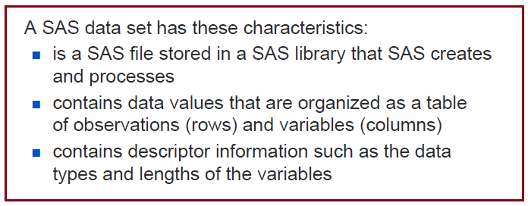
SAS Datasets

Slide 21
SAS Datasets
SAS data sets have a descriptor portion and a data portion.
General data set information
* data set name * data set label
* date/time created * storage information
* number of observations
Information for each variable
* Name * Type * Length * Position
* Format * Informat * Label
Descriptor Portion
Data Portion

Slide 22
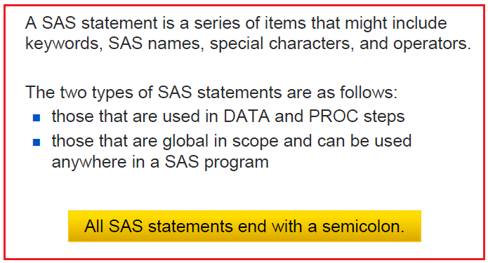
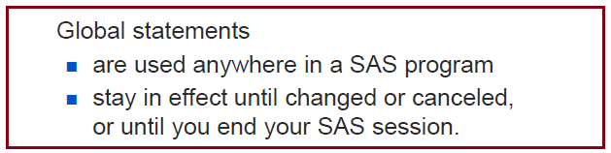
SAS Statements

Slide 23
Browsing the Descriptor Portion
The descriptor portion of a SAS data set contains
general information about the SAS data set (such as data set name and number of observations)
variable attributes (name, type, length, position, informat, format, label).
The CONTENTS procedure displays the descriptor portion of a SAS data set.

Slide 24
Comments
Comments make your code more readable!

Slide 25
SAS Dataset Terminology
SAS documentation and text in the SAS windowing environment use the following terms interchangeably:
SAS Data Set
SAS Table
Variable
Column
Observation
Row

Slide 26
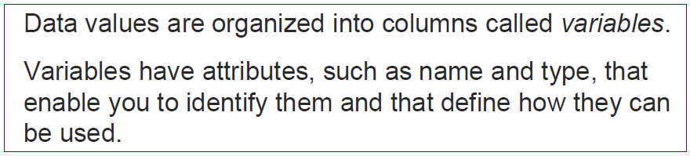
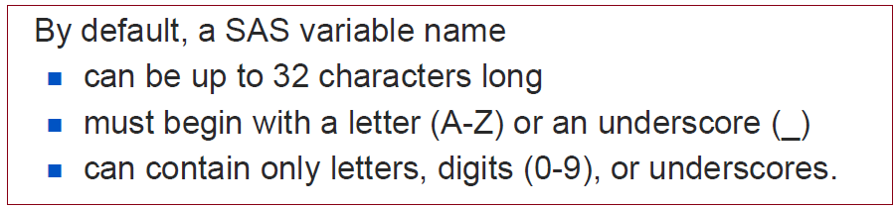
SAS Variables & Variable Naming Rules
The names _N_, _ERROR_, _FILE_, _INFILE_, _MSG_, _IORC_, and _CMD_ are reserved for the variables that are generated automatically for a DATA step. Note that SAS products use variable names that start and end with an underscore; it is recommended that you do not use names that start and end with an underscore in your own applications
An effective programmer always uses meaningful names!

Slide 27
Formats and Informats of SAS Variables
Informats is used to tell SAS how to read a variable whereas Formats is used to tell SAS how to display or write values of a variable.
Informats is basically used when you read or import data from either an external file (Text/Excel/CSV) or read in sample data which was created using CARDS/DATALINES statement. It is also used when you create a new variable in a dataset.
Formats can be used in both Data Steps and PROC Steps whereas Informat can be used only in Data Steps.
We will learn how to define formats/informats later.

Slide 28
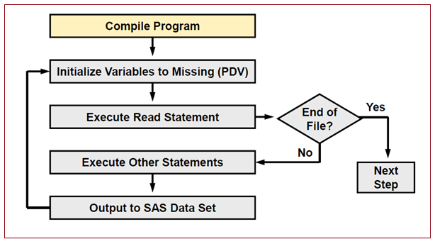
Data Step Execution Process
Compile Phase Creates
An input buffer
A program data vector(PDV)
Descriptor information
Execution Phase
Data step reads data records
interactively. Automatic counter
_N_ updates its value
SAS sets the newly created program
variable to missing in the program
data vector(PDV).
Variables that you read with a
SET, MERGE, MODIFY, or UPDATE
statement are not reset to missing
in PDV.
SAS reads a data record from a raw
data file into the input buffer, or it
reads an observation from a SAS
data set directly into the PDV
The DATA step terminates when
SAS encounters the end-of-file
in a SAS data set or a raw data file
We will do an example data step using INPUT statement to illustrate the detailed process of executing data step and how SAS data set.

Slide 29
Some Best Coding Practices for This Class
The following are some best practices you should always have in mind when you make a program
Write a clear program header;
Write comments and documentation;
Use consistent indentation;
Don’t repeat yourself (aka DRY principle);
Avoid deep nesting;
Limit line length;
Set up a simple and clear file and folder structure;
Follow naming convention;
Keep the code simple!
Save the code a version number – version control;
Never modify the source data!!!

