Slide 1
STA 311 Statistical Computing & Data Management
Instructor: Cheng Peng
Department of Mathematics
West Chester University
West Chester, PA 19383
Office: 25 University Avenue, RM 111
Phone: 610.436.2369
Email: cpeng@wcupa.edu

Slide 2
Topics
Three styles of manual input
Length of SAS variables
A first look at SAS dates
Reading external data files
Data file is not aligned
Dealing with “messy” data file
Writing a nice SAS program.

Slide 3
SAS Data Sets: A Brief Review
SAS Data Set - a binary formatted representation of the input data set stored in such a way that future SAS programs do not need to input the data in again.
Temporary SAS Data Sets - created and remain in working memory for the SAS session, but disappear when the SAS session ends. Fine for small to moderate size, simple input programs.
Permanent SAS Data Sets - created in one SAS session but stored on disk for later reuse. Convenient for large or complex input data sets that may require multiple analysis steps. Reduces time and computer resources.
LIBNAME statement - identifies to the SAS program where the previously created SAS data set is located.

Slide 4
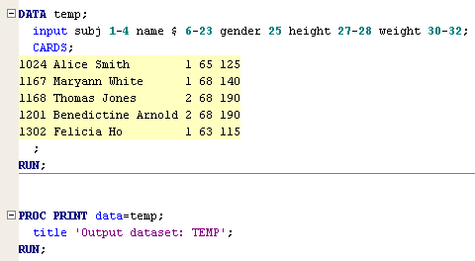
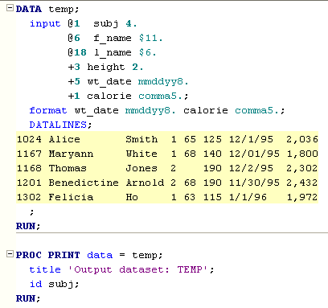
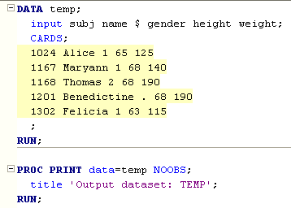
Three Basic Input Styles: An Overview
Formatted Input
Column input
List Input
We will see some hybrid input styles later!

Slide 5
Setting the Length of a Variable
The default length for character and numeric variables is 8 bytes in SAS.
SAS uses exactly one byte for one character! This means that if the value of a character variable has more than 8 characters, SAS only keeps the first 8 characters (including the white space if any) and truncate the rest.
However, for a numeric variable SAS variable, 8 bytes can store a number with up to 16 digits. In other words, the default length of numeric variable is 16 digits.
It is important to note that the minimum length of a numeric is 3 bytes. It does not mean it cannot store a numeric value lower than 3 digits. It can store values of 1 or 2 digits.
The maximum length of any character value in SAS is 32,767 bytes!

Slide 6
Setting the Length of a Variable
Significant Digits and Largest Integer by Length for SAS Variables under Windows
Length in Bytes | Largest Integer Represented Exactly | Exponential Notation
3 | 8,192 | 2¹³
4 | 2,097,152 | 2²¹
5 | 536,870,912 | 2²⁹
6 | 137,438,953,472 | 2³⁷
7 | 35,184,372,088,832 | 2⁴⁵
8 | 9,007,199,254,740,992 | 2⁵³
Tip: Please note you cannot store accurately more than about 16 digits in a SAS numeric variable, so you need to import your column as a character variable and then do string manipulation and data type conversion.

Slide 7
Summary of Setting the Length of a Variable
In SAS, both numeric and character variables have length of 8 bytes by default.
Using the default length of character variable usually causes truncation issue.
You can change the length of the variable by using a subsequent Length statement.
The maximum length of any character variable in the SAS System is 32,767 bytes

Slide 8
Setting the Length of a Variable: Example
General form of a LENGTH statement:
LENGTH variable-name <$> length-specification (bytes) ...;
Reads external files using
INFILE statement!
data airplanes;
length ID $ 5;
infile 'raw-data-file';
input ID $
InService : date9.
PassCap CargoCap;
run;
The colon modifier tells SAS when
it reads in InService to do it until there
is a break in the character and then stop
Omitting this colon may cause error
The value of a SAS date = # of days from January 1, 1960 to the given date! ➔ see more detail on next few slides!

Slide 9
Setting the Length of a Variable
Caution!
LENGTH variable-name <$> length-specification (bytes);
Example: LENGTH state $ 20;
Variable lengths specified in a LENGTH statement affect the length of numeric variables only in the output data set; during processing, all numeric variables have a length of 8 bytes.
Lengths of character variables specified in a LENGTH statement affect both the length during processing and the length in the output data set.

Slide 10
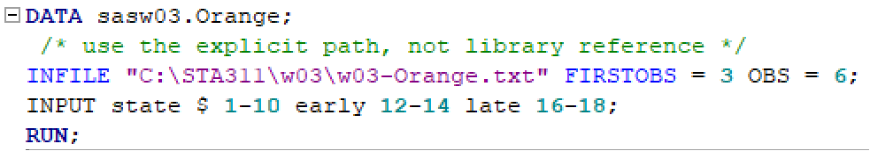
Different ways to read data into SAS
Reading Data from an External Text File
C:\STA311\w03\w03-Orange.txt
external text file
Projected Orange Yields in October 1997
State Early Late
Florida 130 90
California 37 26
Texas 1.3 .15
Arizona .65 .85
Based on information obtained from the
Florida Agricultural Statistics Service
Line 3
Line 6

Slide 11


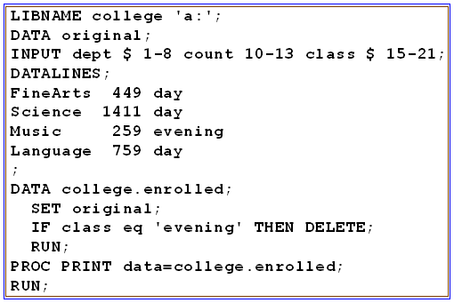
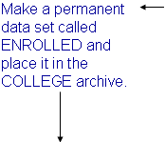
Create Permanent SAS Data Sets
}
ENROLLED.sas7bdat stored on the A drive

Slide 12
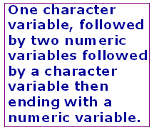

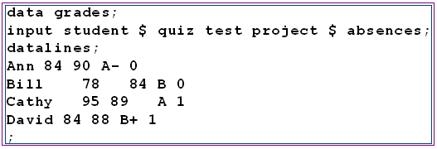
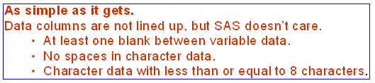
Input Methods: List Input

Slide 13
Input Methods: Column Pointers
123456789012345678
Ann 84 90 A- 0
Bill 78 84 B 0
Cathy 95 89 A 1
David 84 88 B+ 1
data grades;
infile ‘C:\grades.txt’ firstobs=2;
input @1 name $
@7 q1
@10 q2
@13 project $
@16 att;
run;
----+----1----+---
“@1”
“@7”
“@13”
With column pointers you can tell SAS directly which column to begin reading a variable from.
Go directly to the information you really need.
Skip unnecessary information.
Efficient data entry.

Slide 14
Input Methods: Delimited (Formatted)
DELIMITER - character used to separate items.
Ann/84/90/A-/0
Bill/78/84/B/0
Cathy/95/89/A/1
David/84/88/B+/1
grades.txt data set on a drive that SAS can access.
Tell SAS what separates variables in the data set.
Alternate format dlm=
If the file delimiter is a tab - e.g. from EXCEL or LOTUS Tab-delimited file.
infile ‘C:\grades.txt' expandtabs;

Slide 15
Mixed Input
Methods of Input
Column Input
input state $ 1-10 early 12-14 late 16-18;
List Input
input student $ quiz test project $ absences ;
Column Pointers
input @1 name $ @13 project $ ;
12345678901234567890
Ann 84 90 A- 0
Bill 78 84 B 0
Catherine 95 89 A 1
David 84 88 B+ 1
data grades;
infile 'a:\grades.txt’ firstobs=2;
input name $ 1-9 quiz test project $ absences;
run;
SAS allows
you to mix
input types.
OR
data grades;
infile 'a:\grades.txt’ firstobs=2;
input name $ 1-9 @17 project $ absences;
run;

Slide 16
Line Pointers- Multiple Lines
Ann
84 90 A- 0
Bill
78 84 B 0
Cathy
95 89 A 1
David
84 88 B+ 1
Data may come to us with each observation recorded on more than one line. We need to be able to tell SAS to go to the next line.
The slash (/) says skip to next line.
The code #n says go to that line of the observations data to resume reading data.
}
data grades;
infile 'a:\grades.txt';
input name $ / quiz test project $ absences;
data grades;
infile 'a:\grades.txt';
input name $ #2 quiz test project $ absences;
SAS automatically
continues reading
on next line.
data grades;
infile 'a:\grades.txt';
input name $ quiz test project $ absences;

Slide 17
Line Pointers multiple Observations per Line
data grades;
input name $ quiz test project $ absences @@;
datalines;
Ann 84 90 A- 0 Bill 78 84 B 0 Cathy 95 89 A 1
David 84 88 B+ 1
;
Trailing “at” symbols ( @@ ) tells SAS to hold the current data line for further information.
Read in name--absences then hold the current position on the data line.
Read in another set of name--absences then hold position.
Keep doing this until an end-of-line marker is reached.

Slide 18
Input Statement Specifics
Data new;
infile myfile “c:\name\project\mydir\mydata.dat” missover;
input gamedate mmddyy20. @22 name $ 20.;
Once you use @nn SAS uses
a different mode to input data.
Names with spaces in it
will not be read in correctly.
Data new;
infile myfile “c:\name\project\mydir\mydata.dat” missover;
input month 1-2 day 9-10 year 17-20 name $ 22-42;
gamedate = mdy(month,day,year);
A SAS function is used to create a SAS date variable after separate month, day and year values read in.
List input for character data assures that even spaces in the name will be read in and included in the database.

Slide 19
Temporary and Permanent SAS Data Sets
DATA myfile;
Creates a temporary data set that
disappears at the end of the SAS session.
Does not creates any data set, simply reads in data from another SAS file or external data file and PUTs it to some other FILE. Nothing remains at the end of this data step except what you have filed.
DATA _NULL_ ;
LIBNAME TOM “c:\TOM”;
DATA TOM.TOM;
Creates a permanent SAS (binary encoded) data set that is stored in the ‘mydir’ as myfile. Once created you never have to read this into SAS again. You can directly refer to it in other programs.
LIBNAME mydir “c:\mydir”;
DATA mydir.myfile;
LIBNAME mydir “c:\mydir”;
PROC PRINT data=mydir.myfile;
Folder name
File name

Slide 20
Writing nice programs
/* STA 311 Lecture 1 */
Data students;
input name $ age degree $;
datalines;
Mary 21 MA
John 22 MS
Alice 22 MBA
Joe 25 PhD
;
proc print data=students;
title “Student Data”;
run;
DATA Students;
INPUT Name $ Age Degree $; datalines;
Mary 21 MA
John 22 MS
Alice 22 MBA
Joe 25 PhD
;
PROC PRINT Data=Students; RRUN;
Rule: Try to keep at most one SAS statement to a line.
Rule: Indent subcommands within DATA and PROC statements.
Rule: Use comments.
Rule: Use titles.

Slide 21
Comments
*This comment statement starts with an asterick;
/* This is also a comment statement. */
/*
This is a comment block. It can be used to provide more detailed comments. Also blocks of code can be commented out when you are done running that part of the program.
Note, anything, including special characters !@#$%^&() except asterisk and forward slash can be used.
*/

Slide 22
Using Block Comments
Data students;
input name $ age degree $;
datalines;
Mary 21 MA
John 22 MS
Alice 22 MBA
Joe 25 PhD
;
/*
proc print data=students;
var name age;
run;
*/
proc sort data=students;
by degree name;
run;
proc print data=students;
by degree;
run;
Block out some old code but keep it in the program as a record of what you have attempted.

Slide 23
Uses of Comments
1. To note the history of your analysis.
Keep track of the steps you took to create the data set.
Keep track of data modifications.
Keep track of all statistical analyses attempted.
Assist others in understanding your analysis.
To block out sections of the program ( /* and */) allowing you to run partial analyses but return to previous analyses if you change your approach.
5. To refresh your memory about the project when you have to return to the analysis to answer questions from Journal reviewers, academic advisors, colleagues, months or years after the data have been analyzed.

Slide 24
Variable Names
Data students;
input A $ B C $;
datalines;
Mary 21 MA
John 22 MS
Alice 22 MBA
Joe 25 PhD
;
proc print data=students;
title ‘Student file’;
run;
Data students;
input first_name $ age degree $;
datalines;
Mary 21 MA
John 22 MS
Alice 22 MBA
Joe 25 PhD
;
proc print data=students;
title ‘Student File’;
run;
You have up to 32 characters for each variable name, with up to 37 possible characters in each position except the first which has 27. Use this flexibility to give variables understandable names.

Slide 25
The OPTIONS statement
Place at the beginning of your program to control output options.
linesize=124
to print wide output.
options linesize=64
pagesize=90
nocenter
nodate
nonumber;
pagesize=500
to print data without page breakes.
Global Statement

Slide 26
The TITLE and FOOTNOTE statements
Use a TITLE and/or FOOTNOTE statement to place comment information at the top (TITLE) or bottom (FOOTNOTE) of each output page.
Once set, TITLE and FOOTNOTE information will be printed for each procedure output unless a new TITLE or FOOTNOTE statement is encountered.
Data students;
input name $ age degree $;
datalines;
Mary 21 MA
John 22 MS
Alice 22 MBA
Joe 25 PhD
;
proc print data=students;
title ‘Four New Post-Bacc Students’;
footnote ‘Ages as of last birthday’;
run;
title1 ‘First line’;
title2 ‘Second line’;
title3 ‘Third line’;
footnote1 ‘Line one’;
footnote2 ‘Line two’;

Slide 27
Labels
data basket;
input jerseyno $ name $ _3pmpo97 _3papo97 @@;
label jerseyno='Jersey number'
name='Name'
_3pmpo97='3 pt. goals made, 1997 playoffs'
_3papo97='3 pt. goals attempted, 1997 playoffs';
datalines;
0 Irlbeck 4 19 00 Morrison 6 9 11 Perkins 1 4
13 Pinson 4 9 14 Camacho 0 0 22 Gragg 0 0
23 Mitchell 0 0 35 Garcia 0 1 42 Cannon 3 3
44 McGuire 0 0 51 Betts 2 4 55 Galloway 2 4
;
run;
proc print data=basket label;
title 'Playoff results';
run;

Slide 28
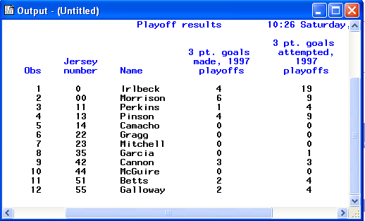
Labels in Output
Label statements provide variable labels with more information.

Slide 29
PROC PRINT options
DATA =name - specifies data set name
DOUBLE - double-spaces output
NOOBS - suppresses the observation number in the first column
HEADING=H - column headings should be printed (h)orizontally
HEADING=V - column headings should be printed (v)ertically
UNIFORM - asks for all pages of output to have the same appearance
proc print data=basket(obs=5);
var jerseyno;
id name;
run;
Print only the first 5 observations for variable jerseyno but add the identification data in variable name.

Slide 30
Output Formats
options nodate nonumber nocenter;
data kids;
input @1 firstnam $11. @12 lastname $11.
@23 birthday mmddyy10. @33 gender $1. @34 wklyrate 3.;
label firstnam='First name' lastname='Last name'
birthday='Birthday' gender='Gender'
wklyrate='Rate';
datalines;
Douglas Lindgren 08/29/1996M115
Elizabeth Wilkerson 01/13/1997F95
Evangeline Chambers 03/11/1997F100
Arthur Hollander 07/19/1996M.
ChristopherKalbfleisch04/13/1995M115
Stacy Siegel 11/15/1996F100
;
run;
proc print data=kids noobs label;
format birthday worddate18. wklyrate dollar7.2;
title 'Day care roster';
run;

Slide 31
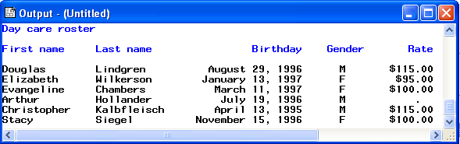
Formatted Output
Douglas Lindgren 08/29/1996M115
Elizabeth Wilkerson 01/13/1997F95
Evangeline Chambers 03/11/1997F100
Arthur Hollander 07/19/1996M.
ChristopherKalbfleisch04/13/1995M115
Stacy Siegel 11/15/1996F100
Input data
using column format

Slide 32
Creating Your Own Formats - PROC FORMAT
proc format;
value $sexfmt 'F'='Female' 'M'='Male';
value ratefmt 0-<100='Low'
100-HIGH='High'
.='Missing';
run;
proc print data=kids noobs label;
var firstnam lastname gender wklyrate;
format gender $sexfmt. wklyrate ratefmt.;
title 'Day care roster';
run;
NOTE: Formats always end with a period.

Slide 33
Formatted Output
First name Last name Birthday Gender Rate
Douglas Lindgren August 29, 1996 M $115.00
Elizabeth Wilkerson January 13, 1997 F $90.00
Evangeline Chambers March 11, 1997 F $100.00
Arthur Hollander July 19, 1996 M .
Christopher Kalbfleisch April 13, 1995 M $115.00
Stacy Siegel November 15, 1996 F $100.00
Day care roster
First name Last name Gender Rate
Douglas Lindgren Male High
Elizabeth Wilkerson Female Low
Evangeline Chambers Female High
Arthur Hollander Male Missing
Christopher Kalbfleisch Male High
Stacy Siegel Female High
Previous Output

Slide 34
Formats and PROC Format
There are formats that SAS has predefined for you.
INPUT gamedate mmddyy20. ;
PUT name $char22. cost dollar7. ;
When you need a format that SAS doesn’t provide, you use PROC FORMAT to create it. Your newly created format is used just like other (output) formats (remember the period at the end of a format statement).
PROC Format;
value $gender ‘M’=‘Male’ ‘m”=‘Male’
‘F’=‘Female’ ‘f’=‘Female’;
run;
PROC Print data=mydata;
var sex;
format sex $gender. ;
run;

Slide 35
Issue Review
TXT files:
when you create a TXT file(using FILE “ “;) you create a permanent file on your disk. To view/print the file use any application that can read a text (ascii) file.
FORMAT and INFORMAT
INFORMATs tell SAS that the variable you are reading in has something special about it.
FORMATs tell SAS that the variable you wish to print out has something special about it.
You can read in with one INFORMAT and write out with a different FORMAT
DATA and PROC statements
Be careful that you do not try to use DATA step statements (such as PUT or FILE) within a PROC step.

Slide 36
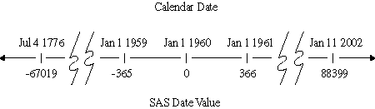
A First Glance of SAS Dates: Value and Formats
A SAS date is stored as a numerical value - 1/1/1960 00:00:00 as ZERO
A SAS Date has different formats, so does SAS time!

